Slide 2
The Global Human Settlement Layer
Lightening talk, 2nd May
Martino Pesaresi / Scientific Official / European Commission, Joint Research Centre

Slide 3
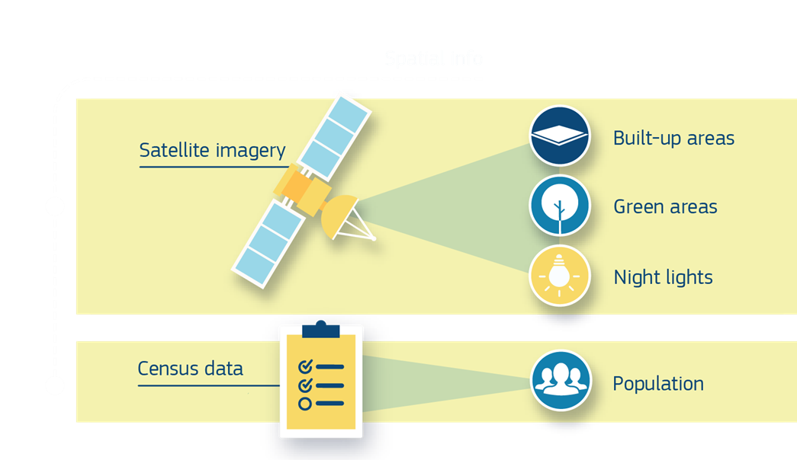
#2May_Session4 / The Global Human Settlement Layer basic
Symbolic Machine Learning
New approach inspired to DNA sequencing and characterization
Spatial-Temporal
Harmonized
Global
Data
(GRIDS)
Data4Policy
Public data for public policies
Evidence-based decision support
Spatial Data Modelling
New models facilitating the science2policy

Slide 4
#2May_Session4 / The Global Human Settlement Layer basic
Operates in a open and free data and methods access policy (open input, open method, open output)
Reproducible, scientifically defendable, fine-scale, synoptic, complete, planetary-size, and cost-effective information production
Facilitating information sharing and multilateral democratization of the information production, collective knowledge building

Slide 5
#2May_Session4 / The Global Human Settlement Layer basic
Three main GIS GRID DATABASE products (R2016)
GHS-BU Density of roofed buildings 10-80m scale/detail → 250m → 1km
GHS-POP Density of resident people 250m scale/detail → 1km
GHS-SMOD Urban-Rural settlement classification 1km scale/detail
One new main GIS VECTOR DATABASE product (R2018)
The global urban centers database More than 10.000 individual cities > 50K reported, population, land cover/land use, environmental measures, exposure to natural hazards, in the city-specific geographical frame
All the above multi-temporal from 1975 until today
The data published on JRC Open Data Catalogue
brokered by GEOSS and other catalogues (Aug 2017):
GEOSS portal: http://www.geoportal.org/
The EU Open Data Portal http://data.europa.eu/euodp
the EU Data portal https://www.europeandataportal.eu/
The BioEconomy Data Catalogue: https://data-bioeconomy.jrc.ec.europa.eu/
The MIDAS catalogue: http://midas-portal.jrc.it/discovery/midas/
The Thomson Reuters Web of Knowledge: http://apps.webofknowledge.com

Slide 6
#2May_Session4 / The Global Human Settlement Layer basic
Since first GHSL release October 2016 (19 months):
53,950 new accesses to the GHSL web platform
More than 3,600 full GHSL data package download from the JRC open Data Platform
More than 150 scientists and policy makers belonging to 85 different organizations (academies, international stakeholders, governmental bodies and the private sector) joined the GEO Human Planet Initiative

Slide 7
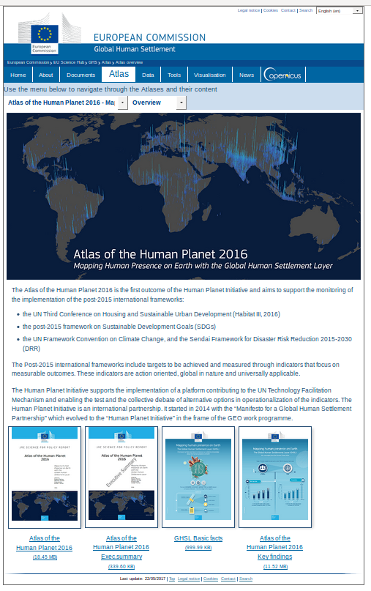
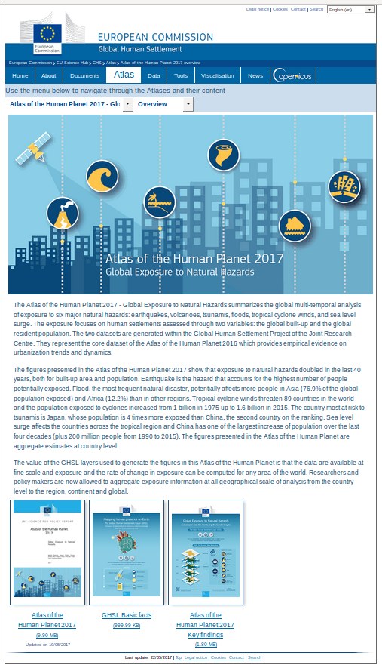
#2May_Session4 / The Atlas of the Human Planet
GEO Human Planet Initiative
post-2015 international frameworks
Sendai Framework
for Disaster Risk Reduction
Agenda 2030 for Sustainable Development
New Urban Agenda
http://ghsl.jrc.ec.europa.eu/atlasOverview.php/

Slide 9
Thank you
martino.pesaresi@ec.europa.eu / http://ghsl.jrc.ec.europa.eu / twitter #GHSL

