Slide 2
ICIMOD data for SDG
Sudip Pradhan / Programme Coordinator / ICIMOD

Slide 3
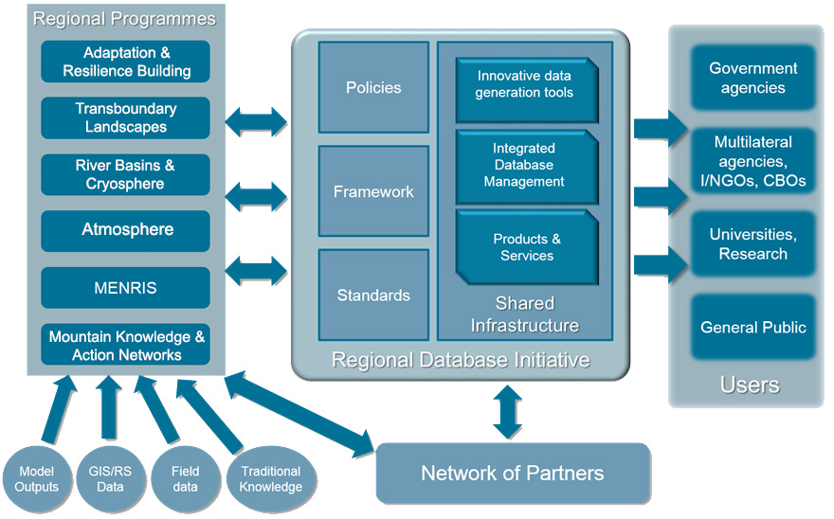
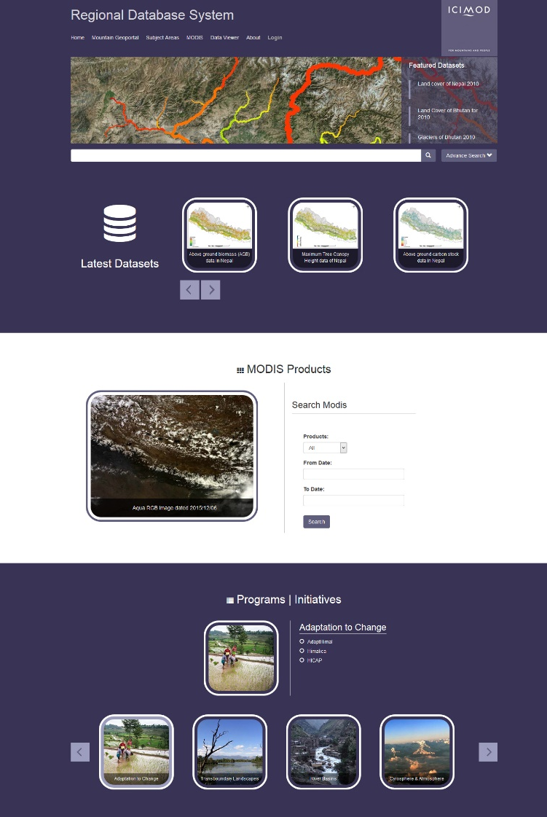
ICIMOD Regional Database System
A central data repository for different thematic areas in the Hindu Kush Himalayan (HKH) region
Regional Database Framework
rds.icimod.org

Slide 4
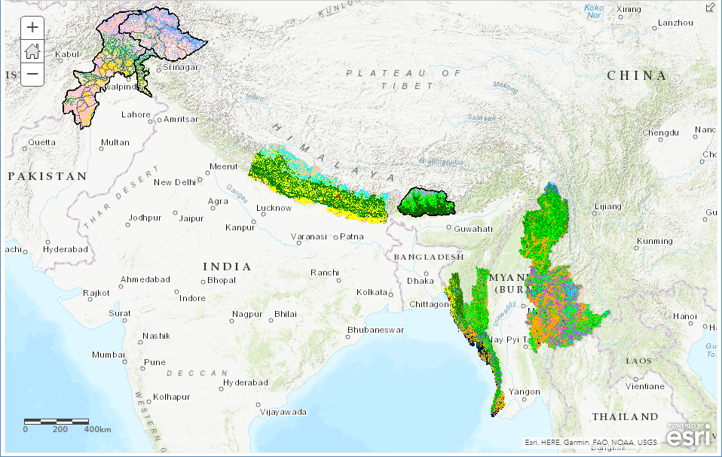
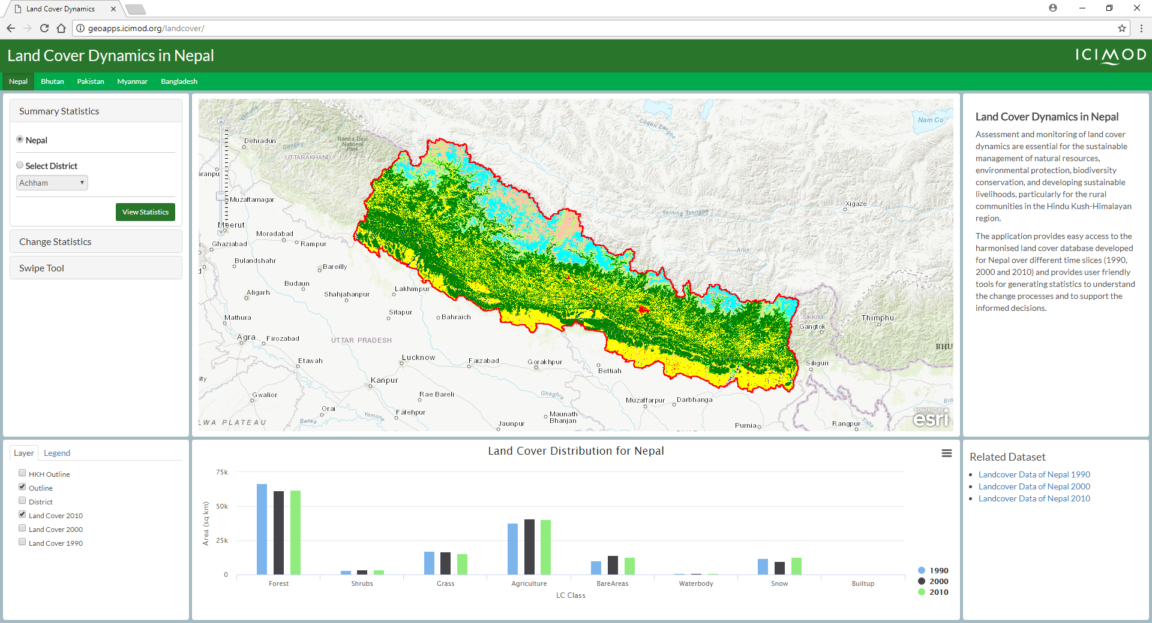
Ecosystem and Biodiversity
Land cover data for HKH region of Bhutan, Bangladesh, Myanmar, Pakistan and Nepal for 1990, 2000 and 2010
Land cover data of Eastern Himalaya Landscape for 1975 and 2000
Land cover data of Koshi Basin and Kangchenjunga Landscape for 2000 and 2010
Above Ground Biomass for Nepal
Above Ground Carbon Stock data for Nepal
Forest Carbon data for 3 REDD pilot sites, i.e. Charnawati, Ludhi Khola, and Kayarkhola watersheds in Nepal for 2010, 2011, 2012 and 2013
Forest fire occurrence data in Nepal and Bhutan
Species occurrence checklist data in various landscapes in the Hindu Kush Himalayan region
Forest vulnerability and adaptation strategy for CHAL landscape
SDG Goal 15: Protect, restore and promote sustainable use of terrestrial
ecosystems, sustainably manage forests, combat desertification, and halt
and reverse land degradation and halt biodiversity loss

Slide 5
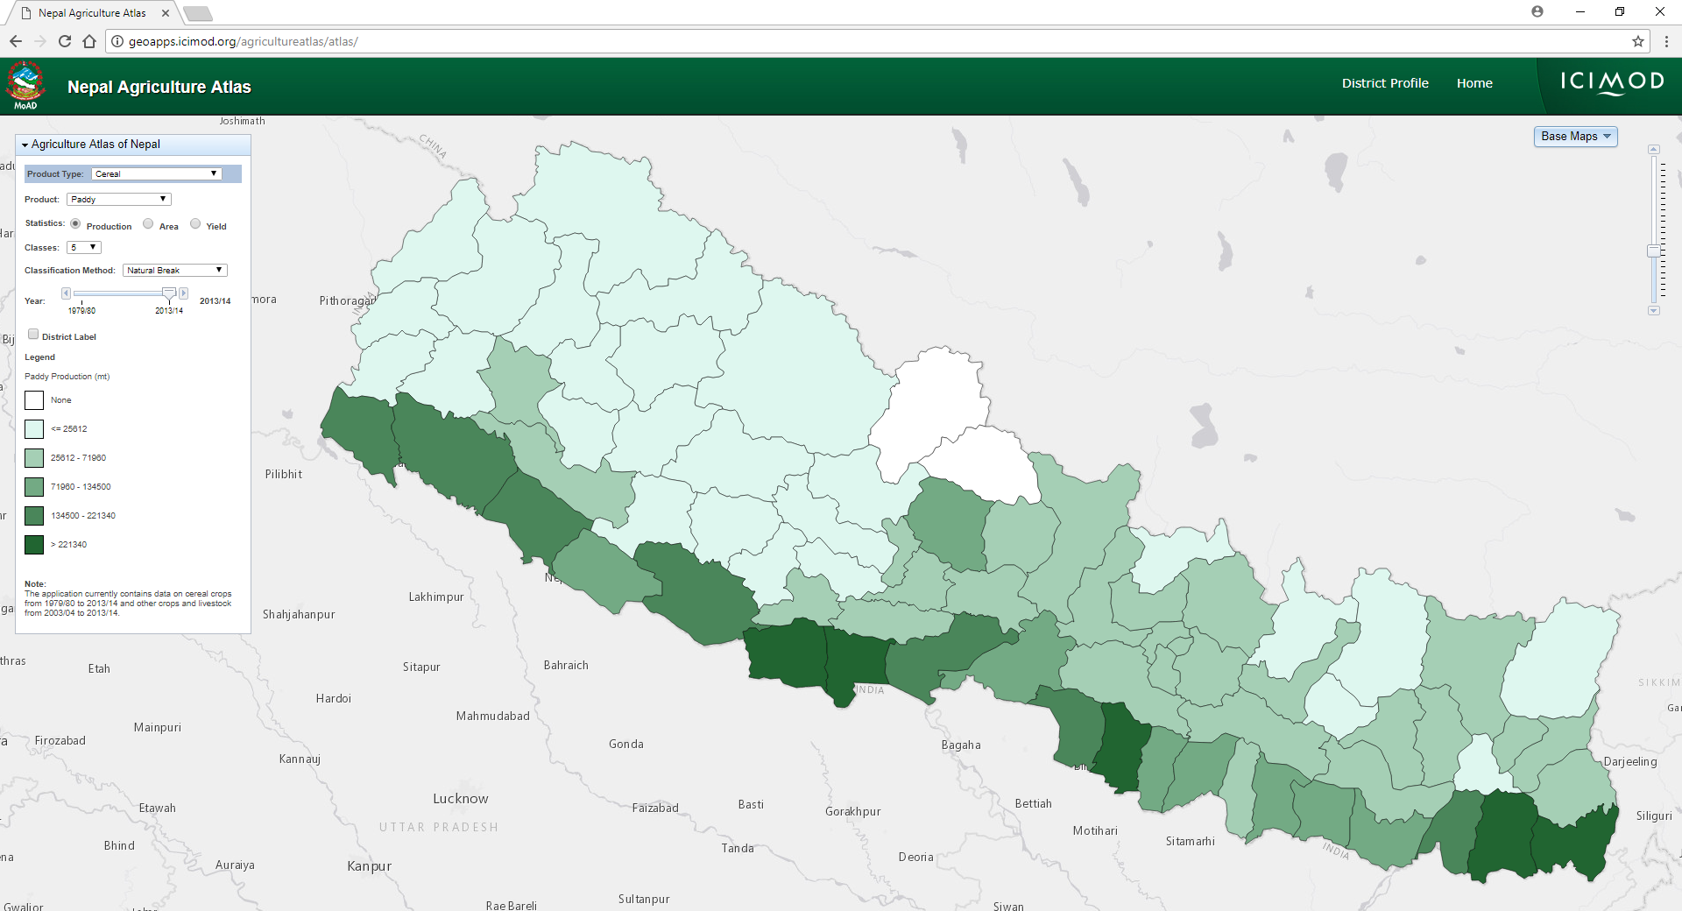
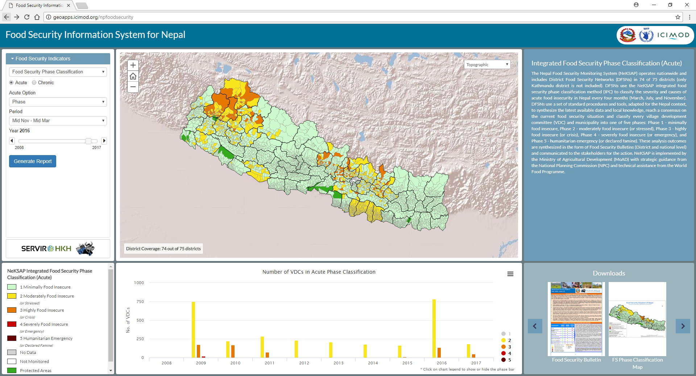
Agriculture and food security
Nepal Agriculture Atlas: historical agriculture statistics on crop ( (cereals, cash crops, legumes, vegetables and fruits) and livestock in Nepal
Food security phase classification
Small area estimation (food insecurity, under nutrition, poverty) in Nepal
District level Cereal Food Self Sufficiency Ratio
Seasonal drought frequency data in Nepal
SDG Goal 2: End hunger, achieve food security and improved nutrition and promote sustainable agriculture
SDG Goal 1: End poverty in all its forms everywhere

Slide 6
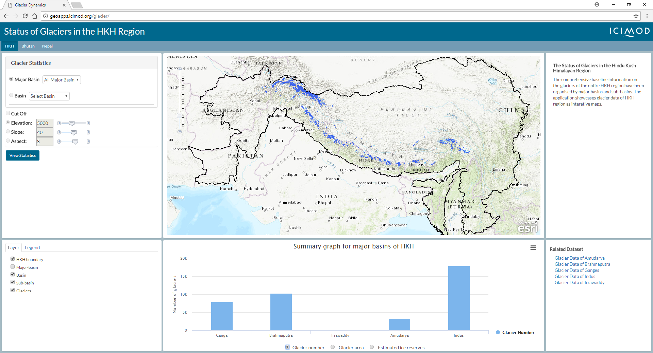
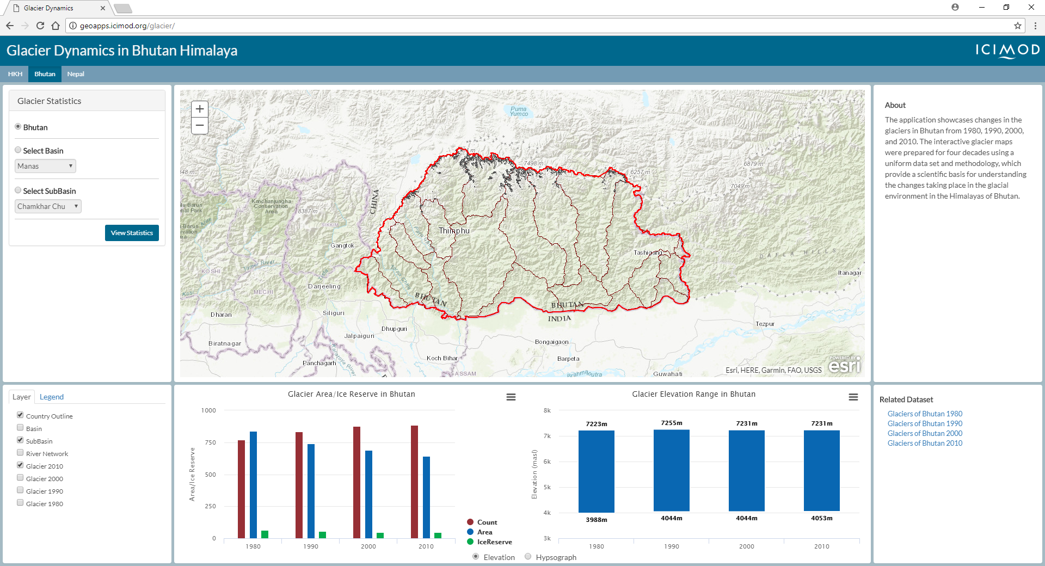
Glacier, glacial lake and snow cover
Glaciers of Hindu Kush Himalaya
Glacial lakes in Hindu Kush Himalaya
Glacier in Bhutan for 1980, 1990, 2000 and 2010
Glacier in Nepal for 1980, 1990, 2000 and 2010
8 day MODIS snow cover data of HKH (non-ICIMOD data)
SDG Goal 13: Take urgent action to combat climate change
SDG Goal 6: Ensure availability and sustainable management of water and sanitation for all

Slide 7
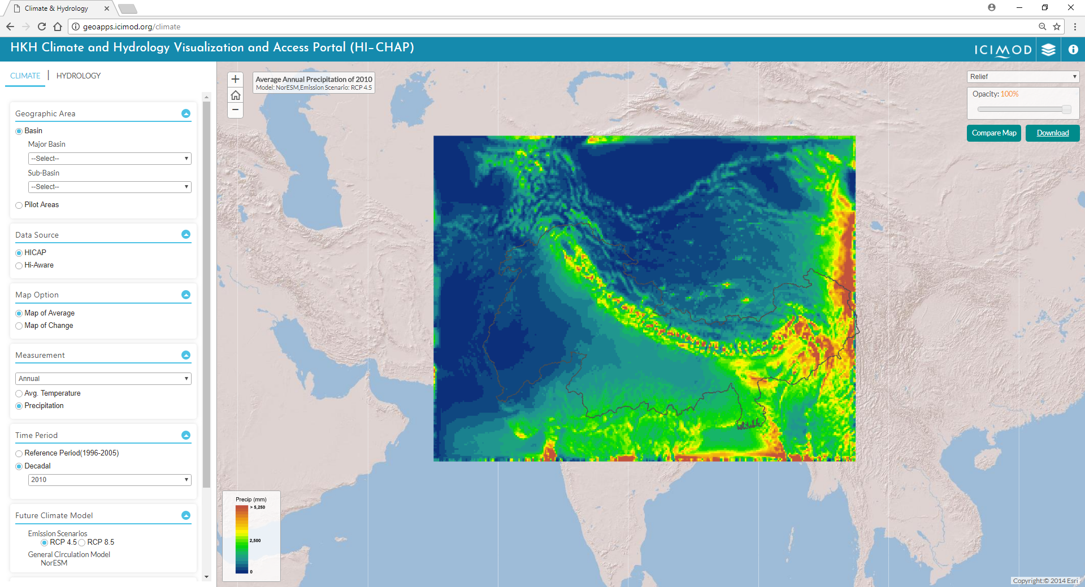
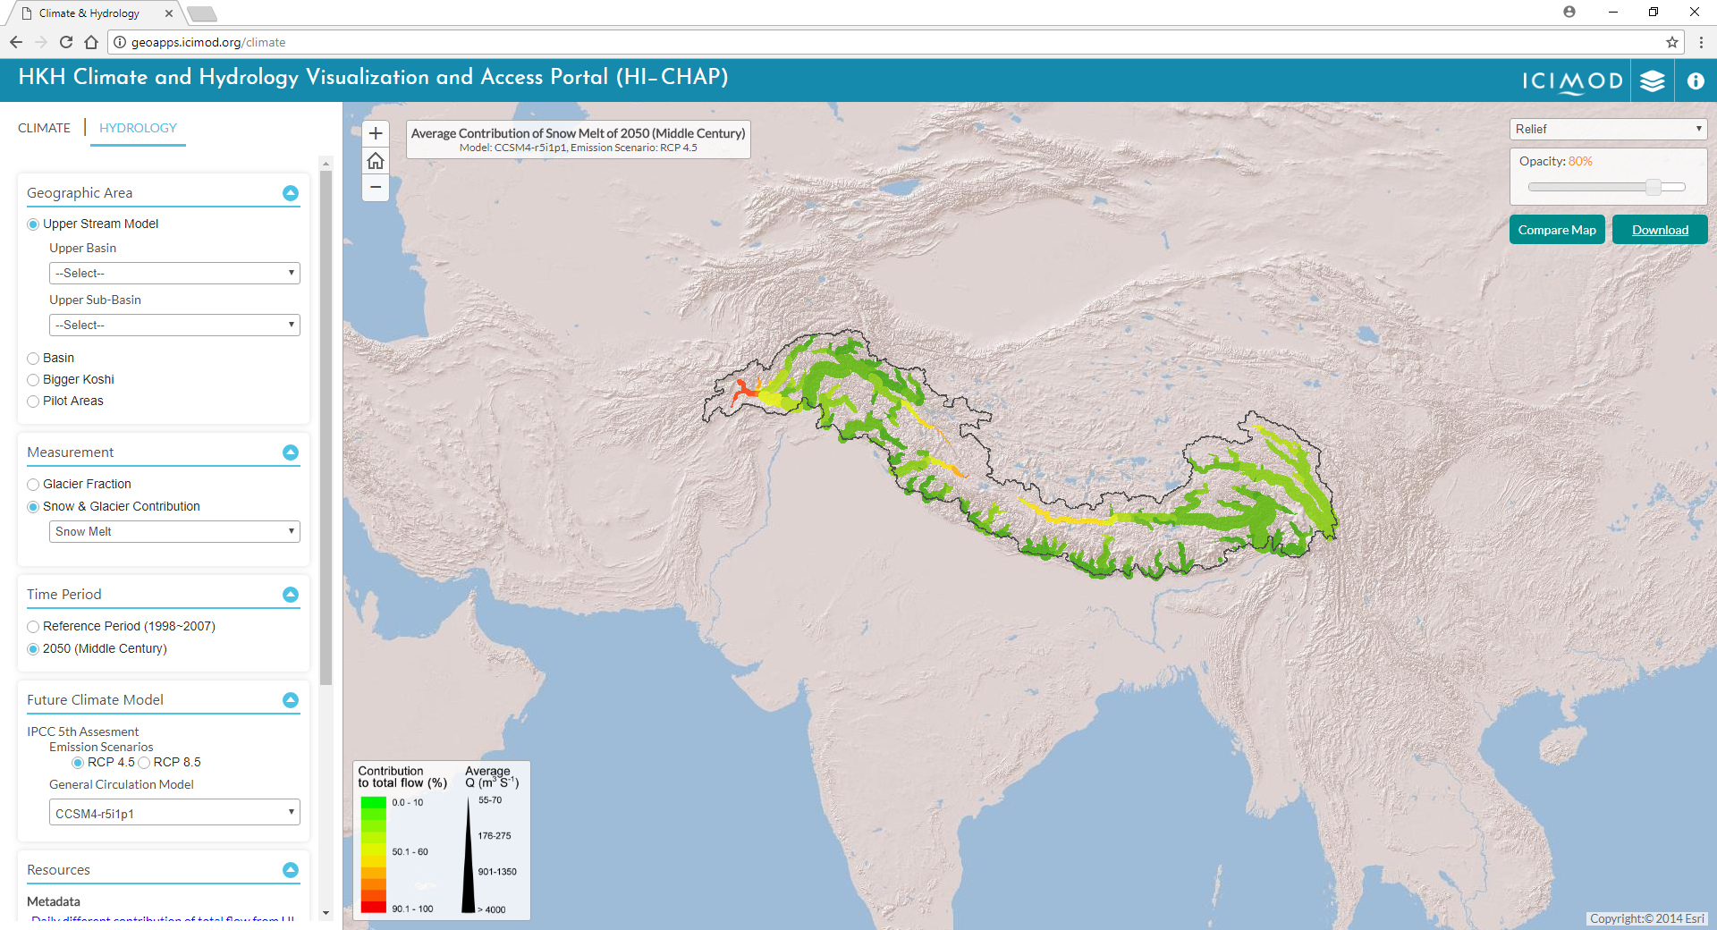
Climate change and water availability information
Map of average for annual or monthly average temperature and precipitation for reference (1965-2005) and decadal (2010, 2020, 2030, 2040) periods
Map of change for annual/monthly temperature and precipitation for mid century (2050), near future (2036-2065) and future (2071-2000).
Glacier fraction and snow and glacier melt contribution to rivers in Upper Indus basin
SDG Goal 13: Take urgent action to combat climate change
geoapps.icimod.org/climate

Slide 8
Poverty and vulnerability assessment
Poverty and vulnerability assessment questionnaire survey data.
SDG Goal 1: End poverty in all its forms everywhere

Slide 9
Ongoing Works
Regional drought monitoring and early warning system – Afghanistan, Pakistan and Bangladeshi
Agro-met advisory service in Nepal
Mountain Livelihood Atlas
Gender and Social Inclusion Atlas
Education Atlas of HKH
Regional and national level annual automatic forest and land cover monitoring (HKH level)
Climate change vulnerability and adaptation planning for forest ecosystems - Nepal and Bangladesh
Comprehensive Streamflow Prediction and Visualization to Support Integrated Water Management in the Himalaya Region
SDG Goal 1: End poverty in all its forms everywhere
SDG Goal 5: Achieve gender equality and empower all women and girls
SDG Goal 2: End hunger, achieve food security and improved nutrition and promote sustainable agriculture
SDG Goal 6: Ensure availability and sustainable management of water and sanitation for all
SDG Goal 4: Ensure inclusive and equitable quality education and promote life-long learning opportunities for all
SDG Goal 15: Protect, restore and promote sustainable use of terrestrial
ecosystems, sustainably manage forests, combat desertification, and halt
and reverse land degradation and halt biodiversity loss

Slide 10
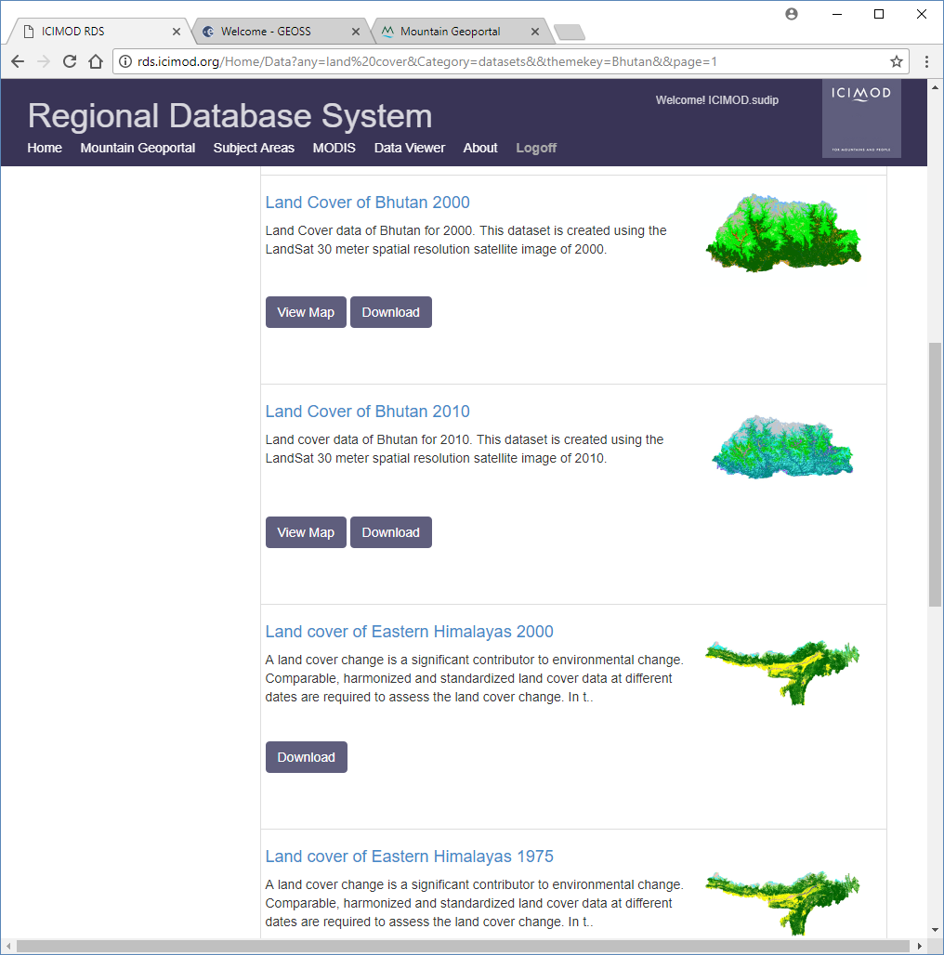
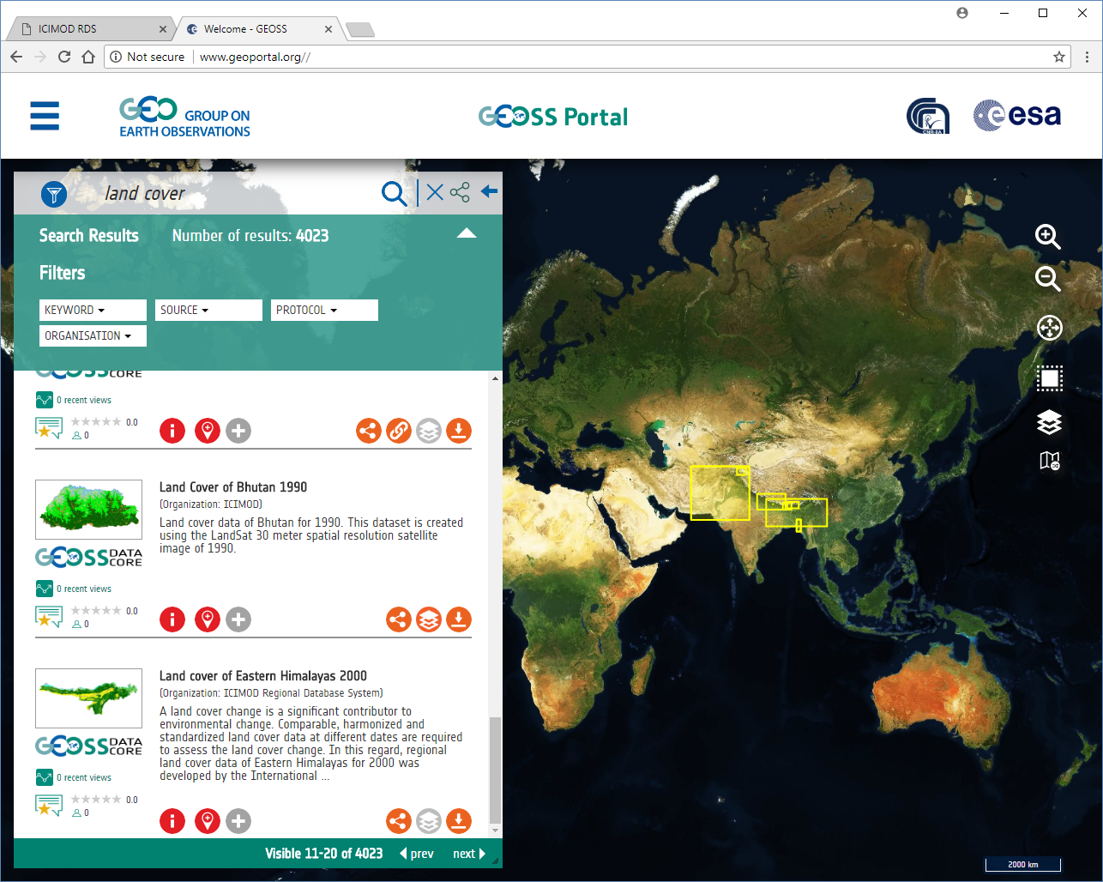
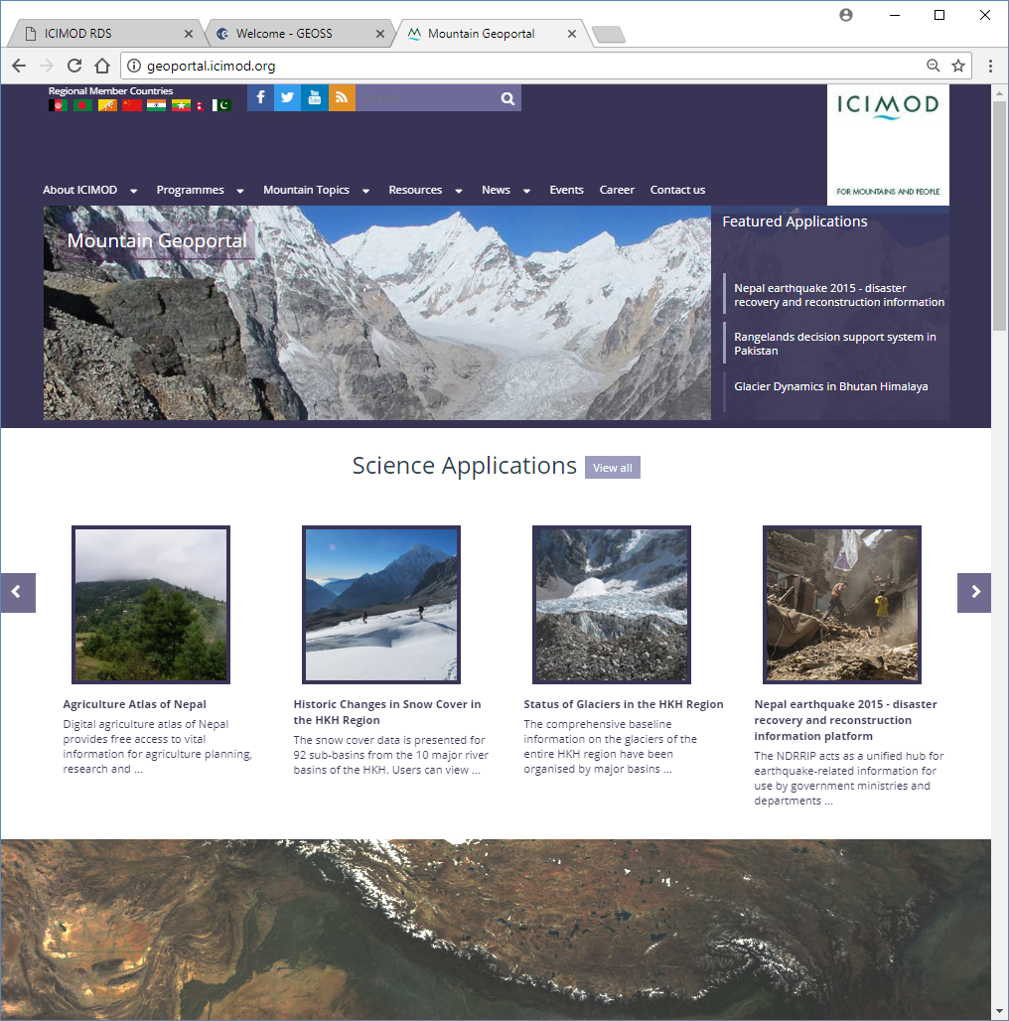
Accessing ICIMOD Data and Information
rds.icimod.org
geoportal.org
geoportal.icimod.org

Slide 12
Thank you
Sudip.Pradhan@icimod.org / http:www.icimod.org, http://rds.icimod.org

