Slide 2
DEIMS-SDR by LTER
Christoph Wohner / Developer/ Environment Agency Austria & LTER Europe

Slide 3
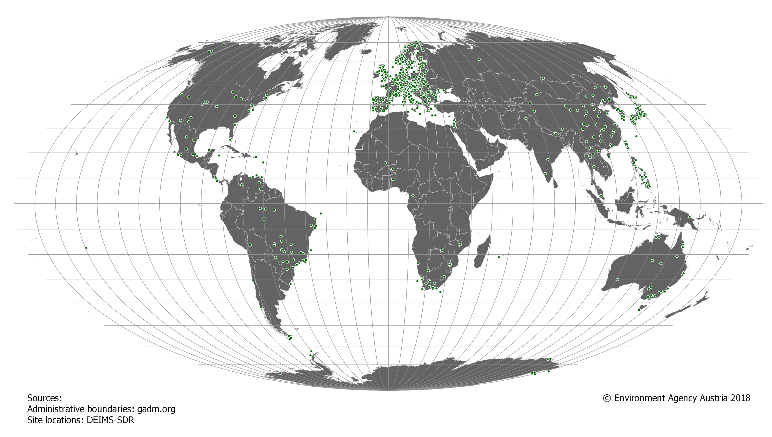
Introduction DEIMS-SDR/ Sites https://data.lter-europe.net/deims/
Site catalogue of the international long-term ecological research (ILTER¹) group, its European regional group (LTER Europe²) and others (e.g. H2020 EcoPotential project) currently featuring 1033 published site records.
¹ https://www.ilter.network/ ² http://www.lter-europe.net/

Slide 4
Introduction DEIMS-SDR/ Associated information https://data.lter-europe.net/deims/
Also allows to stores information about personnel, datasets and sensors.
Information is exposed through various metadata formats and services, e.g.
Metadata formats
EML
BDP
ISO 19115, 19139
Inspire EF
Services
WMS
WFS
CSW
OAI-PMH
ensuring interoperability and reusability of data.

Slide 5
DEIMS-SDR/ How to connect to DEIMS-SDR
https://data.lter-europe.net/deims/
Get information from DEIMS-SDR using the standardised services:
pyCSW: https://data.lter-europe.net/pycsw
CSW: https://data.lter-europe.net/pycsw/catalogue/csw
OAI-PMH: https://data.lter-europe.net/pycsw/csw.py?mode=oaipmh&verb=Identify
GeoServer: https://data.lter-europe.net/geoserver/web/
WMS: https://data.lter-europe.net/geoserver/ows?service=wms&version=1.3.0&request=GetCapabilities
WFS: https://data.lter-europe.net/geoserver/ows?service=wfs&version=2.0.0&request=GetCapabilities

Slide 6
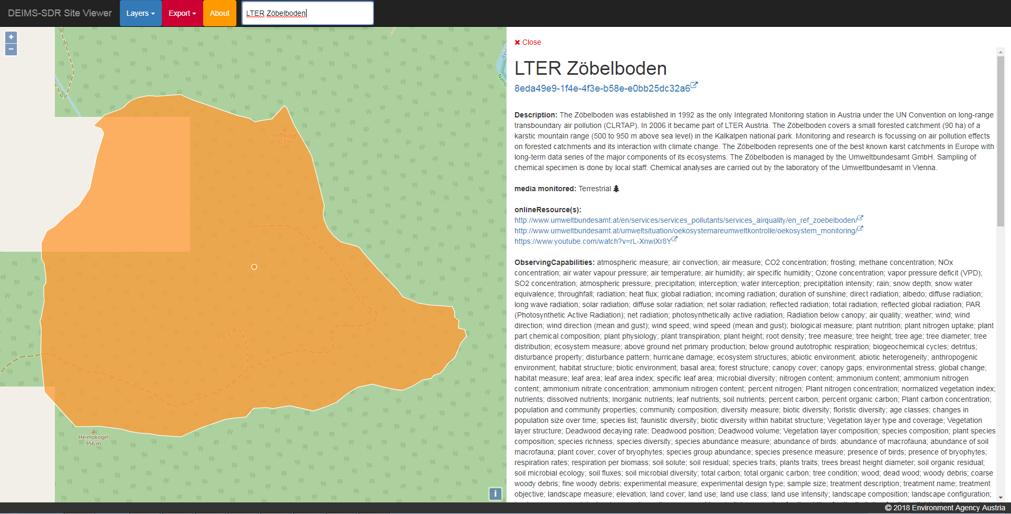
DEIMS-SDR/ How to connect to DEIMS-SDR
https://data.lter-europe.net/deims/
Implementation example: https://github.com/stopopol/ef_viewer
Connects to the DEIMS-SDR GeoServer
Visualises site locations based on available layers on GeoServer instance
Uses site identifier to fetch Inspire EF record of sites
Renders detailed site information
https://data.lter-europe.net/map/
Potential foundation for a federated site catalogue

Slide 7
Thank you
christoph.wohner@umweltbundesamt.at/ umweltbundesamt.at

