Slide 1

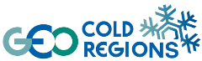
GEOCRI – GEO Cold Regions Initiative Information Service for Cold Regions
Yubao Qiu and co-leads
2018.5 @ ESA ESRIN /GEO Cold Regions Initiative

Slide 2
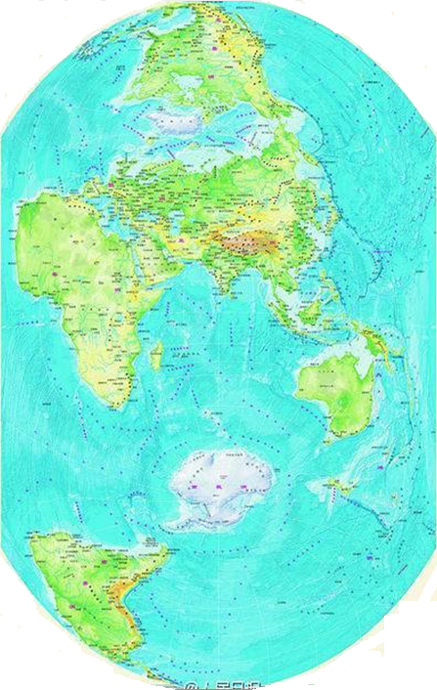
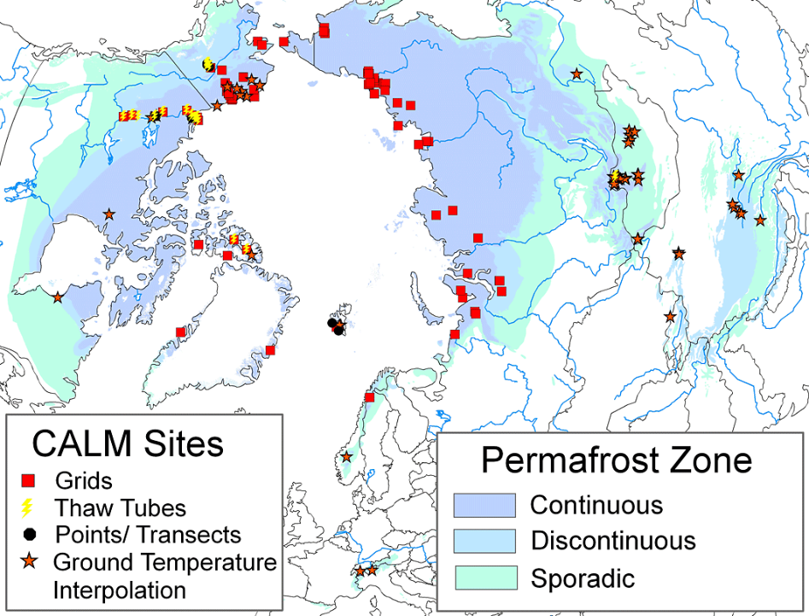
Look at the Earth from a different way : the Earth Poles connected closely.
Cold Regions: are the most important environment that driven the Earth system and the Earth planet.
Frozen Water and Phase changing Domination Role
  High Latitude
  High Altitude

Slide 3
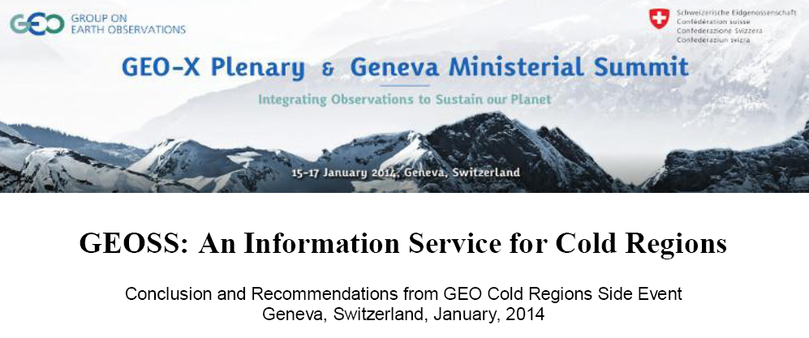
An Information Service for Cold Regions (or GEO Cold Regions), exploiting the GEOSS information system, is needed to provide easy access to observations and environmental information products by users across the globe.

Slide 4
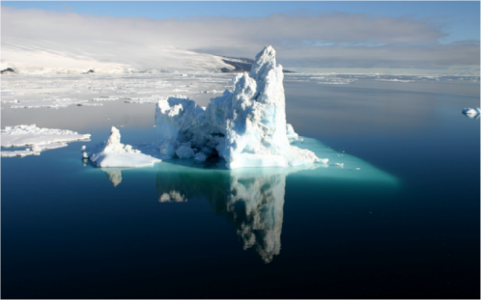
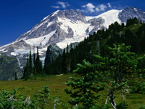
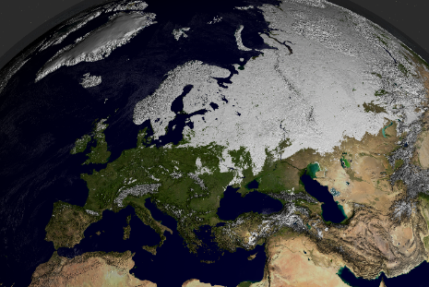
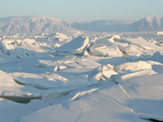
Why GEO Cold Regions?
Scientific and Societal Development Importance
More than 100 countries around the world have cryospheric elements. These elements are a main source of fresh water.
Cold regions are the most ecologically and environmentally sensitive areas, and changes to these areas
comprehensively affect the dynamic earth system, impacting many aspects of society in all parts of the world.
The cold regions of our planet influence our entire world.

Slide 5
Environmental and Socio-Political Challenges
Specific Earth observation needs and requirements
Climate & Weather
Biodiversity & Ecosystems
International Relations & Cooperation
Sustainable Development, Indigenous Communities & Traditional Practices
Health
Agriculture, Fisheries, Hunting & Food
Water
Pollution & Environmental Protection
Hazards
Built Environment, Infrastructure & Transport
Energy
Mining & Fossil Fuels
Forestry
Shipping
Tourism

Slide 6
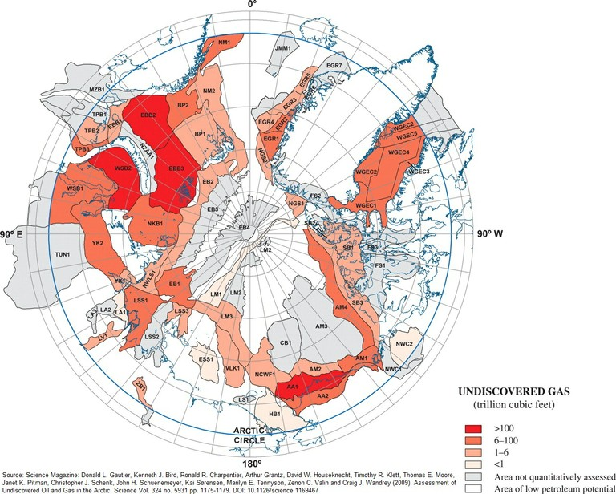

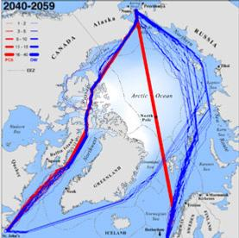
An Example: The melting Arctic creates a new world of shipping and resource opportunities
Make Way for More Ships--and More Species Invasions
Energy Resources in the Arctic Ocean
Arctic: a new geopolitical arena

Slide 7
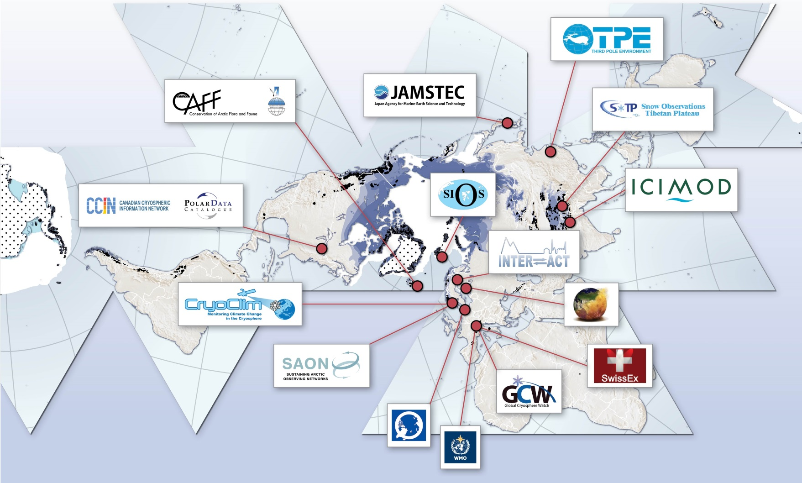
An Arctic Focus on Earth’s Cold Regions

Slide 8
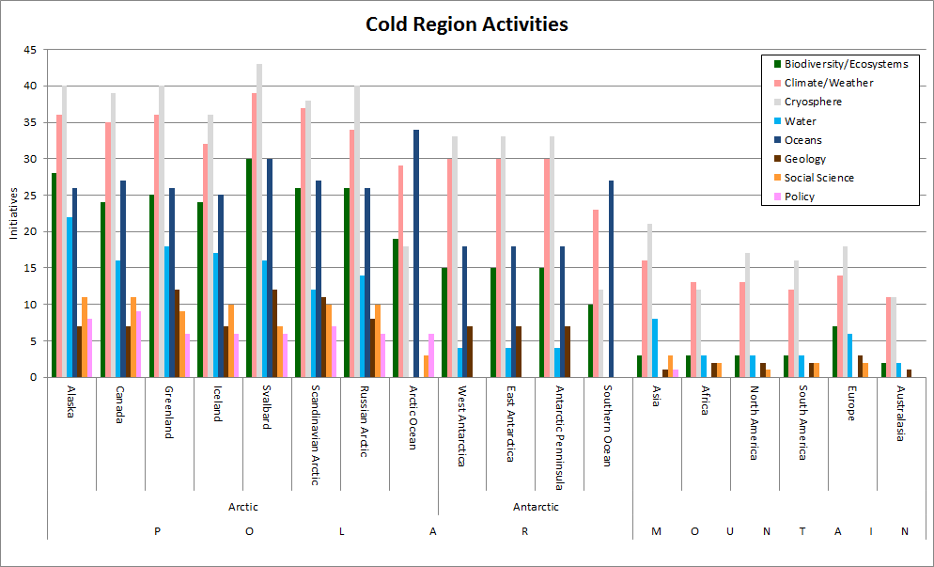
Activates related to Earth Observations and GEOCRI by domain
Numbers for the activities arranged by Regions

Slide 9
GEOCRI – GEO Cold Regions Initiative
Aiming to coordinates global joint efforts for Earth observations and information services over a vast Cold Regions area including the North Pole, South Pole, High Latitude Ocean, Himalaya-Third Pole and Mountain Cold Regions.
The GEO Cold Region Initiative (GEOCRI) is an initiated initiative in GEO XII at Nov. 2015, listed at GI-11: GEOCR imitative.
The AOS summit featured the GEO Cold Region Initiative (GEOCRI) that aims to identify, address and fill observational gaps and improve networks through coordinated observation practices and information services worldwide. See the Statement on the GEO Cold Region Initiative(GEOCRI).

Slide 10
GEOCRI Mission and Objectives
Mission: Develop a user-driven approach for Cold Regions information services to complement the mainly current science-driven effort, and foster the collaboration for improved earth observations and information on a global scale.
Objectives
Integrating, Brokering and Promoting Earth Observations over Earth Cold Regions
Advocating and Practicing Data Sharing
Building Community Portal and Services
Strengthening Capacity building and Partnerships

Slide 11
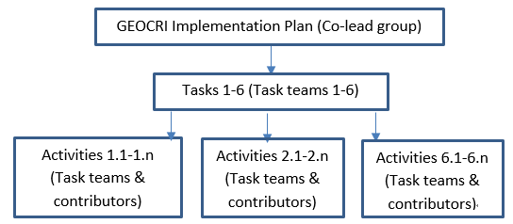
GEOCRI Task and Implentation Plan
Five Tasks:
Hierarchy structure of the activities
T1: Infrastructures
T2: Monitoring Network and Data
T3: Integrating in situ and Remote Sensing Observations
T4: User Engagement and Communication
T5: Capacity Buidling and Knowledge Transfer
T6: Management and Monitoring
Notes:
6 tasks:
Support SAON in maintain an inventory of existing cold region EO initiative (programme, projects, organizations, network, system…)
Leverage GEO’s international position to align other activities with artic Observing System efforts and SAON (GCW, INTERACT)
Support observing system networks

Slide 12
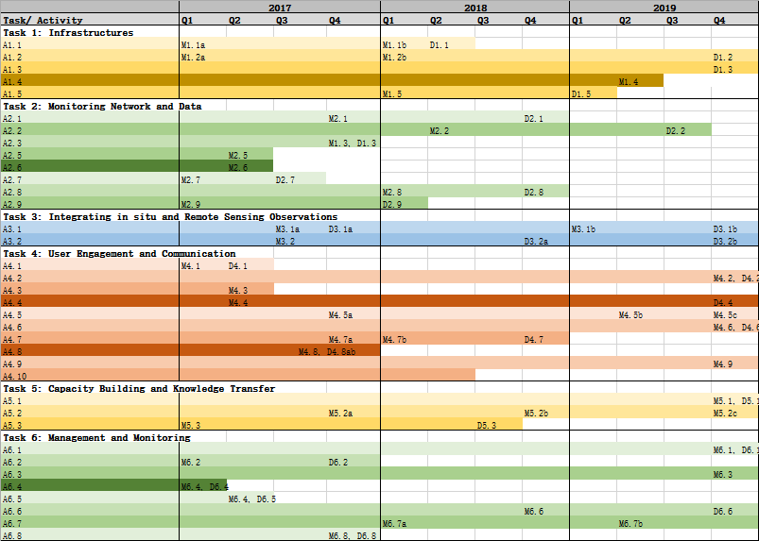
GEOCRI Task and Implentation Plan

Slide 13
The Priorities Identifying Activities
Community Portal Development – GEO CRI
Essential Variables for Cold Regions
Integration: In-situ, Remote Sensing, Model, and its Data Integrating

Slide 14
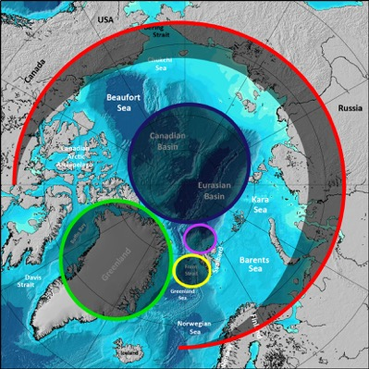

Networking : INTAROS overall objective
to develop an efficient integrated Arctic Observation System by
extending,
improving and
unifying
existing and evolving systems in the different regions of the Arctic

Slide 15
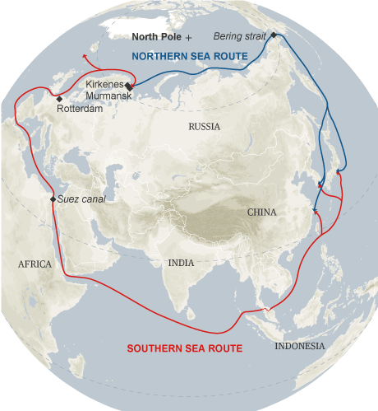
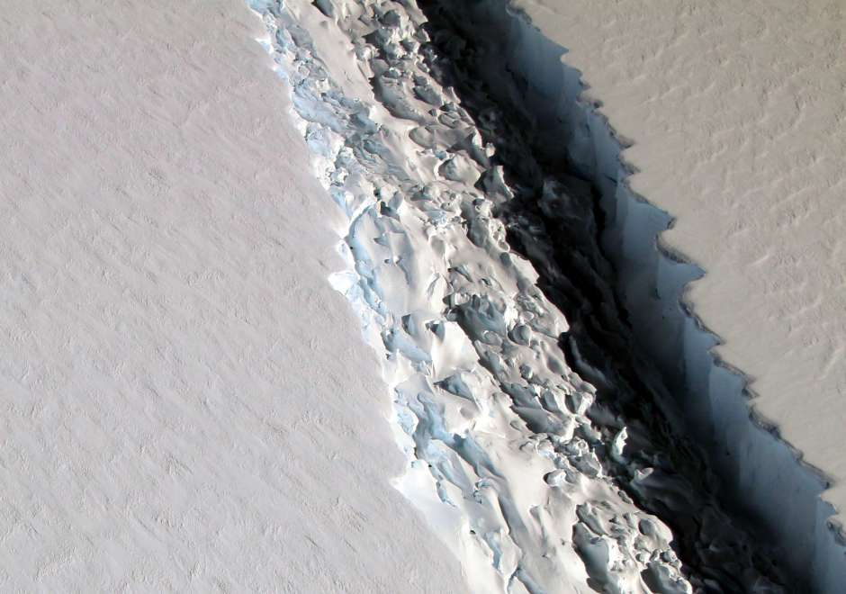
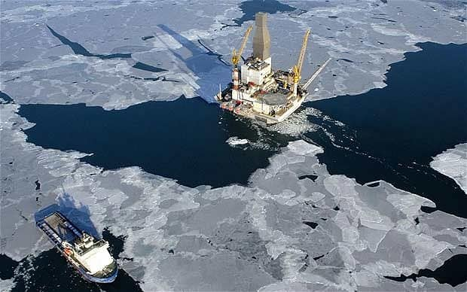
Why this Ad Hoc Committee?
Networking : IEEE Ad Hoc Committee on North & South Poles
Impact on transportation
Impact on Ecology
Impact on Security and Health
To identify ways in which IEEE can efficiently contribute to the different ongoing and planned initiatives to study and address changes that the North and South poles are experiencing from the environmental, communications, transportation, educational, and outreach points of view

Slide 16
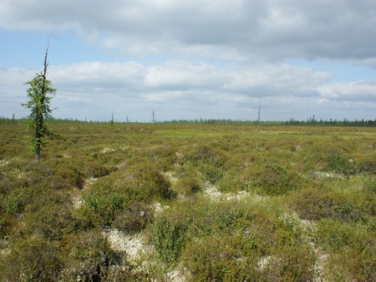
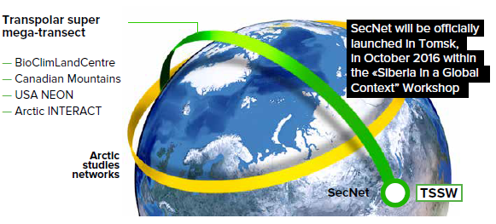
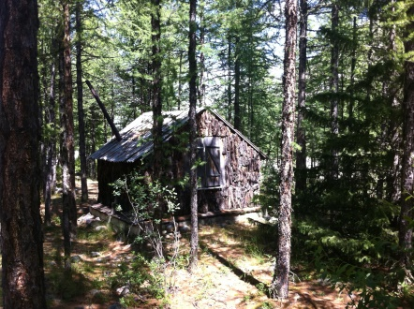
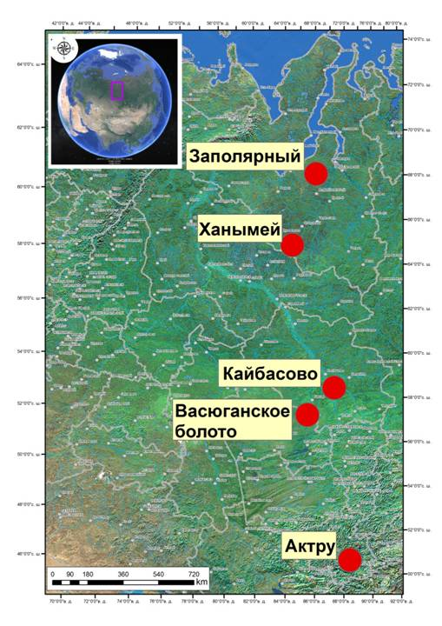
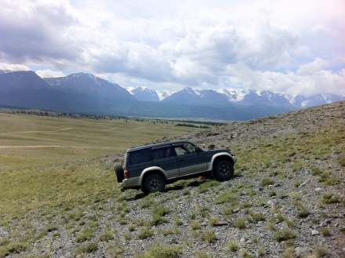
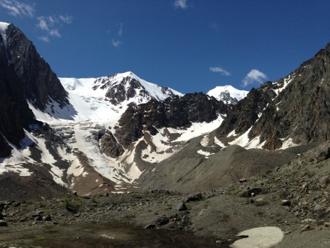
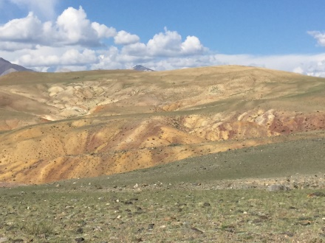
Networking : Mega Transect Project
Mega Transect Research Stations
Tundra
Mega Transect
Environments
Taiga
Zapolyarnyi (polygonal tundra in the continuouse permafrost zone )
Steppes
Khanymey (frozen flat-mound bogs – palsas, thermokarst lakes, rivers, and in the discontinuous permafrost zone)
Kaibasovo (Ob river middle course and flood plain)
Mountain
Great Vasiugan Mire (the biggest peatland at the World) in the south-taiga zone
Aktru (High Altai Mountains)
Desert

Slide 17
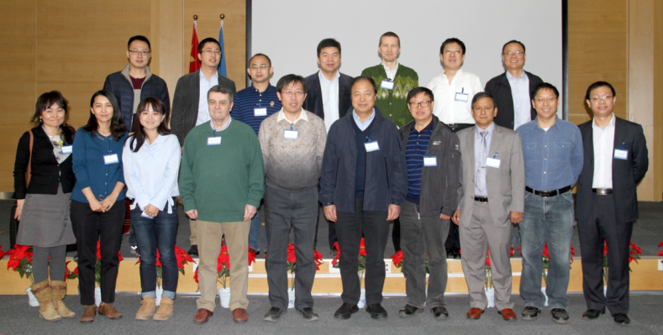

Networking : DBAR-HiMAC Task Force
Under the auspices of DBAR, the Task Force on High Mountain and Cold Regions (HiMAC) was established to address the challenges through collaborations with the national and international programs and initiatives.
Members of DBAR-HiMAC Task Force
DBAR-HiMAC focuses on science objectives to build a HiMAC Big Earth Data component by linking the existing Earth observations, archiving and documenting Earth observation data and geophysical products, producing knowledge and services.

Slide 18

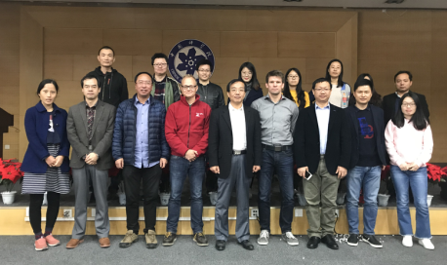
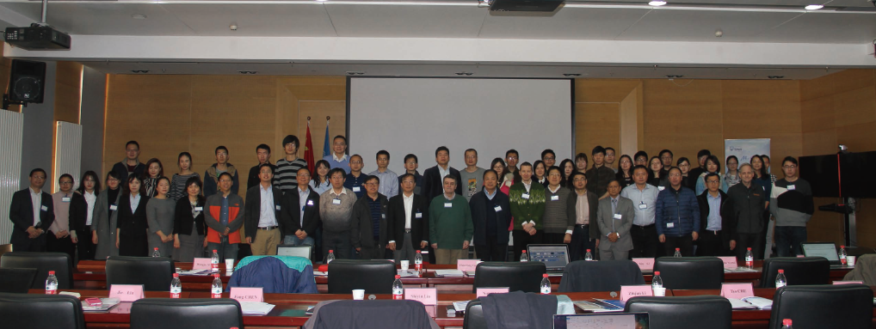
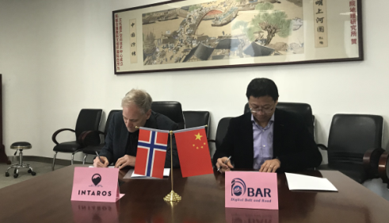
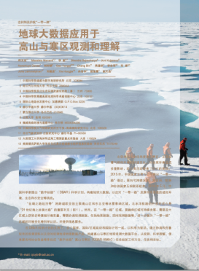
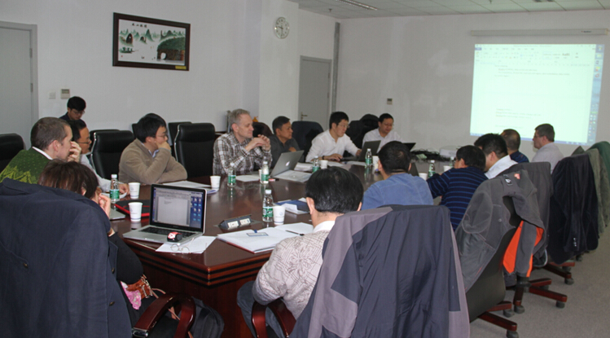


Activities Recently (with NERSC/FMI)
GEO CRI Synergy Activities
Presented at INTAROS Meeting in Helsinki 2018
The 2017 International Workshop on Observations and Understanding of Changes in High Mountain and Cold Regions (HiMAC2017) was held in Beijing, China on 3-4th, March, 2017
30, Oct 2017
Visiting to NERSC (Discussion Note)
HiMAC White Paper: DBAR-HiMAC Publication – Position Paper in CAS Bulletin
DBAR HiMAC Work Meeting on 4th, March, 2017

Slide 19
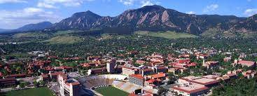
Events : Polar Data Planning Summit
The meeting is being be co-led and co-organized by key polar data projects and programs.
As of writing, organizers include:
IASC/SAON Arctic data Committee
SCAR Standing Committee on Antarctic Data Management
Southern Ocean Observing System
Global Cryosphere Watch and related WMO activities
GEO Cold Regions Initiative
Arctic Spatial Data Infrastructure
Polar View
Arctic Portal
…

Slide 20
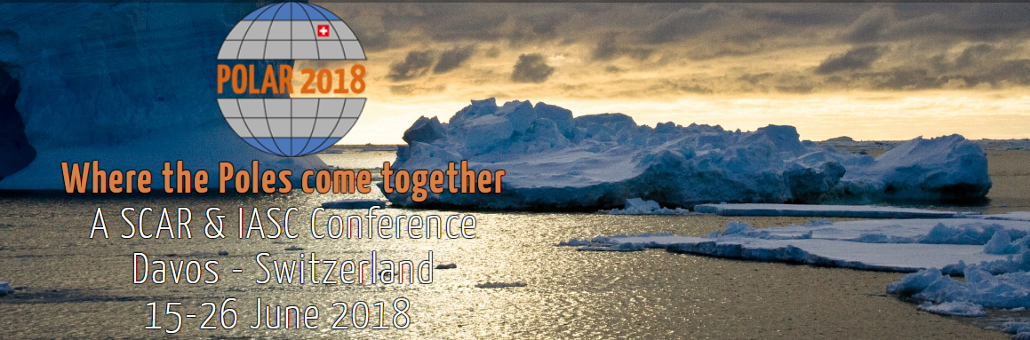
Events : GEOCRI Side Meeting at Polar2018
The side meeting will provide an introduction to the GEOCRI, including its main contributors, activities and services to end-users of cold region related Earth observation data. The meeting will especially highlight two ongoing GEOCRI activities: the development of the GEOCRI Community Portal and the Essential Cold Regions Variables.
Tuesday, 19 June 2018; 12.30pm – 2pm; Room A Wisshorn ; Open meeting

Slide 21




Events : 2018 International Workshop on Observations and Understanding of Changes in High Mountain and Cold Regions (HiMAC2018)
Late Oct @ Sodankylä, Finland
…

Slide 22
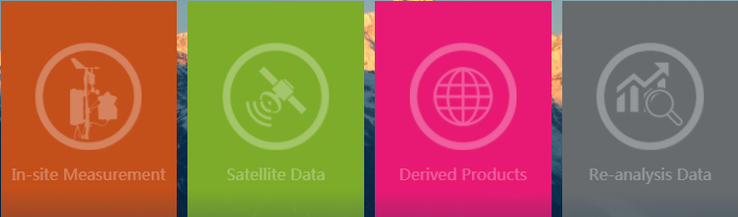
CAS-GMELT : A HMA Community Portal

Slide 23
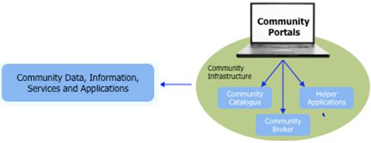
CAS-GMELT : A HMA Community Portal
Concept of Community Portal
A Community Portal is “a community-focused ‘website’ that provides a human interface to content that may come from distributed resources.”
Portals provide easy and open (free) access to data tools, and services.
Data resources may be raw data and data products, but also metadata about observational programs, projects, and observational platforms.
Externals access to resources and services, Externals can be humans or machines.

Slide 24
CAS-GMELT : A HMA Community Portal
CAS-GMELT : HMA Community Portal
An online Community Portal for the Observations (In-Situ, Satellite Data, Derived / Thematic Products, Re-Analysis Data) , Tools/Algorithms, and Models for the research community of HMA, especially the glacier, snow, ice, and relevant water, energy and environmental data products.
To support the Research community of HMA, based an data sharing Policy and principle,
  Metadata management
  Store, Search and discovery of resources
  Harvesting remote resources - Interoperability

Slide 25
Design and Implementation of CAS-GMELT
CAS-GMELT Functions
Data/Tools Resource
  Integrate both CAS-HiMAT and non-HiMAT resources (data, tools, algorithm)
  Registration Service : Dialogue with the individual information providers.
  Harvesting from public resources
Services
  Build specialized applications and components that provide value-added services within the HMA Communities.
Stakeholders/Users
  Externals can have access to its resources and services (humans or machines).
Interoperability
  Exchange with the international portals, especially the NASA-GMELT, BED …
Portal Management
  Documents/Publications Services
  User management system
  English/Chinese version
  …
CAS-GMELT
Services
Interoperability
Resources
Users/Stakeholders
International Data
Data Publications
High Quality Data
from HMA Community.

Slide 26

Design and Implementation of CAS-GMELT
CAS- GMELT
Interface
In-situ and Ground Data
News and Events
CAS-HiMAT
RS Data and Products
Users and Admin
Models/Tools/Algorithm
International Connection
Services (cases and demonstration application)
Admin
DBAR High Mountain and Cold Regions
Data and Products Standards
Protocol / Interoperability

Slide 27
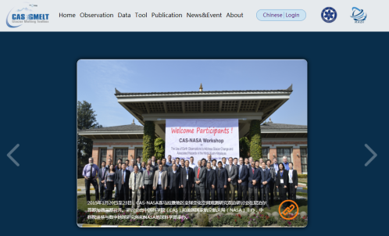
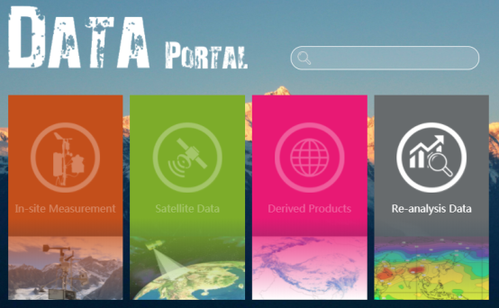
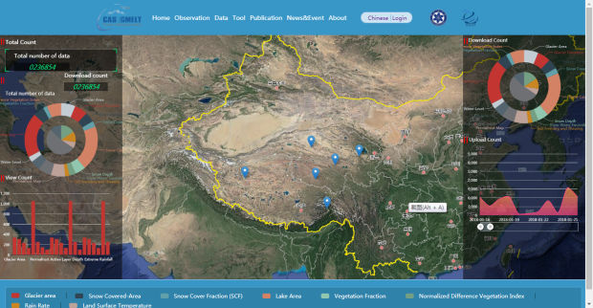
Design and Implementation of the GMELT
Web Portal
Data Portal
Observations
Web Portal
Data
Service
Cloud Archive and Computing

Slide 28
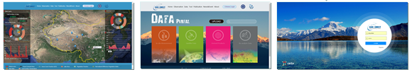
Design and Implementation of the GMELT
CAS-GMELT - http://118.89.236.164:8091/
CAS-GMELT (Community Portal)
Observation / Service
Data Portal
User / Data Policy

Slide 29
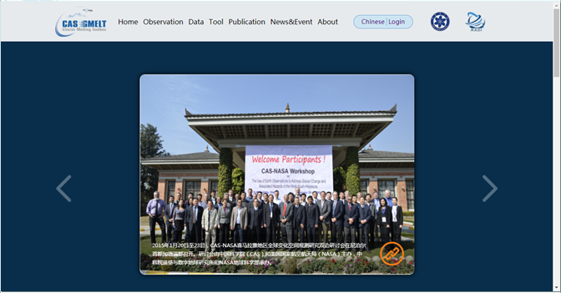
Design and Implementation of the GMELT
Web Portal: Website Elements

Slide 30
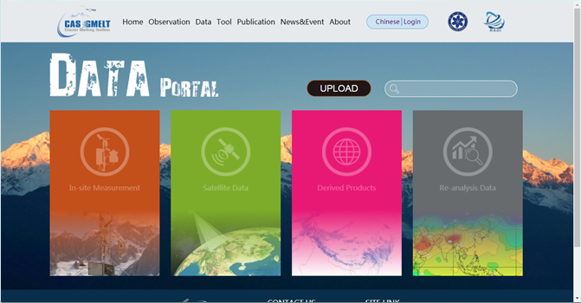
Design and Implementation of the GMELT
Data Portal: Website Elements

Slide 31
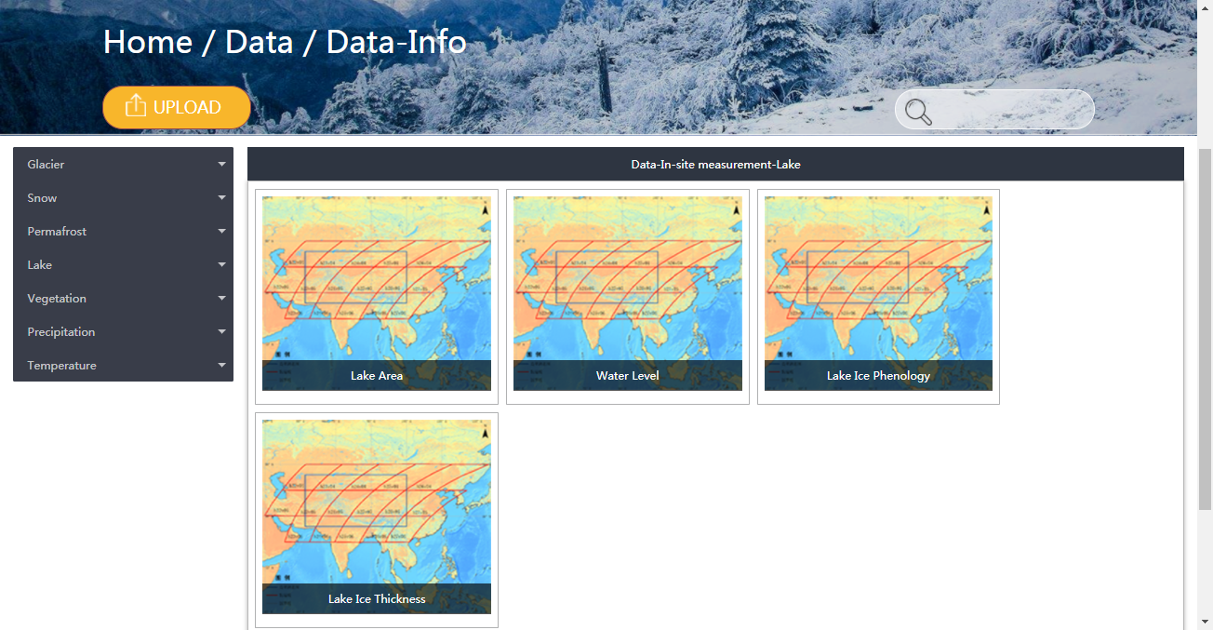
Design and Implementation of the GMELT
Data Portal: Data Portal for Users and Providers

Slide 32
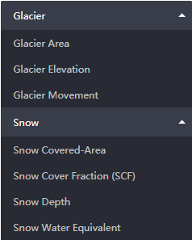
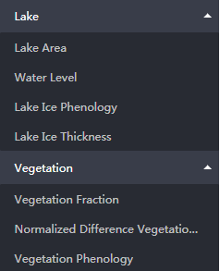
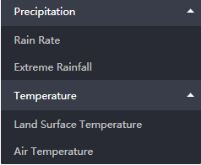
Design and Implementation of the GMELT
Data Portal: Data Portal for Users and Providers

Slide 33
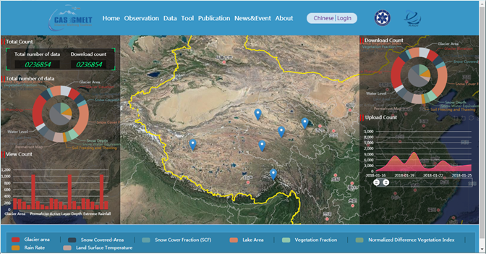
Design and Implementation of the GMELT
Observation: Information Service and Data Viewer
Two folders:
  Data Statistic/Big Data
  Service (Glacier/Snow/Lake…)

Slide 34

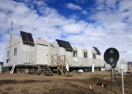
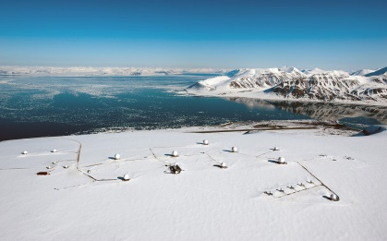
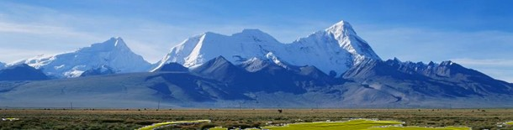
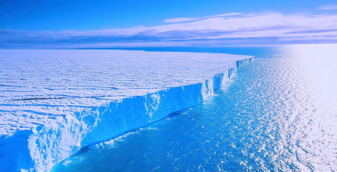

Thank You
Contact details :
Yubao QIU: qiuyb@radi.ac.cn
Hannele Savela : Hannele.Savela@oulu.fi

