Slide 1
The GSNL way to Open Science
Stefano Salvi
Chair of the GSNL Scientific Advisory Committee

Slide 2
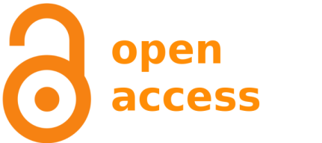
Open Science
In essence, OS is about making Scientific Knowledge openly shared and reusable (at least the one which is publicly funded).
While Open Data is a fundamental component of OS, it is not sufficient to attain a full sharing of scientific information. There is a lot more to knowledge than just data.
Open Access to scientific literature is another component of OS, however publications do disseminate scientific knowledge, they do not optimise timeliness , completeness, reusability and reproducibility.

Slide 3
Earthquake and Volcano Science
Limited commercial interests
Strong benefits for the protection of lives and economic assets
Important ethical motivations of scientists
Mainly sustained by public funding
Mostly public users with good capacitiy to uptake scientific information
During ongoing disasters, sharing of scientific knowledge must be timely and unrelated to publications
Well suited for Open Science implementation !

Slide 4
Research Objects for Open Science
A Research Object (RO) is a machine-readable aggregation of digital resources that bundles the content of a research work to facilitate reusability, reproducibility and sharing.
www.researchobject.org

Slide 5
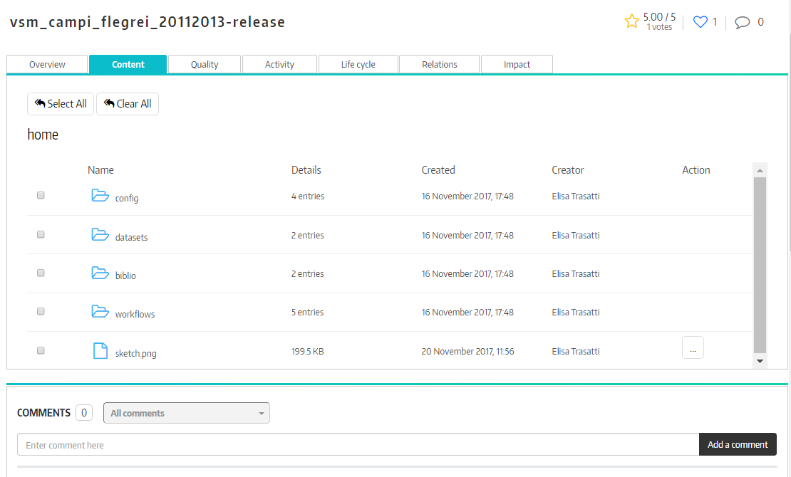
Research Object implementation
A Research Object can contain (or link) one or more of these resource types:
Data
Results
Experiments
Workflows
Metadata
Annotations
Bibliography
Provenance info
A RO can have a DOI for persistent identification and attribution of intellectual property

Slide 6
Research Objects are stored in
Rohub is a portal providing access to the RO database and to a complete set of management functions
It has been developed within different EC projects during the last 10 years and contains ROs from different communities (e.g., biology, marine science, natural hazards, etc.)
www.rohub.org

Slide 7
The ever-est Virtual Research Environment for GSNL
ever-est is a Virtual Research Environment (VRE) developed within a H2020 project during 2015-2018.
ever-est is collaborative web platform, designed to provide a scientific community with a set of tools and services, improving data access and sharing scientific knowledge, to effectively implement Open Science.
ever-est exploits the Research Object paradigm to implement Open Science in the Geohazard Supersite scientific community

Slide 8
For more info
www.geo-gsnl.org
info@geo-gsnl.org

