Slide 1
Expanding Access to Geospatial Data
Iain Macinnes, director – emea, digitalglobe

Slide 2
Four Business Units, complementary capabilities

Slide 3
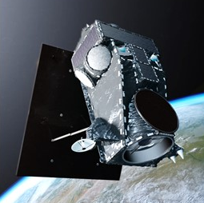
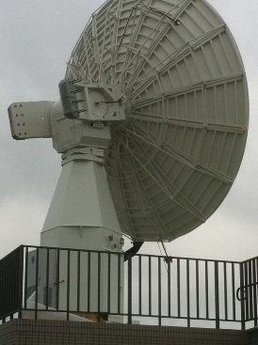
End-to-end spectrum for space-based solutions
Space Segment
Mission design
EO Imagery
EO Analytics
SAR Imagery
Ground Segment
Analytics
ML/AI

Slide 4
Notes:
We at DigitalGlobe have a unique vantage point that allows us to provide location intelligence that is needed to answer these pressing challenges. Our constellation of satellites leverage space as our location intelligence vantage point, collecting data every minute about our ever-changing planet. It equals about 80 terabytes of data per day! We then process and extract useful information out of the data – things like inventories of buildings, population centers, roads – and add to our digital living inventory of the earth.

Slide 5
Notes:
We call this the ‘The DigitalGlobe’. Our combination of sensors and platforms have created an unrivaled archive of location intelligence information, 100 petabytes worth of data. And this is growing by the minute.

Slide 6
Notes:
DigitalGlobe is the world leader in earth observation imagery. We have an unparalleled constellation of satellites that capture the highest resolution commercial satellite imagery available. And we’re gearing up to expand our imaging capabilities with our next constellation, called WorldView Legion, which is on track to launch in 2021 and it will almost double our capacity for 30cm imagery.
These satellites – starting with Ikonos which launched in 1999 and is no longer operational – have created our unrivaled, 18-year, 100 PB archive that shows how our planet has been changing over time. It became ineffective to continue building and maintaining our own data centers, so over the past year, we’ve moved our archive to the cloud with AWS. We announced at the end of last year that we’re “all-in on AWS” – so our data will be hosted there (because that’s where our customers are working), we’ll fly our satellites in AWS, and we’ll produce imagery in AWS. Our Geospatial Big Data platform – GBDX – is already built in AWS so we’ll continue expanding our machine learning capabilities there.
We have 30 ground stations around the world, enabling us to be in direct contact with our constellation during 40% of their orbit time.
Using our satellites and ground stations, we’re able to provide the world with new information about what’s happening on Earth daily. With our archive and fresh imagery now in the cloud, we’re able to quickly move data around the world – at speeds that help our partners make mission-sensitive decisions. In some cases, key partners can receive the imagery and information within a half-hour of its capture.
We do this work with just over 11-hundred employees… more than half of whom have clearances.

Slide 7
Key growth drivers / market trends
Notes:
DigitalGlobe is committed to helping everyone See A Better World™ by providing accurate high-resolution satellite imagery to support disaster recovery in the wake of large-scale natural disasters.
We release open imagery for select sudden onset major crisis events, including pre-event imagery, post-event imagery and a crowdsourced damage assessment.
When crises occur, DigitalGlobe is committed to supporting the humanitarian community by providing critical and actionable information to assist response efforts. Associated imagery and crowdsourcing layers are released into the public domain under a Creative Commons 4.0 license, allowing for rapid use and easy integration with existing humanitarian response technologies.
Additional talking points/background:
Purpose:
After a disaster, our objective is to equip every organization and every person responding or helping with the best geospatial information for the impacted area. This means both the information before the disaster and after. By creating a specific website for the Open Data Program and providing the imagery license, it gives the disaster response community clarity and confidence that DigitalGlobe will be there to support them, no matter what. With all of the chaos and uncertainty after an event, this seems like a simple thing to do where we can remove some of the chaos.
Which imagery is available:
We actually wrote a protocol that considers many factors of the disaster, including how quickly it happened and its impact, the number of people affected, and the ability of the local authorities to handle and respond to the disaster. We also recognize that each disaster is unique, so we gather as much data and information as possible to make the decision.
What is the best way for people who are looking for the imagery to access it?
All the open imagery and associated vector data will be available on DigitalGlobe’s Open Data Program website. You can either download individual images or do one bulk download for an event, and all previous open data events are available as well. Also, if you want to sign up for email alerts for new activations or your organization is interested in becoming an official program partner, you can contact us through the site. We’re looking to get these data into the hands of people who need it during these crises, so any partner organizations that can help us further disseminate the data are welcome to join.

Slide 8
The DigitalGlobe Open Data Program
Supporting Response to Natural Disasters
Aims at providing essential information required for emergency planning, risk assessment, monitoring, damage assessment and emergency response
What’s included - Open Imagery & Data:
Access to archive imagery of the location
Tasking for the most up-to-date imagery
Crowdsourcing for additional data layers (damaged structures, impassable roads, areas of major destruction)
Notes:
In the wake of major natural disasters, DigitalGlobe has historically responded to requests for imagery and data for humanitarian purposes in an ad hoc fashion. In the past five years, there has been free and open imagery and data provided in response to Hurricane Patricia, the Nepal earthquake, Typhoon Haiyan, the tsunami in Japan, and the Haiti earthquake. Those ad hoc responses are a tacit acknowledgement of our corporate social responsibility to support these types of crisis situations. Our historical support has set a precedent and expectation that DigitalGlobe has the capability to and will assist with the response to major natural disasters. By articulating an official open data program, DigitalGlobe can set appropriate expectations and ensure consistency of the response.
Natural Disaster Protocol
DigitalGlobe’s FirstLook is a service for emergency management that provides fast web-based access to pre- and post-event imagery of natural disasters. High-resolution satellite imagery provides the essential information required for emergency planning, risk assessment, monitoring of staging areas and emergency response, damage assessment, and recovery.
This protocol aims to improve DigitalGlobe’s response to natural disasters and more effectively communicate our role with partners and the broader humanitarian community. Much of this protocol is designed to align with existing criteria and procedures already defined by key partners like the Humanitarian OpenStreetMap Team (HOT), UN Spider and others.
Open Imagery and Data
As a public good, DigitalGlobe would offer this combination of imagery and crowdsourced data layers.
This bundle of imagery and data layers will be available for humanitarian purposes:
• Access to archived images of location prior to natural disaster
• Satellite tasking for most up-to-date imagery
• Crowdsourcing for additional data layers
o Damaged structures
o Impassable roads
o Areas of major destruction

Slide 9
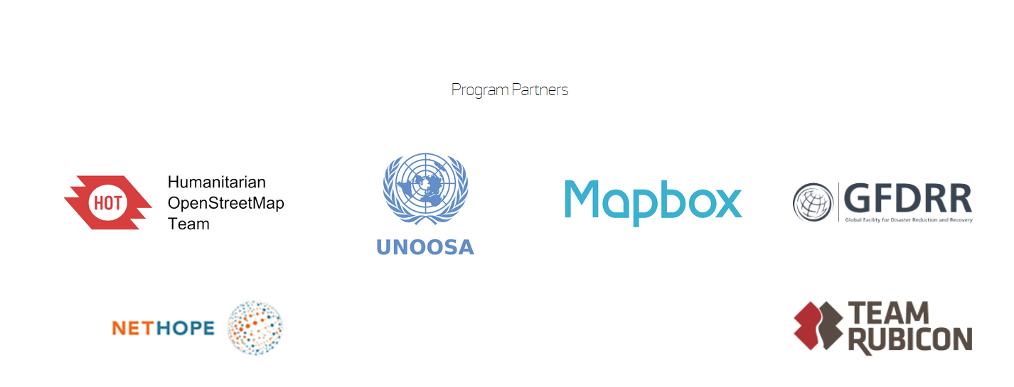
The DigitalGlobe Open Data Program
Notes:
In the wake of major natural disasters, DigitalGlobe has historically responded to requests for imagery and data for humanitarian purposes in an ad hoc fashion. In the past five years, there has been free and open imagery and data provided in response to Hurricane Patricia, the Nepal earthquake, Typhoon Haiyan, the tsunami in Japan, and the Haiti earthquake. Those ad hoc responses are a tacit acknowledgement of our corporate social responsibility to support these types of crisis situations. Our historical support has set a precedent and expectation that DigitalGlobe has the capability to and will assist with the response to major natural disasters. By articulating an official open data program, DigitalGlobe can set appropriate expectations and ensure consistency of the response.
Natural Disaster Protocol
DigitalGlobe’s FirstLook is a service for emergency management that provides fast web-based access to pre- and post-event imagery of natural disasters. High-resolution satellite imagery provides the essential information required for emergency planning, risk assessment, monitoring of staging areas and emergency response, damage assessment, and recovery.
This protocol aims to improve DigitalGlobe’s response to natural disasters and more effectively communicate our role with partners and the broader humanitarian community. Much of this protocol is designed to align with existing criteria and procedures already defined by key partners like the Humanitarian OpenStreetMap Team (HOT), UN Spider and others.
Open Imagery and Data
As a public good, DigitalGlobe would offer this combination of imagery and crowdsourced data layers.
This bundle of imagery and data layers will be available for humanitarian purposes:
• Access to archived images of location prior to natural disaster
• Satellite tasking for most up-to-date imagery
• Crowdsourcing for additional data layers
o Damaged structures
o Impassable roads
o Areas of major destruction

Slide 10
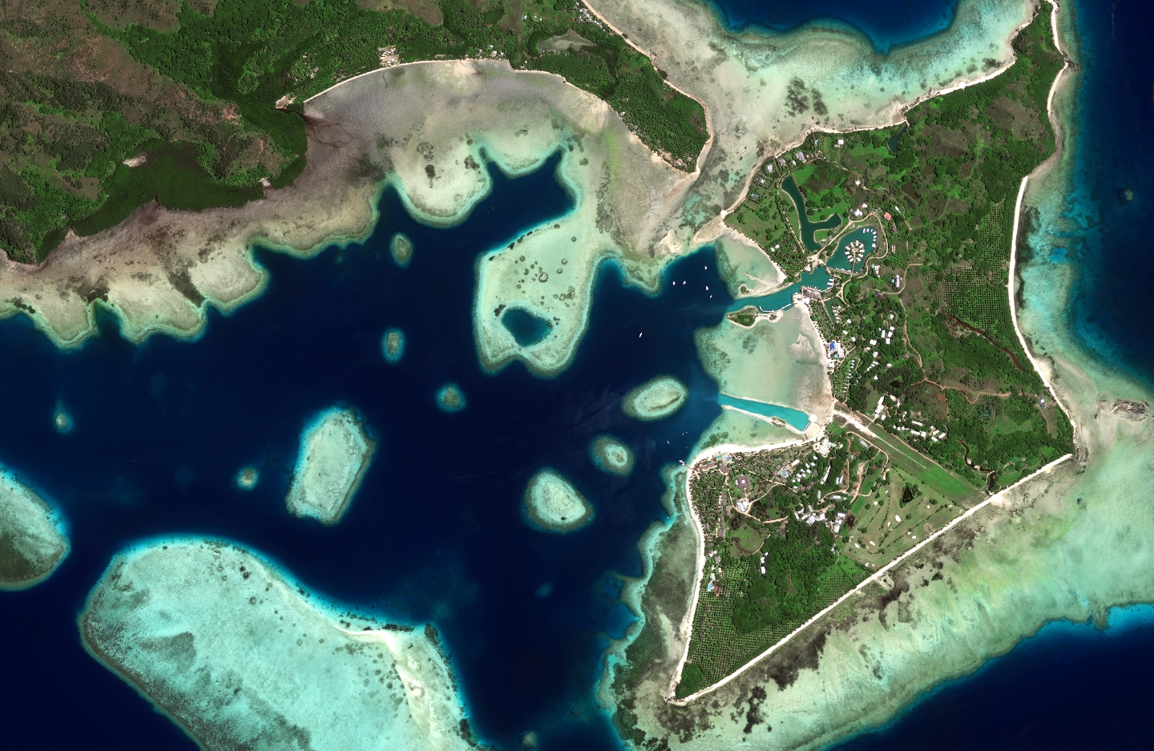
Disaster Response after Cyclone Winston
On February 20, 2016, Cyclone Winston struck Fiji with sustained winds of 145 mph. With more than 100 inhabited islands scattered across thousands of square kilometers of open ocean in the South Pacific, Fiji faces unique challenges when it comes to disaster response and recovery

Slide 11
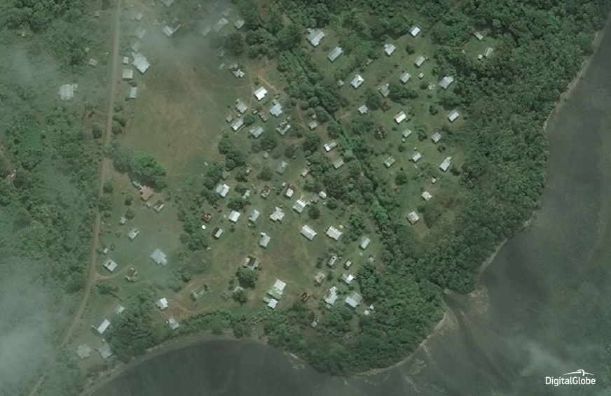

Slide 12
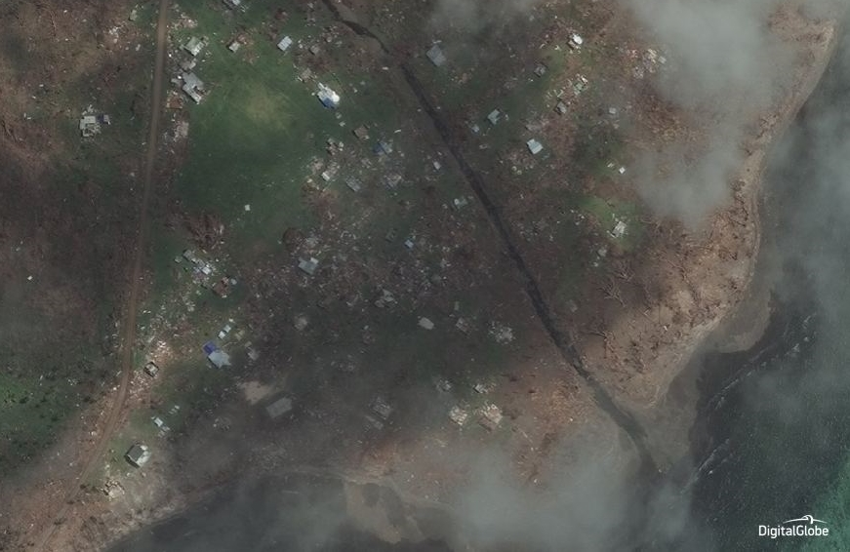
Within 24 hours, the crowd reviewed over 6,000 km2
They identified 5,500 damaged areas and helped the Fiji government organize a multi-agency relief effort

Slide 13
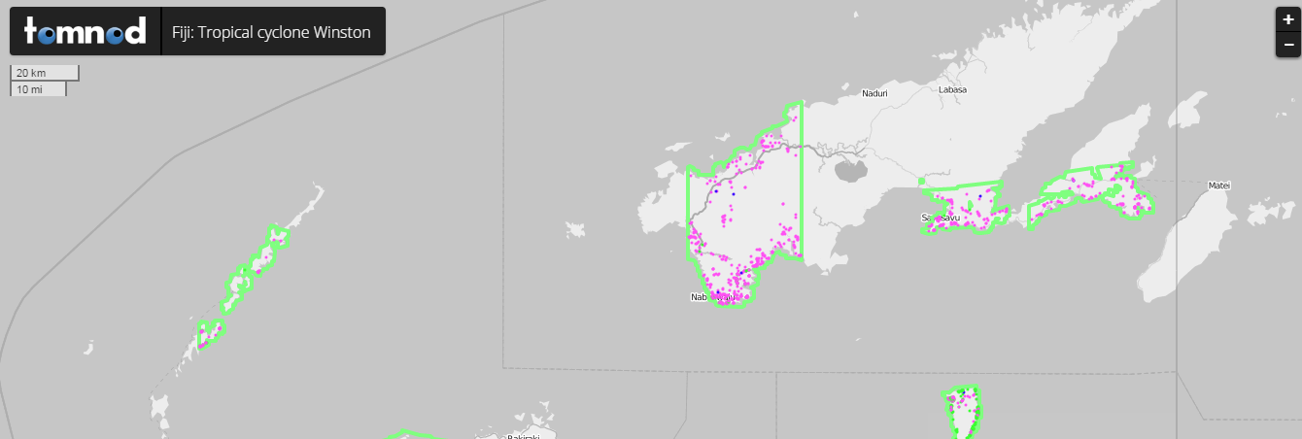
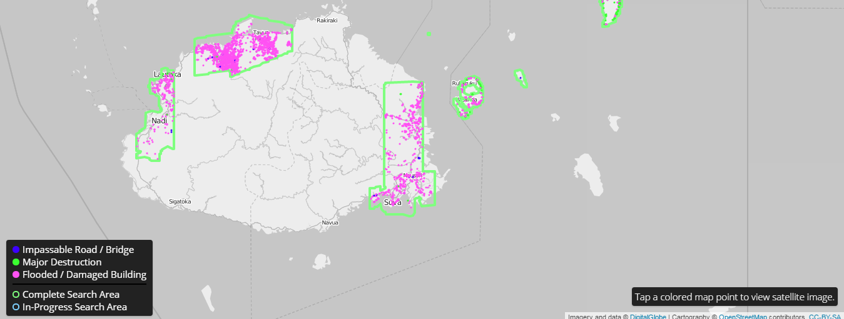
Notes:
the crowd has searched through more than 5,400 sq. km. of high-resolution, high-accuracy imagery and identified 5,500 unique points of interest that are helping the Fiji government and the Secretariat of the Pacific Community (SPC) organize a multi-agency relief effort. Fresh imagery and crowd-sourced results are being delivered in near real-time as the crowd searches through new areas each day.

Slide 14
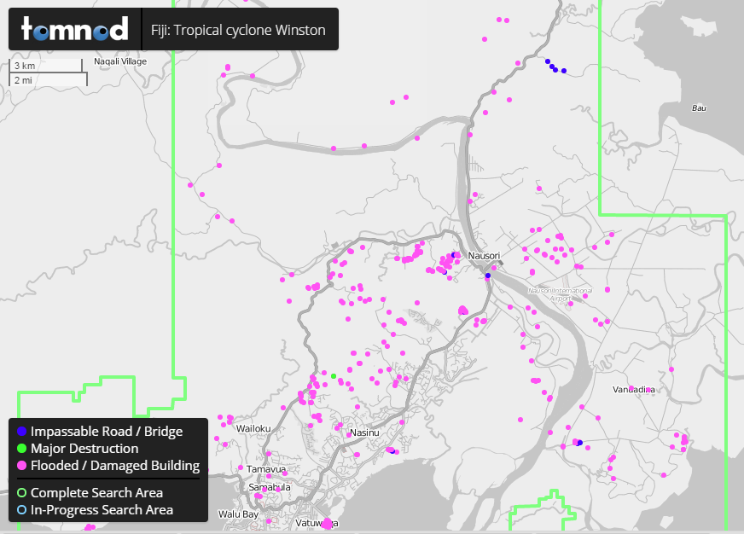
Notes:
the crowd has searched through more than 5,400 sq. km. of high-resolution, high-accuracy imagery and identified 5,500 unique points of interest that are helping the Fiji government and the Secretariat of the Pacific Community (SPC) organize a multi-agency relief effort. Fresh imagery and crowd-sourced results are being delivered in near real-time as the crowd searches through new areas each day.

Slide 15
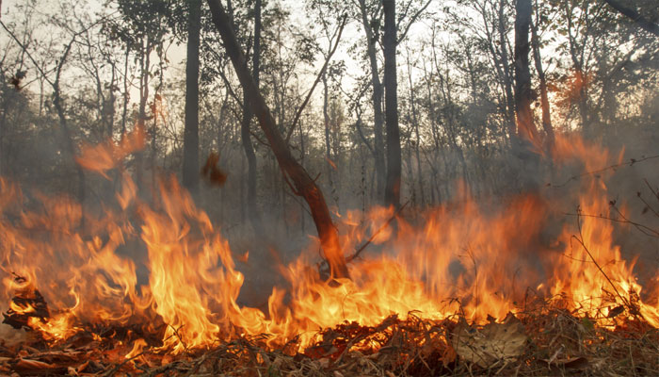
Responding to Indonesian fires in real-time
Indonesia is a rich archipelago with an abundance of natural resources. At the same time, the country is the world’s sixth-largest emitter of greenhouse gases, mainly due conversion of its forests and carbon-rich peat lands to agricultural fields. Indonesia’s rainforests—the world’s third largest—are home to more than 3,000 known species of animals, and 29,000 species of plants, and the livelihoods of 50-60 million people depend directly on these ecosystems. With World Resources Institute’s Global Forest Watch platform, the Indonesian government leverages crowdsourcing, high-resolution imagery and real-time analytics to deploy task forces to prevent fires from spreading.

Slide 16
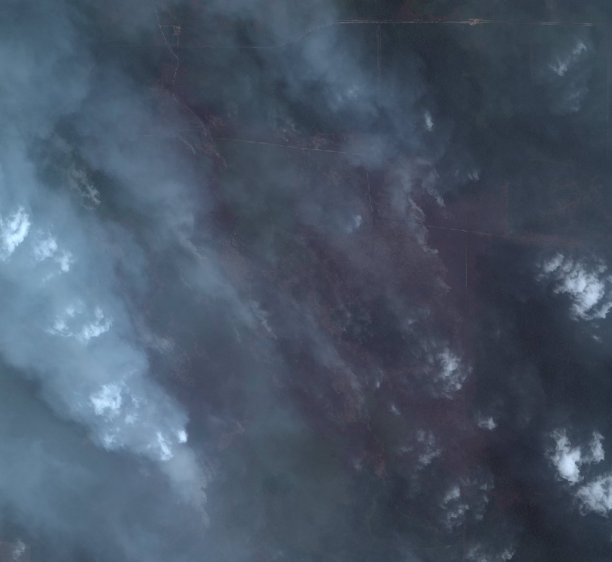
Indonesia
True Color Imagery

Slide 17
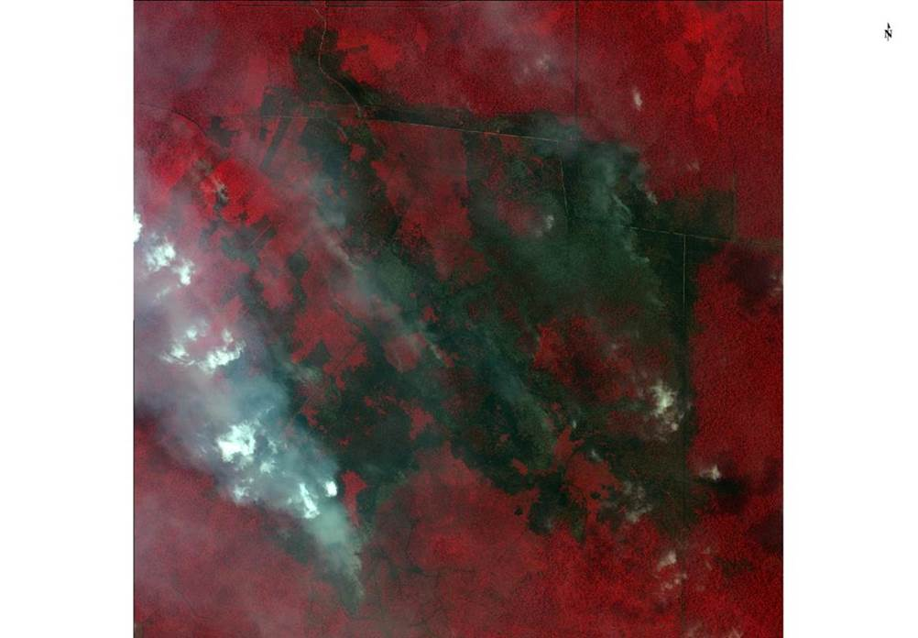
Indonesia
False Color Imagery

Slide 18
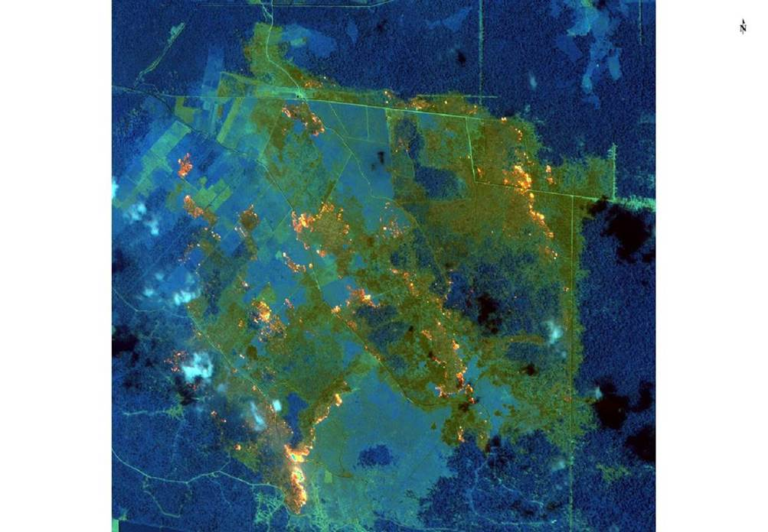
Indonesia
SWIR Imagery
Notes:
High-resolution imagery identifies the fires in progress, short wave infrared pinpoint the hotspots beneath the smoke. We support first responders, then later document burn scars and measure the impact of the fires on the environment. Satellite imagery also provides clear visual evidence that governments can use to direct law enforcement.

Slide 19
Notes:
One way we’re helping “see a better world” is through sponsoring the GBDX for Sustainability Challenge. We asked people to submit their ideas for how to use machine learning to contribute to solving one of the 17 United Nations Sustainable Development Goals.

Slide 20
Five finalist teams
Mapping Schools to Reduce the Digital Divide in Education
Building an Open Database of Global Power Plants
Global Green City Watch
Monitoring Economic Activity in Large-Scale Industrial Areas Across African Cities
Deforestation Intelligence for Cerrado
Notes:
I’d like to introduce you to our 5 finalist teams and what they’re looking to do. They’re set to turn in their solutions for evaluation and judging in 2 days!
Mapping schools to reduce the digital divide in education
Building an open database of global power plants
Global green city watch
Monitoring economic activity in large-scale industrial areas across African cities
Deforestation intelligence for Cerrado
We will be announcing the winner of the challenge in May!

Slide 21
And we would like your help solving some of the world’s most challenging problems…
Notes:
And we would like your help solve more challenging problems…

Slide 22
Notes:
I’m pleased to introduce the Earth Observation Challenge. The European Space Agency and DigitalGlobe have teamed up to present developers, startups, established companies and entrepreneurs in Europe with the Earth Observation Online challenge. Leveraging best in class imagery from DigitalGlobe & Sentinel 2 on the most advanced geospatial big data platform GBDX, the challenge to you is to help solve two of the most pressing problems for the continents of Africa and South East Asia, and the world at large.

Slide 23
Notes:
The first problem focuses on assisting developing countries inventory and manage their scarce water resources and the second focuses on measuring the impact of urban change to the environment. Winners of the challenge not only receive financial rewards, but also access to ESA Incubation and business development support to help accelerate the winners business aspirations.

Slide 24
Sign up on eochallenge.bemyapp.com
Notes:
Please – help us solve these pressing global challenges! For more information on how to participate in this challenge, log on to eochallenge.bemyapp.com – the competition is live and you have to May 22nd to enter your submission.

