Slide 1
Visualizing Data to Build Climate Resilience
Lauretta Burke, World Resources Institute
Notes:
Josh
Thank you for joining. I am Josh from FE…
Problem
Adaptation practitioners face a confusing landscape of datasets, platforms and tools. Navigating the many fragmented resources available can be overwhelming and most users struggle to access the climate data they need.
Solution
The Partnership for Resilience and Preparedness (PREP) is a public-private collaboration that seeks to improve access to useful data and empower communities and businesses to better plan for and build climate resilience.
Why a Webinar?
The Partnership recently launched PREPdata on Feb 7th. PREPdata is an intuitive, user designed, map-based platform that enables users to visualize, download and layer data to inform adaptation decision making. During this webinar, you will learn about the partnership, how to find relevant data for climate adaptation and resilience planning and build “dashboards” to monitor key indicators.

Slide 2
The Challenges
Data access – and deluge!
Fragmented resources, websites and platforms
Complexity of climate datasets
Lack of feedback mechanisms
Disparate data needed for resilience planning
Notes:
Lauretta
A crucial challenge in building resilience to climate change is the lack of access to useful, timely and credible data and information.
Adaptation and resilience practitioners face a confusing and fragmented landscape of platforms and tools, and lack guidance on how to understand and manage climate risk using the data available.
Access to the right data has been identified as a problem across sectors (public, private, civil society) and across geographies.
The data landscape is uneven – in the Global North, countries have a lot of data, much of which is difficult to navigate and goes unused. For countries in the Global South, data availability and access is often insufficient to support adaptation planning needs.
This problem is exacerbated by a lack of feedback mechanisms to help data providers understand user needs.
Finally, there is a pressing need for better cross-sectoral collaboration and knowledge-sharing on climate and adaptation planning.

Slide 3
Building Resilience Through Data
Goal of the public private partnership:
To make it easier for people around the world to find and access data for climate adaptation and resilience planning
Launched September 2016;
Platform revised in February 2018.
Notes:
PREP was launched in September 2016. US government agencies like NASA have amassed hundreds of datasets yet they remained largely underutilized, and difficult to access. PREP, through the data platform, aimed to leverage the extensive data resources to support innovation and entrepreneurship in support of national climate change preparedness. (Note: that was the initial focus – US data, but we are now adding US and global data, and will soon begin adding data for India.)
There are two key elements to PREP: the partnership and the online platform it supports (PREPdata).

Slide 4
PREP Partners
Coordination & Core Partners
NGO Partners
Private Sector Partners
Public Sector Partners
Notes:
Lauretta
Currently, PREP has 33 members: 6 public sector partners, 12 NGOs, and 15 private sector
(numbers include WRI/FE as NGOs and USCGRP as public sector)

Slide 5
Who can use PREPdata?
Science Translators and Analysts
Those using data and information to conduct climate risk assessments and create risk management reports
Data developers and innovators
Those aiming to leverage climate-relevant data to create value-added products and tools to support climate resilience
Decision-makers and policy experts
Those consuming the risk management information and reports created by the primary audience
Notes:
PREPdata is a map-based, open-data online platform (www.prepdata.org) that allows users to access and visualize climate, physical, and socioeconomic data for climate adaptation and resilience planning.
It is being developed as a flexible tool for climate adaptation planning, designed to address many of the gaps and challenges adaptation practitioners face.
PREPdata also enables users to:
monitor and share indicators on customized dashboard.
share their climate adaptation stories with a global community.
We don’t go deep on stories later, so if you want to say more: The Stories feature supports user communication efforts –highlighting climate vulnerability analyses efforts and findings through case studies, and adaptation planning solutions.
PREPdata will also provide feedback mechanisms enabling adaptation practitioners to inform data providers about the tools and information they need and use – filling a critical gap in the climate data ecosystem.
I’ll now provide examples of several of these feature.

Slide 6
Principles of PREP
Curation of content
Honoring user input
Open source / open data
Notes:
PREPdata is a map-based, open-data online platform (www.prepdata.org) that allows users to access and visualize climate, physical, and socioeconomic data for climate adaptation and resilience planning.
It is being developed as a flexible tool for climate adaptation planning, designed to address many of the gaps and challenges adaptation practitioners face.
PREPdata also enables users to:
monitor and share indicators on customized dashboard.
share their climate adaptation stories with a global community.
We don’t go deep on stories later, so if you want to say more: The Stories feature supports user communication efforts –highlighting climate vulnerability analyses efforts and findings through case studies, and adaptation planning solutions.
PREPdata will also provide feedback mechanisms enabling adaptation practitioners to inform data providers about the tools and information they need and use – filling a critical gap in the climate data ecosystem.
I’ll now provide examples of several of these feature.

Slide 7
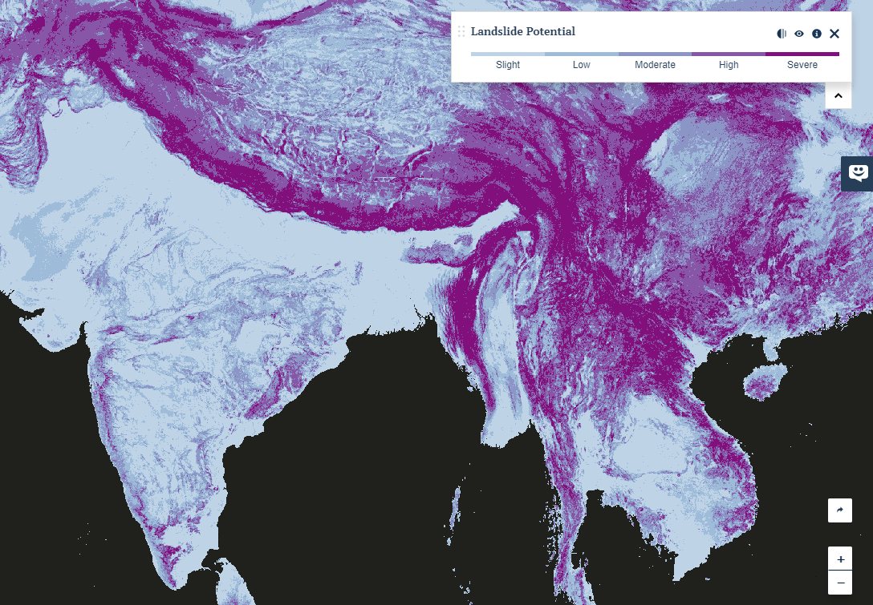
FEATURES
What is PREPdata?
Explore | Find, visualize, and overlay datasets
Interact | Create and share custom graphs and charts
Customized Dashboards | Monitor indicators of interest for specific geographies
Stories | Share insights and use case studies with global community
Resources | Find a variety of climate resources
Notes:
PREPdata is a map-based, open-data online platform (www.prepdata.org) that allows users to access and visualize climate, physical, and socioeconomic data for climate adaptation and resilience planning.
It is being developed as a flexible tool for climate adaptation planning, designed to address many of the gaps and challenges adaptation practitioners face.
PREPdata also enables users to:
monitor and share indicators on customized dashboard.
share their climate adaptation stories with a global community.
We don’t go deep on stories later, so if you want to say more: The Stories feature supports user communication efforts –highlighting climate vulnerability analyses efforts and findings through case studies, and adaptation planning solutions.
PREPdata will also provide feedback mechanisms enabling adaptation practitioners to inform data providers about the tools and information they need and use – filling a critical gap in the climate data ecosystem.
I’ll now provide examples of several of these feature.

Slide 9
Downscaled Climate Projections
Downscaled climate scenarios with projections for two greenhouse gas emissions scenarios: RCP 4.5 and RCP 8.5.
Average Temperature
Average High Temperature
Average Low Temperature
Cooling Degree Days
Heating Degree Days
Frost Free Season
Extreme Heat
Cumulative Precipitation
Extreme Precipitation
Dry Spells
NASA Earth Exchange Global Daily Downscaled Projections (NEX-GDDP)
Max. Temperature
Min. Temperature
Precipitation
Localized Constructed Analogs (LOCA)
Notes:
The NASA Earth Exchange Global Daily Downscaled Projections (NEX-GDDP) dataset is comprised of downscaled climate scenarios for the globe that are derived from the General Circulation Model (GCM) runs conducted under the Coupled Model Intercomparison Project Phase 5 (CMIP5) and across two of the four greenhouse gas emissions scenarios known as Representative Concentration Pathways (RCPs). The CMIP5 GCM runs were developed in support of the Fifth Assessment Report of the Intergovernmental Panel on Climate Change (IPCC AR5). The NEX-GDDP dataset includes downscaled projections for RCP 4.5 and RCP 8.5 from the 21 models and scenarios for which daily scenarios were produced and distributed under CMIP5. Each of the climate projections includes daily maximum temperature, minimum temperature, and precipitation for the periods from 1950 through 2100. The spatial resolution of the dataset is 0.25 degrees (~25 km x 25 km). The NEX-GDDP dataset is provided to assist the science community in conducting studies of climate change impacts at local to regional scales, and to enhance public understanding of possible future global climate patterns at the spatial scale of individual towns, cities, and watersheds. Each of the climate projections includes monthly averaged maximum temperature, minimum temperature, and precipitation for the periods from 1950 through 2005 (Retrospective Run) and from 2006 to 2099 (Prospective Run).

Slide 11
What makes PREPdata unique?
A focus on visualizing data for climate resilience
A map-based platform that is user-friendly and customizable to different contexts and skill levels
Active curation of data sets
Commitment to global coverage
A user-needs based strategy for platform development and data content
Benefits from diverse partner / expert input
Notes:
Several factors distinguish PREPdata from other adaptation platforms, including:
A specific focus on visualizing data for climate resilience;
A map-based platform that is user-friendly and customized to different contexts and skill levels;
Active curation of data sets, streamlining the process of accessing and navigating to relevant data;
A commitment to global coverage, with an emphasis on increasing access to data sets for the Global South, and support for applications across different scales and geographies;
A user-needs based strategy for platform development, utilizing the knowledge and network of the partners and platform users, and lessons from platform applications to enable continuous improvement.

Slide 12
Visit www.prepdata.org
Contact: lauretta@wri.org
General PREP inquiries and comments: info@prepdata.org

