Slide 2
Thematic Exploitation Platforms
Alessandro Marin, Antonio Romeo, Adrian Rose , Itziar Alonso, Jolanda Patruno,
Francesco Barchetta, Paulo Sacramento, Marco Leonardi
Notes:
I give this presentation on behalf of the TEPCoreTeam
Q- how did not herd about the ESA Exploitation Platform initiative?

Slide 3
Exploitation Platform
“Move User activities to the Data”
A complementary operations concept: users access a work environment containing the data and resources required, as opposed to downloading and replicating the data ‘at home’.
→ An R&D scenario for data intensive exploration gradually complementing the traditional operations concept for the ground segment
Exploitation platforms
EO
software
ICT
resources
EO data
In-situ data
Exploitation platform (or community platform)
=
Virtual open and collaborative environment
bringing together:
data centre (EO and non-EO data)
computing resources and hosted processing
collaborative tools (processing tools, data mining tools, user tools, …)
development tools and test bench functions
communication tools (social network) and documentation
Community
Collaboration
Notes:
A PARADIGM
An exploitation platform is
a virtual open and collaborative work environment
Providing access to data, and the resources required to work with it
Direct connection with Communiies

Slide 4
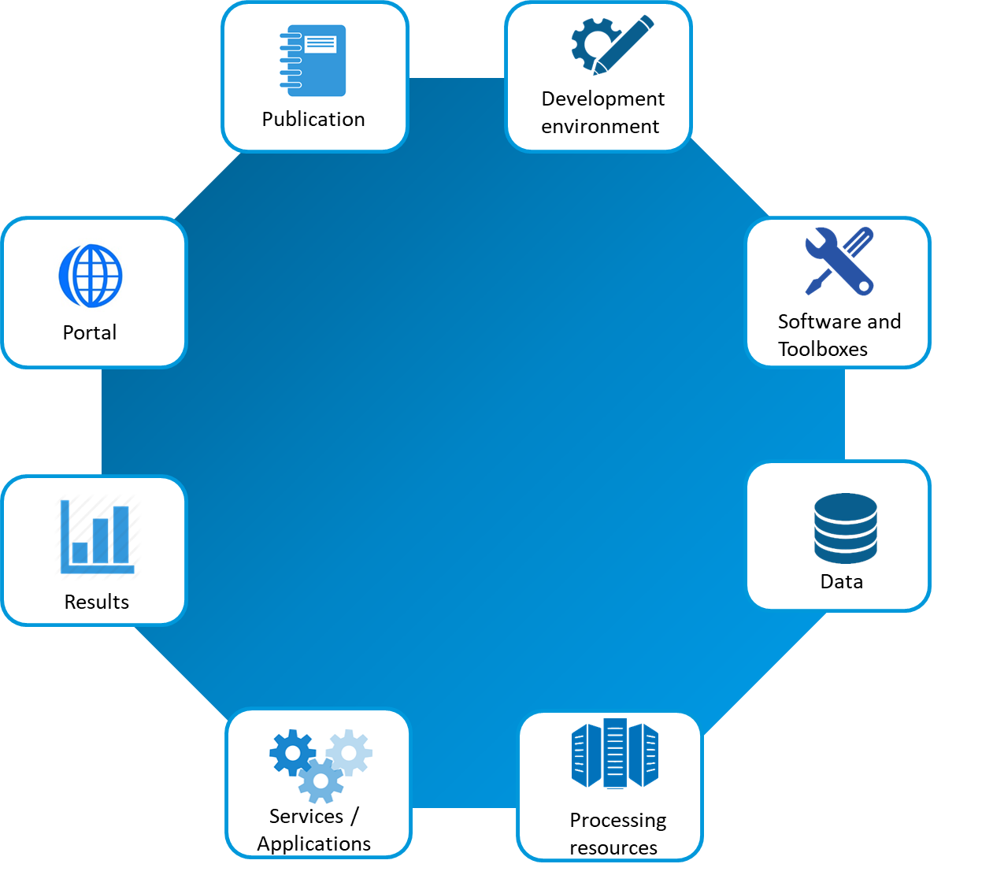
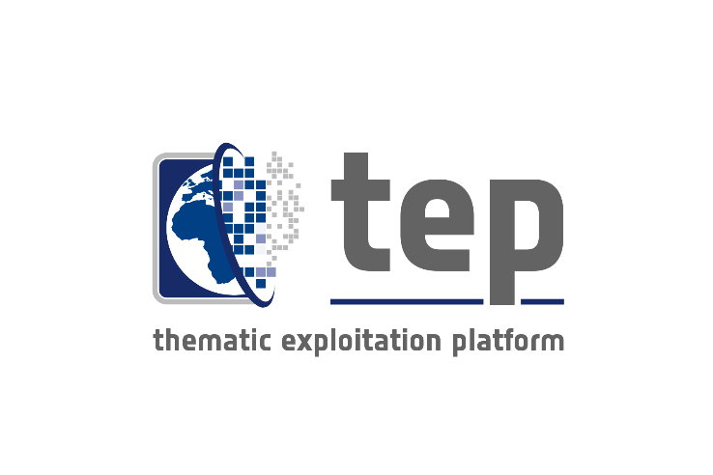
EP Elements and actors
Actors
Software vendor
ICT providers
Data providers
End User
Developers
Service Provider
Community
[…]
Elements
Portal (web interface)
Data
Software and Toolboxes
Services/ Application
Processing resources
Development environment
Results
Publications
Notes:
A TEP capabilities to enables different actors to play

Slide 5
Canonical Scenarios 1: EO Data Exploitation
Allows a user to discover/select data and pre-existing processing service; process data; and visualize/analyse or select and apply data manipulation tools to the result

Slide 6
Canonical Scenarios 2: New EO Service Development
Allows a user to develop and validate an application (such as a processor); and deploy the application on the platform for use also by other users.
Notes:
Each Consortium a combination of Thematic aspect
IT providers
Direct connection with Communiies

Slide 7
Canonical Scenarios 3: New EO Product Development
Discover/select data; process the data; and eventually publish the resulting product.
Notes:
Each Consortium a combination of Thematic aspect
IT providers
Direct connection with Communiies

Slide 8
Data Partnership Policies
Mirroring: Data is made available on TEP infrastructure and under TEP access control and authorization
Caching: Data is temporarily cached and made available on TEP infrastructure and under TEP access control and authorization
Remote access: Data is made available on data provider’s infrastructure; either under TEP or data provider’s access control and authorization
Notes:
Each Consortium a combination of Thematic aspect
IT providers
Direct connection with Communiies

Slide 9
Data Policies
Open: Data is freely accessible to all registered and authenticated users
Restricted: Data is accessible to authorized subset of registered and authenticated users
Quota restricted: Data is accessible to authorized subset of registered and authenticated users according to assigned quota
Notes:
Each Consortium a combination of Thematic aspect
IT providers
Direct connection with Communiies

Slide 10
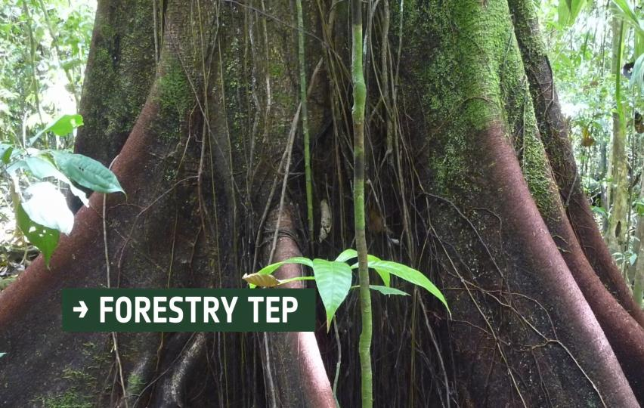
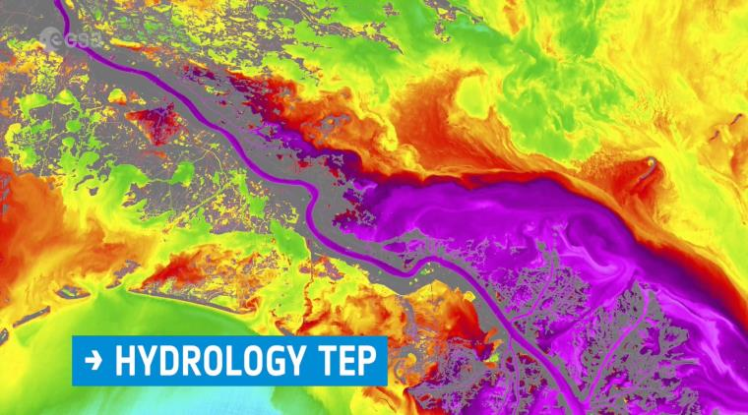
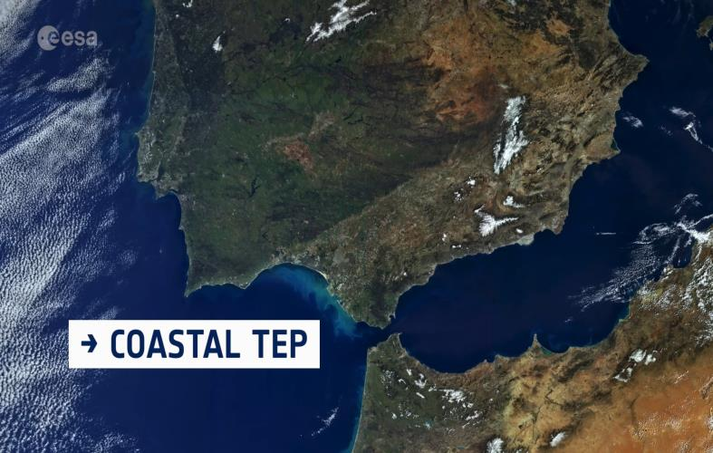
ESA TEPs

Slide 11
TEP Consortia in one slide
SMHI
Notes:
Each Consortium a combination of Thematic aspect
IT providers
Direct connection with Communiies

Slide 12
What a TEP looks like

Slide 13
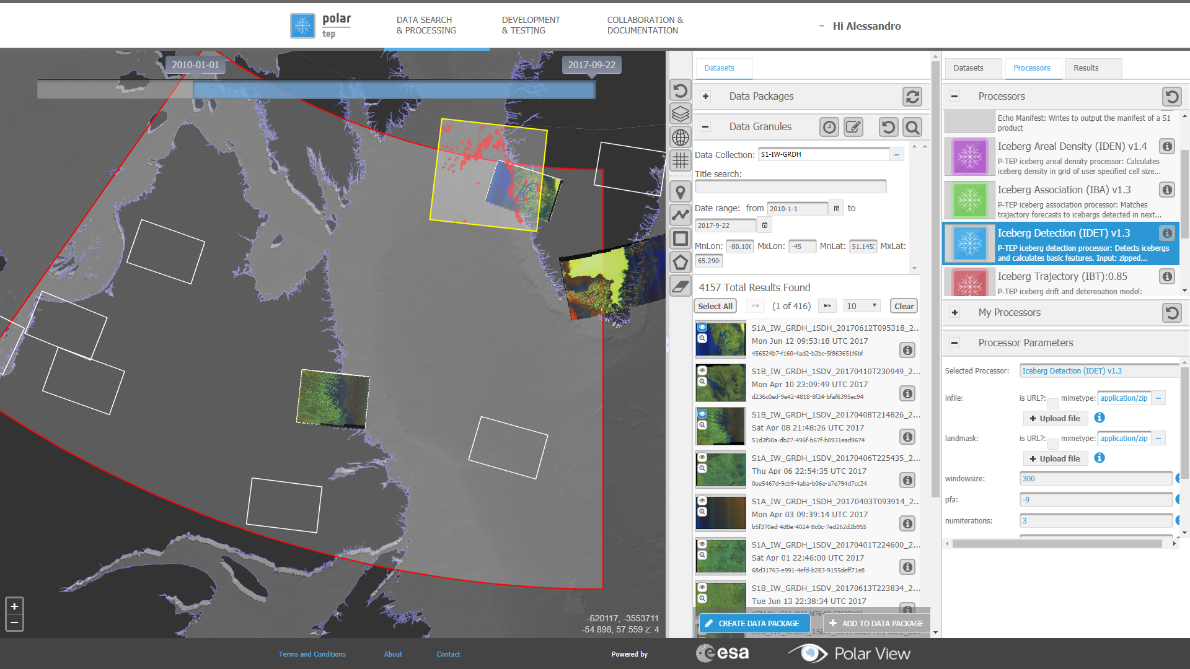
Canonical Scenario 1 EO data exploitation: Interactive and non-interactive EO data processing
Notes:
<Slide 1, SL, ESA evolution activities natural progression> Key message:
1. In the presence of a coherent progression of R&D activities increasing the capabilities available to eo data expoitation
2. None of these are the end – now move on
3. And they are already in use

Slide 14
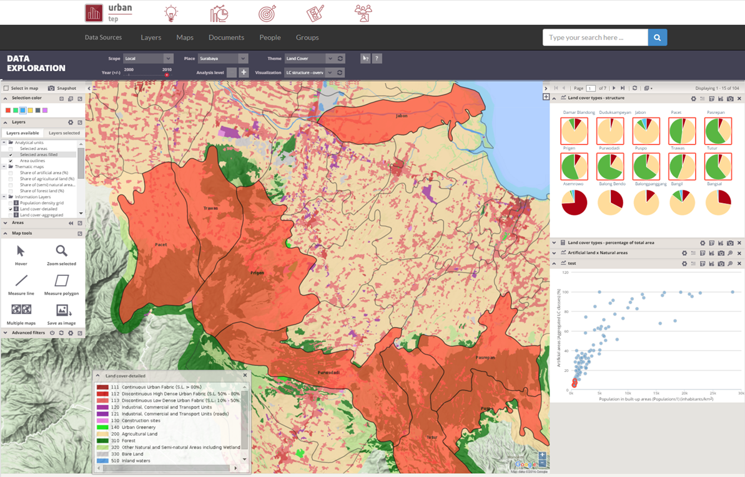
Canonical Scenario 1 EO data exploitation: EO and non-EO data analytics and fusion

Slide 15
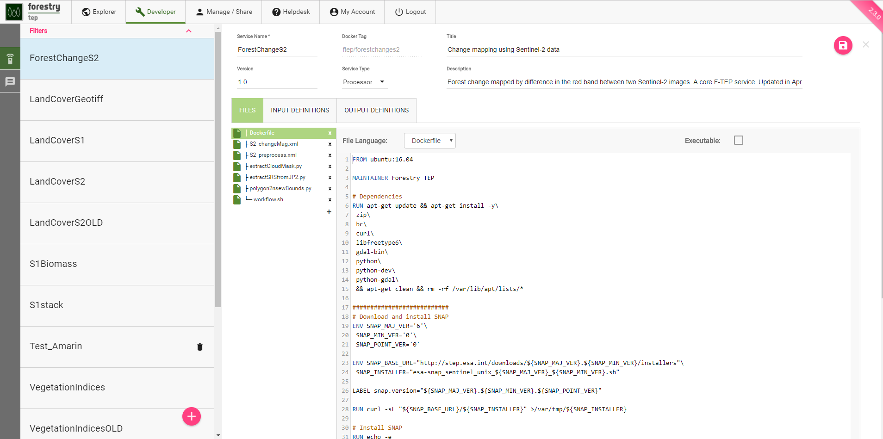
New EO Service Development: Integrate or develop your own processing service

Slide 16
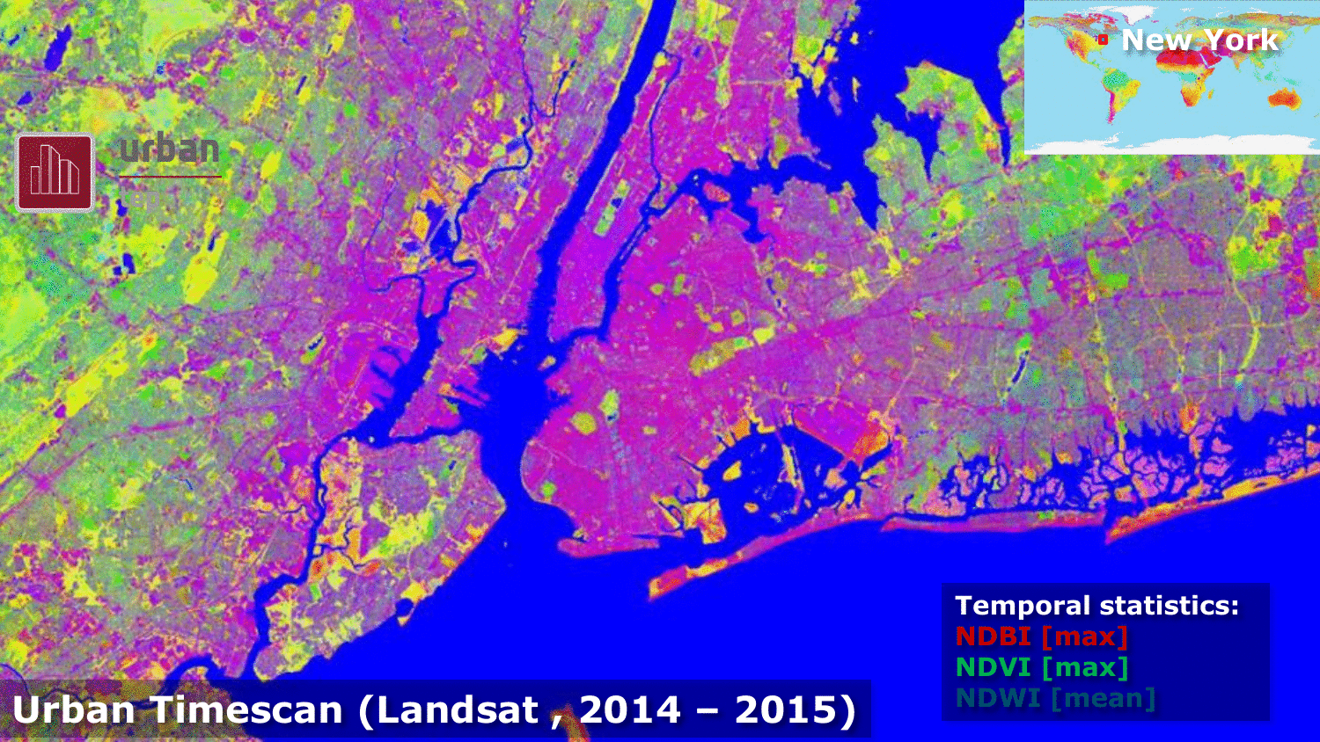
New EO Product Development: Perform massive processing, systematic generation, publication and sharing of products

Slide 17
TEP & GEOSS

Slide 18
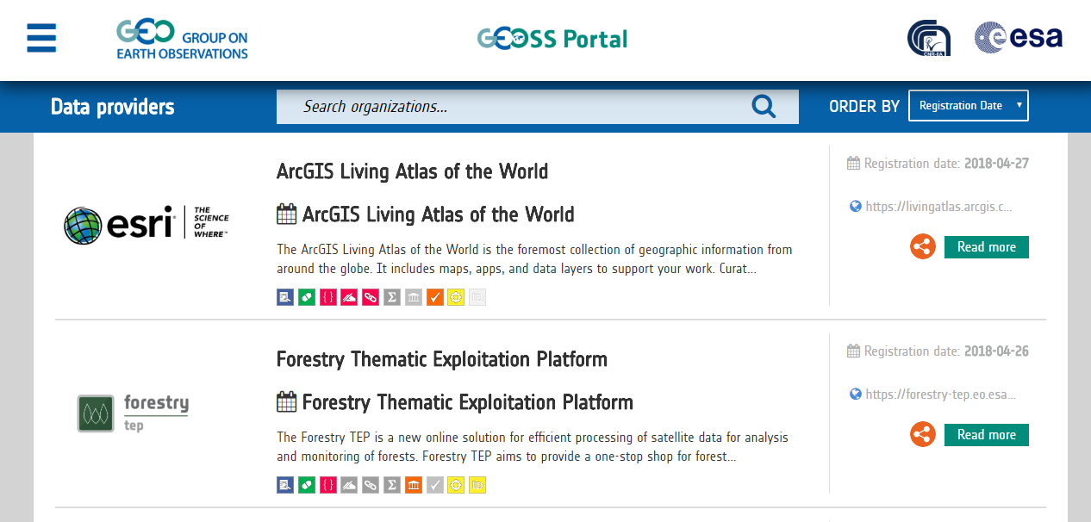
Notes:
Each Consortium a combination of Thematic aspect
IT providers
Direct connection with Communiies

Slide 19
Conclusion
Being part of the GEOSS ecosystem as a data provider will enable you to interface with TEPs
If As a user you want to exploit EO data available on the GEOSS -TEPs are able to interface with the GEOSS catalogue-
TEPs results can be published on GEOSS catalogue

Slide 21
Thank you
TEPCoreTeam@esa.int / http://tep.eo.esa.int

