Slide 1



Slide 2
Towards an EBV Data Portal
Christian Langer / IT Officer / GEO BON

Slide 3
Structure
Overview GEO BON
Essential Biodiversity Variables (EBVs)
Task Force Data
EBV Spatial Browser - usecase

Slide 4


Overview GEO BON
GEO BON´s 2025 Vision Statement:
A global biodiversity observation network
that contributes to effective management policies
for the world’s biodiversity and ecosystem services.
- geobon.org, 2018

Slide 5
Overview GEO BON
GEO BON´s 2025 Vision Statement:
25 national biodiversity Observation systems (BONs)
10 regularly updated operational products
A functional biodiversity observation community

Slide 6










Overview GEO BON
GEO BON - A Global Partnership
Notes:
GEO BON core focus is to develop a standard and flexible framework for biodiversity observations and to support the development of Biodiversity Observation Networks to produce Policy Relevant Outputs

Slide 7
Essential Biodiversity Variables (EBVs)
Essential Biodiversity Variables (EBVs)
EBV are defined as harmonised measurements required for studying,
reporting, and management of biodiversity change.
EBVs are conceptually located on a continuum between
primary data observations (‘raw data’) and
synthetic or derived indices (‘indicators’).
Notes:
EBVs represent a minimum set of variables to measure the biodiversity ('pulse') of the planet, complementary to one another, that can capture major dimensions of biodiversity change and produced by the individual GEO BON Working Groups on the basis of international, national, regional and local open data infrastructures

Slide 8
Essential Biodiversity Variables (EBVs)
Understanding Raw data / EBV data / Indicators
Raw data
(Raw observations from surveys, sensors, satellite RS, DNA...)
EBV-usable datasets
(Datasets with measurements and observation protocols in right format)
EBV-ready datasets
(Harmonized datasets (common format, standard unit, quality-checked))
Derived & modelled EBV data
(Data inter- or extrapolated with model)
Indicators
(Changes in species distributions or population abundances)

Slide 9
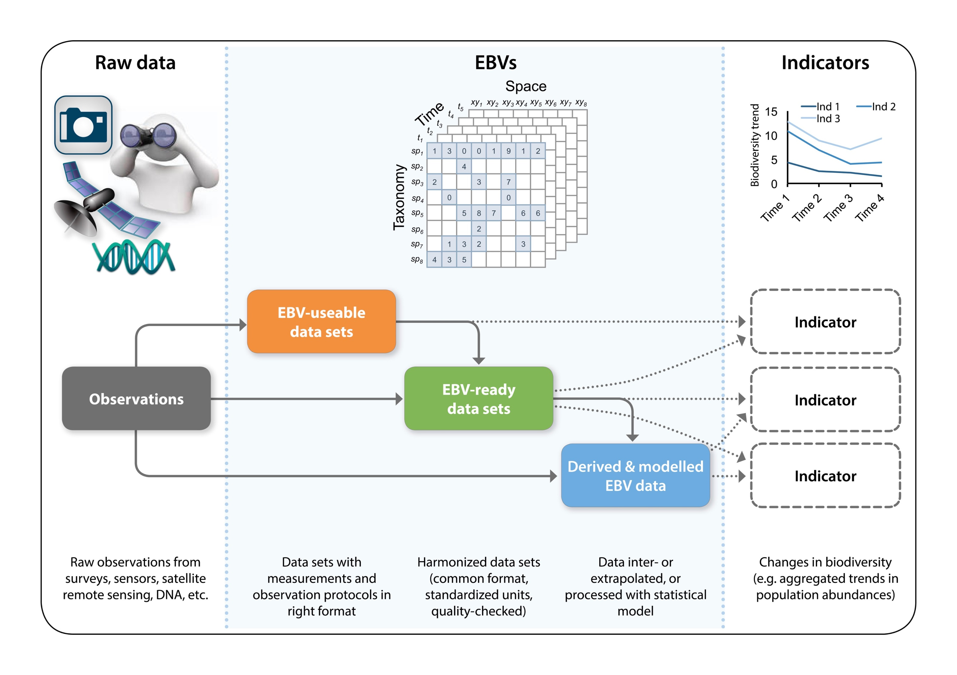

Essential Biodiversity Variables (EBVs)
Understanding Raw data / EBV data / Indicators
Users
National Governments
Kissling et al., (2017)
Biological Reviews

Slide 10
Essential Biodiversity Variables (EBVs)
Essential Biodiversity Variables classes
Genetic Composition
e.g. Allelic diversity
Species Populations
e.g. Species distribution
Species Traits
e.g. Body size, phenology
Community Composition
e.g. Species interactions
Ecosystem Structure
e.g. Ecosystem extent
Ecosystem Functions
e.g. Disturbance
Mobilisation of biodiversity observations

Slide 11

Task Force Data
Task Force Data - Key activities
Coordination and promotion of EBV workflow development for all EBV classes, following lessons learned from previous EBV operationalization initiatives (e.g. GLOBIS-B)
Development of GEO BON EBV Metadata Standards and Guidelines for the endorsement of EBV datasets.
Participation and promotion of data mobilization initiatives (APIs)
Notes:
An overarching goal of GEO BON is to promote more efficient ways of sharing, producing and communicating biodiversity observations and analyses. The TF Data will foster the development of standards, protocols and workflows for EBV datasets (Incl. developing, defining and refining minimum requirements to evaluate which datasets are appropriate for building EBV data products).

Slide 12
Task Force Data
Key activities
Development of EBV Data Portal
Enhance the distribution of EBV datasets that have been produced or endorsed by the GEO BON community as appropriate data for measuring biodiversity change.
Provide discoverable EBV datasets that can be visualized, analyzed and downloaded easily from one unique location.
EBV Data Portal includes EBV Spatial Browser/Analyzer and Metadata catalog

Slide 13
Task Force Data
Simplified Structure EBV Data Portal
Langer, (2017)

Slide 14
Task Force Data
EBV Metadata Standards
Describe EBVs as accurately and comprehensively as possible
Specification of a
minimum information standard for an EBV
Consultation process within the GEO BON community to identify, draft, and agree on core descriptors that are common for all EBV classes
Earthsystemdatacube.net

Slide 15
Task Force Data
EBV Labelling system
Is the EBV dataset fit for purpose?
Report on the maturity / readiness of EBV products (Draft in progress)
Template for reporting biodiversity change at different levels from subnational to global, and in a way that datasets are flagged according to their usability at each of these levels

Slide 16
Task Force Data
EBV Labelling system
Space
Time
Spatial Extent
High: Global
Intermediate: National to supranational (incl. marine exclusive zone)
Low: Subnational (e.g. P.A. network)
Spatial coverage
High: Fully continuous
Intermediate: Interpolated (incl. modelled)
Low: Site sampling distribution
GEOSS Data Management Principles
Probability of detecting
change
Spatial resolution
High: Relevant for local management
Intermediate: Relevant (supra) national
Low: Only for global-level applications

Slide 17
EBV Spatial Browser - usecase
Usecase for EBV class „Ecosystem Structure“
i
Genetic Composition
e.g. Allelic diversity
j
Species Populations
e.g. Species distribution
k
Species Traits
e.g. Body size, phenology
f
Community Composition
e.g. Species interactions
Global Forest Change Dataset
http://earthenginepartners.appspot.com/science-2013-global-forest
h
Ecosystem Structure
e.g. Ecosystem extent
g
Ecosystem Functions
e.g. Disturbance

Slide 18
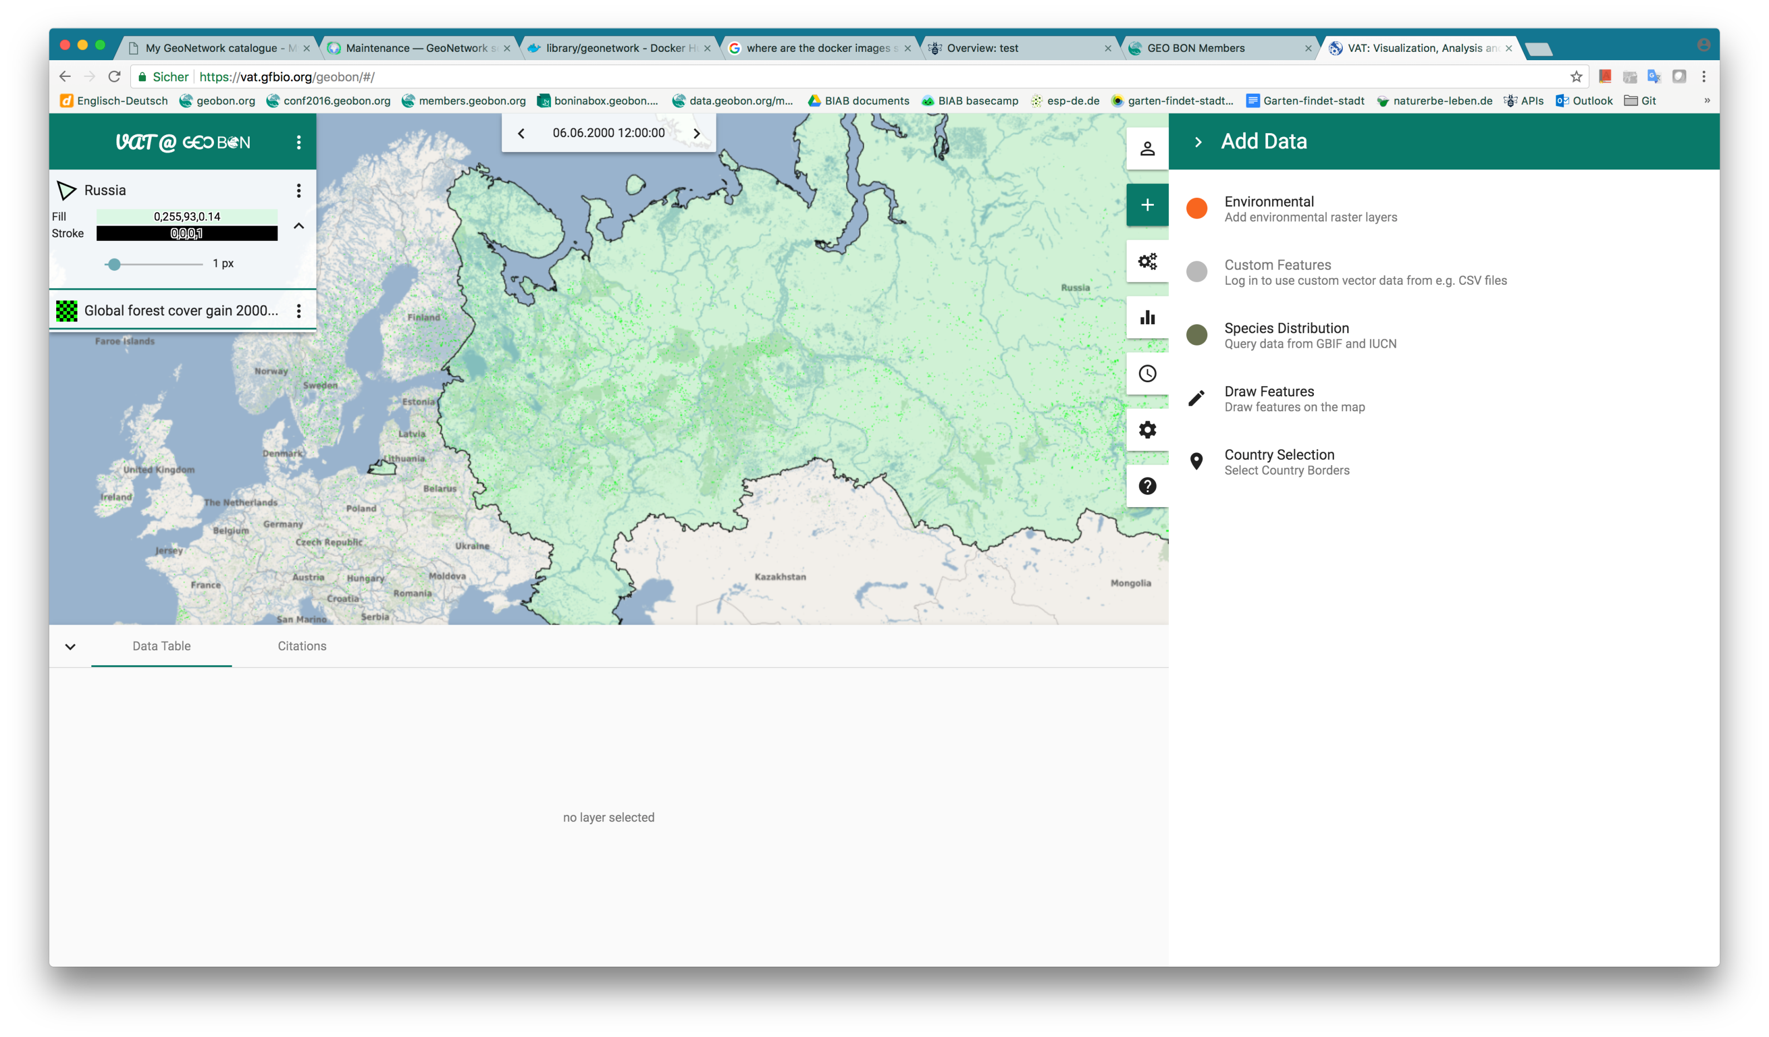
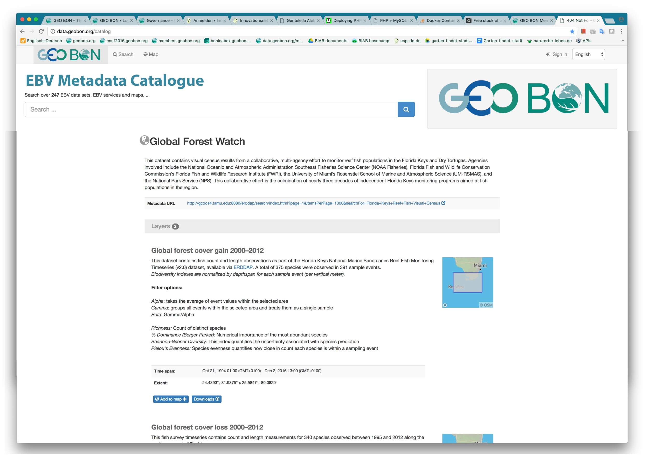
EBV Spatial Browser - usecase
EBV Spatial Browser / Metadata Catalog – look and feel
EBV Spatial Browser/Analyzer
EBV Metadata Catalog (in progress)
Notes:
Live Demo: https://vat.gfbio.org/geobon

Slide 19



Task Force Data
Task Force Data
Co-leads:
Rob Guralnick
Néstor Fernandez
Daniel Kissling
Operative Support:
Christian Langer

Slide 20


Slide 21
Thank you
christian.langer@idiv.de / geobon.org / @GEOBON_org

