Slide 1



Slide 2
Integration with Radiant.Earth
Dan Lopez / CTO / Radiant.Earth

Slide 3
Radiant.Earth / Platform Mission Support
Food Security & Agriculture
Property Rights
Humanitarian Response
Water
Poverty Reduction
Conservation, Forestry & Environment
Climate Change
Transparency & Journalism
Global Health

Slide 4
Radiant.Earth / Platform Experience

Slide 5
Radiant.Earth / Platform API Conceptual Architecture

Slide 6
Radiant.Earth / Platform API Specs
https://github.com/radiantearth
Metadata based on open web standards, GeoJSON
Help address things like band-band registration, on-demand rendering
Support federated data access
Scalable Pub/Sub on AOIs for tipping and queuing strategies
Catalog
Events
Notifications
…
…
…

Slide 7
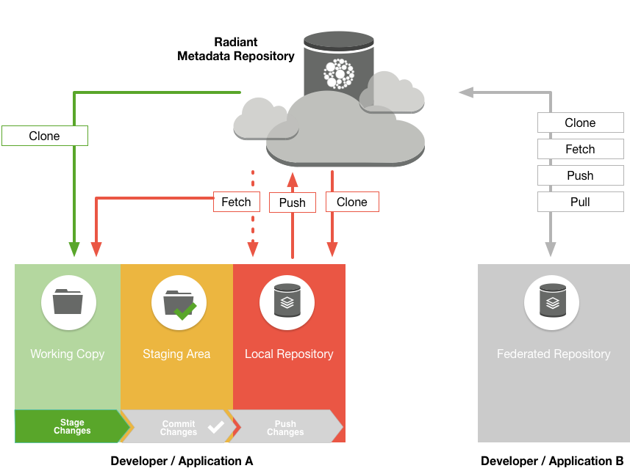
STAC Repositories / Federated & Decentralized
Faster updates to federated JSON metadata
Support global availability and scale through federated data access
Scalable flows similar to linux, or other open source development

Slide 8
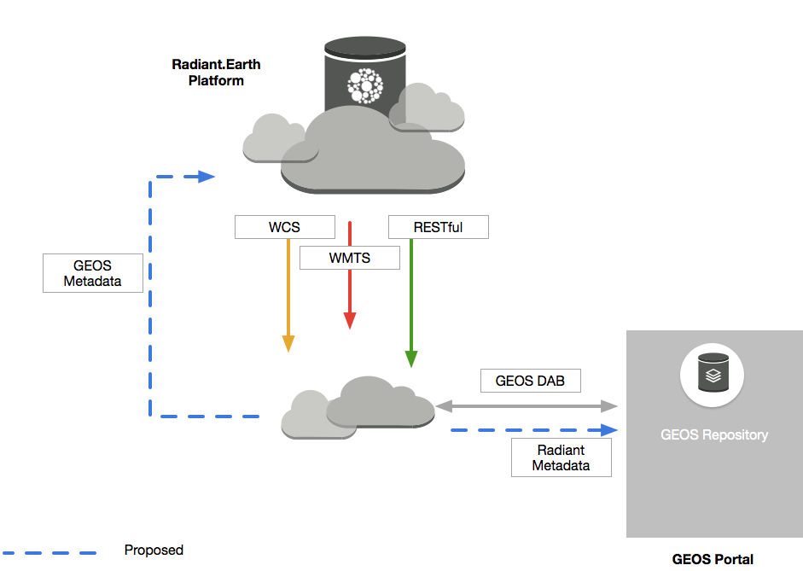
Platform API / GEOS Integration

Slide 9
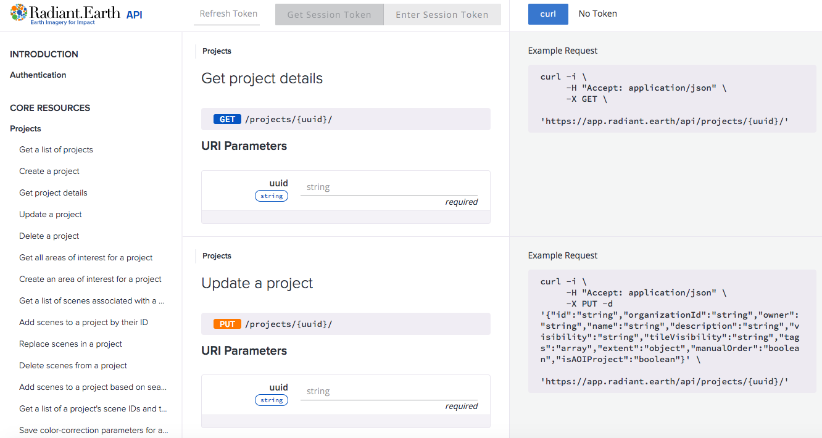
Platform API / Documentation

Slide 10
Platform API / API Functionality
Raster APIs
Data APIs
Imagery from Drones, Aerial, Balloons, Satellites
Projects
Area of Interests
Annotations
Band math algos in Labs
Sharing via OGC (e.g. WMTS, etc)
Teams, Organizations
Weather forecasts
Air Quality
Population
Global Health
Events, Notifications
Satellite Ephemeris
Global Crop Suitability
ML / AI Pipeline services (Planned)

Slide 11
Radiant.Earth / Platform Demos

Slide 12
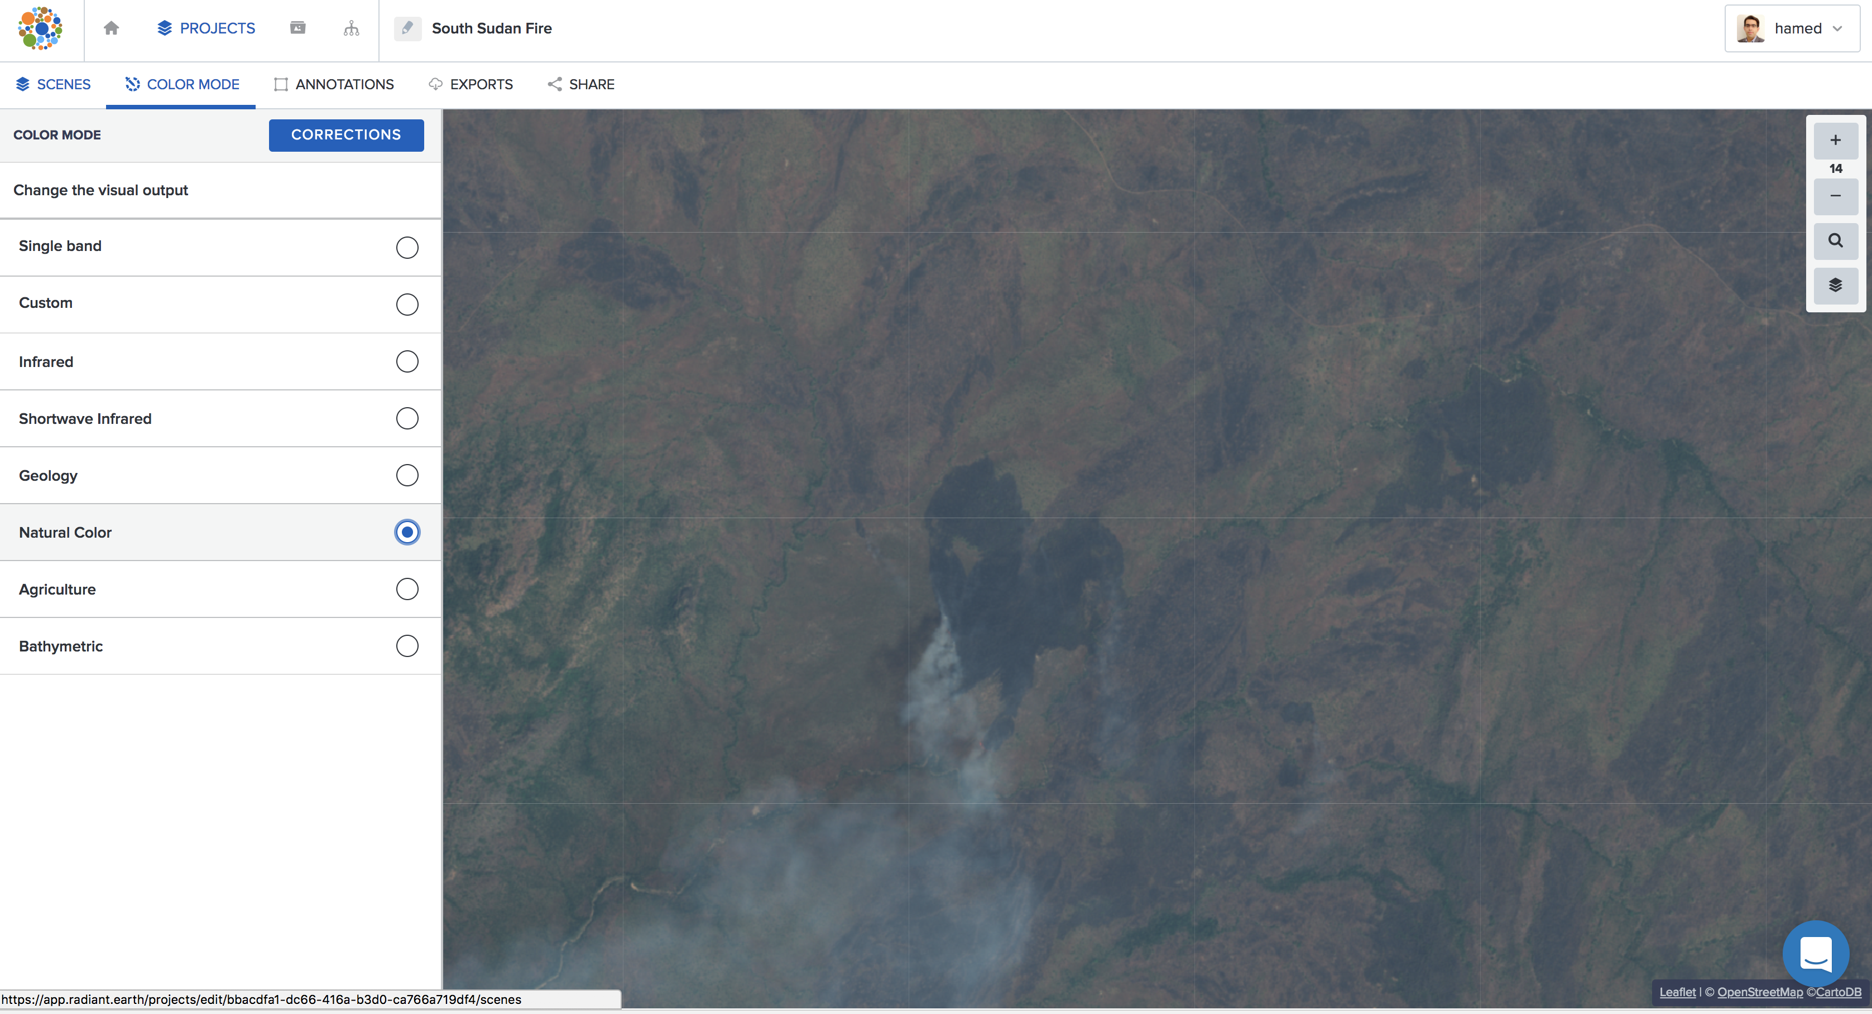
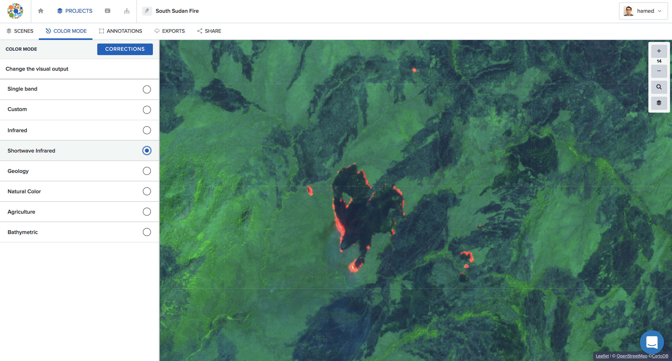
Platform Demo / South Sudan Fires Analysis

Slide 13
Platform Demos / Post-Hurricane Analysis

Slide 14
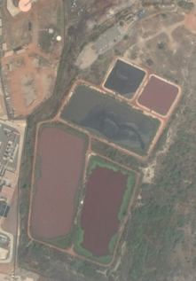
Platform Use Case / Sanitation in Senegal
Problem
Estimating fecal sludge volume at a treatment facility.
Developing a ML algorithm to use multi-spectral and SAR data from Sentinel satellites.
Case Study: Three sites in Dakar, Senegal.
Status
POC under development.
Weekly data provided by the operating company.
Investigation of Sentinel-2 data shows potential value, but Sentinel-1 SAR data can be used to monitor the dry sludge as well.
DigitalGlobe WV sample data for POC.

Slide 15

Hack the Planet

Slide 16


Slide 17
Thank you
email@email / website / @twitter / etc.

