Slide 2
Status of the Volcano Observations EPOS-TCS
Giuseppe Puglisi / Istituto Nazionale di Geofisica e Vulcanologia

Slide 3
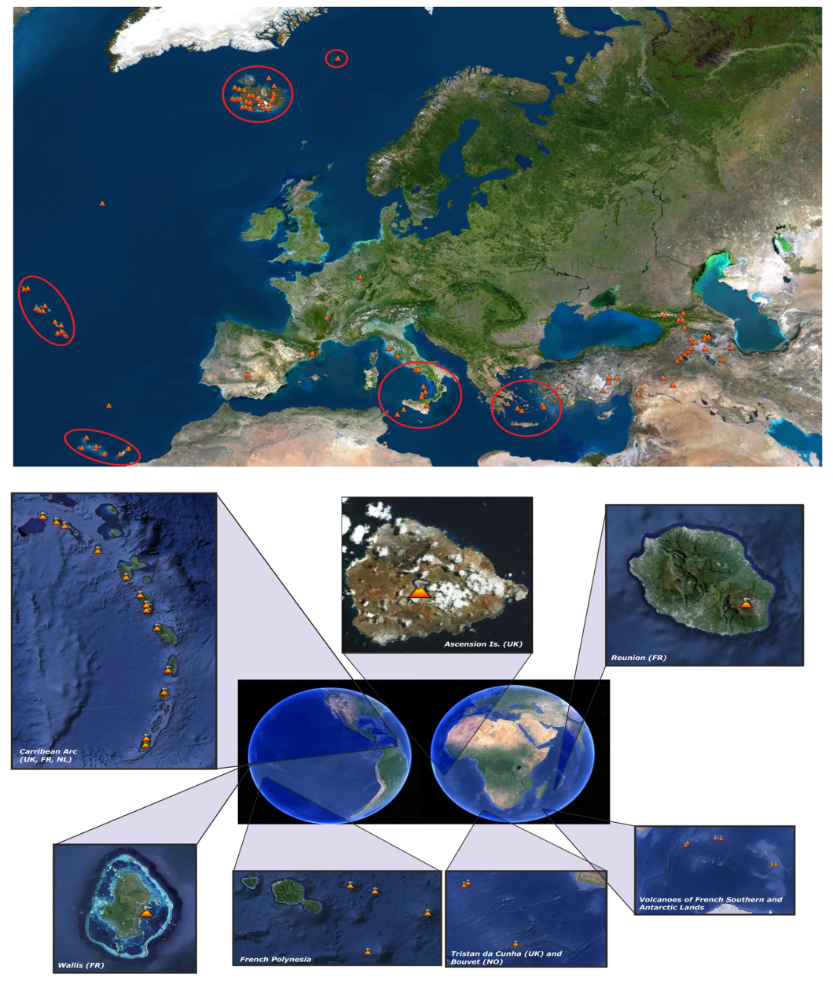
Volcano Observations: is the theme for the EPOS Thematic Core Services of the volcanological community (VO-TCS). VO-TCS is built by the EPOS WP11, which brings together European Volcano Observatories (VO) and Volcanological Research Institutions (VRI) providing data, products and services on European volcanoes. WP11 extends the activities of EPOS to regions outside “continental” Europe
EPOS WP11 team

Slide 4
Volcano Observations: is the theme for the EPOS Thematic Core Services of the volcanological community (VO-TCS). VO-TCS will provide long-term access to the Volcano Observatories and Research Institutions data and products. It aims at implementing facilities allowing easy access to volcanological data and interoperable services. Due to their broad variety of phenomena, active volcanoes are quite different from other geological environments and the relevant data needs to be characterized and organized according to specific approaches and exploiting the experience of a large community.

Slide 5
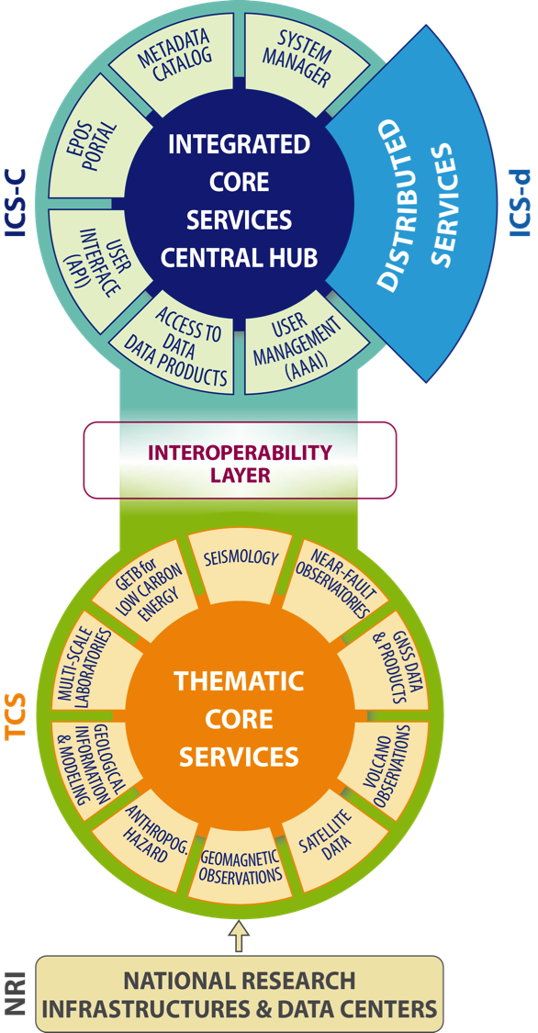
Volcano Observations
Main topics of the VO-TCS are:
Seismic data and products
Geodetic data and products
Remote sensing data and products
Geological products
Volcanological products
Petrological products
Environmental data and products
Geochemical products
Modelling products
Hazard products
Software tools

Slide 6
Technical Implementation: The gateway
The proposed solution is the development of a smart federator able to connect data providers (e.g. ICS) and common users such as researchers, students, industry, and enthusiasts.
The role of the Gateway is to harmonize different kind of data, products and service and create multidisciplinary environment, supporting specifically standards widely used by the community of European researchers.
VO-TCS GATEWAY
Volcanic Portal
API / web service
Using EPOS paradigm: mapping VO-TCS community Web Services into standard Catalogs
TCS Catalogs
National network
National
repository
Local HPC
Repository
Repository

Slide 7
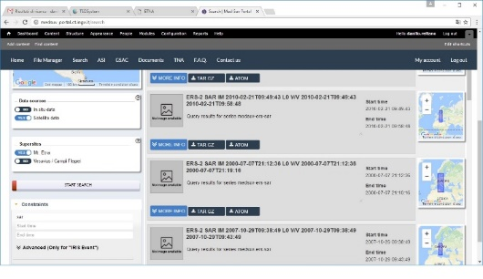
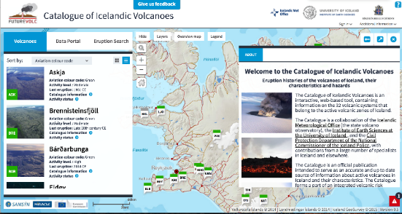
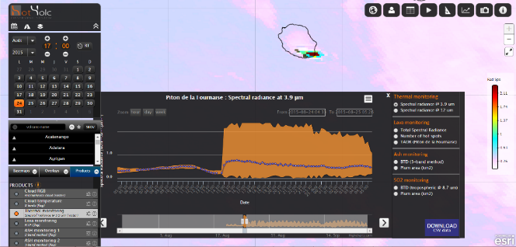
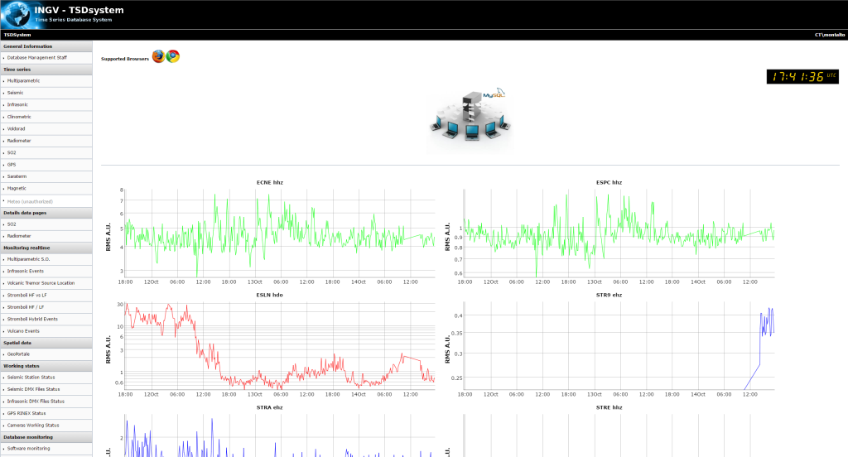
Web services of the VO community:
VO-TCS will provide the first European Portal for Volcano Observatories.
It will be developed using the existing Volcano Observations web services community’s passing through the SUPERSITE experiences
VO-TCS GATEWAY
Volcanic Portal

Slide 8
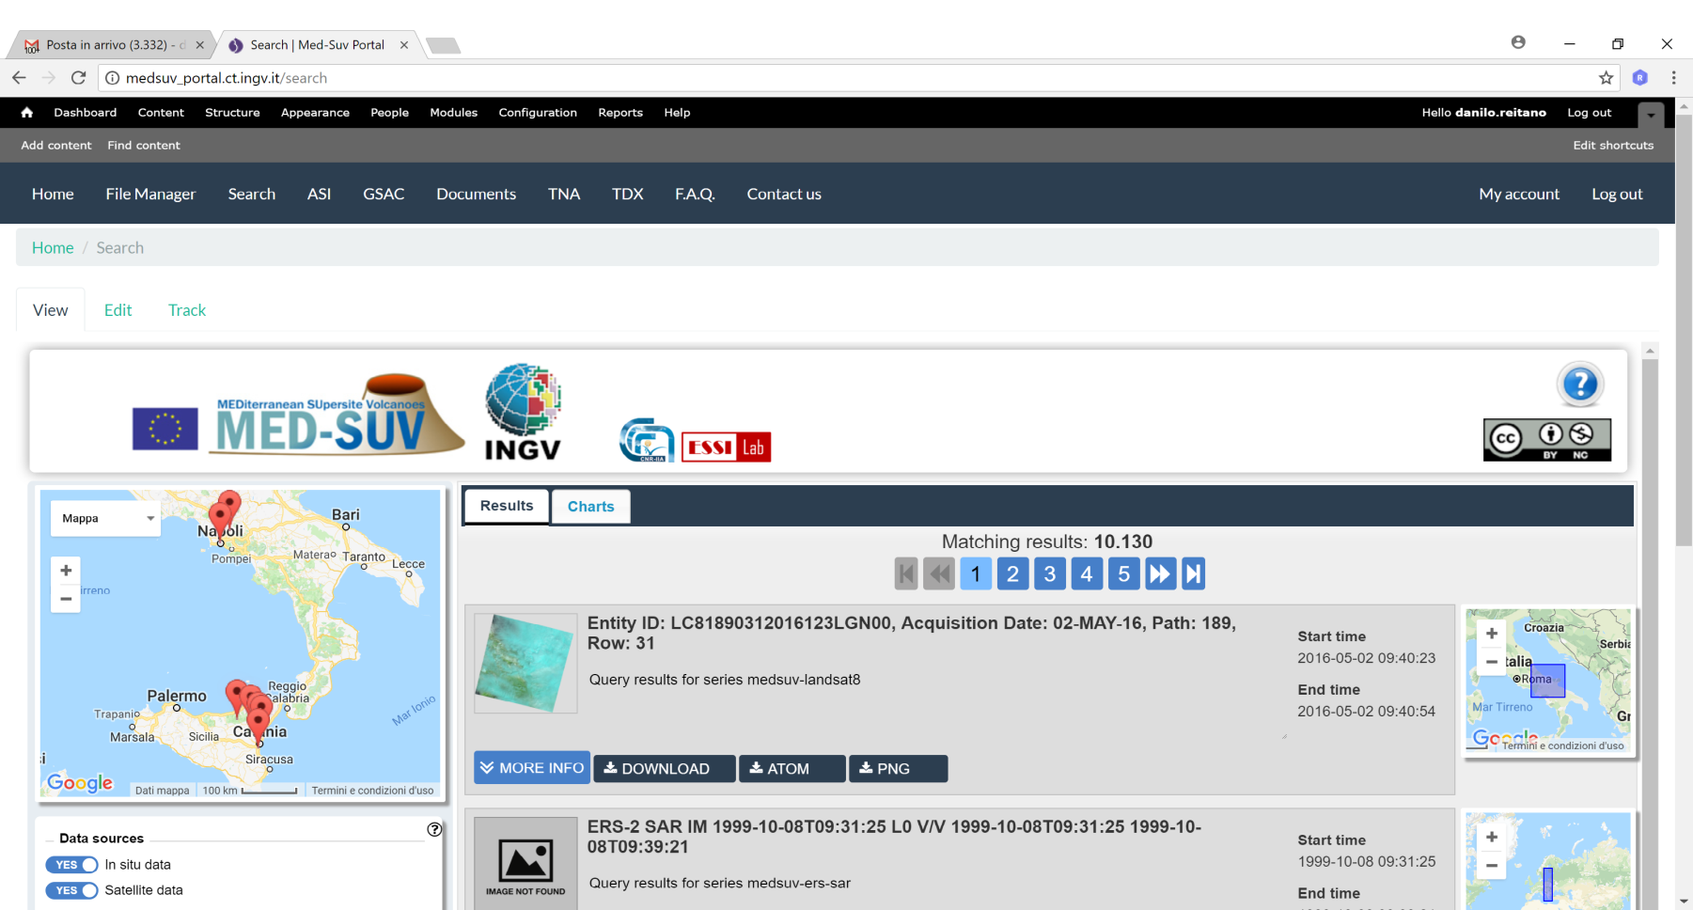
MED-SUV: an example of VO community webservice:
MED-SUV provides access to satellite and in-situ data of two volcano GEO Supersites (both in Italy):
Mt. Etna
Campi Flegrei & Vesuvius
MED-SUV intends to submit an Expressions of Intent for the 2018 EuroGEOSS Request for sharing its experience among the GEO GEOSS community

Slide 9
Thank you
giuseppe.puglisi@ingv.it / www.ingv.it

