Slide 2
The POPGRID Data
Collaborative
Alex de Sherbinin / Associate Director / CIESIN, Columbia University

Slide 3
Population & Human Settlement Data Support the SDGs
“Population distribution” and “Cities and Infrastructure Mapping” are key for indicators and decision making related to all 17 goals
Alignments of the Goals with specific types of Earth observations and geospatial information

Slide 4
POPGRID
There is a proliferation of global gridded
population and settlement data
We need to help users understand
which ones are most appropriate
for different applications

Slide 5
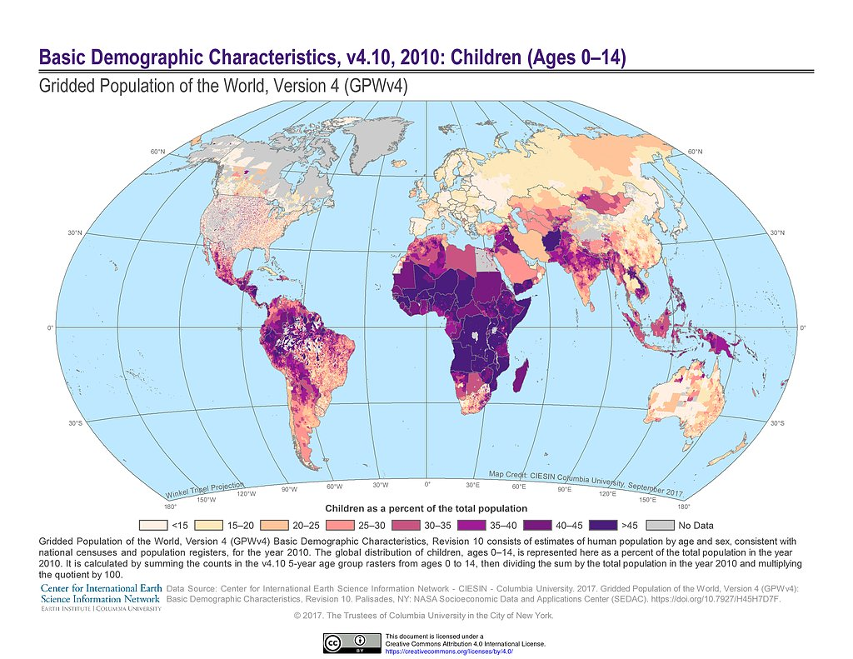
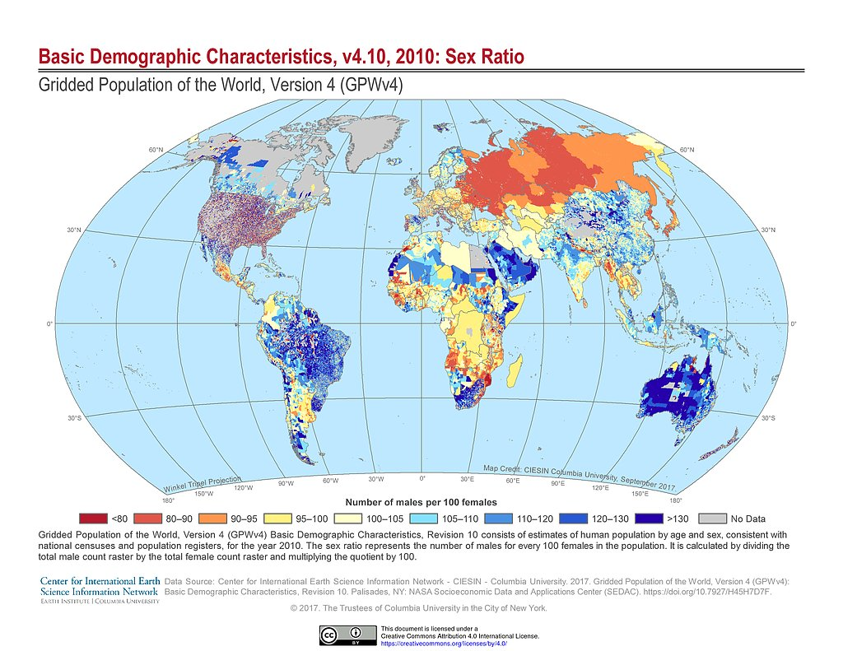
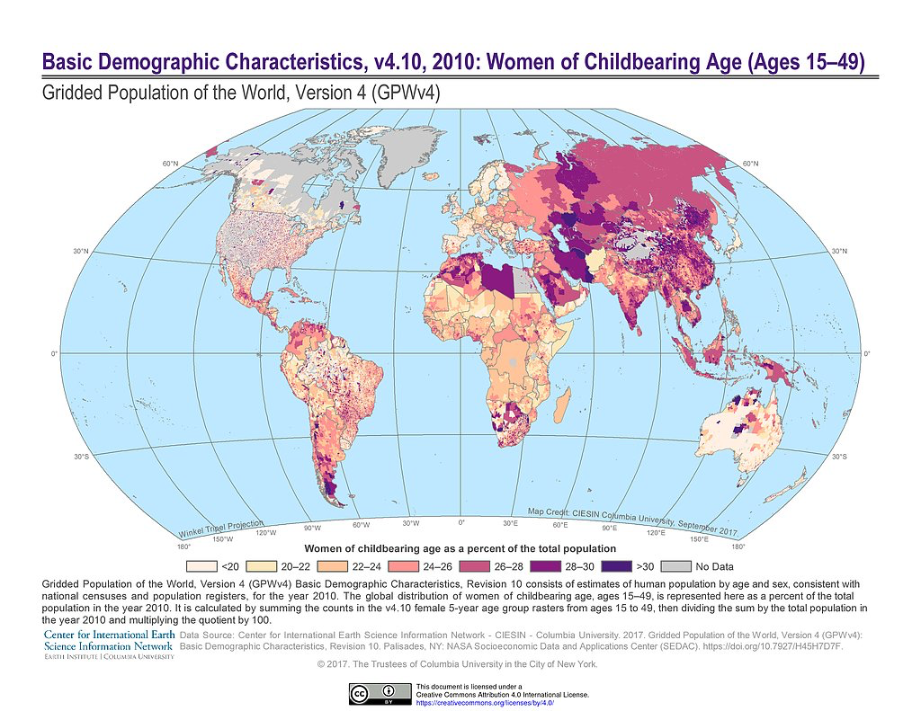
GPWv4.10, Population by Age Group & Gender, 2010
GPWv4.10 now Includes new dataset on Basic Demographic with gridded estimates of population by age groups and gender for 2010
http://sedac.ciesin.columbia.edu/data/collection/gpw-v4/sets/browse

Slide 6
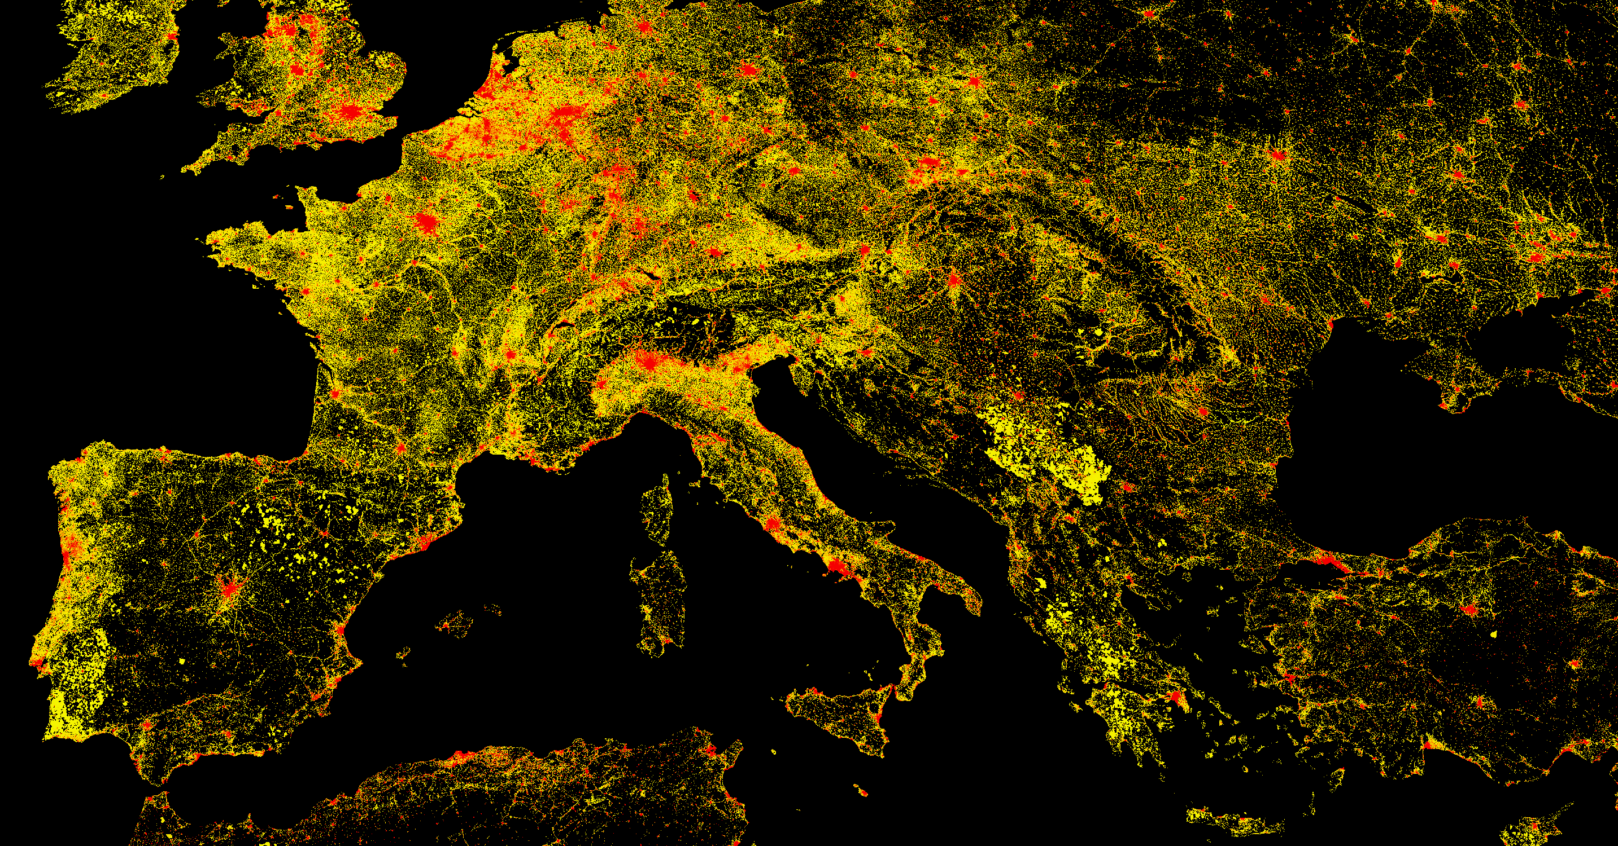
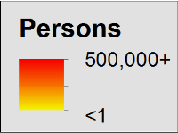
Linking Human Settlements with Population Data
Global Human Settlement Layer (GHSL)
Collaboration with the European Commission’s Joint Research Center to produce open access 250m and 1km resolution population count estimates based on Landsat
Global data set
http://ghsl.jrc.ec.europa.eu/

Slide 7
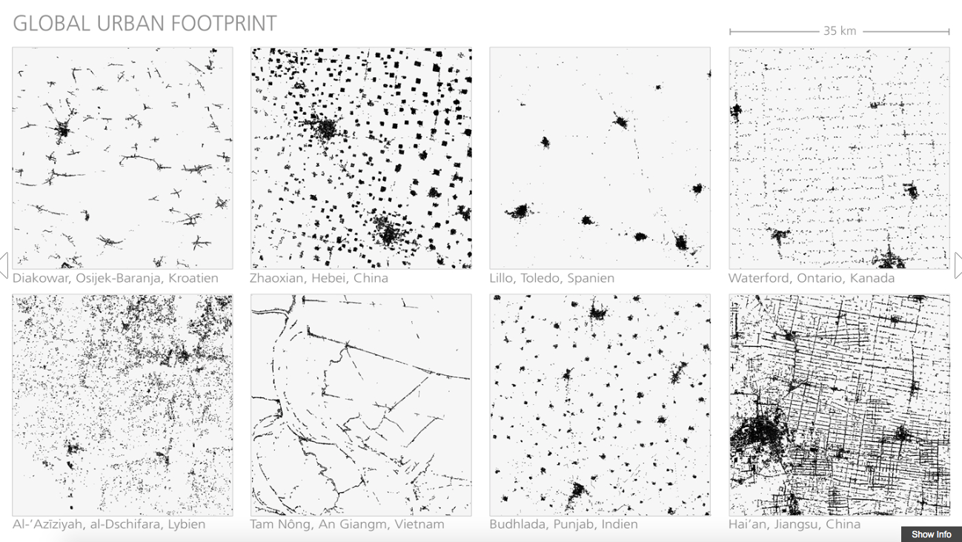
Global Urban Footprint (GUF)
http://www.dlr.de/eoc/en/desktopdefault.aspx/tabid-9628/16557_read-40454/

Slide 8
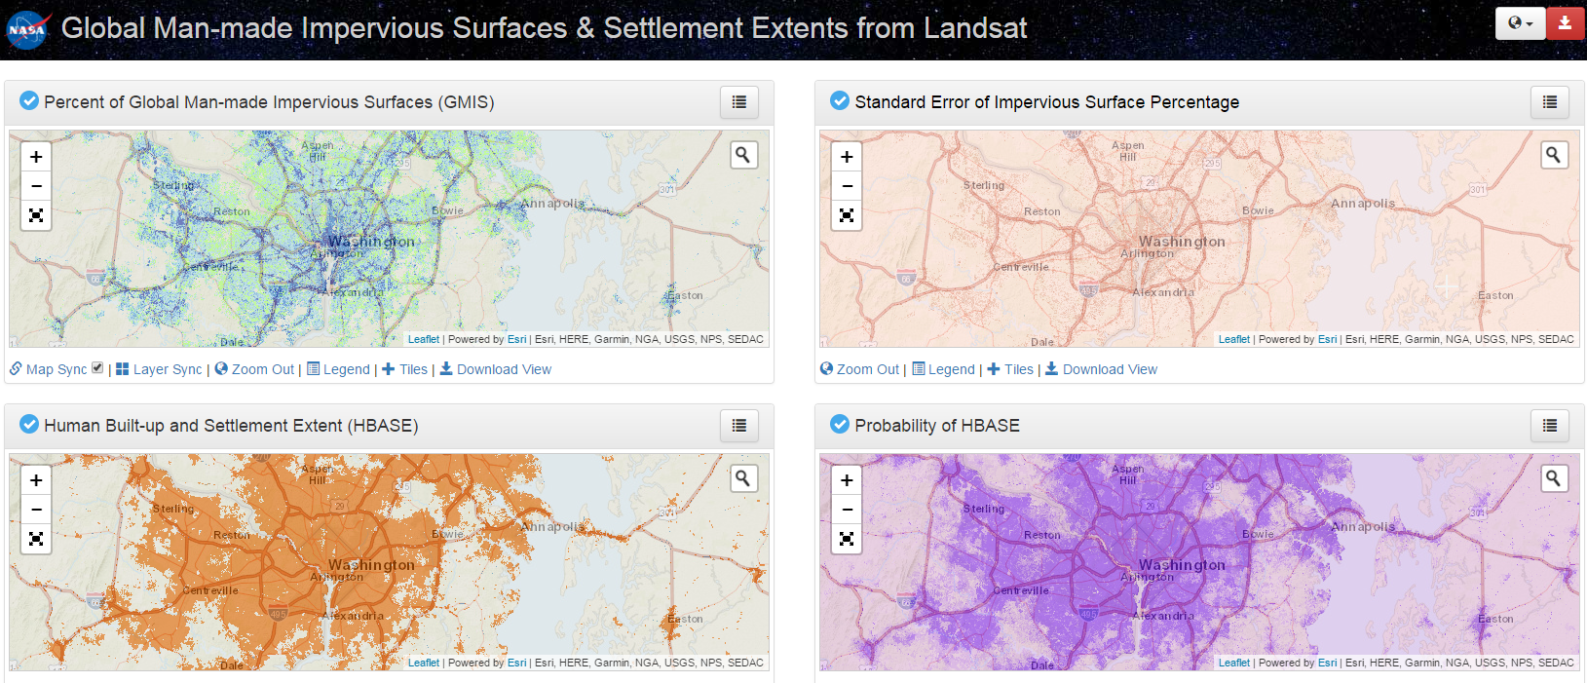
Global Impervious Surface/Settlement Data Sets Based on Landsat
Global Man-made Impervious Surfaces & Settlement Extents from Landsat (GMIS) and Human Built-up and Settlement Extent (HBASE)
Developed by E. Brown de Coulston et al. at NASA GSFC http://sedac.ciesin.columbia.edu/mapping/gmis-hbase/explore-view/

Slide 9
Increasing Range of Population and Settlement Products Now Available
Project | Proportion-al Allocation | Dasymetric | Statistical / machine learning | Time Series | Imagery / spectral data | Radar
Gridded Popultion of the World (GPW) | ✔ |  |  | ✔
Landscan |  | ✔ |  | ✔ | ✔
WorldPop |  |  | ✔ | ✔ * | ✔✔
Global Human Settlements Layer (GHSL) |  |  | ✔ | ✔ | ✔✔
Global Urban Footprint (GUF) |  |  | ✔ |  |  | ✔
Esri |  | ✔
High Resolution Human Settlement Layer |  |  | ✔ |  | ✔
✔ Fixed in time ✔✔ Time series ✔* Use varies based on model
* Exists for some countries, planned for WorldPop Global

Slide 10
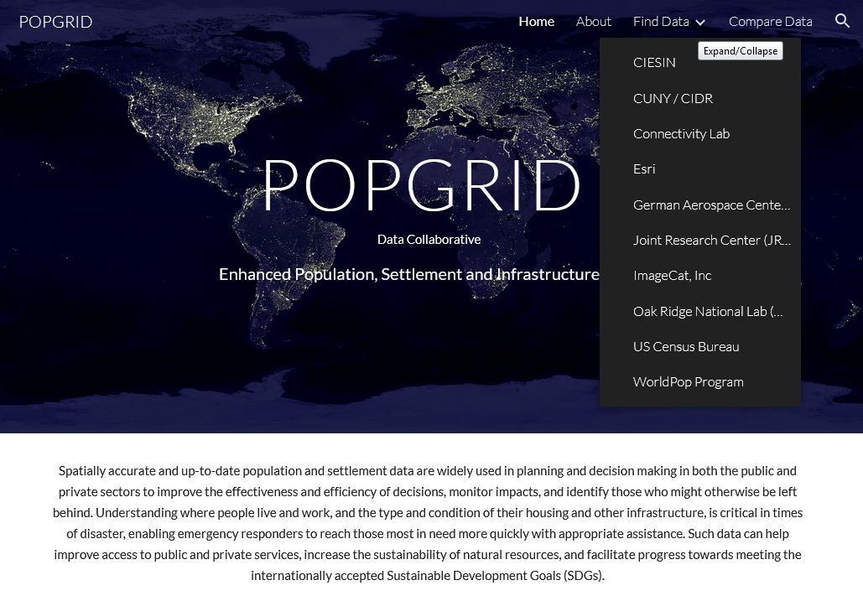
Population & Human Settlement Data Support the SDGs
Information on available datasets provided by POPGRID participants
Access to consistent metadata and documentation
Comparison tools
Access to user support (via SEDAC)
www.popgrid.org

Slide 12
Thank you
email@email / website / @twitter / etc.

