Slide 1
HYDROWEB a operational Satellite Altimetry Database
for Rivers and Lakes
P. Maisongrande (CNES/LEGOS)
on behalf of
J.-F. Crétaux (CNES/LEGOS), S. Calmant (IRD/LEGOS), J. Dorandeu (CLS)

Slide 2
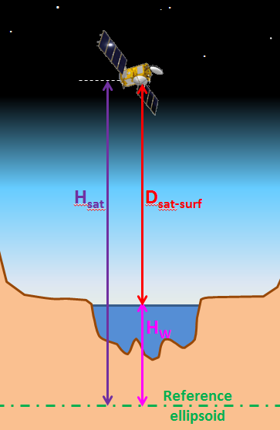
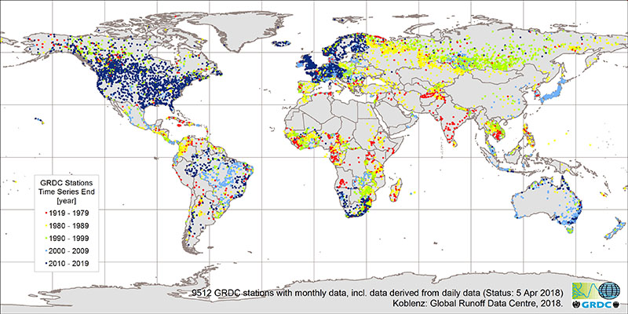
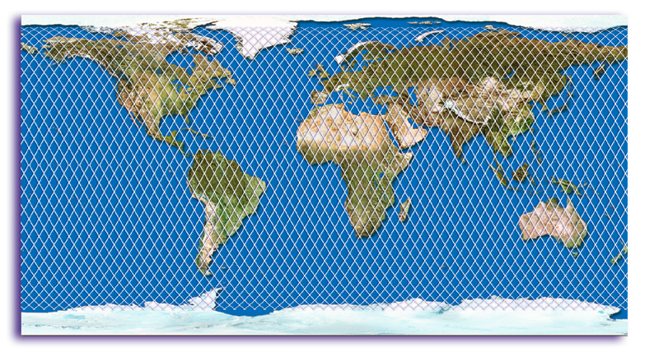
a solution for the Global Runoff Inventory
HYDROWEB why and how?
Satellite Altimetry
Only dark blue points are now available
Avalaible time series of water levels
for rivers and lake from 1992 to 2018
(ERS-1, Topex/Poseidon, ERS-2, GFO), Jason-1 , Envisat, Jason-2 Altika, S3…...)

Slide 3
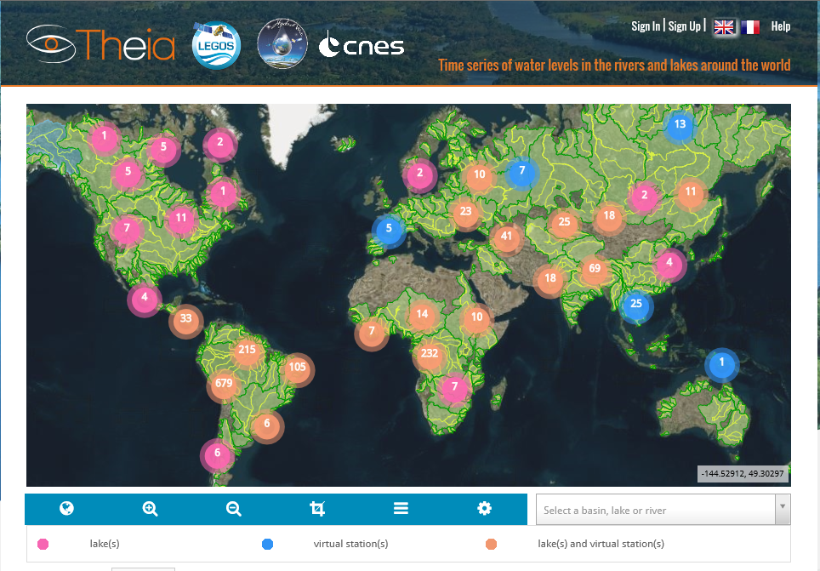
HYDROWEB.Theia-Land.fr
Frequent water levels for rivers & lakes
Rivers | 1490
Operational | 260
Research | 1290
Lakes | 155
Operational | 64
Research | 91
Operational: calculated and released automatically (1day latency)
Research: longer latency ( ~months) adjusted (small water bodies, signal analysis, artifacts…)
Developed by LEGOS, maintained & operated by CLS (since 2016) under CNES & Copernicus contracts

Slide 4
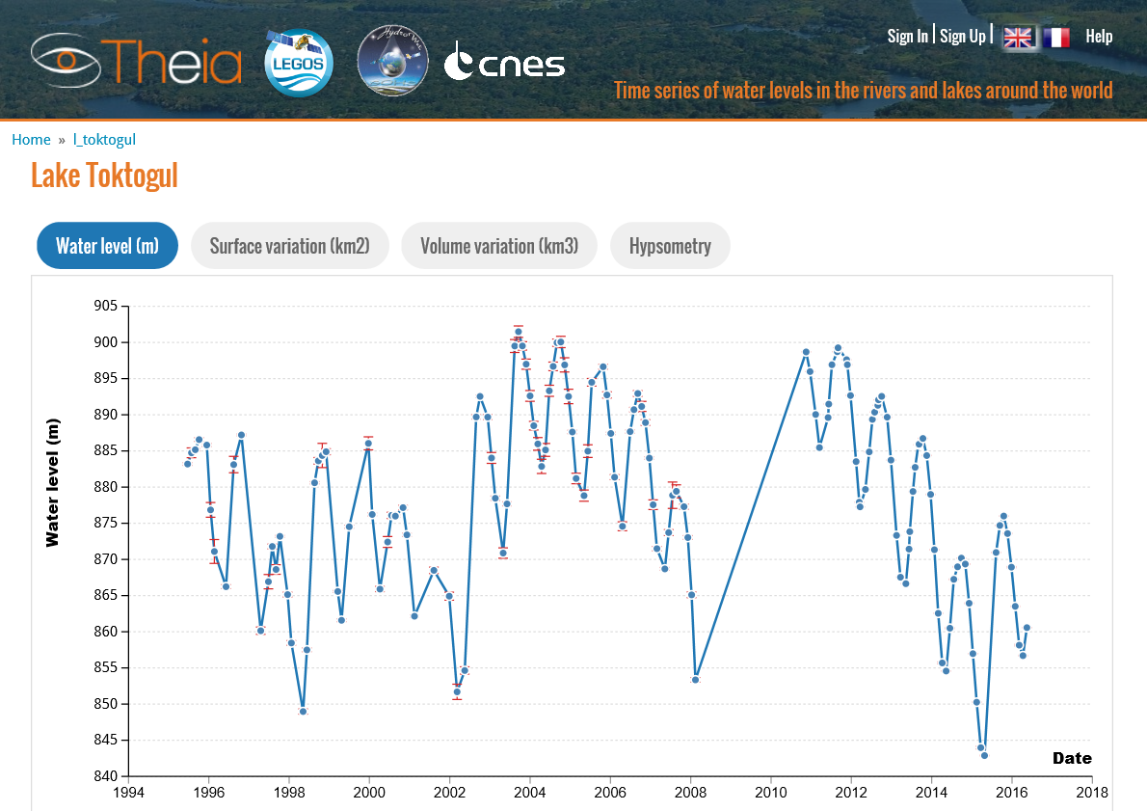
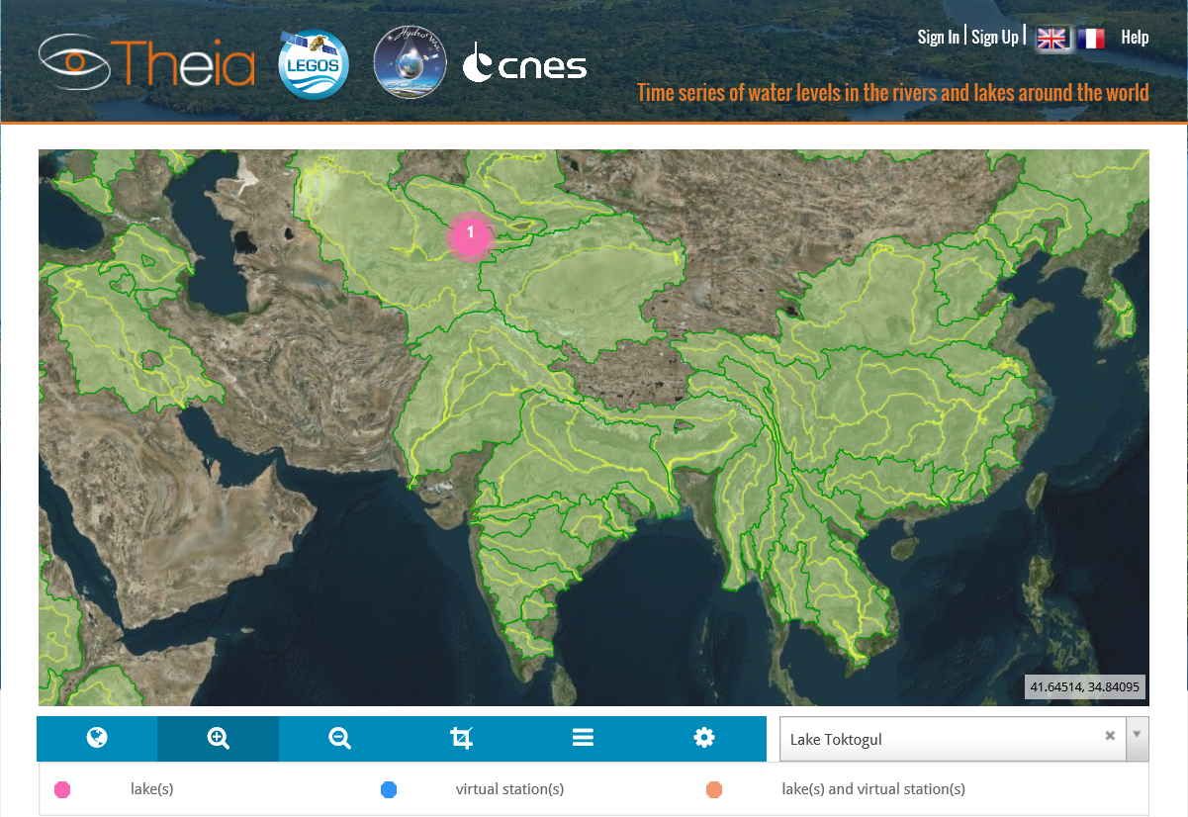
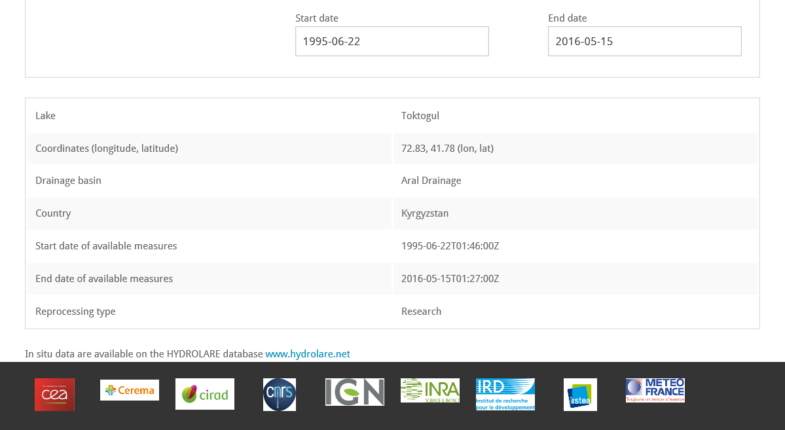
HYDROWEB.Theia-Land.fr Examples
Lake Toktogul

Slide 5
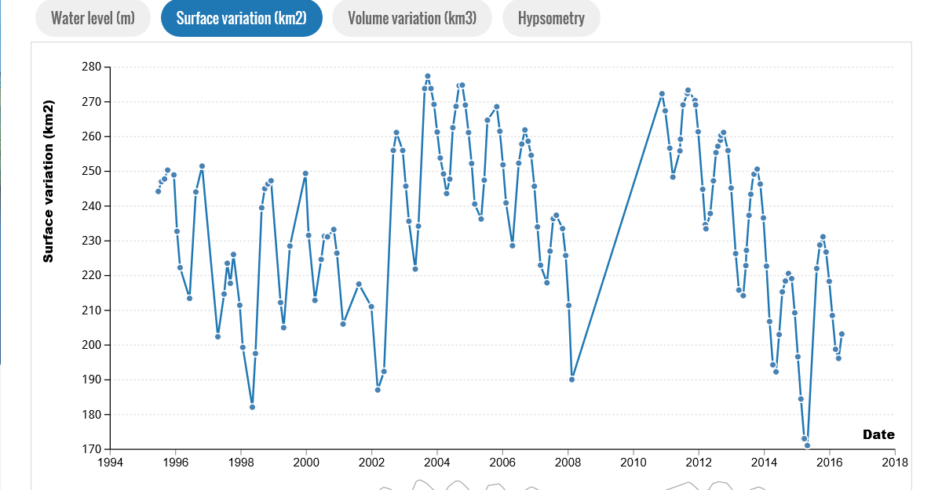
HYDROWEB.Theia-Land.fr Examples
Lake Toktogul

Slide 6
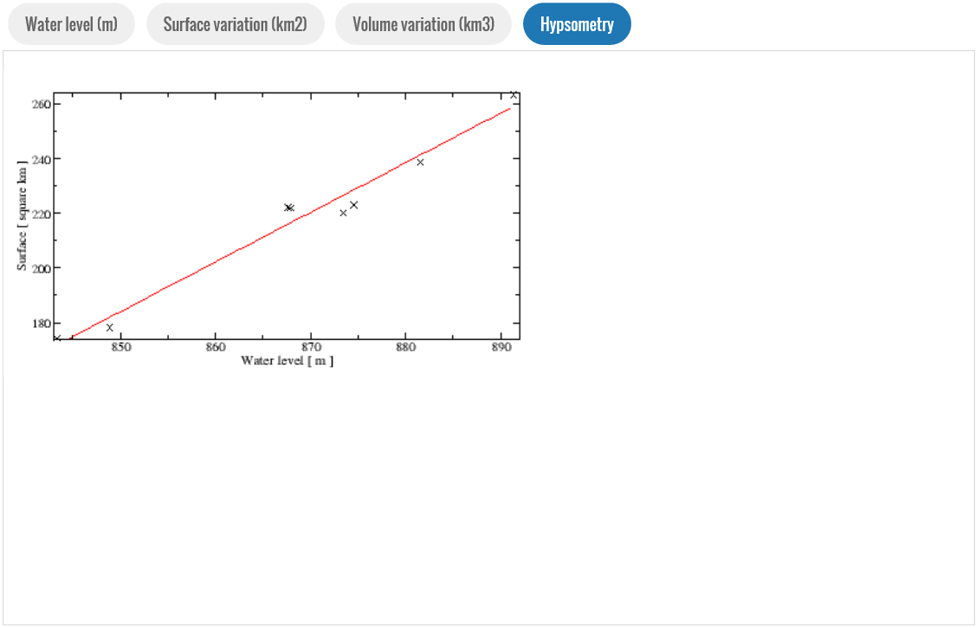
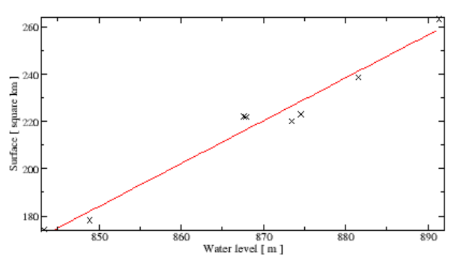
HYDROWEB.Theia-Land.fr Examples
Toktogul lake

Slide 7
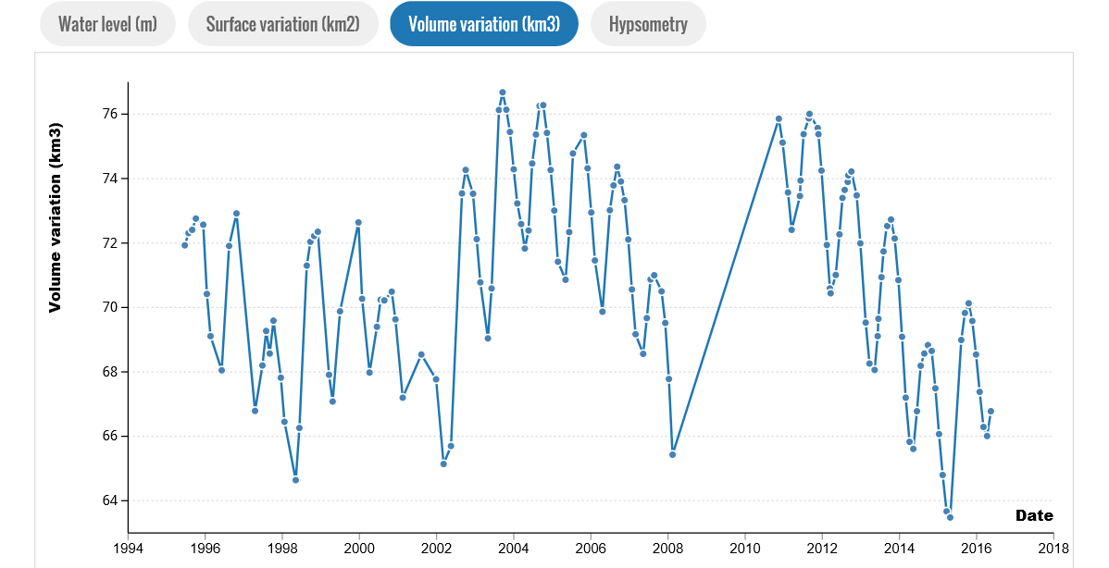
HYDROWEB.Theia-Land.fr Examples
Lake Toktogul

Slide 8
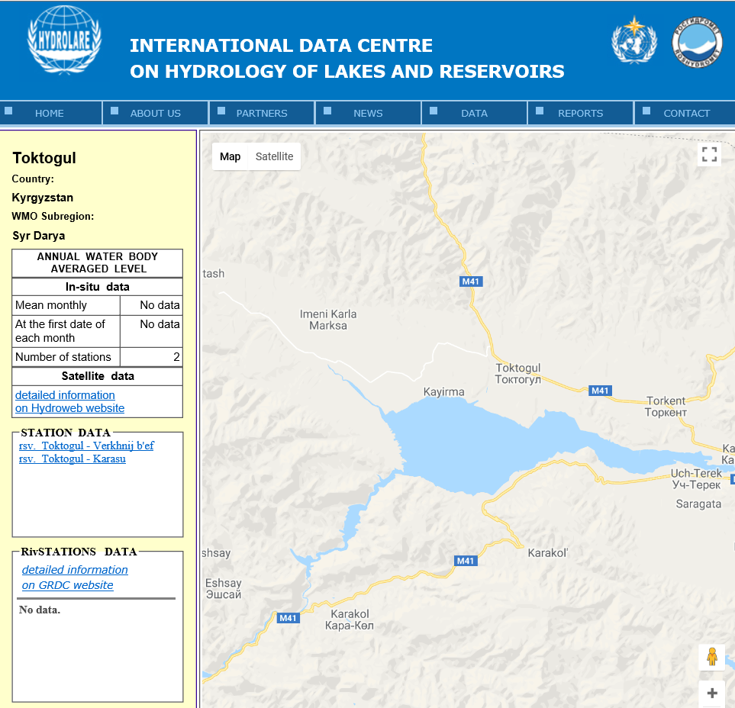
HYDROWEB.Theia-Land.fr Examples

Slide 9
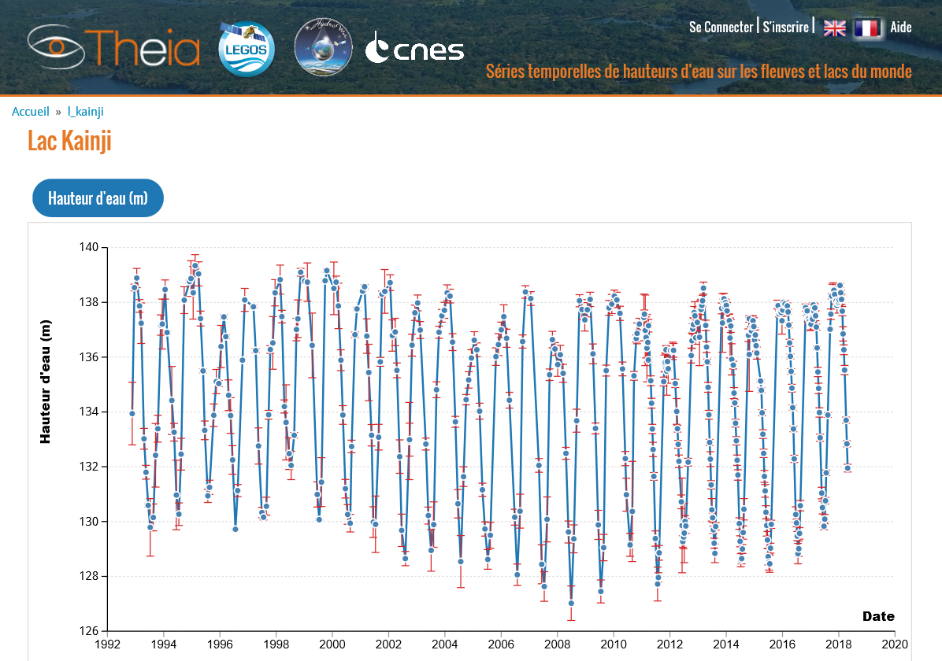
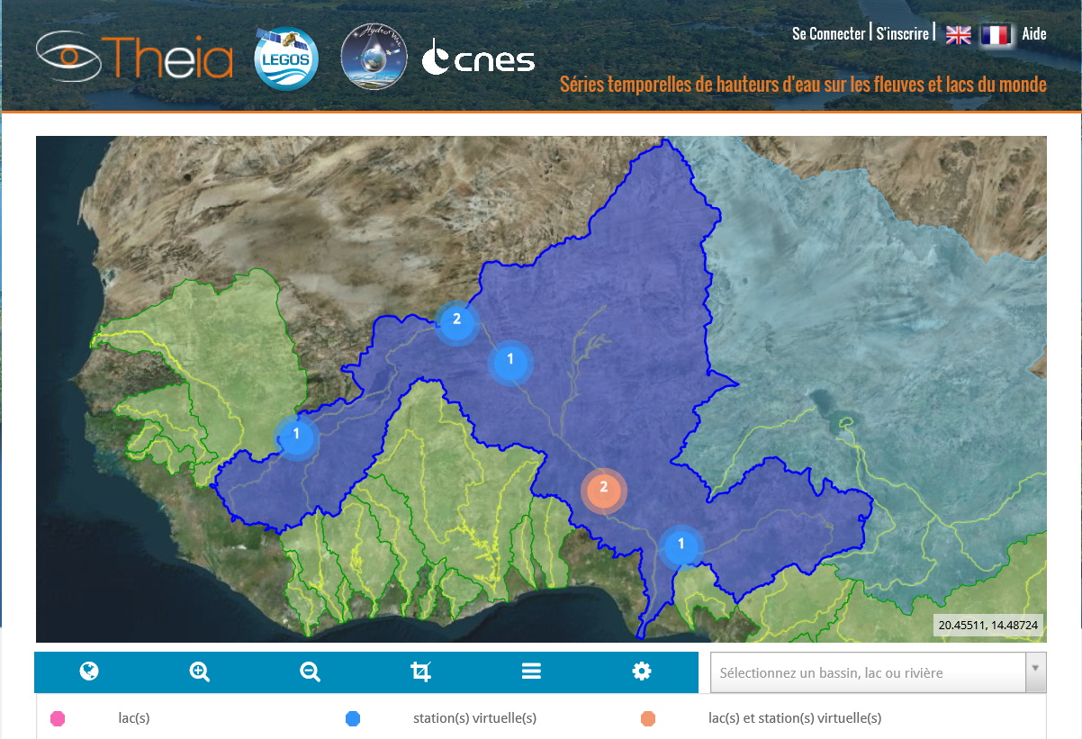
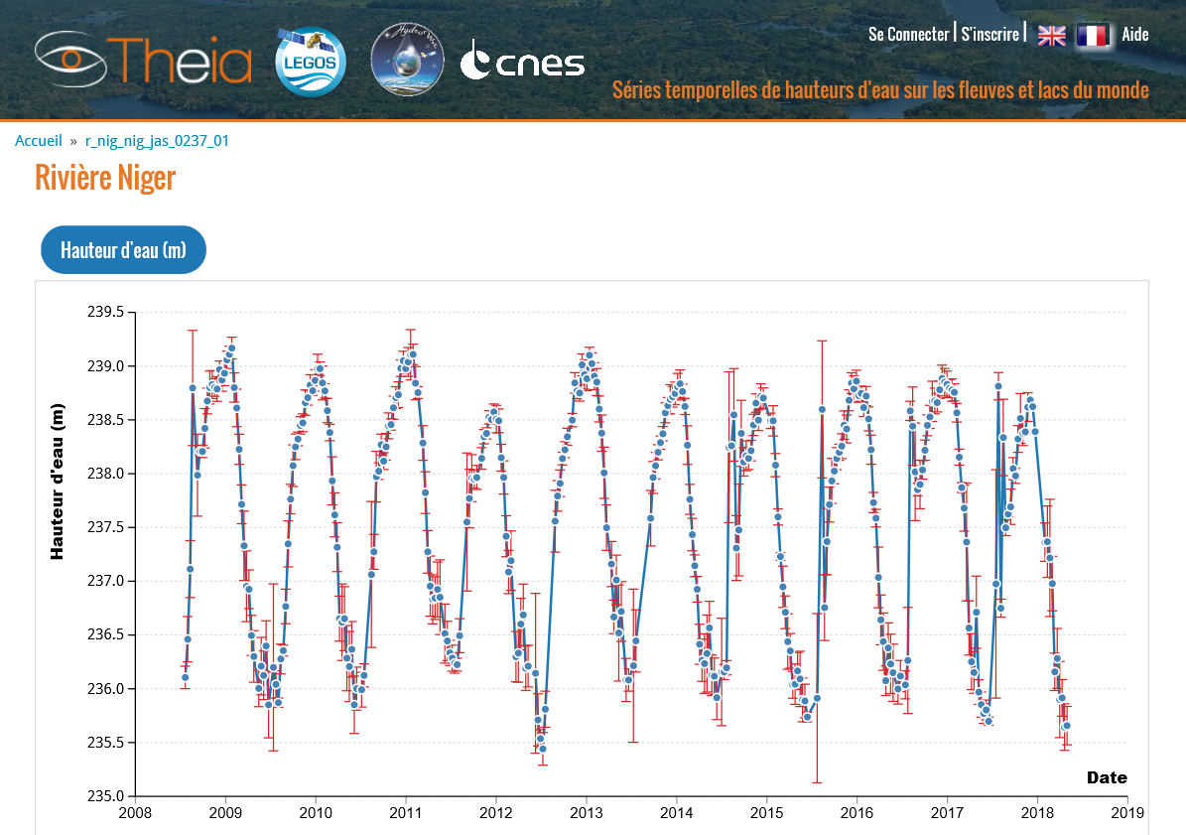
HYDROWEB.Theia-Land.fr
Kainji lake & Niger River

Slide 10
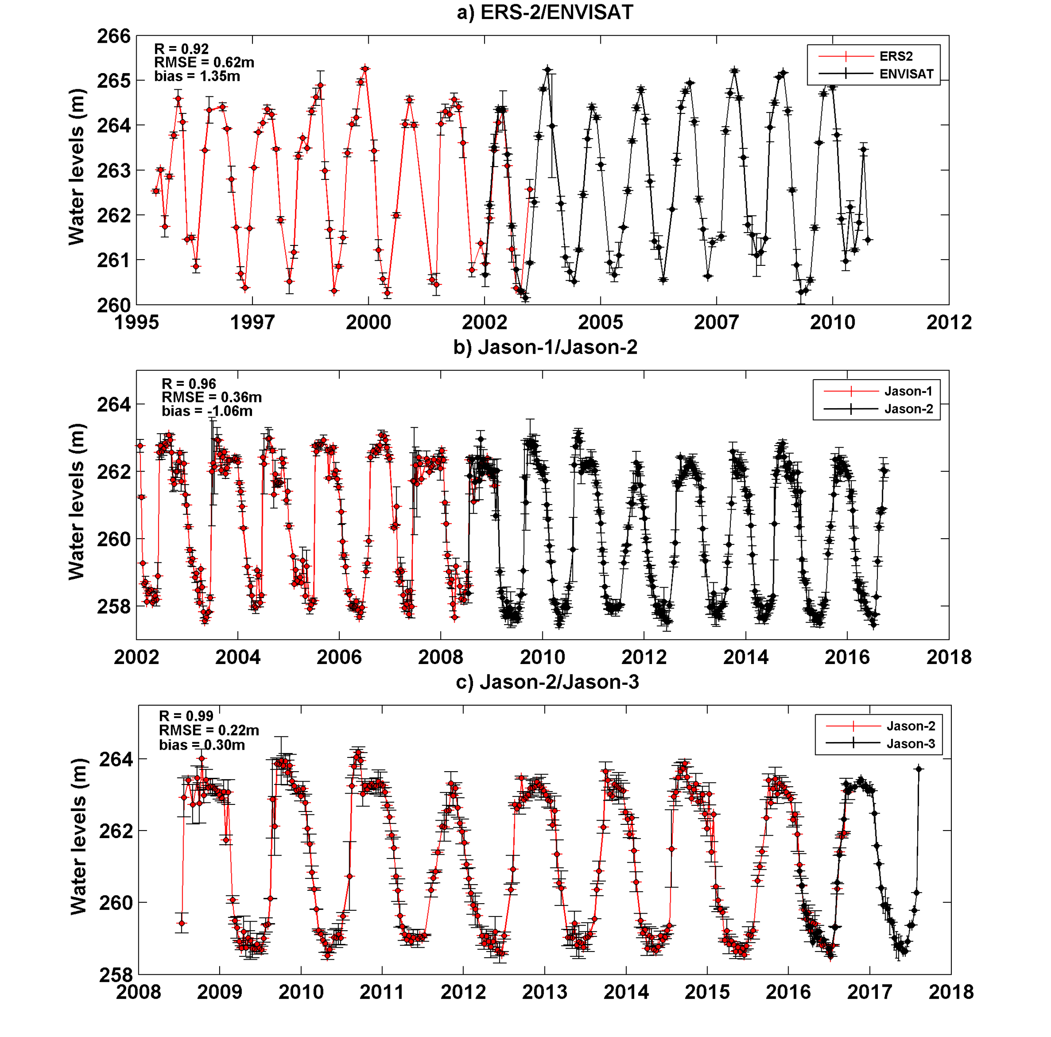
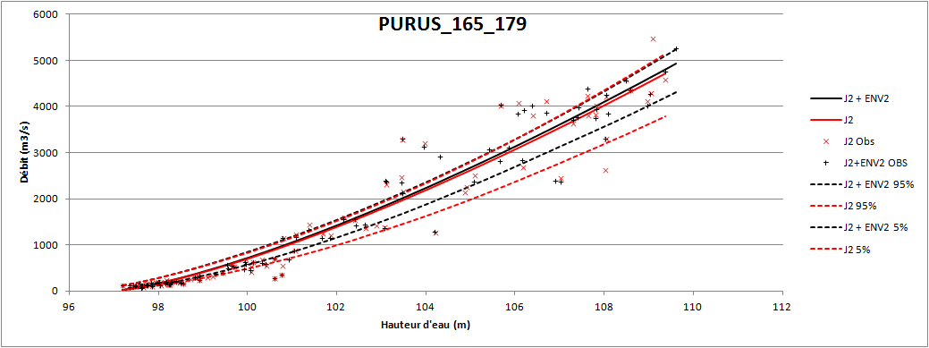
HYDROWEB Futur Products (by 2019)
Floodplains water level, extent and volume changes
River discharge over more than 1000 virtual stations
Rating curves
Discharge (m3/s)
Watel level (m)
Creation of rating curves using the MGB model estimates of river discharge
New product
A priori information for SWOT
Inner Niger Delta Combination of water level from satellite altimetry & water extent from satellite imagery.

Slide 11
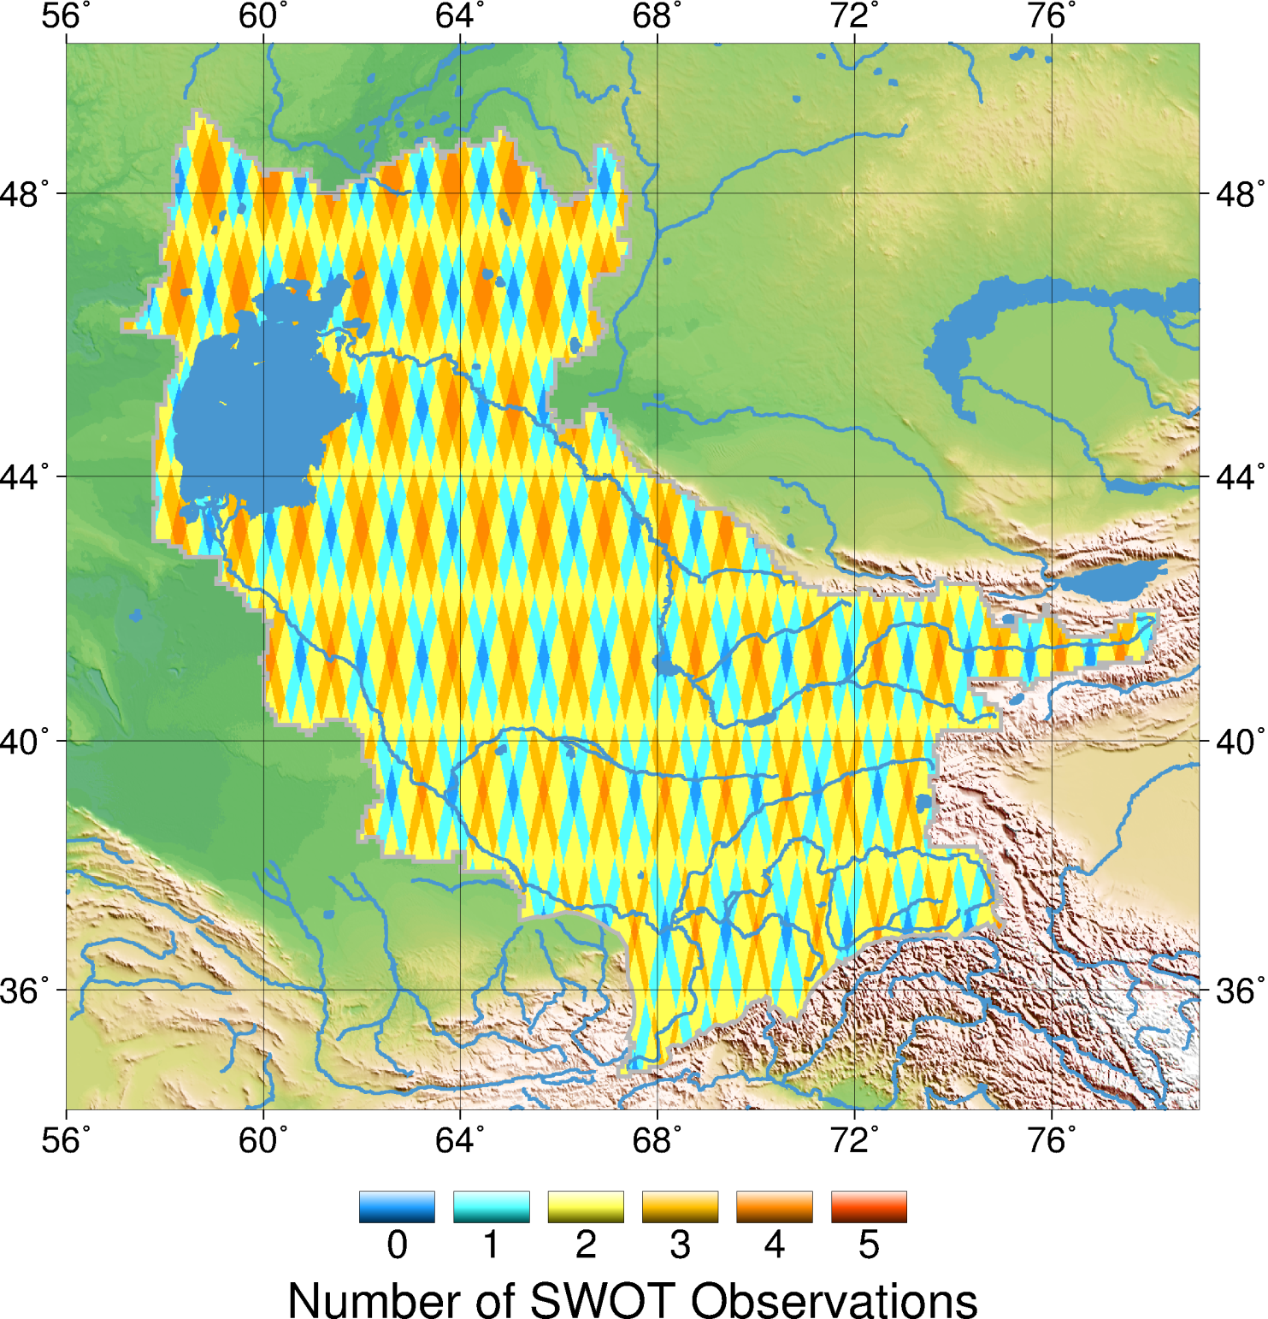
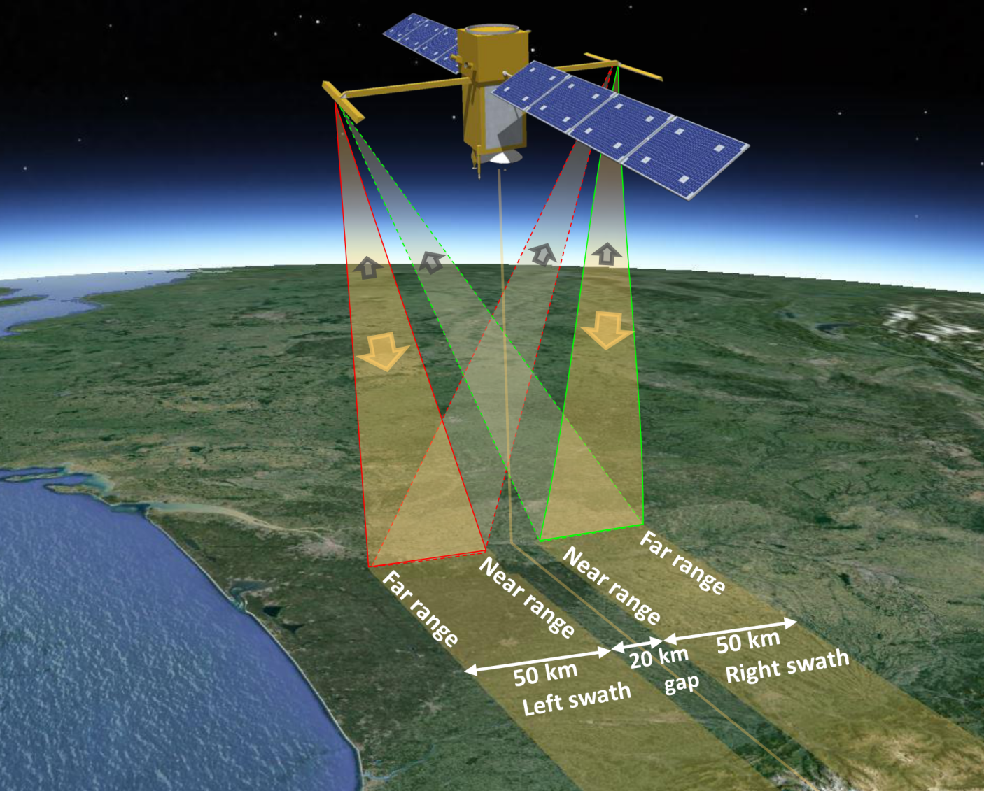
2021: SWOT arrival in HYDOWEB
Surface Water and Ocean Topography
Provide a global inventory of all terrestrial water bodies whose surface area exceeds (250m)2 (lakes, reservoirs, wetlands) and rivers whose width exceeds 100 m (rivers).
Water levels of lakes, rivers and wetlands with a vertical accuracy of few cm for lakes and 10 cm over 1km² for rivers;
Measurement of the global storage change in fresh water bodies at sub-monthly, seasonal, and annual time scales.
Estimation the global change in river discharge at sub-monthly, seasonal, and annual time scales.
Observations of estuaries
Notes:
Parler de revisiting capacity

Slide 12
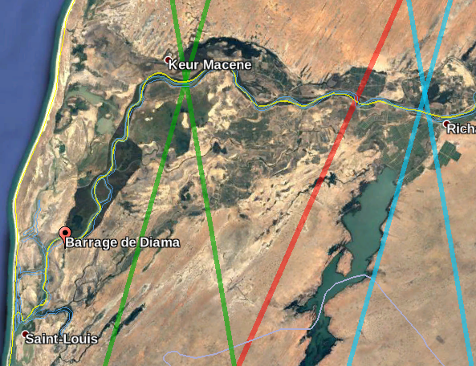
Altimetry revisiting capacity
~50 km de Diama
~95 km de Diama
Jason-3 (1 every 10 days)
Sentinel- 3A (1every 27 days)
Sentinel- 3B (1 every 27 days)

Slide 13
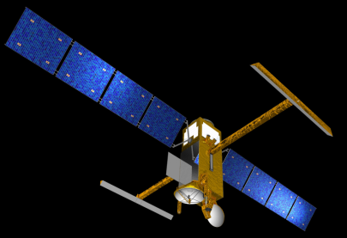
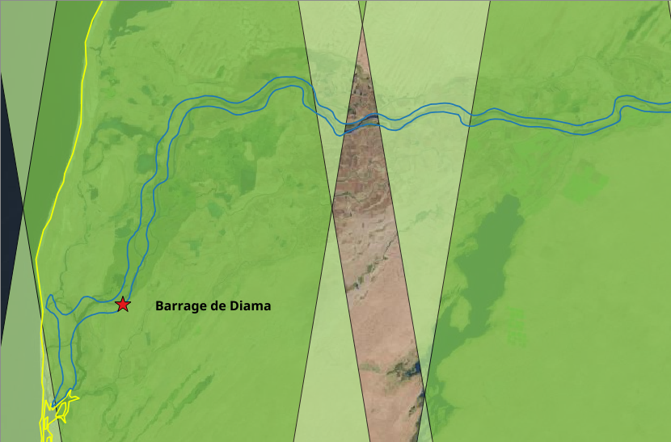
SWOT revisiting capacity
~50 km de Diama
~95 km de Diama
2 obs. SWOT par période de revisite (21j)
1 obs. SWOT /21 days

Slide 14
HYDROWEB.Theia-Land.fr
Summary
An operational data base at
An embedded database Hydroweb<Theia<Copernicus<others
An increasing number of Stations (eg S3 in progress)
Linkage with in situ data, an infrastructure challenge
From water level to added value products: volume and discharge
HYDROWEB prepares the arrival of SWOT in 2021

Slide 15
HYDROWEB.Theia-Land.fr
Thank you
Contact : Jean-François.Crétaux@legos.obs-mip.fr

Slide 16
HYDROWEB a operational Satellite Altimetry Database
for Rivers and Lakes
P. Maisongrande (CNES/LEGOS)
on behalf of
J.-F. Crétaux (CNES/LEGOS), S. Calmant (IRD/LEGOS), J. Dorandeu (CLS)

