Slide 1

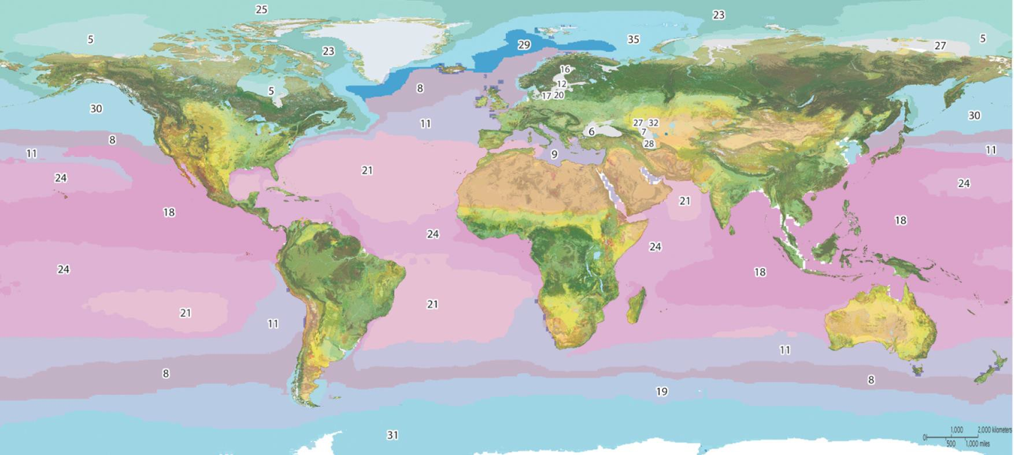
Global Ecosystem Mapping Initiative
Roger Sayre (U. S. Geological Survey); Dawn Wright, Sean Breyer, Pat Cummens, and others (Esri)
GEO Data Providers Workshop 2-4 May 2018 Frascati, Italy
ELUs (land)
EMUs (marine) ECUs (coastal)

Slide 2
Objectives
1) The Need and GEO Commission
2) Work to Date – ELUs (land) and EMUs (marine)
3) Ongoing and Future Efforts – ECUs (coastal) and EFUs (freshwater)
4) Apps
ELUs (land)
EMUs (marine) ECUs (coastal)

Slide 3
UN Sustainable Development Goals
The need to conserve global ecosystems is mandated in three UN SDGs (below). To conserve them requires knowing where they are on the landscape and in the oceans, and thus the need for global ecosystem mapping.
Terrestrial: By 2020, ensure the conservation, restoration and sustainable use of terrestrial and inland freshwater ecosystems and their services, in particular forests, wetlands, mountains and drylands. By 2030, ensure the conservation of mountain ecosystems, including their biodiversity, in order to enhance their capacity to provide benefits that are essential for sustainable development.
Freshwater: By 2020, protect and restore water-related ecosystems, including mountains, forests, wetlands, rivers, aquifers and lakes.
Marine: By 2020, sustainably manage and protect marine and coastal ecosystems to avoid significant adverse impacts, including by strengthening their resilience, and take action for their restoration in order to achieve healthy and productive oceans By 2020, conserve at least 10 per cent of coastal and marine areas, consistent with national and international law and based on the best available scientific information.

Slide 4
GEO ECOSYSTEMS Initiative: Global Ecosystem Mapping
Develop a standardized, robust, and practical global ecosystems classification and map for the planet’s terrestrial, freshwater, and marine ecosystems.

Slide 5
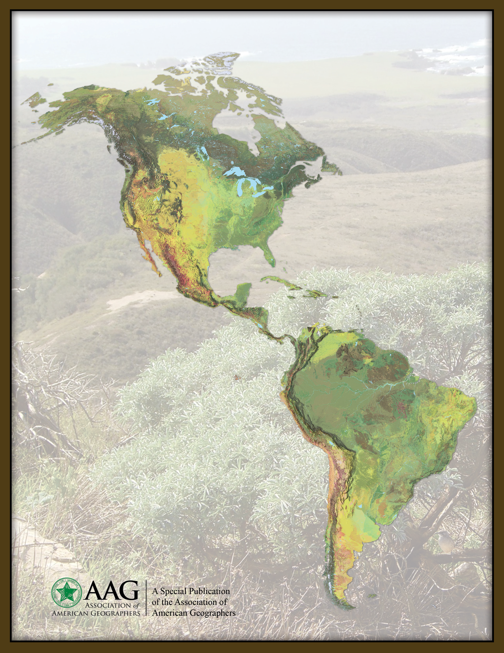
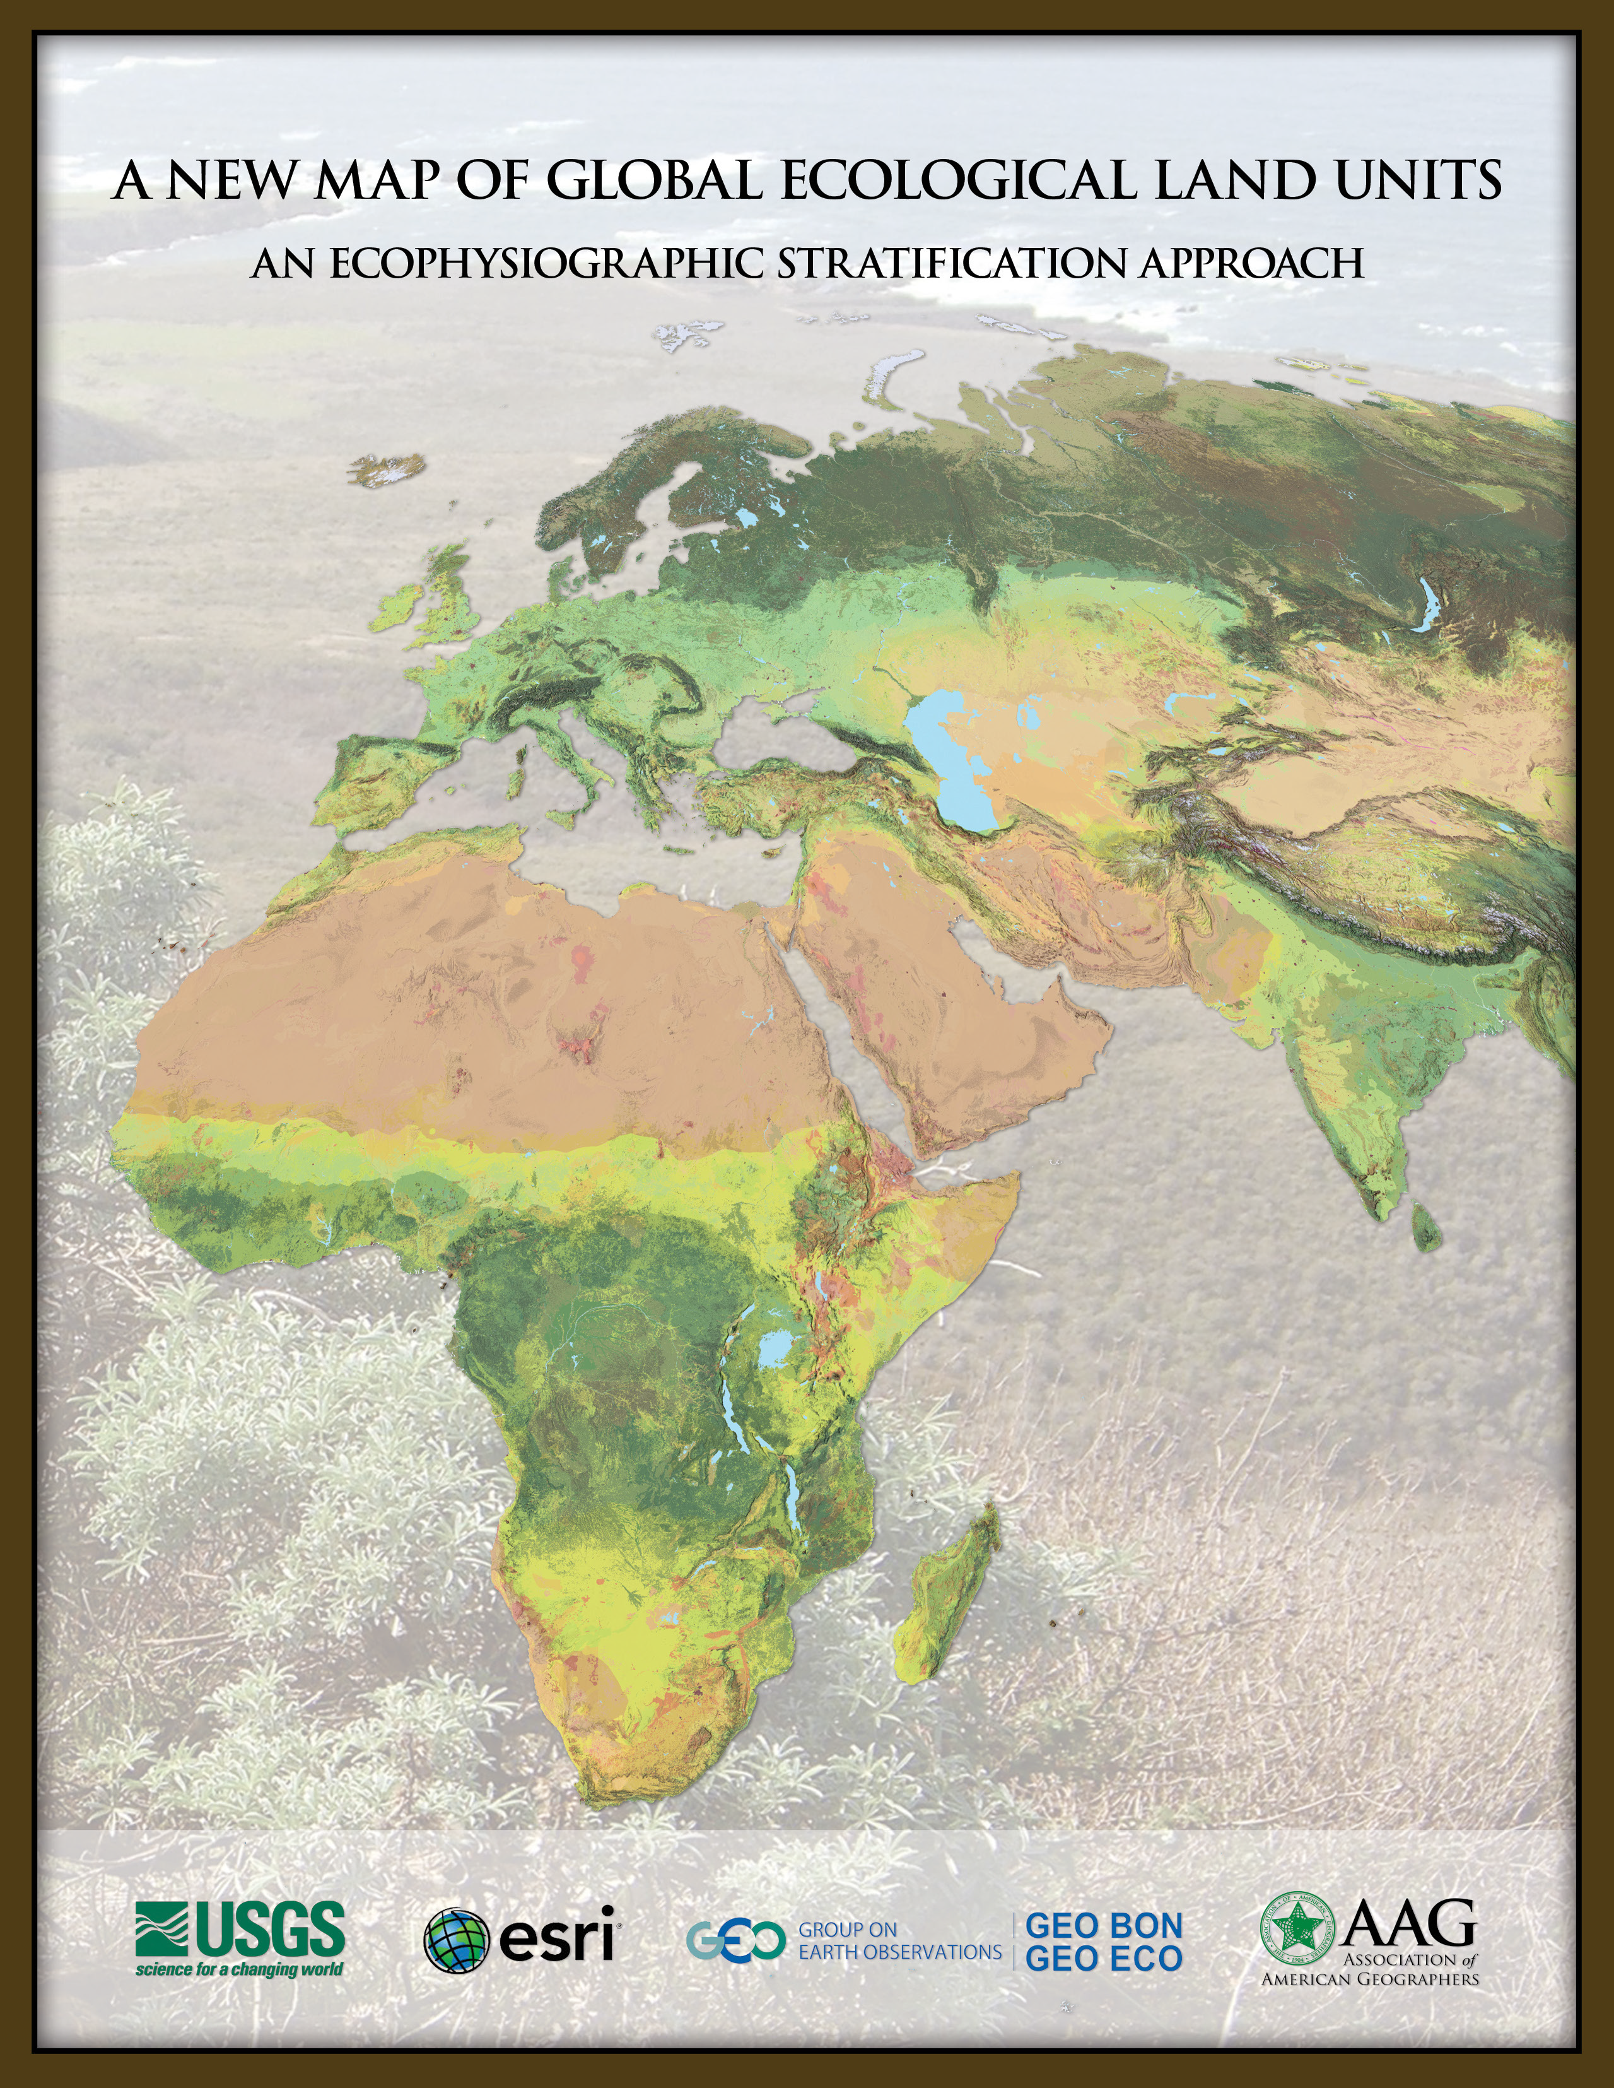
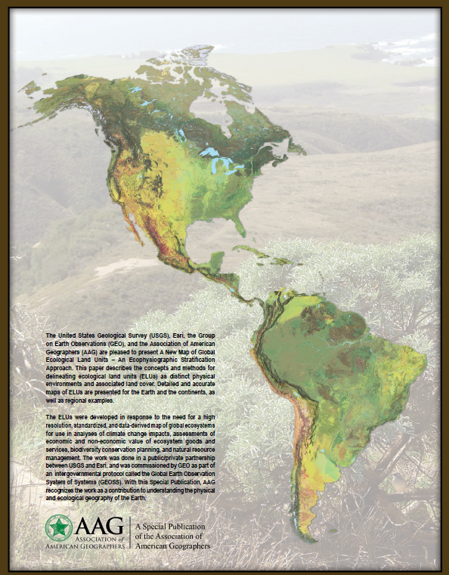
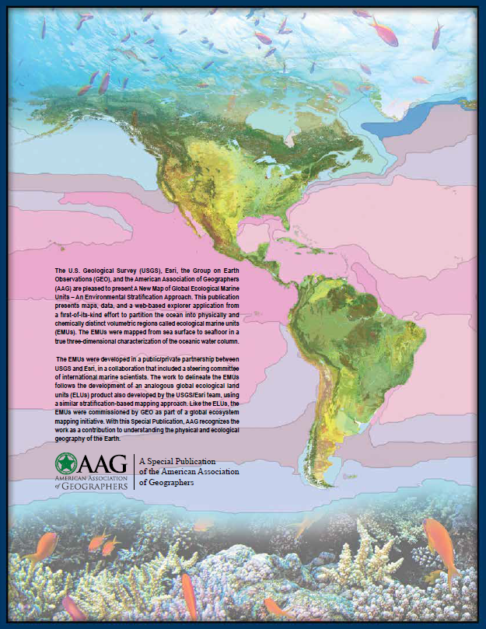
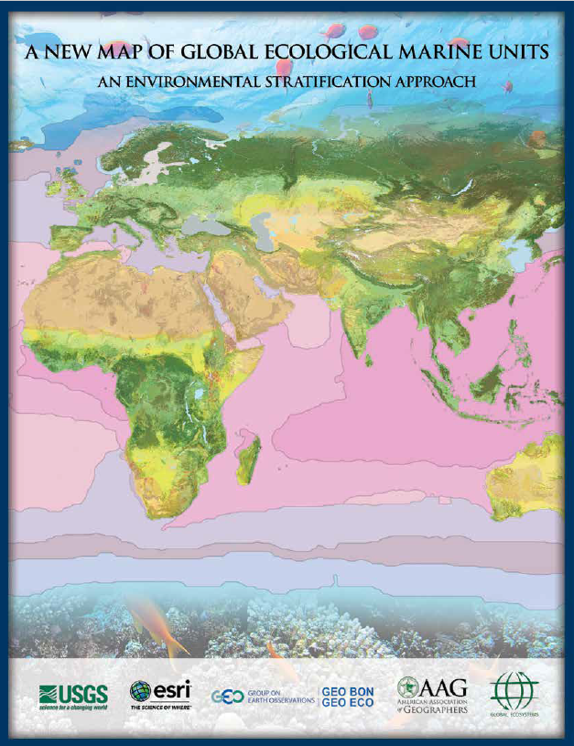
Global Ecological Land Units (ELUs)
Globally comprehensive
~4000 ELUs
Climate/Landform/Geology/Vegetation
250 m spatial resolution
Global Ecological Marine Units (EMUs)
Globally comprehensive and true 3D
37 EMUs
Temperature/Salinity/Oxygen/Nitrate/Phosphate/Silicate
27 km m spatial resolution

Slide 6
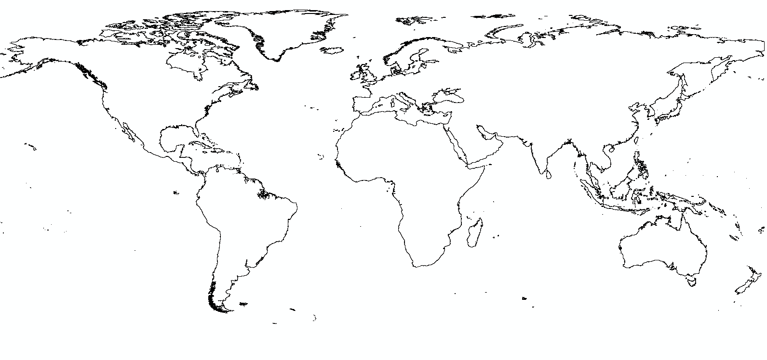
Ongoing Work – Global ECUs (Ecological Coastal Units)
We will quantitatively segment (stratify) the global coastal zone into environmentally distinct/ecologically meaningful units.

Slide 7
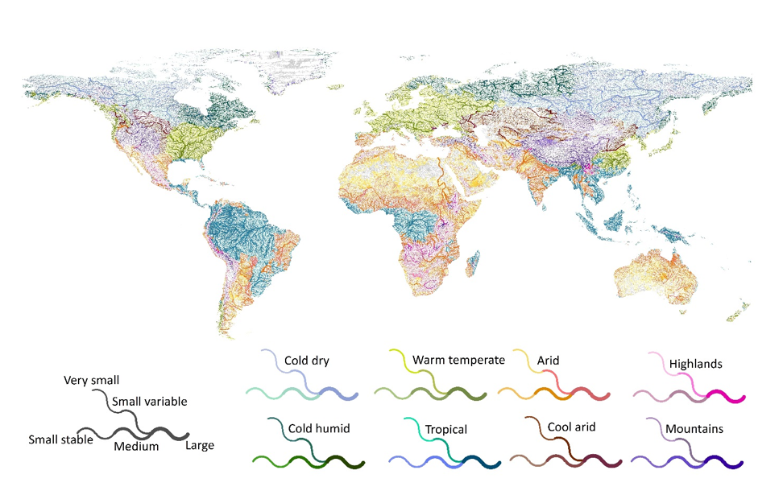
Future Work – Global EFUs (Ecological Freshwater Units)
We will distinguish global freshwater ecosystems as ecologically significant river reaches, lakes and ponds, and wetlands, and will map these features into meso-scale basins.

Slide 8
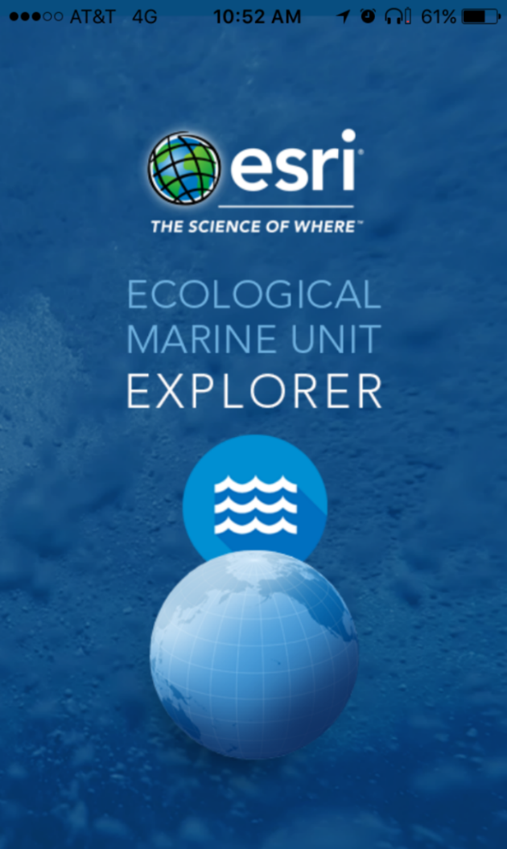
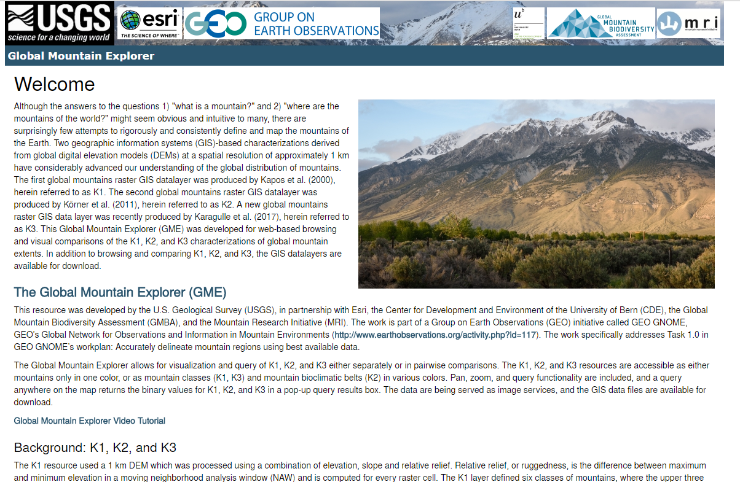
Apps

Slide 9
Take Homes
Ecosystems – Distinct Abiotic Settings + Matrix-forming Biological Assemblages
Domains - Terrestrial, Freshwater, Marine
Products – Data, Maps, Tools/Services, Publications
Uses – Ecosystem Assessments, Ecosystem Accounting, Conservation and Green/Blue Infrastructure Planning, Resource Management, etc.
Public/Private Partnership - Esri and USGS with NGO and Academic Collaborators

Slide 10
Links and Contact Information
ELUs – esriurl.com/elu
ecoexplorer.arcgis.com/eco/
EMUs - livingatlas.arcgis.com/emu/
Global Mountain Explorer – rmgsc.cr.usgs.gov/gme/
Roger Sayre
Senior Scientist for Ecosystems
Land Change Science Program
U.S. Geological Survey
rsayre@usgs.gov

