Slide 1
Session 1: The role of EO for Decision Making and the importance of GEOSS for Users
Dr. Michel Schouppe, EO Research and Innovation Policy Officer, European Commission

Slide 2
Content
Focus on: EU support towards a user-driven GEOSS
Seven examples of activities in the period 2009-2020
Lessons learnt

Slide 3
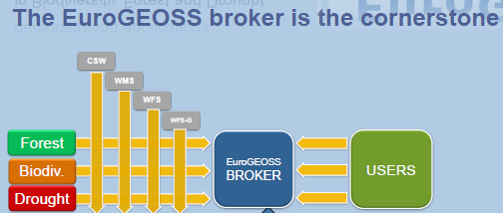
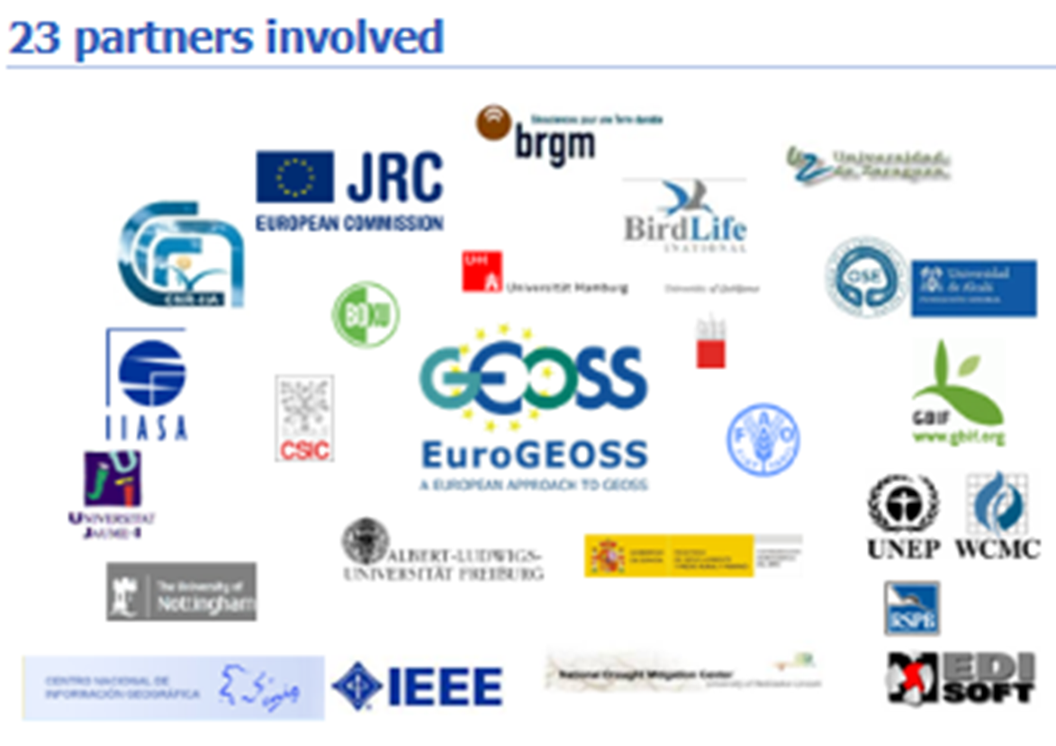
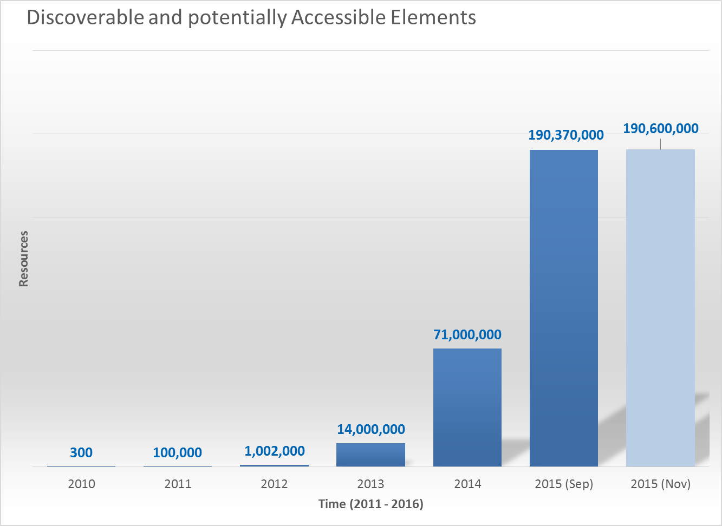
EU support towards a user-driven GEOSS
2009 - 2011
Introduction of the Brokering approach

Slide 4
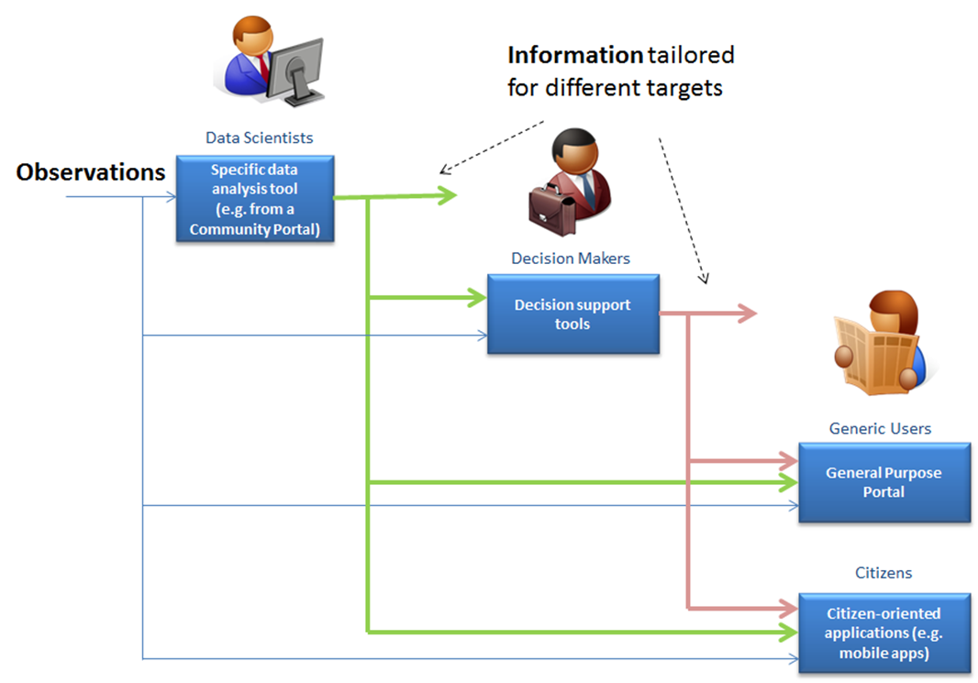
EU support towards a user-driven GEOSS
2011 - 2014
A structured system engineering approach based on User requirements from and across SBAs (weather, oceans and water)
Enhancement of data discovery and access including result ranking and semantic-enriched search
Development of Enablers* [Developer Cloud Sandbox, Cloud Controller], for the development of geo-processing components

Slide 5
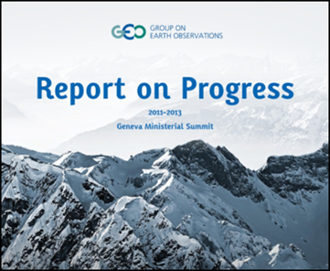
Reports 2013 and 2015 on the GEOSS Common Infrastructure
2013 and 2015
EO data interoperability greatly advanced thanks to the GCI GCI mentioned as a key achievement of the first GEO decade
But
GEO has not fully achieved a “user-driven GEOSS”
Some user categories are not yet adequately incorporated into the value cycle
GEO should communicate use cases to demonstrate GEOSS value to users
Access to GCI should be more user-friendly
Data discovery and accessibility should be improved

Slide 6
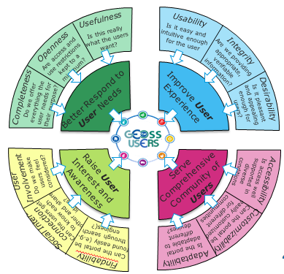
EU support towards a user-driven GEOSS
2017 - 2019
Main objectives:
Engaging the user communities
Better understanding their needs
Advocating the benefits of GEOSS
Improving the user experience on the GEOSS platform
Delivering solutions in response to actual user requirements
Raising interest and awareness amongst a comprehensive community of users
In close collaboration with GEO flagships and initiatives
Coordination with the GEO secretariat, the relevant foundational tasks and GEO stakeholders

Slide 7
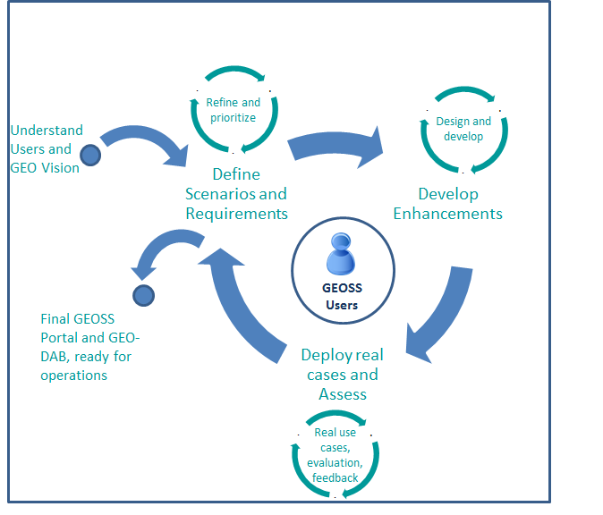
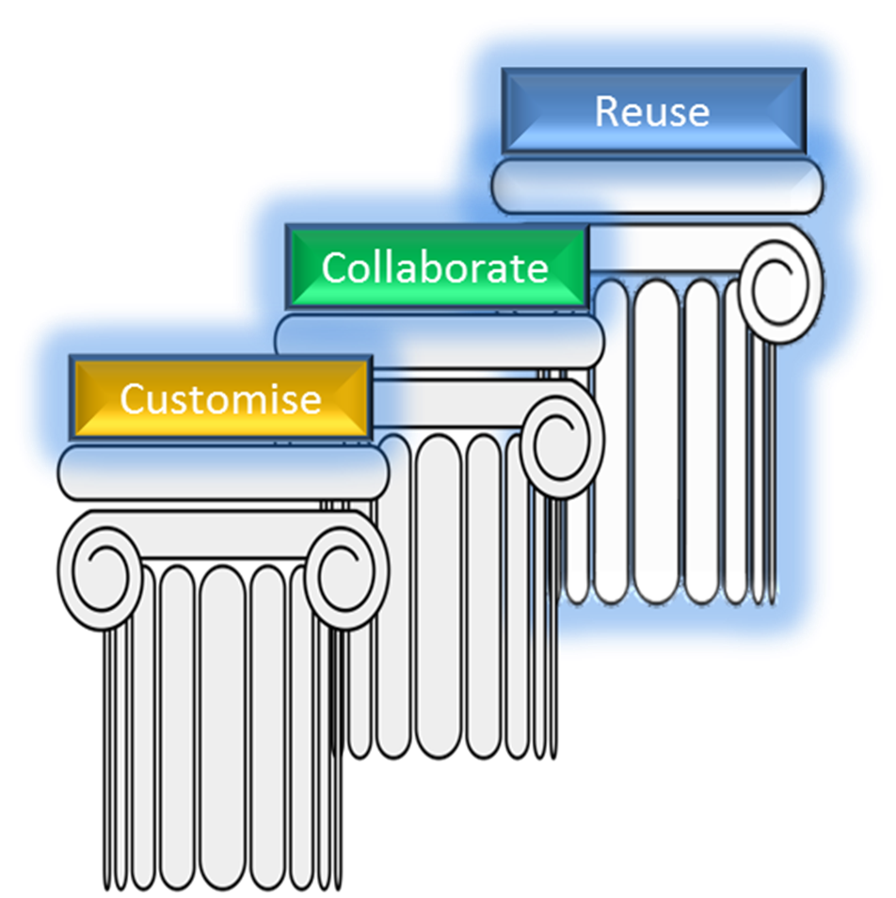
Enhancement of the GEO Web Portal (GWP) and increased synergies with the GEO Data Access Broker (DAB) based on:
Agile development approach
Repetitive cycle of enhancements
Focus on reusability by various communities
GEOSS APIs
GEOSS Widget
Portal Mirror Site
Increased synergies with regional data hubs and other e-infrastructures (e.g. ChinaGEOSS, Copernicus, VLabs)

Slide 8
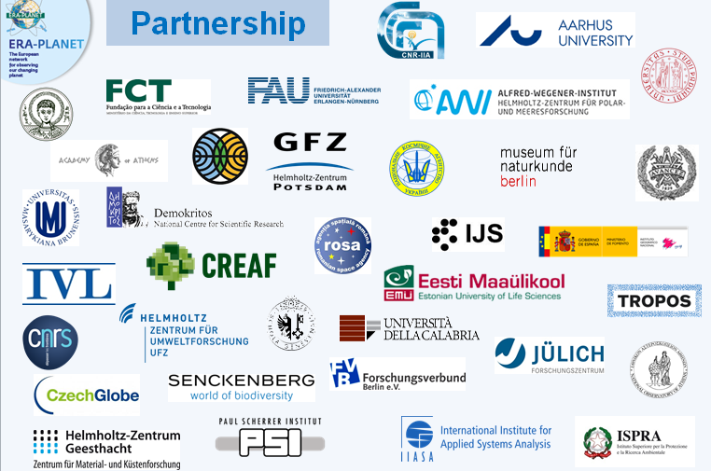
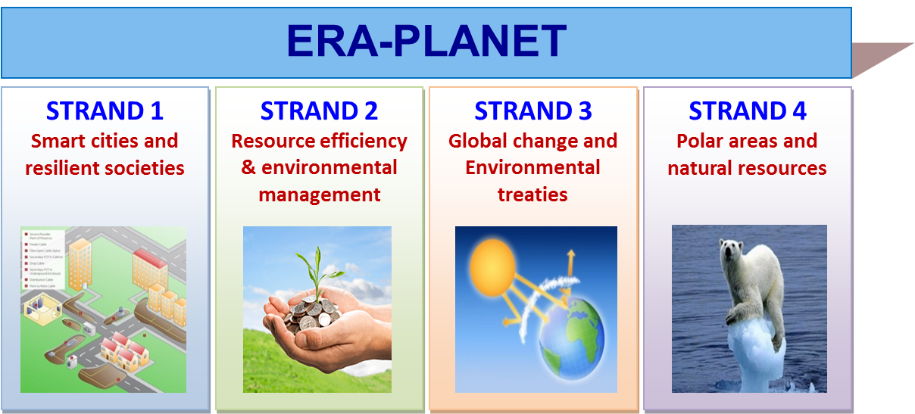
EU support towards a user-driven GEOSS
2016 - 2021
Horizontal activities, including to:
Prioritize and coordinate the acquisition of Essential Variables (EVs)
Apply/use the GEOSS brokering approach
Implement the GEOSS Data Principles
Advocate the utilization of the GEO APIs
Encourage contributions in the GEO tasks
Contribute systematically to GEOSS via the GCI and collaborate in the experimentation of new GEOSS requirements/components
Apply the GEO Model Web pattern

Slide 9
EU support towards a user-driven GEOSS
2017 - 2020
Contributions to GEOSS:
Engage communities, promote innovative GEOSS powered applications
User-driven applications in support of EuroGEOSS
Test / contribute options to GEOSS EVOLVE and GEO-DAB operations
Test and deliver a federated data hub for access and exploitation of GEOSS resources and other European data
Engage European providers of Earth Observation data including Copernicus Collaborative Ground Segments, Core Services and DIAS platforms
Improved connectivity to the European and global data centres

Slide 10
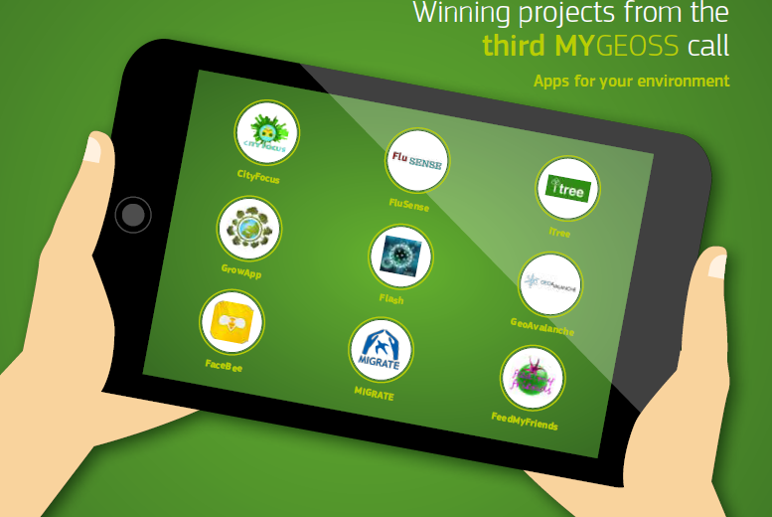
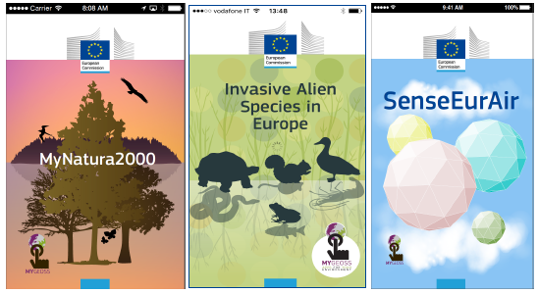
EU support towards a user-driven GEOSS
2015 - 2016
Contributions to GEOSS:
Raising awareness of GEOSS and the GEOSS Data-CORE
Experience gained to make the GEOSS Platform more user-centred
Open data and open code collected in a catalogue brokered into the GEOSS platform
Three Calls resulting in 40 mobile or web-based apps informing European citizens on the changes affecting their local environment
Using openly available or crowd-generated data including GEOSS Data-CORE and other open data

Slide 11
EU support towards a user-driven GEOSS
2018 - 2020
Contribution to GEOSS:
Think tank on the evolution and adaptation of the GCI
Bringing GEOSS closer to the user communities in Europe
Direct contribution to
 GEOSS INVOLVE
 EuroGEOSS
EOVALUE H2020 project
Analysis of current offerings of the GCI including extent of application of GEOSS data principles.
Characterization and evolution of the EO/geospatial data economy
EuroGEOSS demonstrator of European apps exploiting interoperability between GEOSS, Copernicus and INSPIRE, alongside data from open government sources and citizen observatories.
Follow-up of

Slide 12
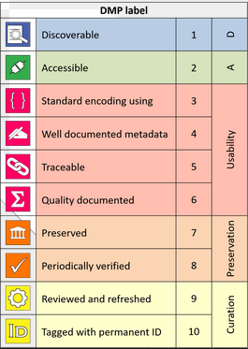
Lessons learnt on the importance of GEOSS for Users
It all starts from the right data and metadata
 Timely, accurate, relevant, sustainable, comparable, reproducible data sets: towards actionable data sets GEO DSP and DMP implementation !!!
 Multi-scale and multi-disciplinary data: From global … to regional … to local scales
Very often, EO brings only part of the solution
 From EO data to knowledge: the many value chains
 EO highly technical products
requiring expertise

Slide 13
Lessons learnt on the importance of GEOSS for Users
Let the users select the platform of their choice
 ! APIs and Widgets in an ecosystem of data platforms
 Need to enable machine-to-machine interactions
Disrupting big data and web technologies
 Flexible and adaptive GEOSS design
 Progressive shift from: "Discover / Evaluate / Download data sets" to: "Discover resources / execute workflows / retrieve information“
 Interoperable multidimensional data cubes
Evaluating User Requirements – not once, but over and over
"We need direct contact with the ‘Elusive User’ (…) It’s not possible to build a truly user-driven GEOSS if Everyone is a potential user" (IDIB, 2014).

Slide 14
Thank you
Michel.Schouppe@ec.europa.eu

