Slide 2
Browsing a data cube
Joakim Adrup / Trainee / ESRIN, ESA

Slide 3
background
Trainee at ESRIN
Writing master thesis for home university
Looking into how to inspect, browse and interact with data cube for the GEOSS platform

Slide 4
demo
Quick demo

Slide 5
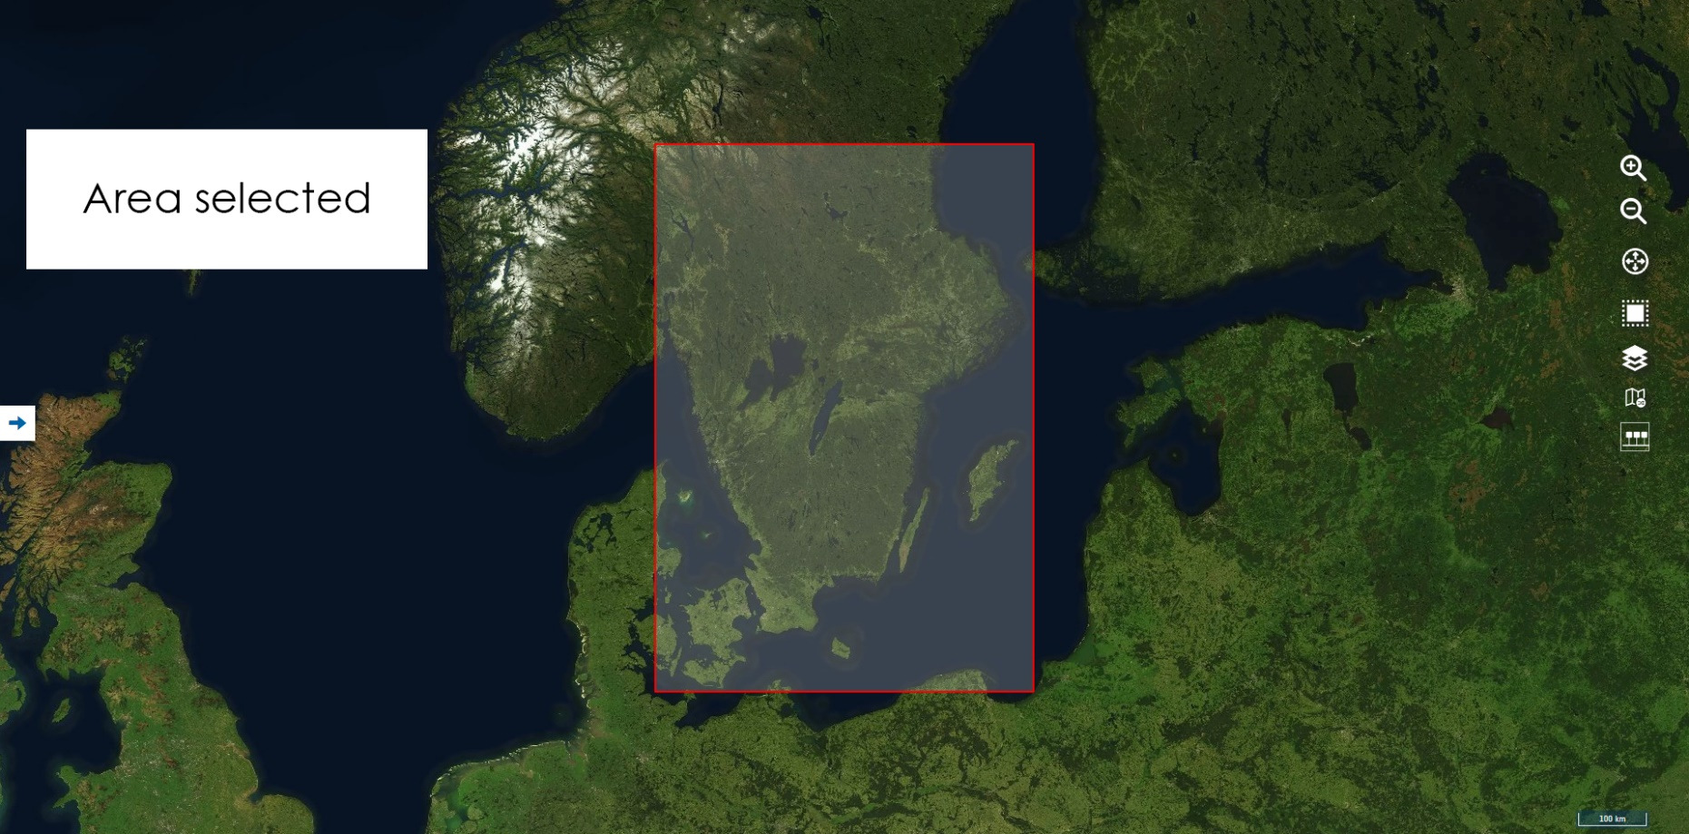
Portal

Slide 6
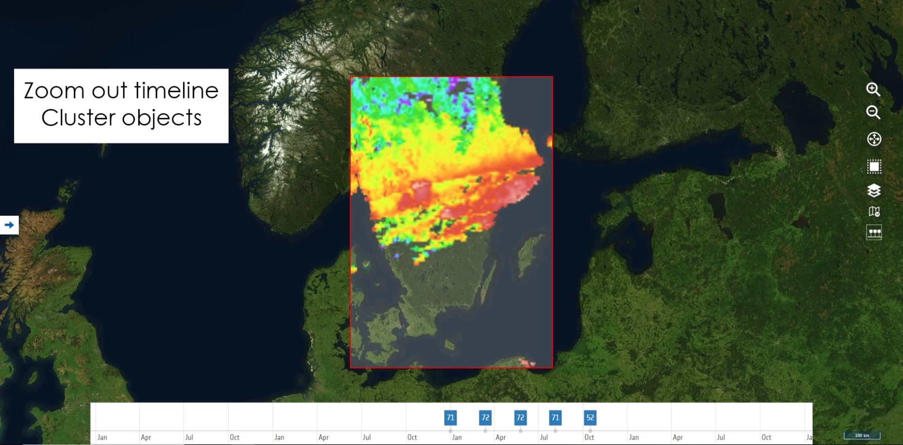
Portal
* MODIS land surface temperature

Slide 7
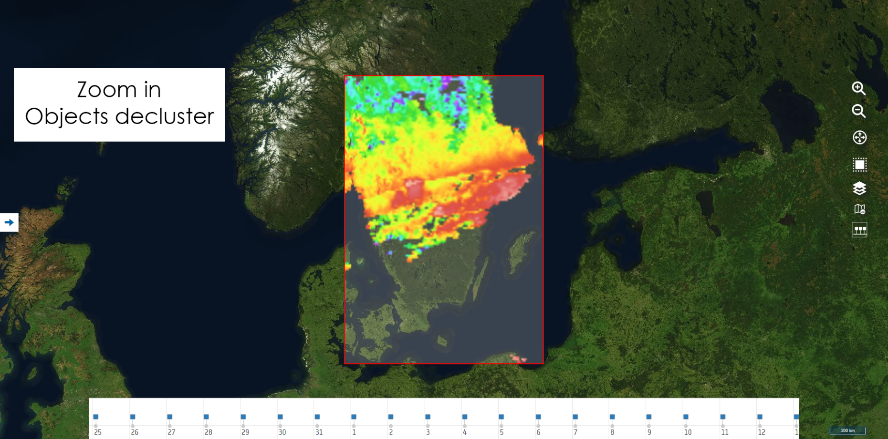
Portal
* MODIS land surface temperature

Slide 8
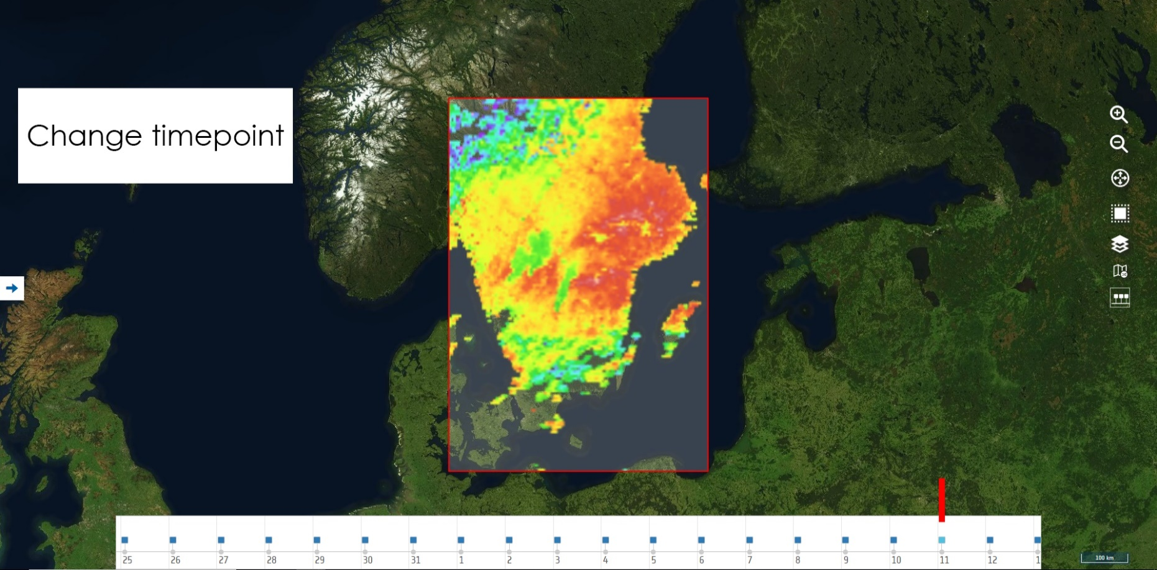
Portal
* MODIS land surface temperature

Slide 9
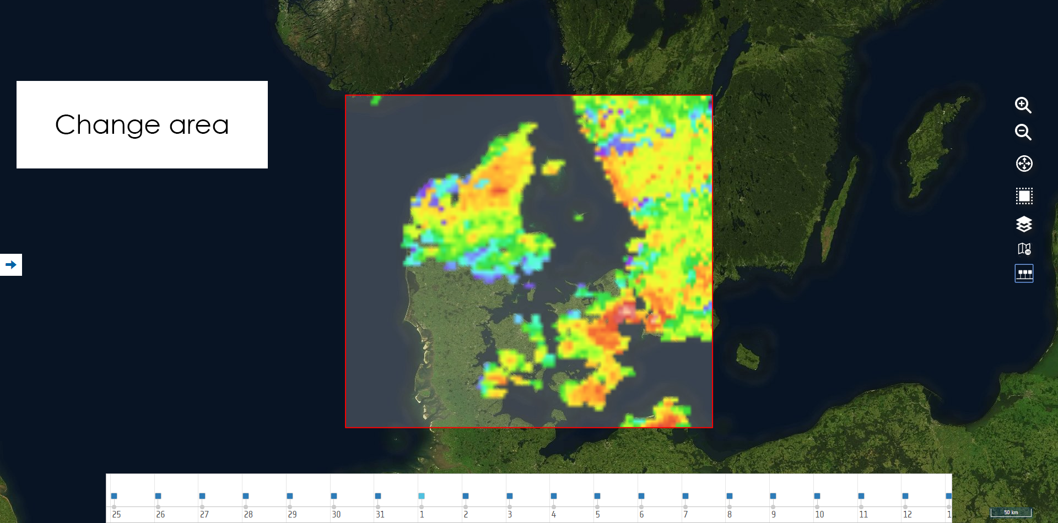
Portal
* MODIS land surface temperature

Slide 10
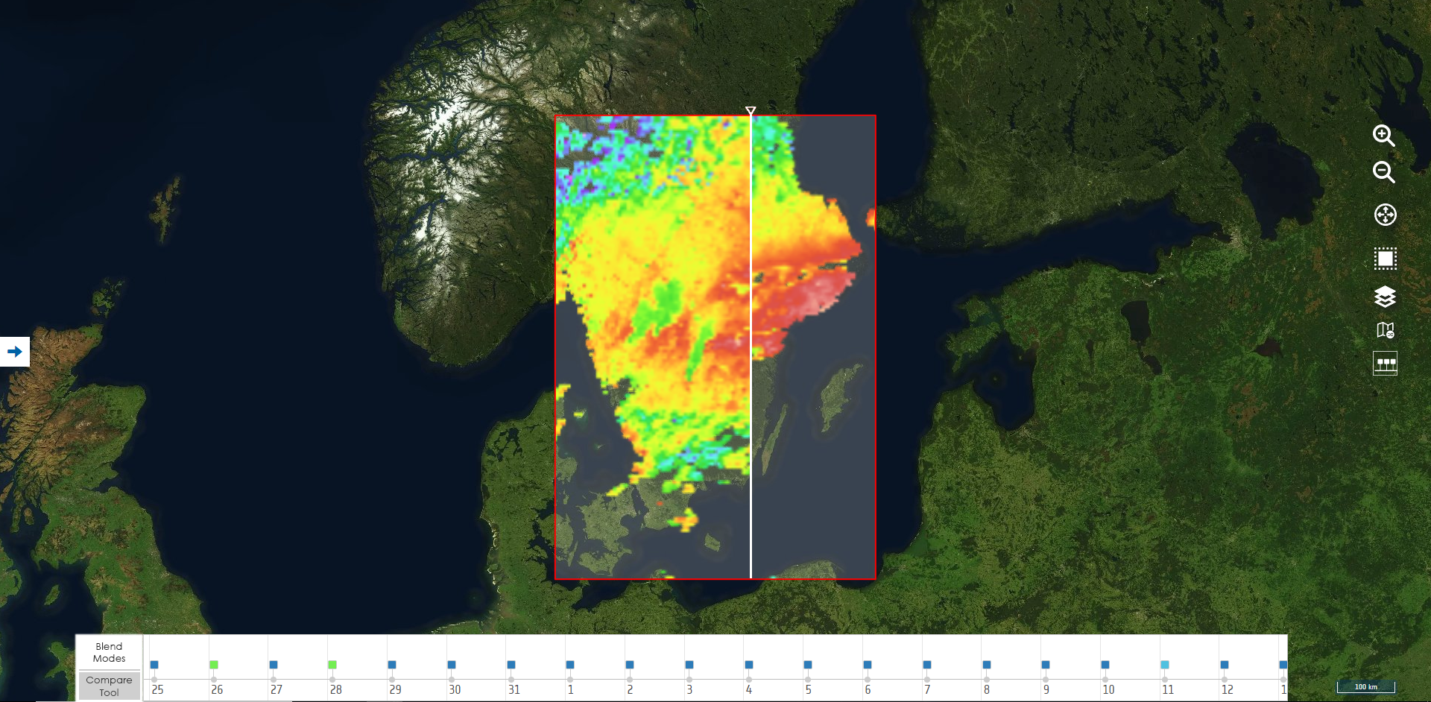
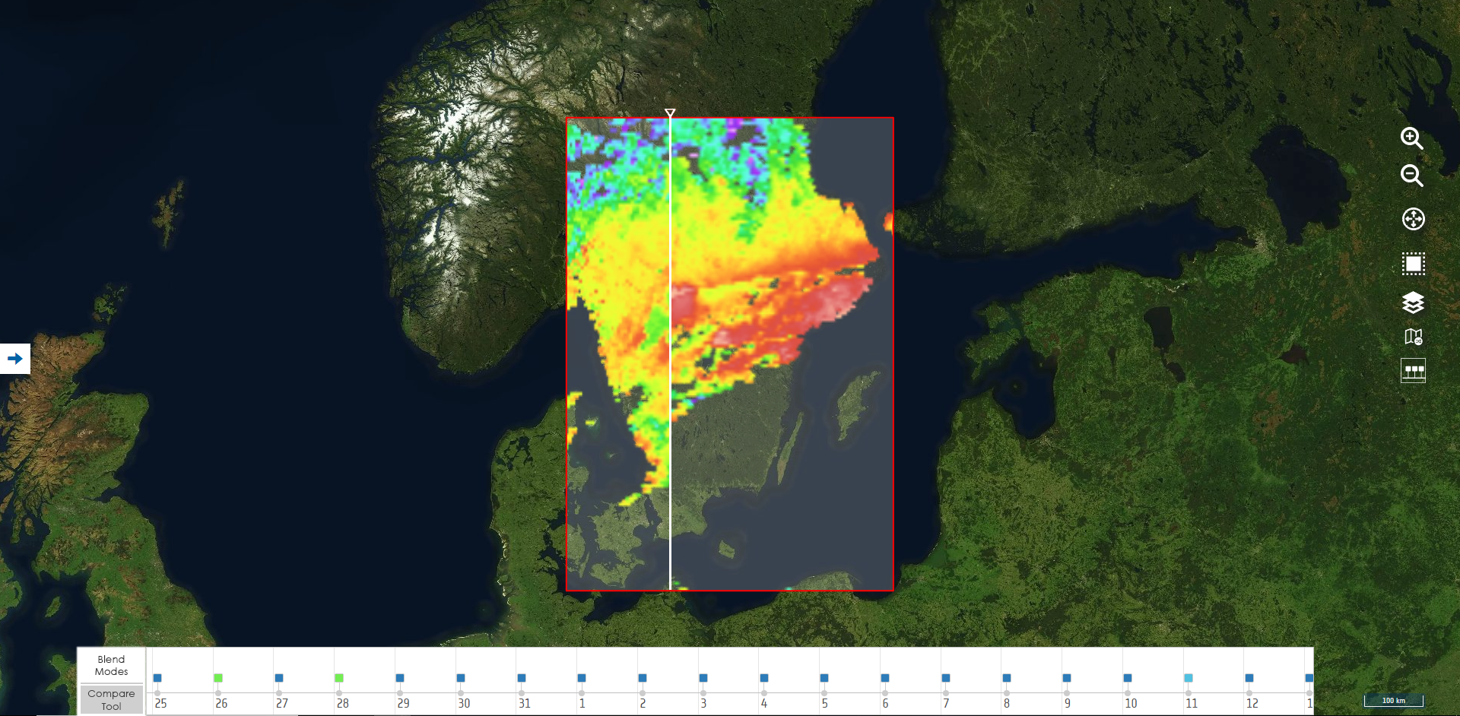
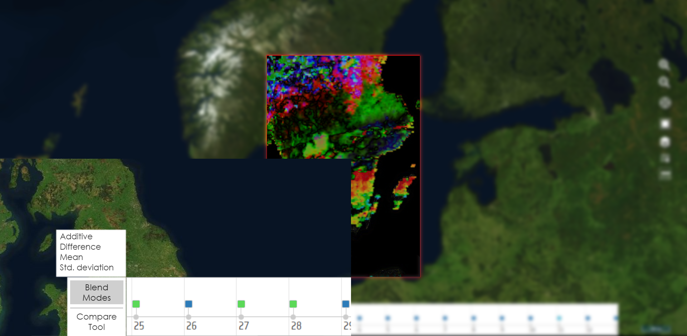
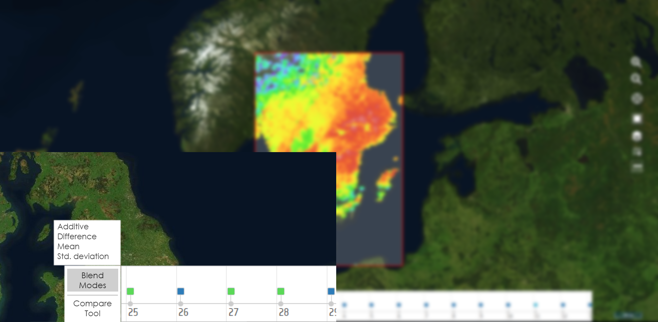
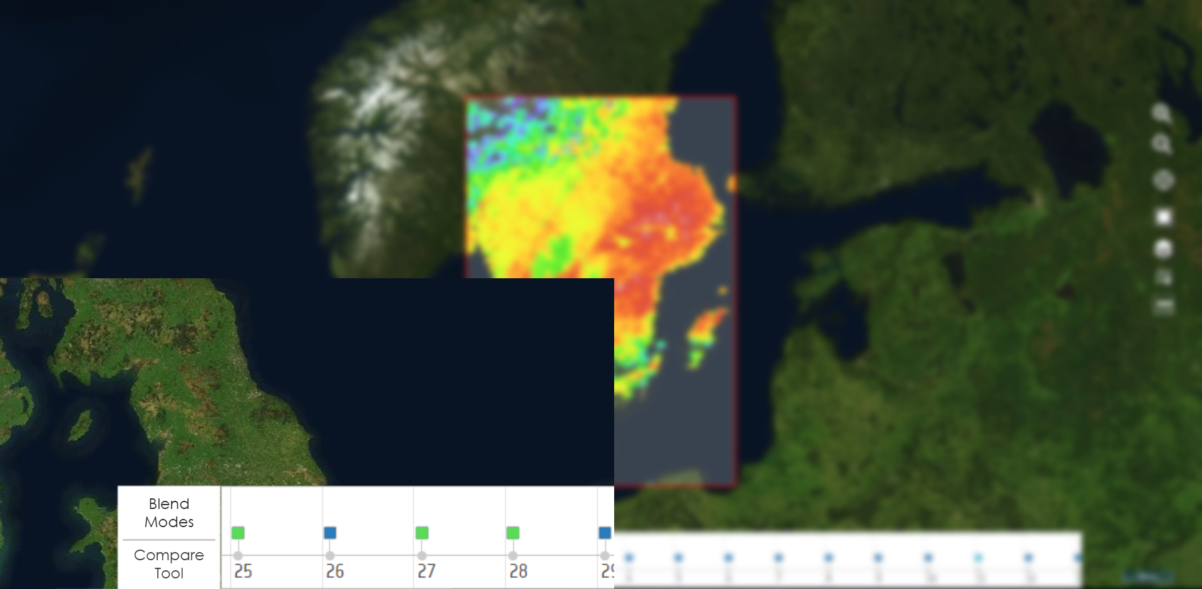
more features!
* MODIS land surface temperature
Blend Modes
Compare Slider

Slide 12
Thank you
Joakim.Adrup@esa.int

