Slide 1


Slide 2


Xin Zhang/ GEOGLAM Infrastructure
Institute of Remote Sensing and Digital Earth (RADI)
Chinese Academy of Sciences (CAS) , China
Email: zhangxin1010@radi.ac.cn

Slide 3
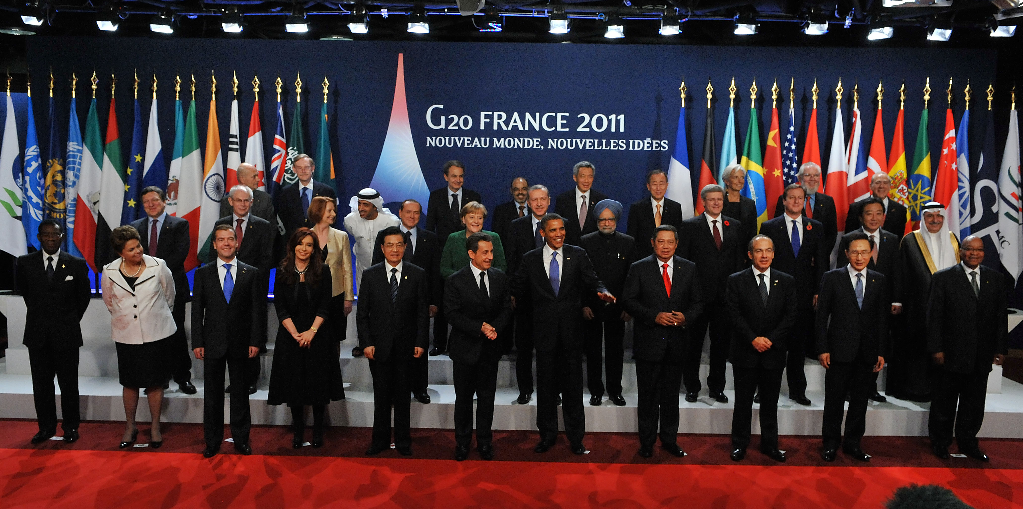
GEO Flagships / GEOGLAM Origins
GEOGLAM Origins: The G20 Policy Mandate
In 2011the G20 launched GEOGLAM as part of the action plan to reduce market volatility by improving information on crop conditions using Earth observations. The mandate has since expanded to address early warning for food insecure regions.

Slide 4
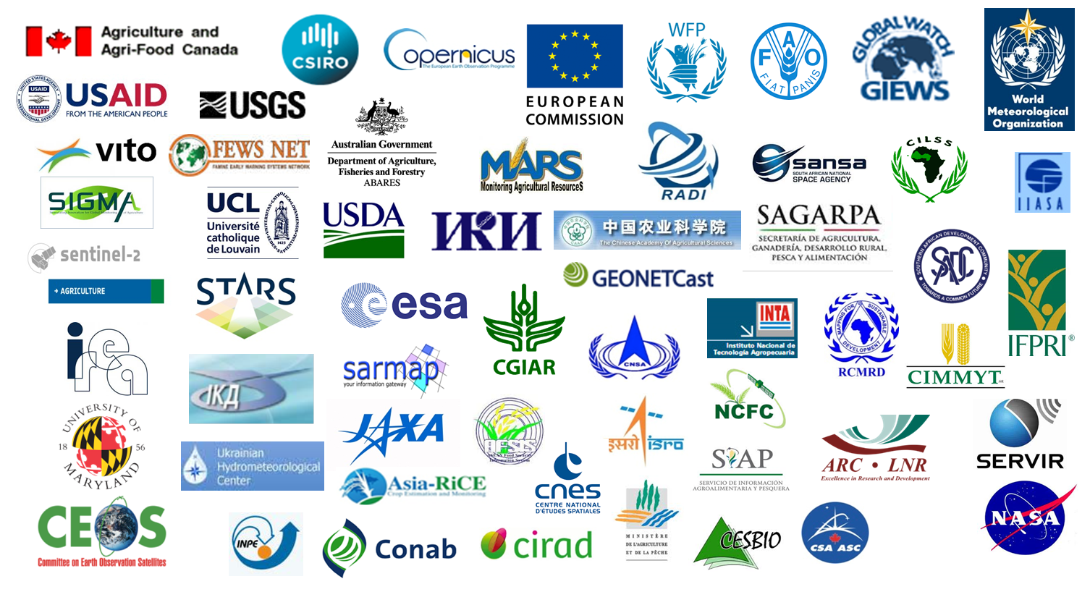
GEO Flagships / GEOGLAM Community
GEOGLAM is a Global Partnership
In 2017 there were 138 contributors from 62 organizations in 28 countries and 16 inter-governmental organizations actively participating in the GEOGLAM community
Participants in the Early Warning and AMIS Crop Monitors

Slide 5
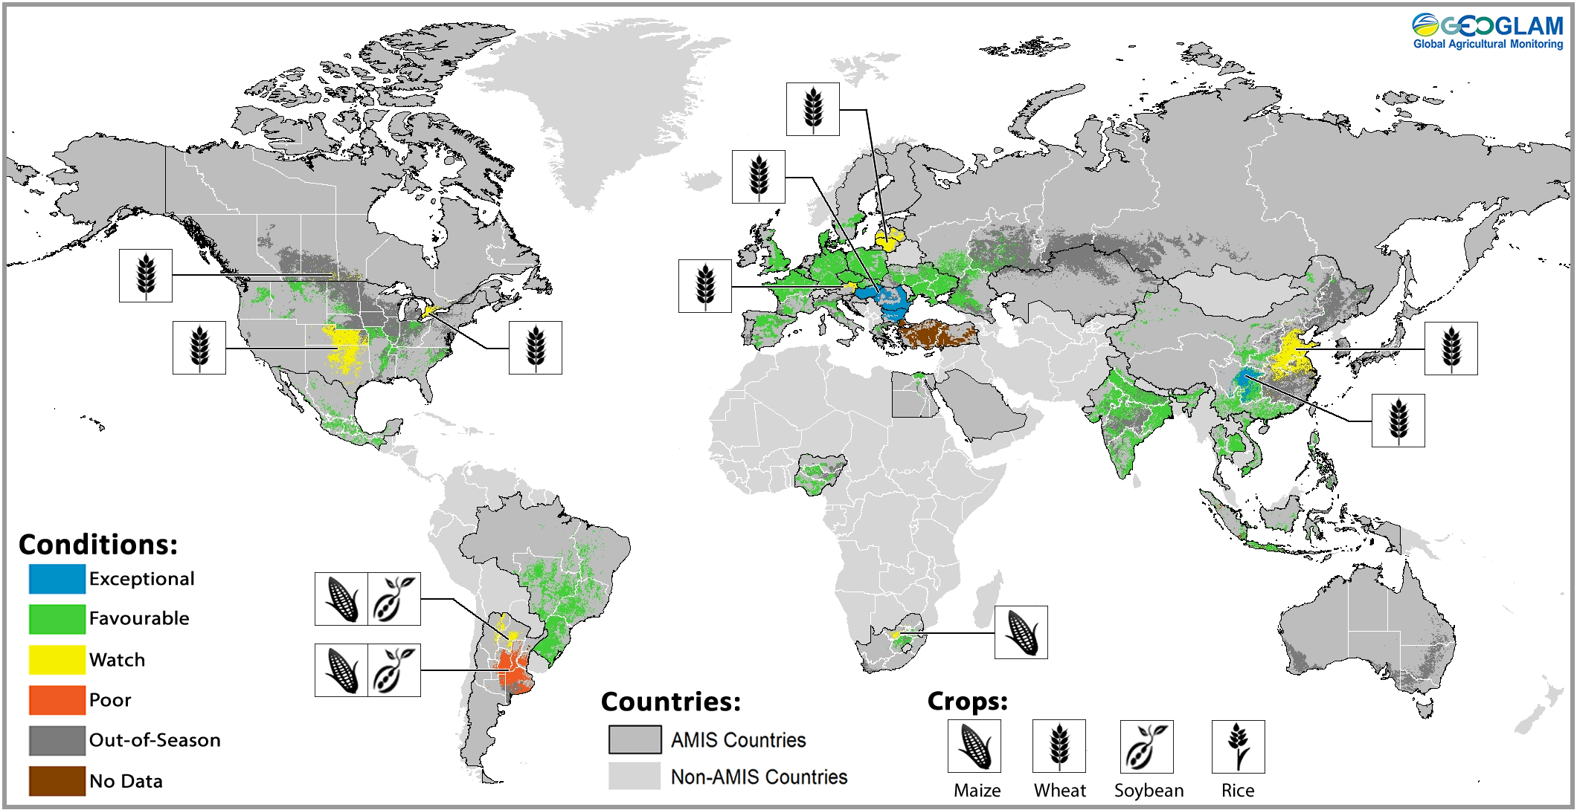
GEO Flagships / Global Monitoring in Support of Markets
March 28, 2018
Monitoring the Major
Crop Producers
Using Earth observations, and regional expertise GEOGLAM produces a monthly crop monitor for the Agricultural market Information System (AMIS). This Map represents over 80% of global production for the 4 major commodity crops

Slide 6
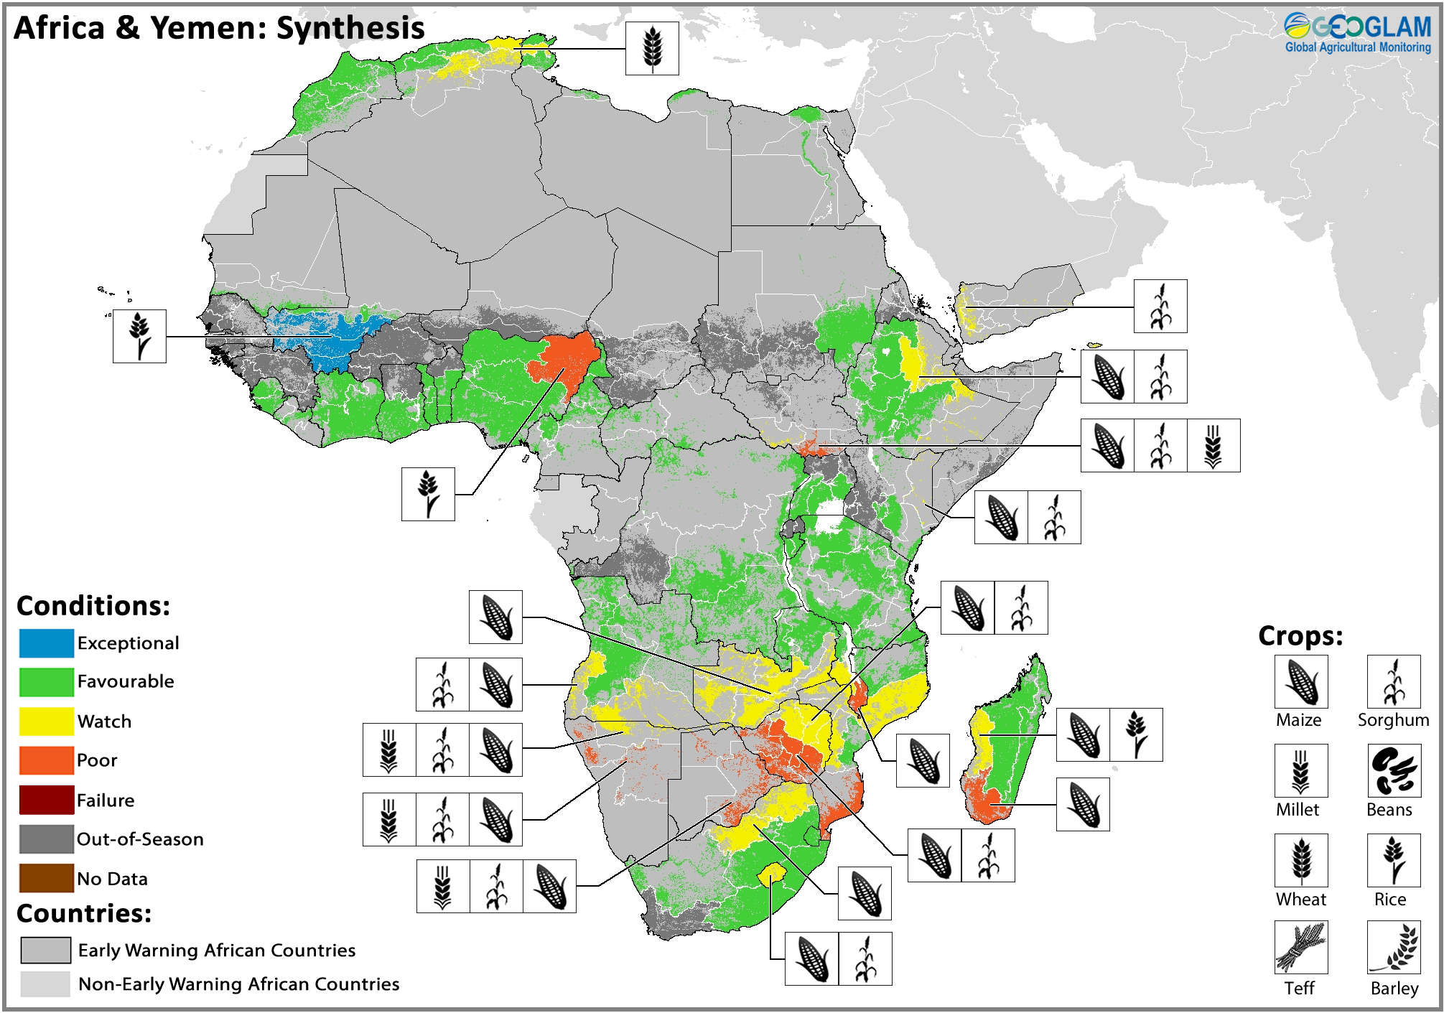




GEO Flagships / Global Monitoring for Food Security
User Community
Early Warning Crop Monitor
Beyond the major commodity crops, GEOGLAM monitors regionally important food crops monthly to provide early warning in regions susceptible to food insecurity
Conditions as of March 28, 2018

Slide 7

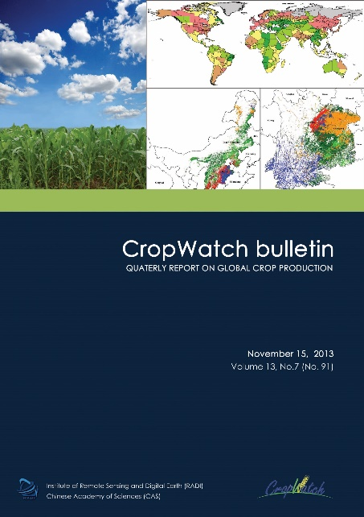
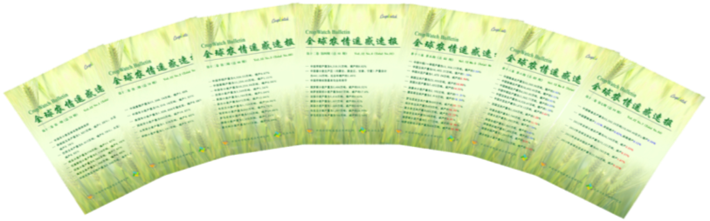
CropWatch® Development
Kick off in 1998
Release first bulletin in August, 1998
Improvement and development (18 Years)
  Monitoring China -> Global
  From manual judgment to quantitative monitoring
  From instant investigation to dynamic monitoring
  From after harvest measurement to early prediction. The crop production data can be available one month before its harvest.
CropWatch aims at improving food information availability, quality and transparency
CropWatch Bulletin

Slide 8
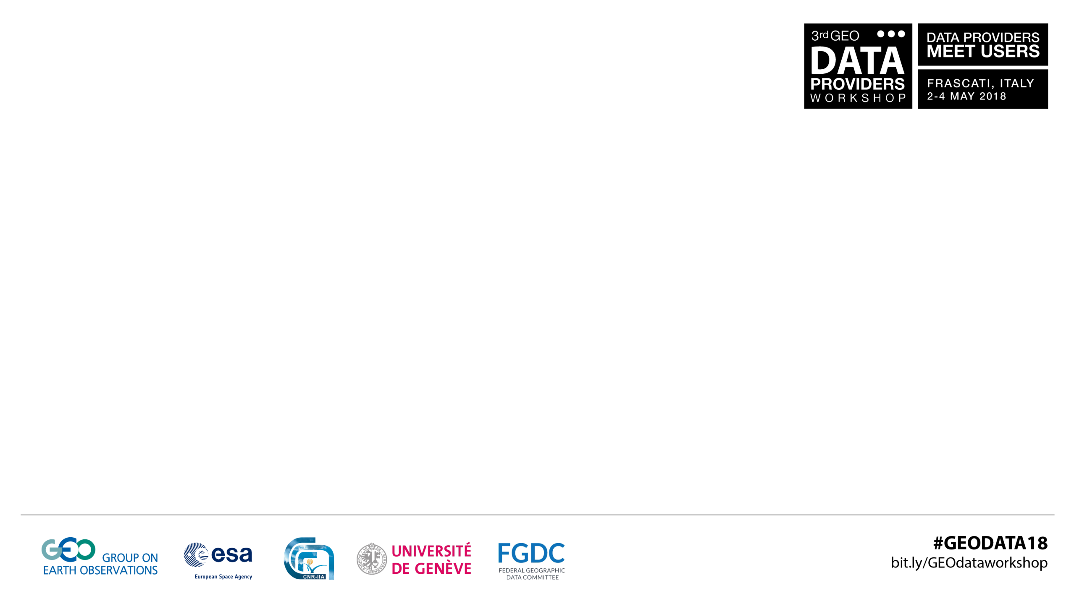
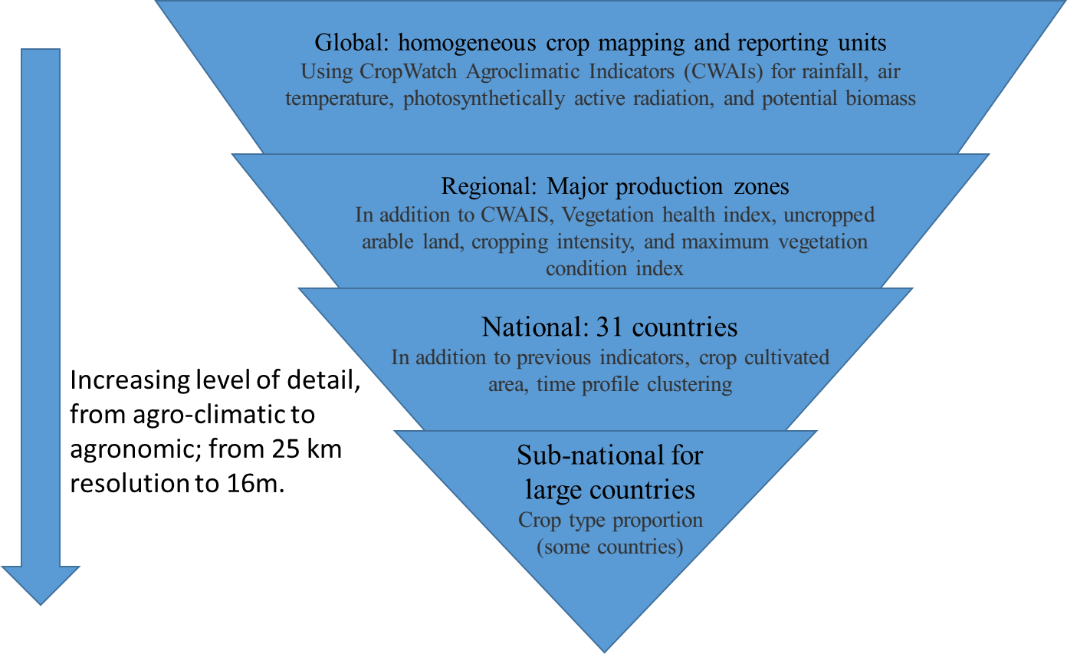
CropWatch Hierarchical approach

Slide 9
CropWatch Hierarchical Approach
CropWatch
  4 scales
    Covering 31 main crop producing countries
    Taking account of 80% of global production and exports
  4 temporal resolution
    16 Days: NDVI, Crop condition
    Seasonal：Agro-climatic indicators, CAL, VHI, VCIx
    Growing season：Area, Yield, Production
    Year: Cropping intensity
  4 spatial resolution
    0.25°(Global) (ECWMF reanalysis data)
    1km (7 MPZ, 31 countries, Sub countries) (MODIS)
    100m-250m China (PROBA-V, FENGYUN,MODIS)
    30m/16m main production regions in China (Landsat, Sentinel, Gaofen,Ziyuan)

Slide 10
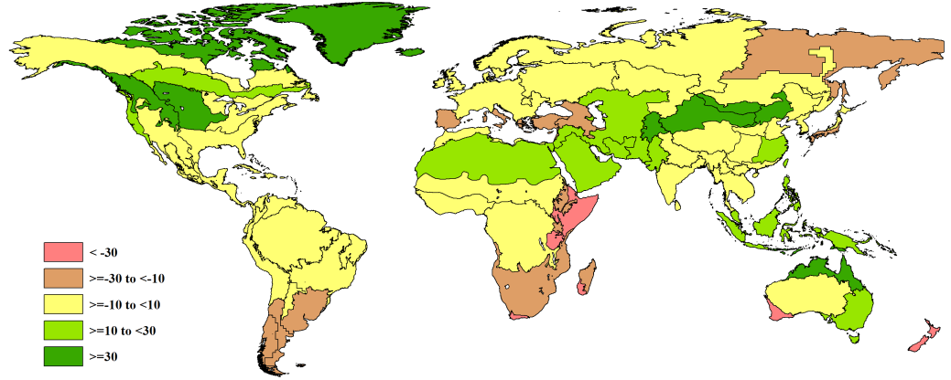
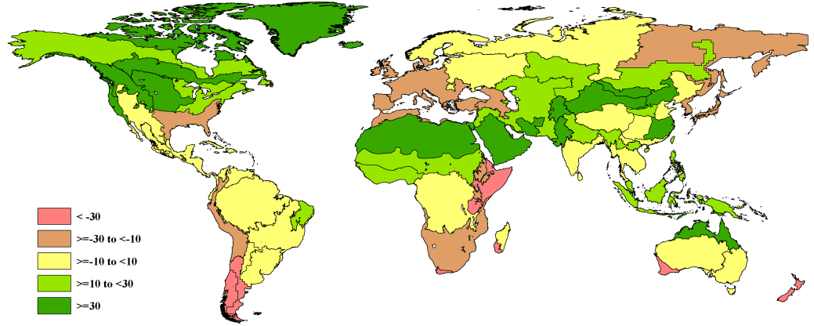

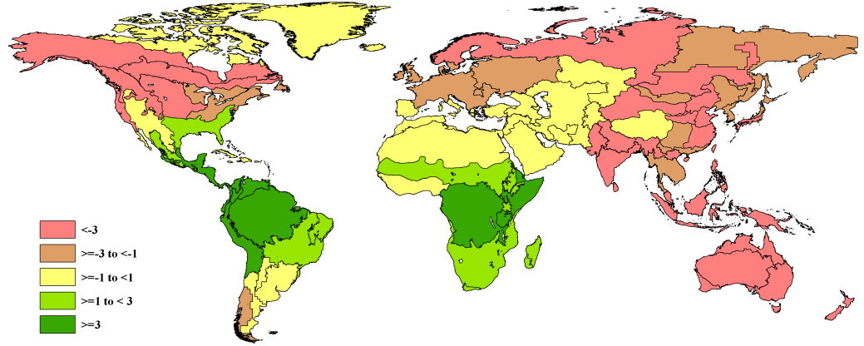
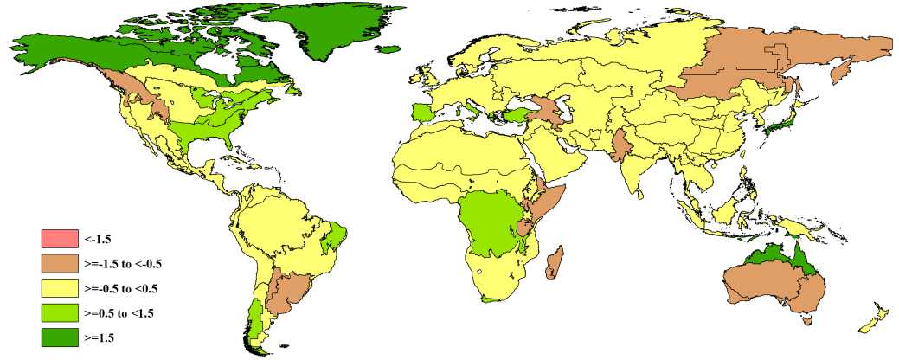
Global: 65 Monitoring and Reporting Units
PAR
TEMP
BIOMASS
RAIN

Slide 11
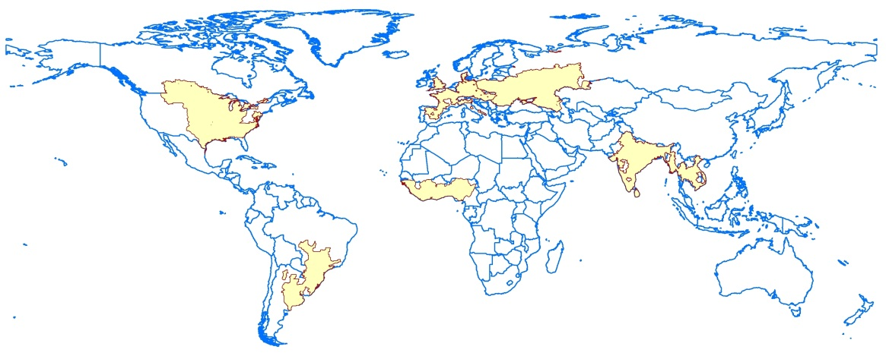
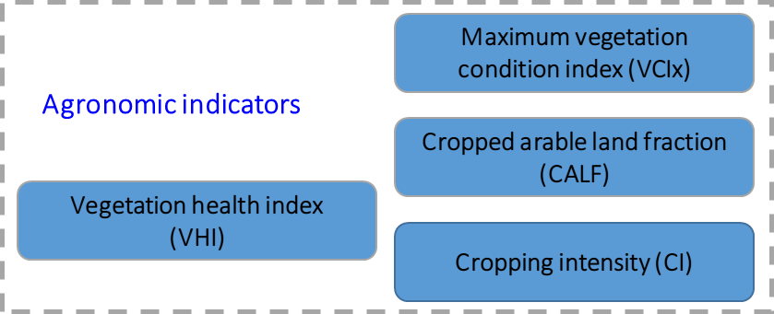
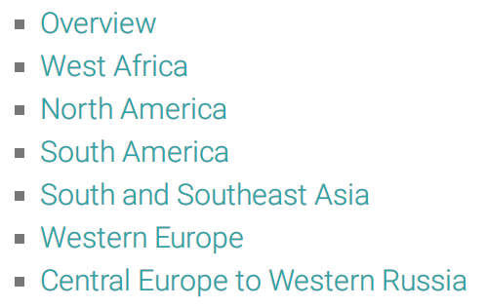
Regional: 6 Major production zones
Abnormal weather pattern by time series clustering

Slide 12
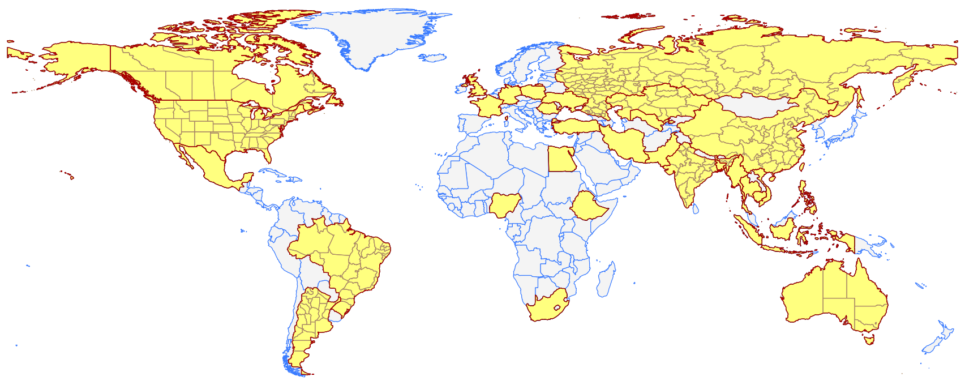
Country: 31 key producing countries
Covering at least 80 percent of global production and export of the major cereals and soybean
  Sub-national monitoring for 9 large countries

Slide 13




CropWatch Cloud System
Processing
Explore
Analysis
Bulletin
CropWatch Processing provides an online interface for people producing CropWatch indicators at anytime and anywhere from county to global scales.
CropWatch Explore provides a visualization web service for our users to smoothly explore CropWatch data including agro-climatic indicators, agronomic indicators related with crop area, crop yield and crop production.
CropWatch Analysis is cloud collaboration documentation tool for the CropWatch teams or invited people from over the world analyzing their CropWatch indicators anywhere.
CropWatch Bulletin publishes the CropWatch bulletin for each season, CropWatch updates for each month and global crop information on http://www.cropwatch.com.cn.

Slide 14
CropWatch-Processing

Slide 15
CropWatch-Processing
Pre-processing
Data conversion
Projection and transformation
Agro-meteorology
PAR
Agronomic indicator
CALF
Crop condition
Production Forecast
Vector to Raster
Merge
Clip
Resample
Band-combination
Spectral-merge
Temporal and spatial merge
Temperature
Rainfall
Biomass
CI
VCIx
VHI
NDVI development
Real Time development
Cluster
Yield
Area
Production
Enrich

Slide 16
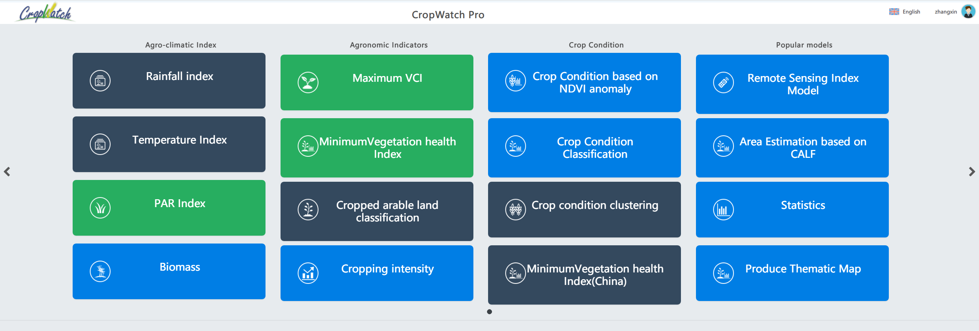
Easy to use interface
CropWatch-Processing

Slide 17
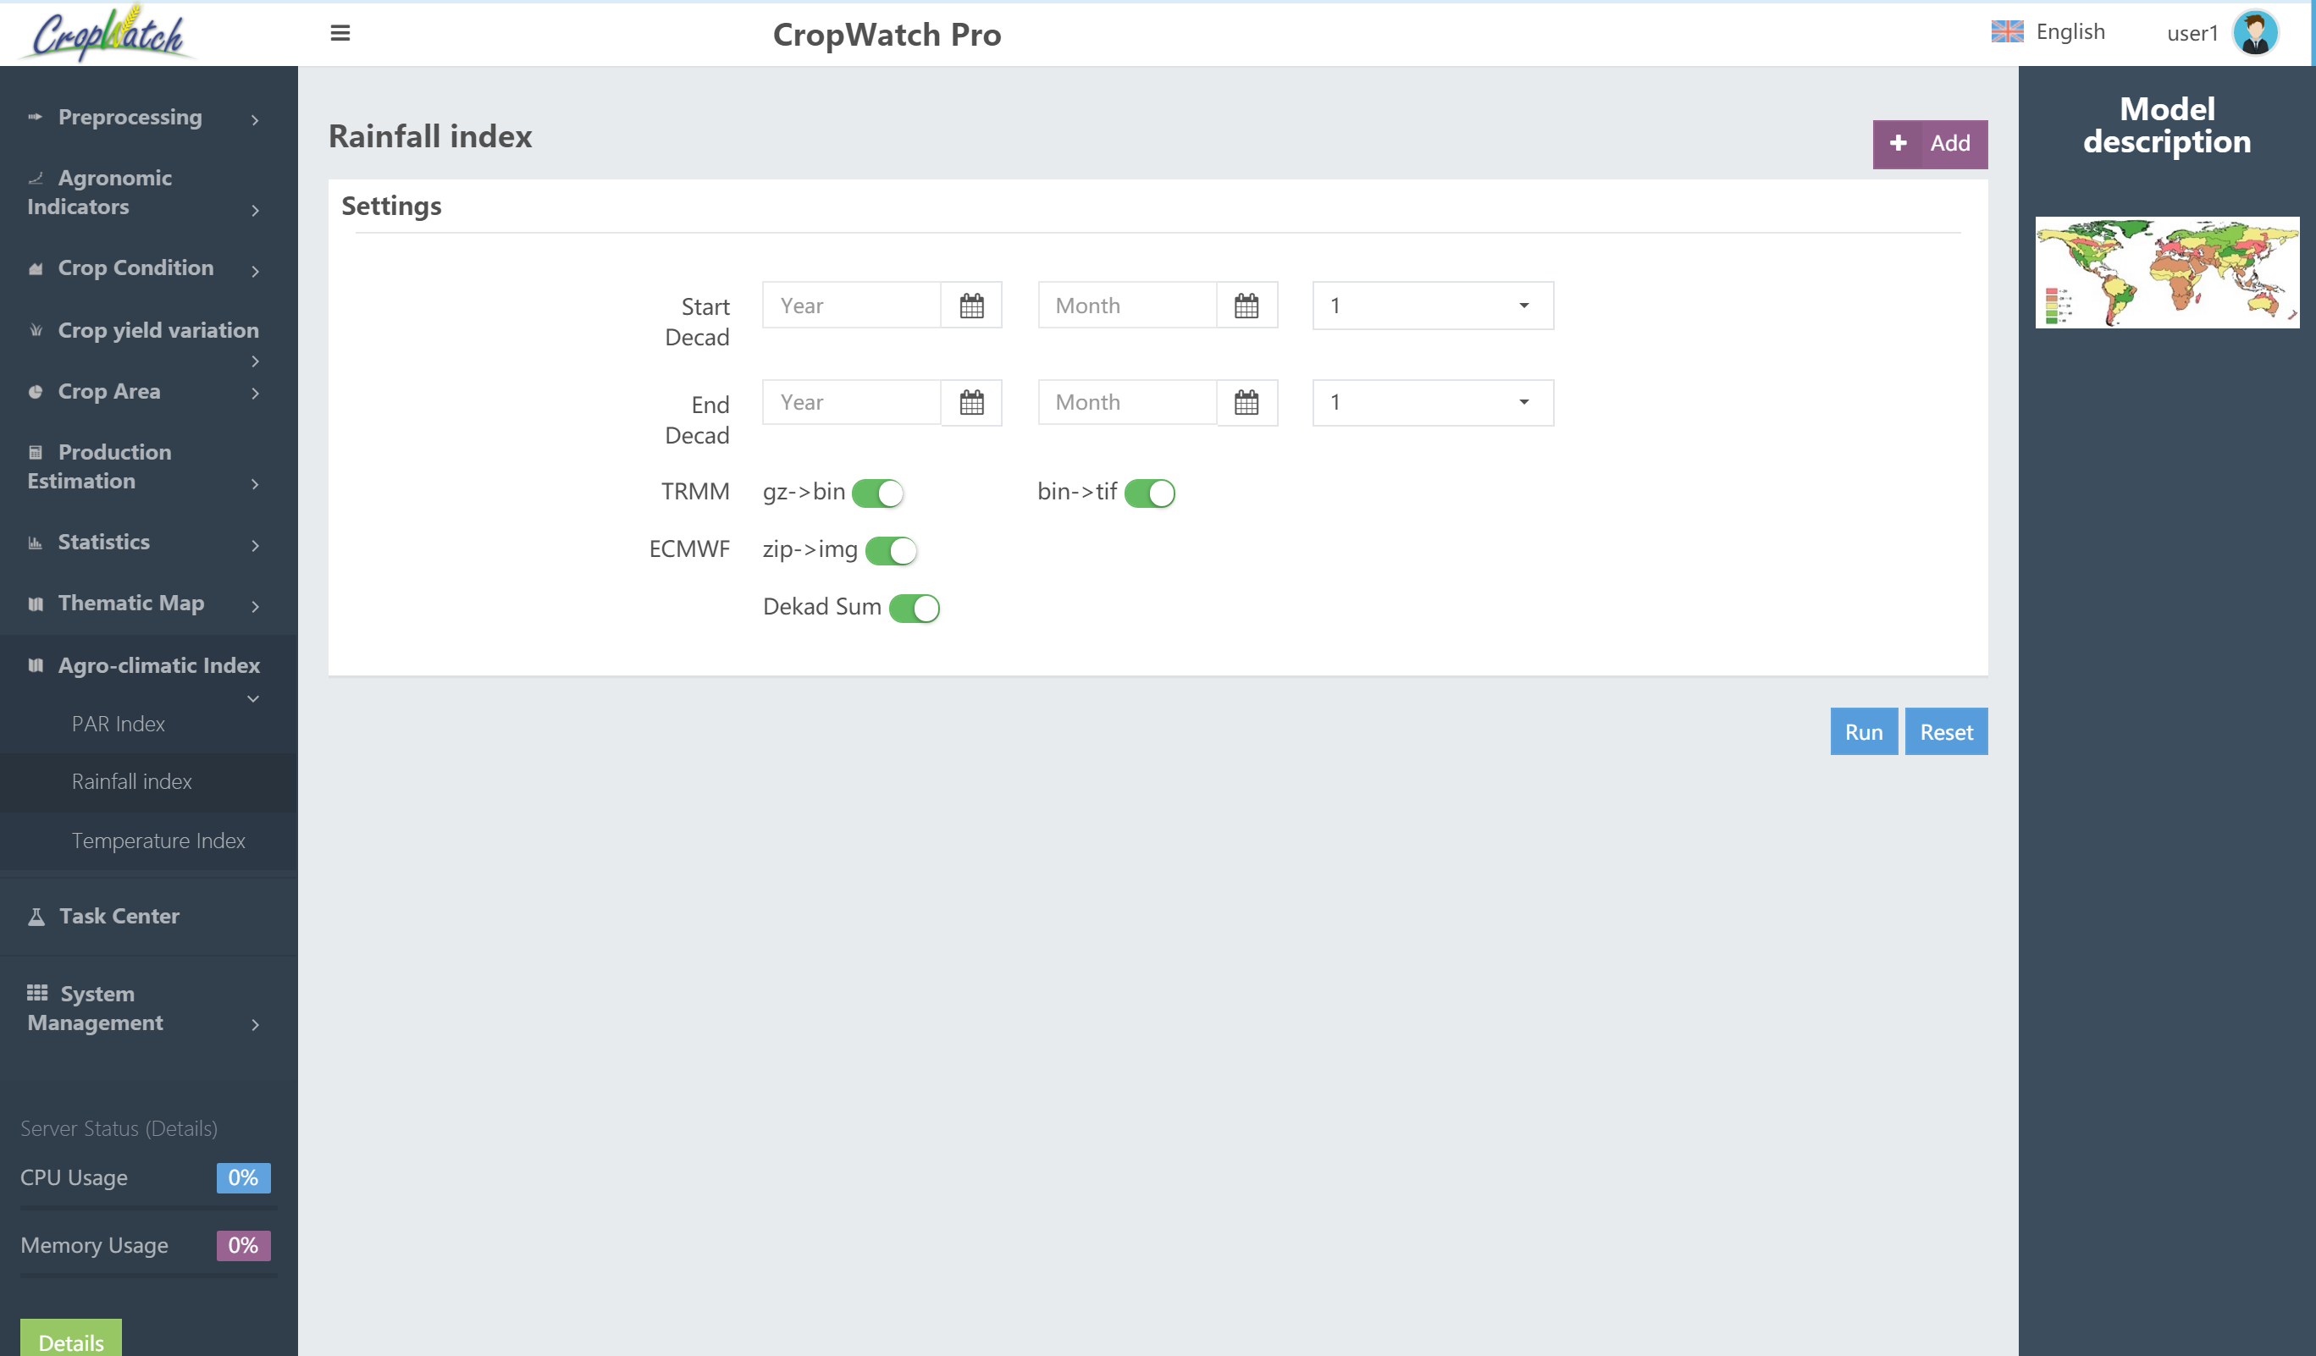
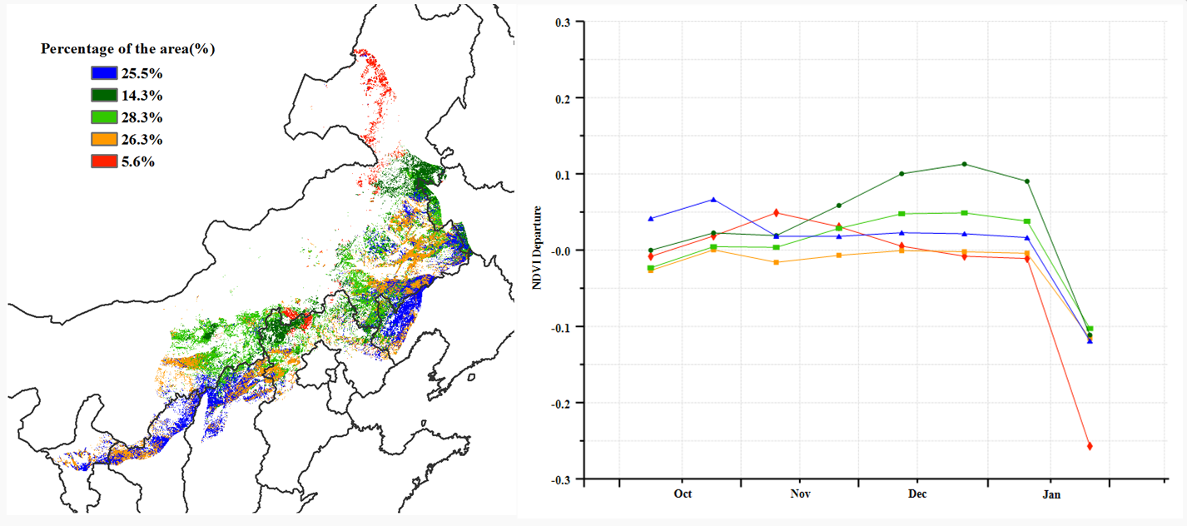
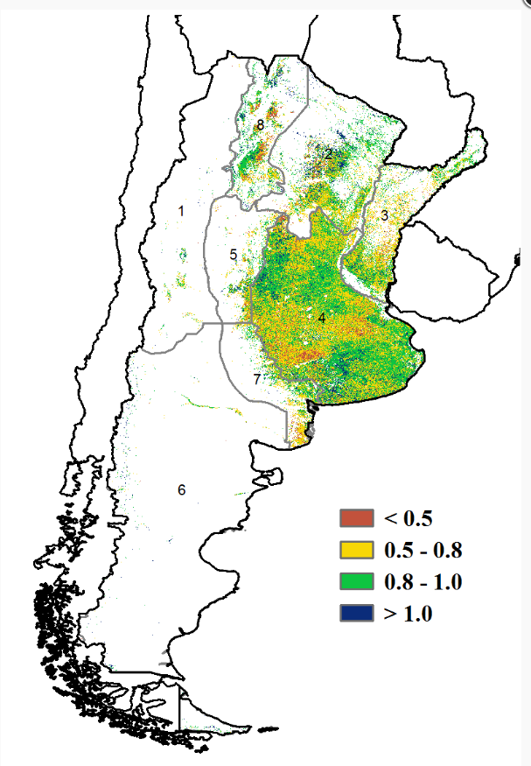
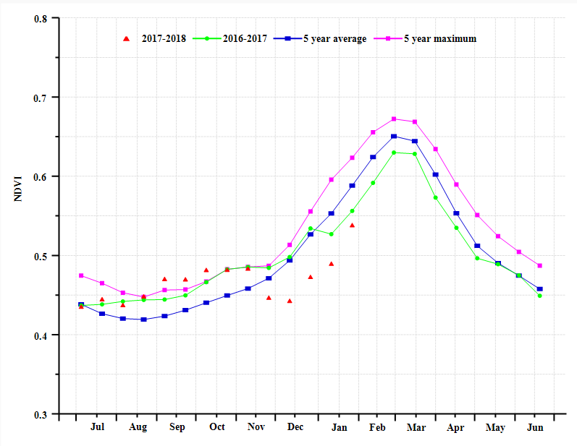
CropWatch-Processing

Slide 18
CropWatch-Explore

Slide 19
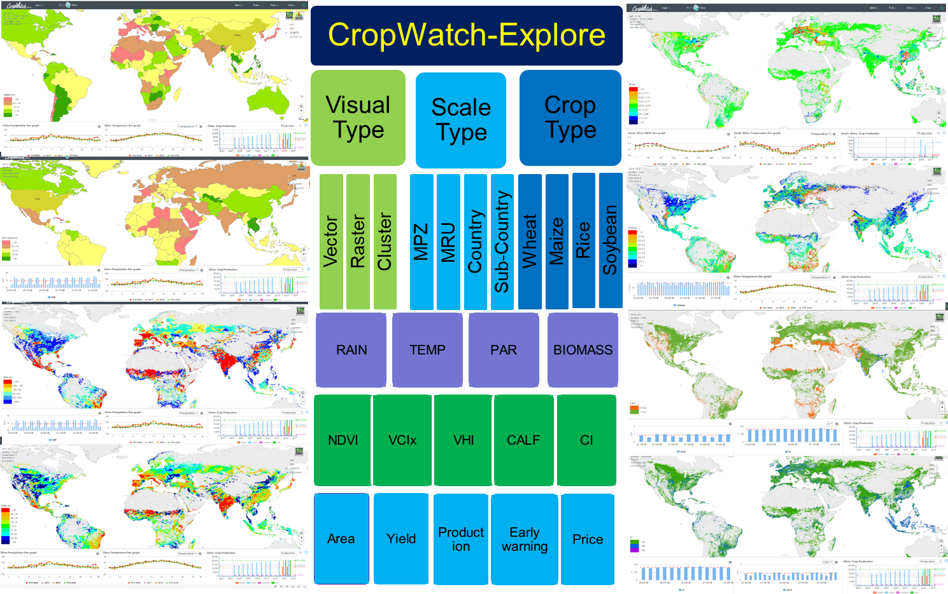
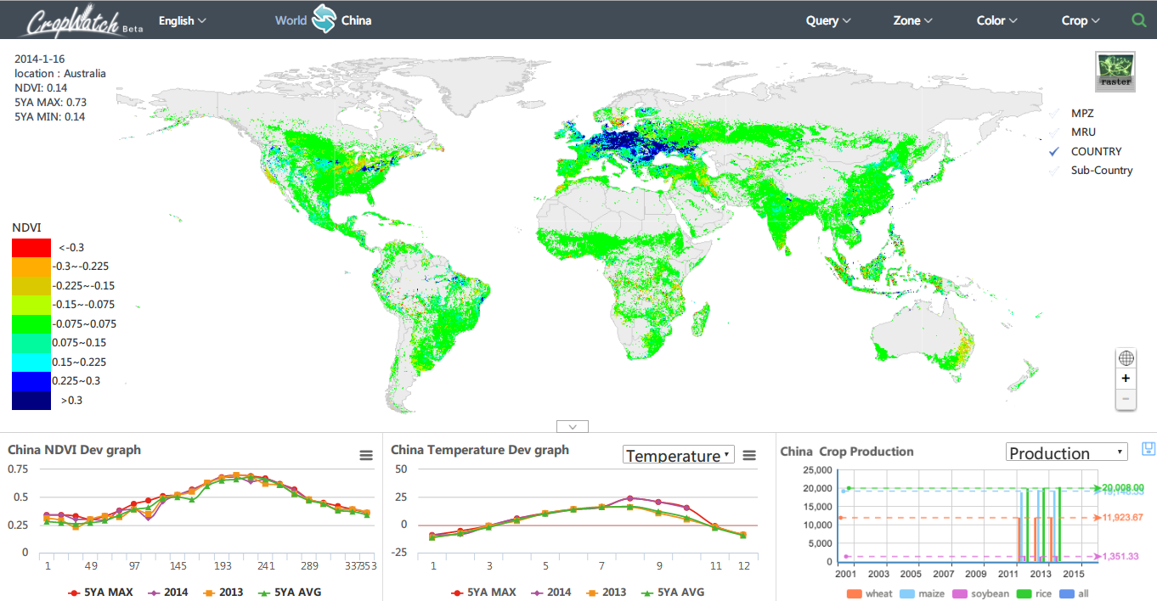
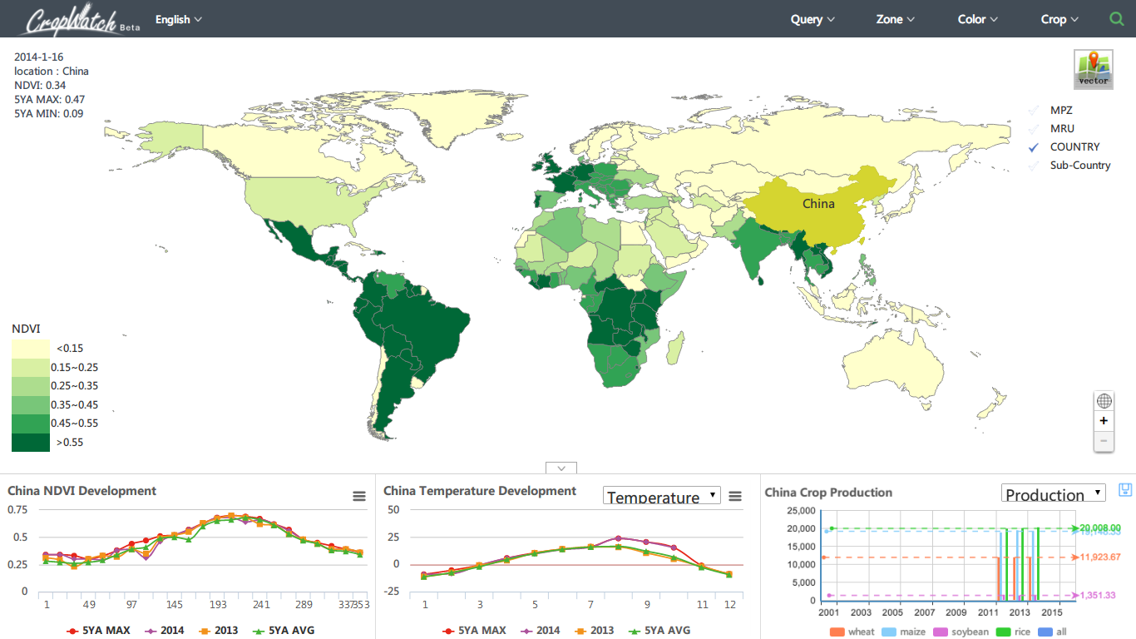
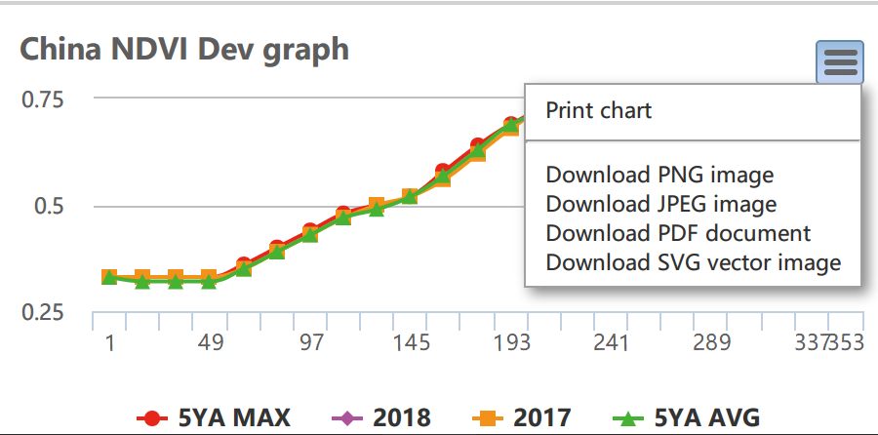
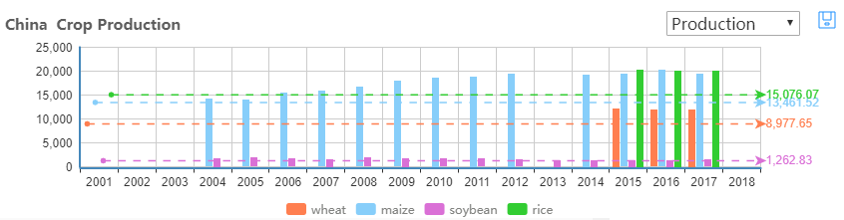
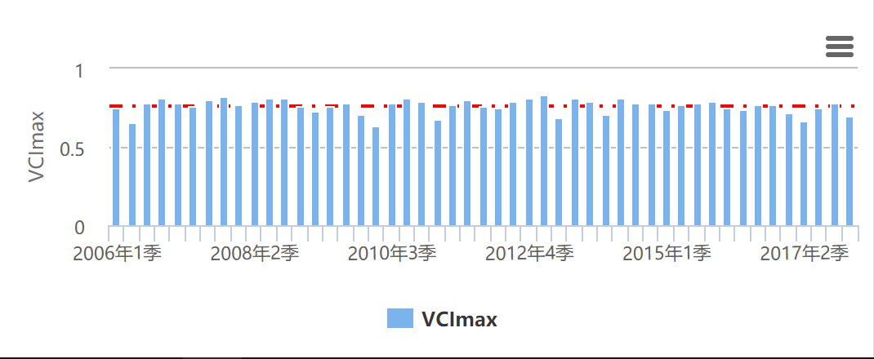
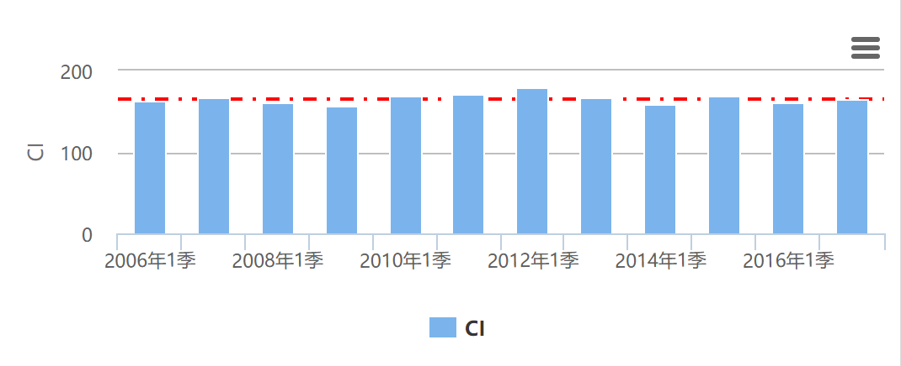
CropWatch-Explore
Webgis based interface
Statistical data by Vector mode
Spatial distribution information by Raster mode
Time series analysis by chart

Slide 20
CropWatch-Analysis

Slide 21


Easy to use interface
CropWatch-Analysis
CropWatch Analysis is cloud based group analyzing tool for the CropWatch teams or invited author all over the world.
Until February 2018 CropWatch bulletin (Vol. 18, No. 1)，37 colleagues from 9 countries and 4 teams from China have joined the Cropwatch analysis platform.

Slide 22
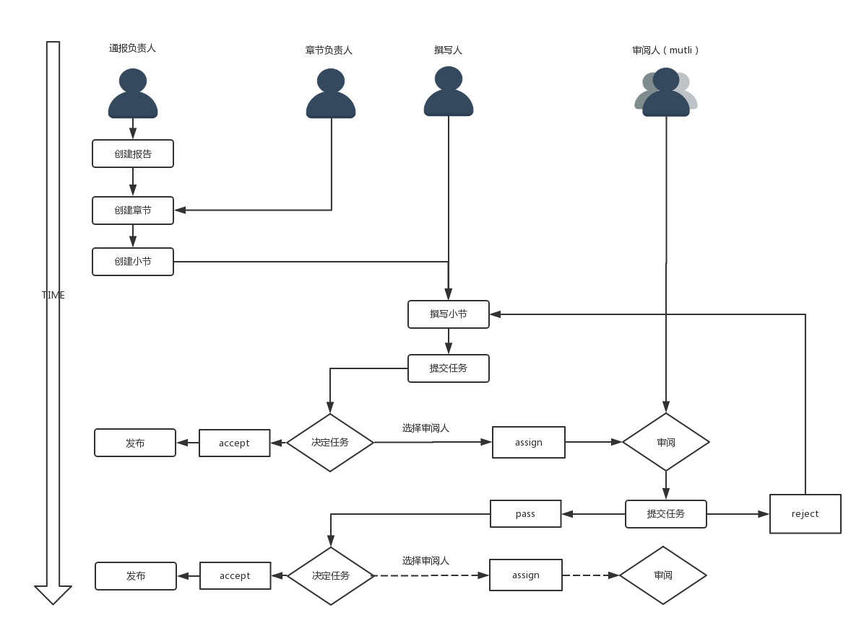
Custom your own Bulletin/Report
CropWatch-Analysis

Slide 23
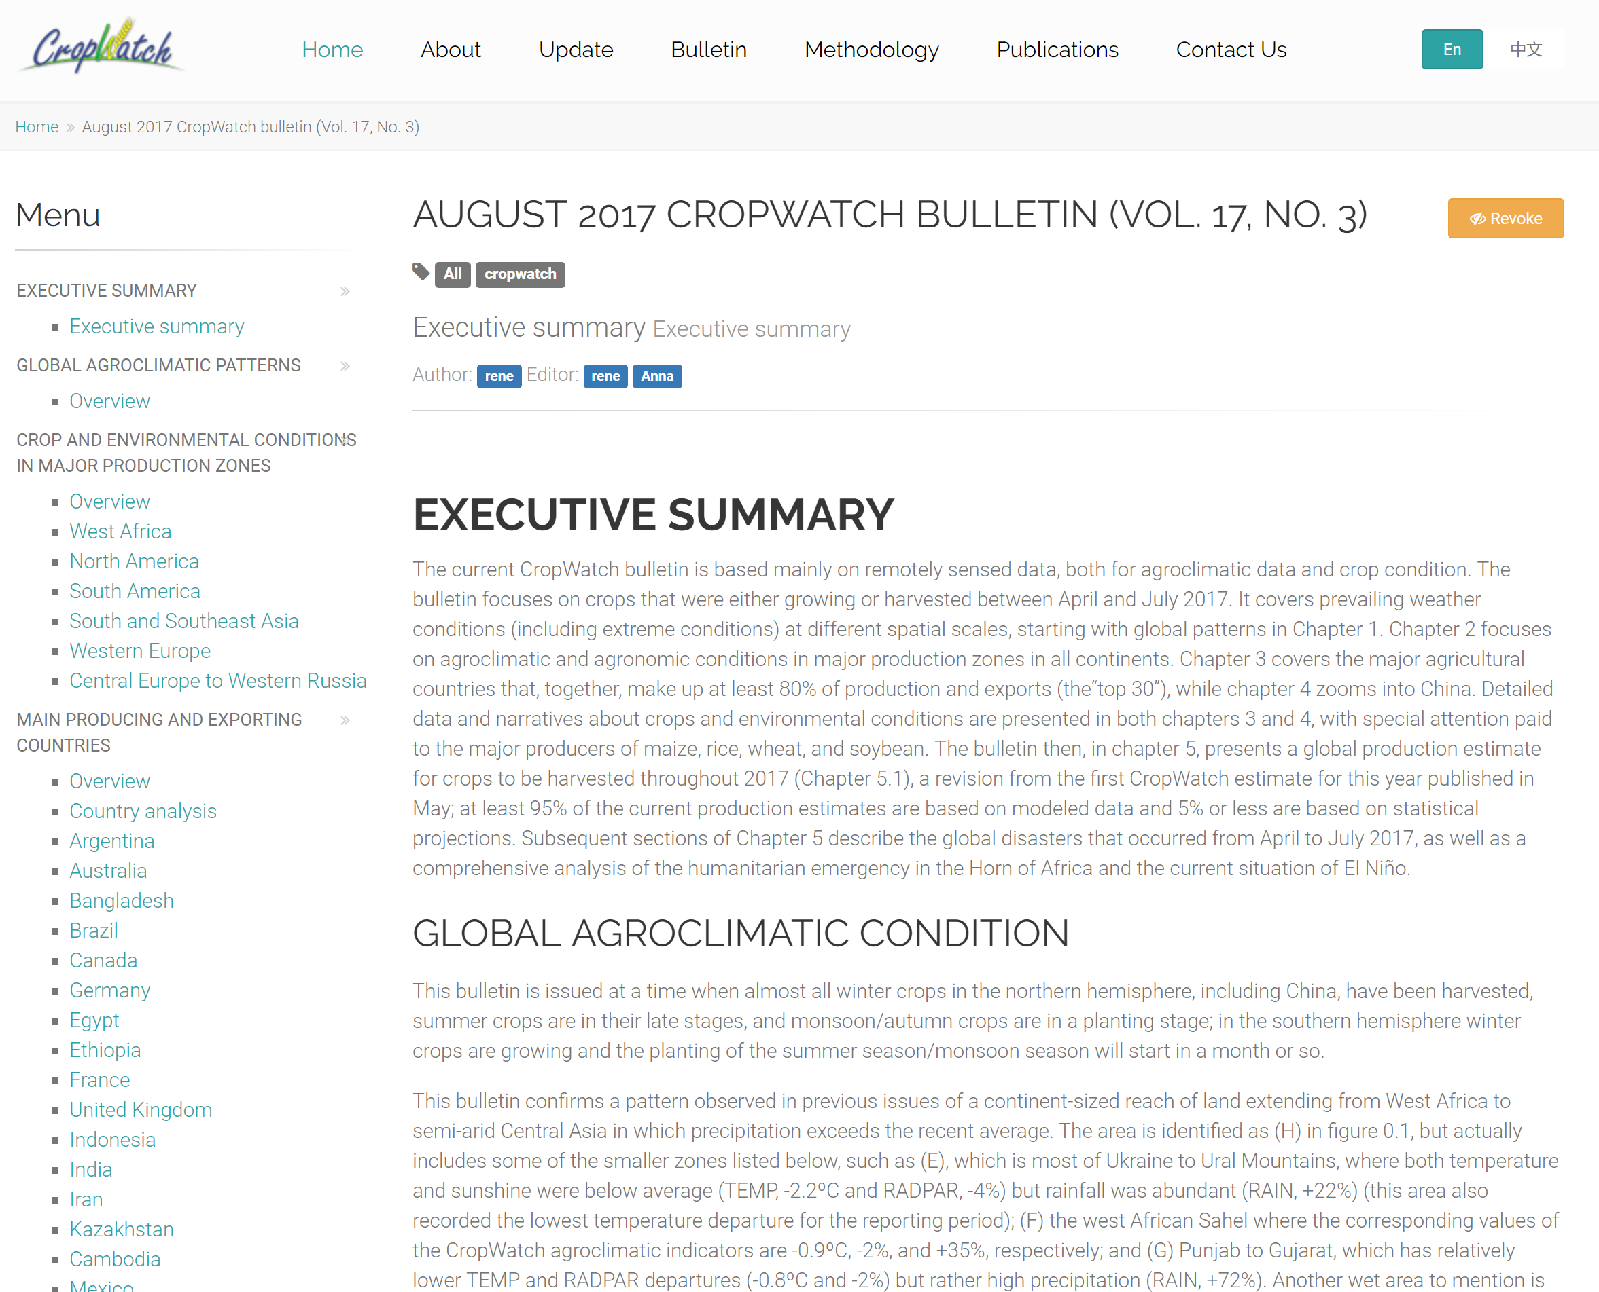
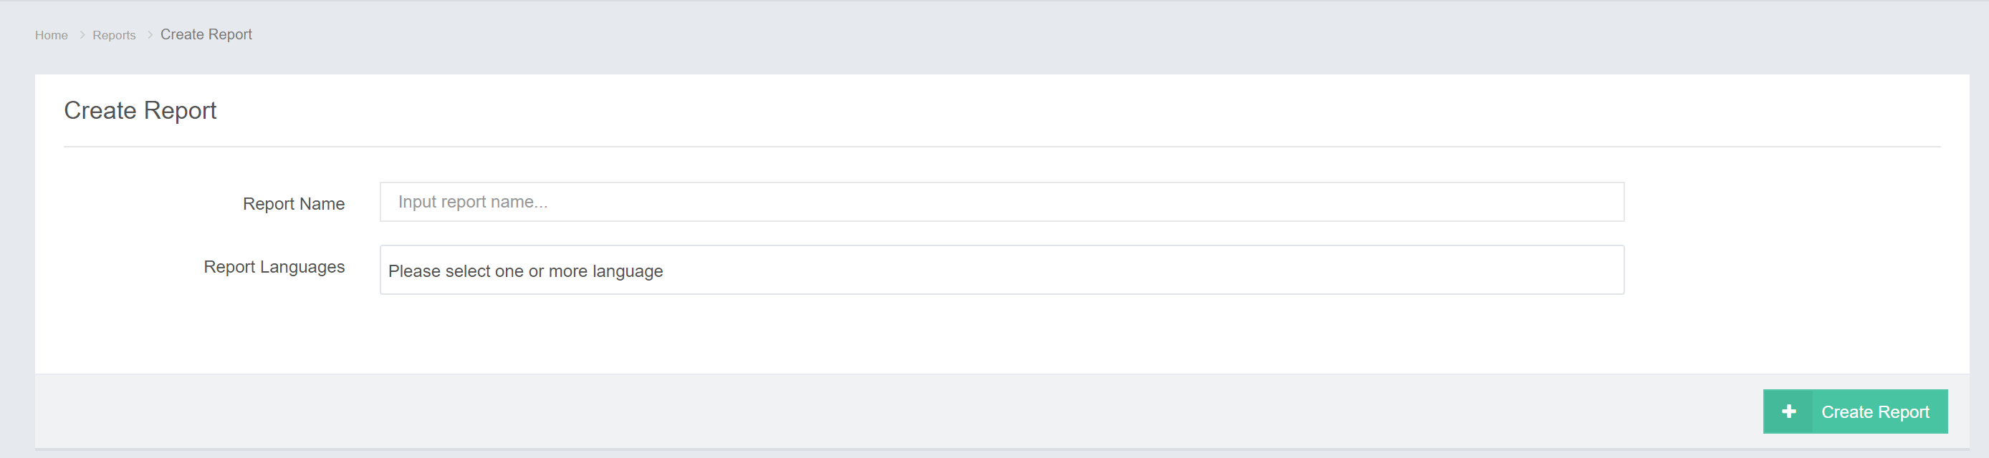
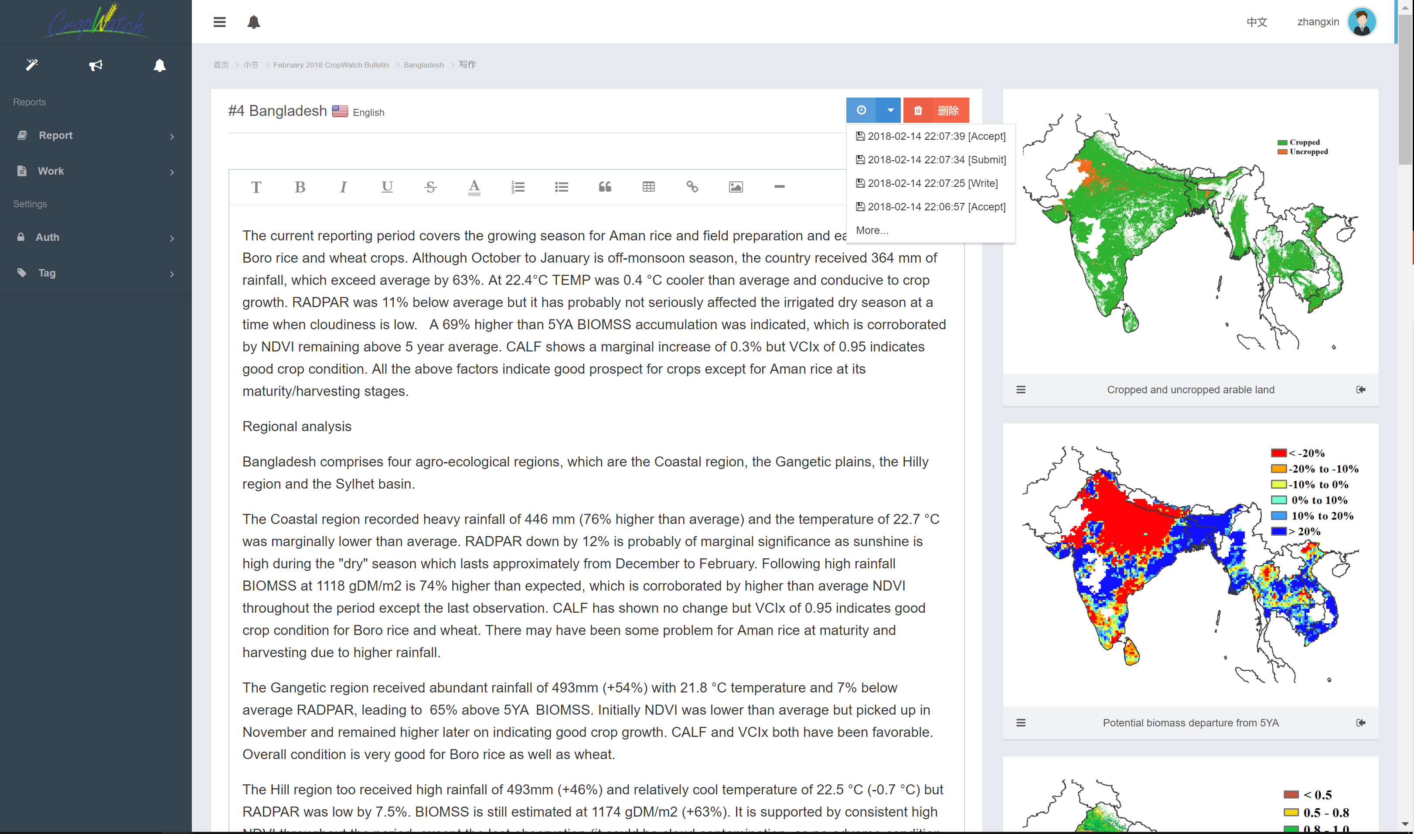
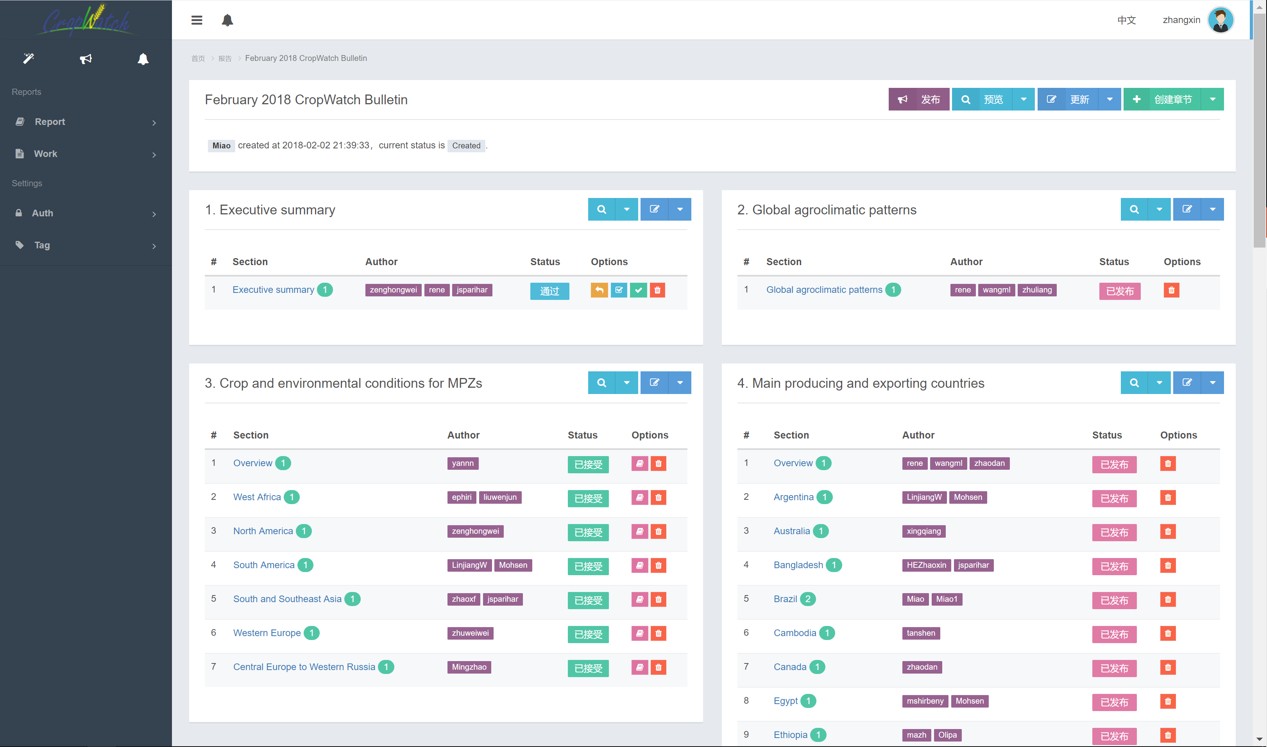
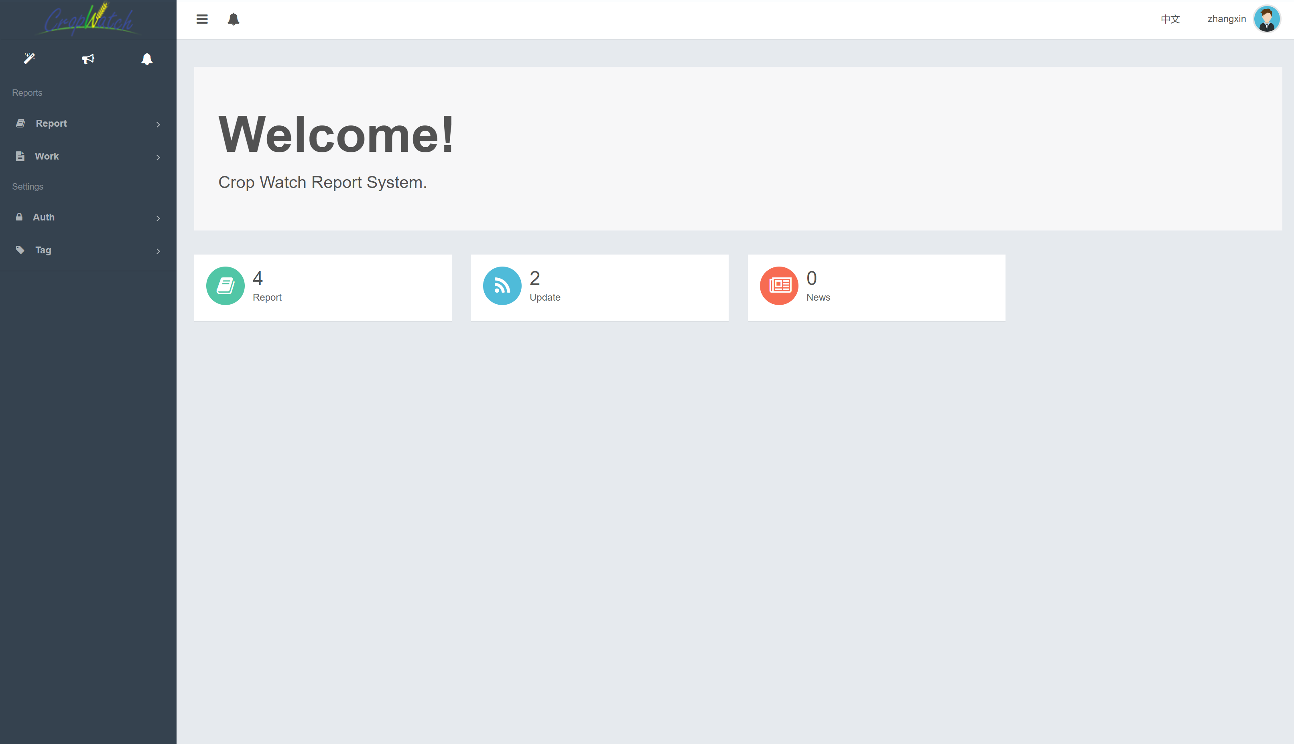
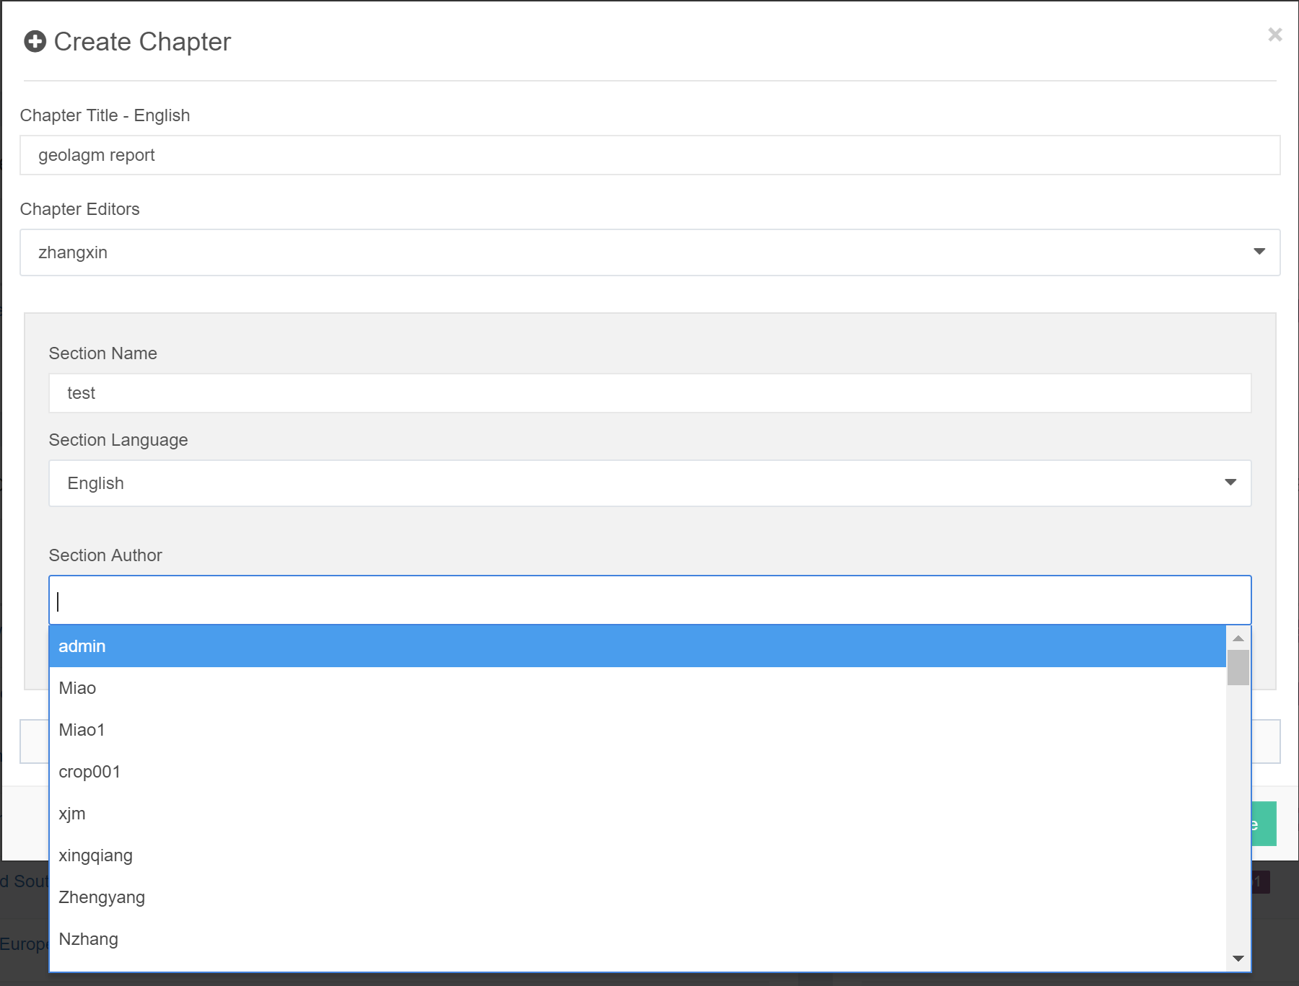
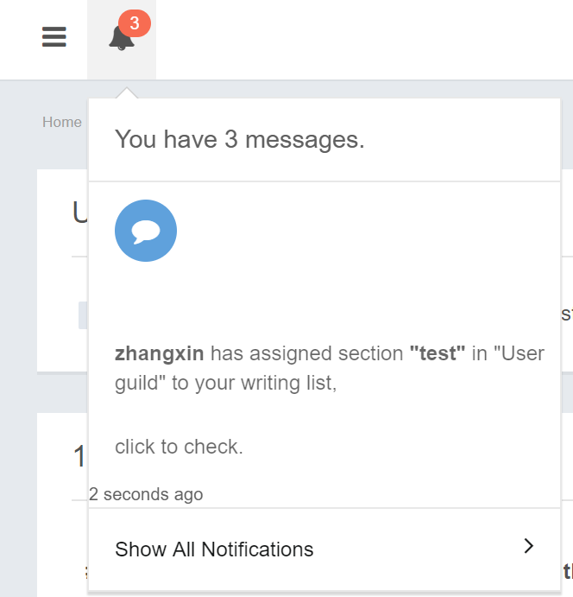
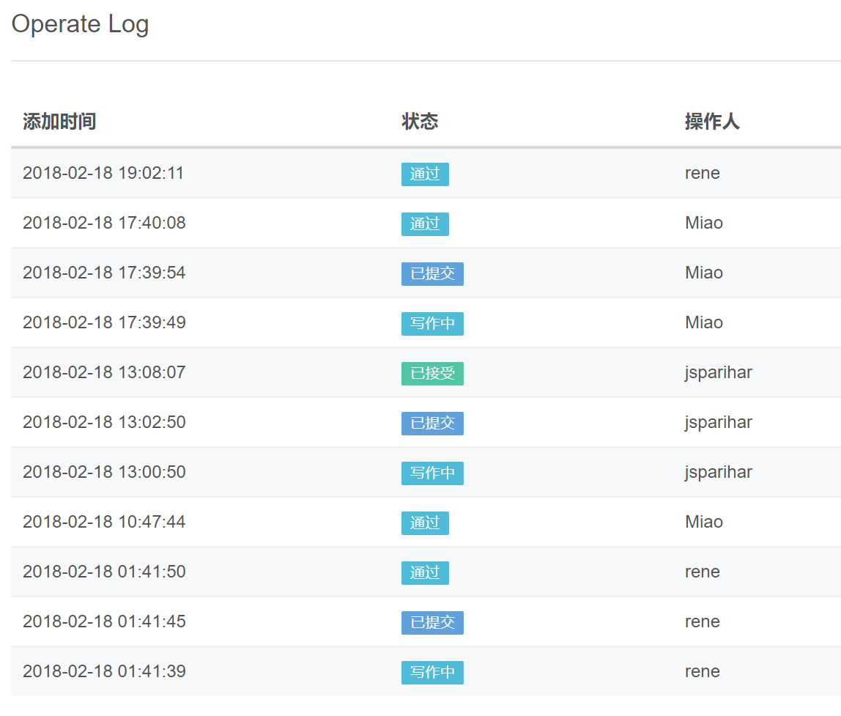
CropWatch-Analysis
Create customize collaborative bulletin/report
Create task/invite analyzer/reviewer
Import thematic figure and write analysis
Review/comments
Publish
Version & History control
Operation history

Slide 24









CropWatch-Future
Chart
Image
Table
Cropwatch – Mozambique
Cropwatch – Zambia
Cropwatch – ….
Data download
Data Processing
Database
Map
Advanced Processing
Customize

Slide 25
GEO Flagships / GEOSS Opportunities and Key Questions
GEOGLAM:
produces authoritative assessments of crop production>> Need to make these discoverable on the GEOSS platform
is a significant consumer of data>> Is there a role for GEOGLAM to broker linkages between the authoritative data sources and GEOSS?
is exploring the development of a Knowledge Management System to capture best practices for agricultural monitoring>> Is there a role for the platform to support the development of this capacity?
is a systems of systems (national, regional, global)>> Would the community benefit from the development of a GEOSS Mirror site to consolidate the system of systems?
We are Here to Learn…
GEOGLAM supports open access to data and makes the crop monitors available in near real time:
http://www.amis-outlook.org/amis-monitoring/crop-monitor/
https://cropmonitor.org/
https://cropwatch.com.cn/

Slide 26
Thank you
Xin Zhang/ GEOGLAM Infrastructure / RADI, CAS, China

