Slide 1
EOSC-hub contribution to the European Open Science Cloud
Tiziana Ferrari, EOSC-Hub Project Coordinator
3rd GEO Data Providers workshop, Frascati

Slide 2
Outline
The European Open Science Cloud
EOSC-hub and GEO DAB
EOSC implementation roadmap

Slide 3
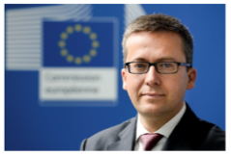
PART I
The European Open Science Cloud Vision
Credits: EC, DG-RTD
Europe’s virtual environment for all researchers
to store, manage, analyse and re-use data
for research, innovation and educational purposes

Slide 5
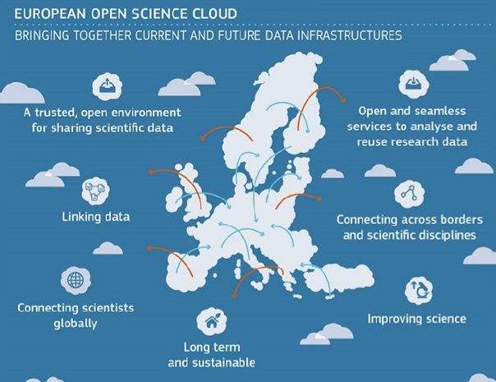
The vision
EOSC-hub project mission is to create the integration and service management structure of the European Open Science Cloud.
Start: Jan 2018, 36 months
Involves major European e-infrastructures and research infrastructures
The vision

Slide 6
PART II
The EOSC-hub Project
EOSC-hub mobilises providers from 20 major
digital research infrastructures, EGI, EUDAT CDI and INDIGO-DataCloud jointly offering services,
software and data for advanced data-driven
research and innovation

Slide 7
EOSC-hub Mission
The project will enable an open access to research resources from a myriad of scientific disciplines via a digital hub: an integration system of software and services from major European e-infrastructures and research infrastructures.
The hub will act as an
entry point for researchers and innovators to discover, access, and use a variety of advanced data-driven resources

Slide 8
The Project in numbers
European Commission Horizon2020 programme
100 Partners, 76 beneficiaries (75 funded)
3874 PMs, 108 FTEs, more than 200 technical and scientific staff involved
Budget: €33,331,18, contributed by:
European Commission: €30,000,000
EGI Foundation and its participants: €2,155,540
EGI participants: €1,221,094
36 months: Jan 2018 – Dec 2020

Slide 9
Service Providers
Service Providers
e-Infra
Humanities
Engineering
Medical and Health Sciences
Natural sciences
Physical Sciences
Astronomy (LOFAR)
Fusion (ITER)
High Energy Physics (CMS and VIRGO)
Space Science (EISCAT-3D)
Generic and general services
EGI Federation
Language and literature (CLARIN)
Environmental engineering (sea vessels, LNEC)
Biological Sciences (ELIXIR)
Earth Science
EO Pillar
GEO
Climate Research (ENES)
Seismology (ORFEUS, EPOS)
EUDAT CDI
Arts (DARIAH)
Civil Engineering (Disaster Mitigation)
Structural biology (WeNMR)
Biological Sciences
Marine and freshwater biology (IFREMER)
Biodiversity conservation (LifeWatch)
Ecology (ICOS)

Slide 10
Collaboration - Research infrastructures and communities
GEO
Current and future ESFRI Cluster Projects
Thematic clouds
eROSA, AGRINFRA+
Blue Cloud
Research collaborations
Virtual Research Environments
FAIR implementation guidelines
Discovery/Access to community specific scientific products (data, publications, software) through the EOSC-hub marketplace
technical innovation and co-design
Scaling up of data/compute infrastructure
AAI
...

Slide 11
PART II
Project contribution to “the Hub”
An open set of process, policies and support tools for EOSC onboarding of providers and end-users and the human resources to run it

Slide 12
The Hub
A European-level contact point for researchers and innovators to discover, access, use and reuse a broad spectrum of resources for advanced data-driven research.
Through the virtual access mechanism, more scientific communities and users have access to services supporting their scientific discovery and collaboration across disciplinary and geographical boundaries.
Open to service providers and end-users
The project will support the integration new thematic services and scientific products from research communities and disciplines.

Slide 13
Value proposition
Publish services and products
Define Hub policies and comply to these (general & community-specific) → community labels
e.g. FAIR best practices, access and usage policies, interoperability and standards
Define/Adopt standard-compliant general service management processes with other providers
Exploit tools and for service management
Accounting, monitoring, federated AAI
Incident management, order management, SLA management, IT security management …
Providers
Use institutional credentials for access
Discover, compare
Order, get access and support
Request additional services and products
End-users

Slide 14
Hub service management system
Manage alignment of services to defined policies and standards
Align services and products metadata to community guidelines (eInfraCentral, OpenAIRE-Advance)
Define/maintain/review service level agreements
Conduct service audits and quality assurance reviews
Manage end-to-end service level management performance retaining overall accountability
Provide the tools for aggregating demand and supply, make services and research artifacts discoverable and accessible at European level etc.
Coordinate IT security operations
Support users with incident management

Slide 15
Marketplace functions
Promote and share
Discover
Order
Access

Slide 16
Marketplace
Open catalogue of services and products
Integrated discovery, order & access management
Service options
Service provider branding
Integrated with AAI (eduGAIN, social IDs, IGTF, etc.)
AARC blueprint conformance
First release: July 2018
https://marketplace.eosc-hub.eu/
Professional services
Compute
Thematic services
Storage & Data
Platforms
Identity & Security

Slide 17
Milestones
Feb 2019 Majority of Service Management System completed
Dec 2018 Consistent monitoring of all EOSC-Hub services
Nov 2018: Accounting and monitoring of all general services Integrated Helpdesk system
July 2018: Order general services through the EOSC-Hub Marketplace
May 2018: General services accessible through federated AAI (B2ACCESS and Check-In)
Service portfolio management process

Slide 18
Contribution to the EOSC implementation
Architecture
Federating Core
General and Thematic services
Service management system (process and policies)
Data
Data products
Data analytics tools
FAIR guidelines from participating communities
Services
AAI, accounting, monitoring
Helpdesk
Service catalogue
Access and Interfaces
Marketplace
AAI
Standards roadmap
Rules
Policies for users
Policies for service/product suppliers
Governance
Service Management System Governance

Slide 19
Engage with the Hub!
Service/Product providers
Contribute to the catalogue & Integrate
Promote, Train, Exploit
Manage the Hub
Early adopters
Pilot
Use
Co-develop
Consumers
Credit allocation & exploit
Support
Improve with feedback
technical support, exploit

Slide 20
EOSC-hub and GEO DAB
Explore the integration of the GEOSS Common Infrastructure within EOSC via the GEO DAB
access via open APIs the virtual IaaS and PaaS provided by EOSC-hub through EGI
EGI Federated Cloud: to access computing and storage resources currently not available to end-users, who currently need to procure and manager their own compute infrastructure for data exploitation;
EGI Data Hub for advanced data management services and “Cloud Workload optimisation”.
EGI Core Infrastructure platform services (e.g. monitoring, AAI, etc.).

Slide 21
The EGI Cloud Federation
Pan-European cloud federation for research
Multi-cloud IaaS with Single Sign-On (via EGI “Check-In”)
Technology agnostic, supports OpenStack, OpenNebula and Synnefo
Extra features
Virtual Appliance catalogue
Unified GUI dashboard
Centralised accounting
Resource discovery
SLA monitoring
➔ Bring compute to distributed data!
Cloud
Compute
Cloud Container
Compute
Online
Storage
AoD
Training
Infrastructure

Slide 22
An Open Infrastructure
20 resource centres
15 OpenStack
4 OpenNebula
1 Synnefo
5 centres under integration
2 centres expressed interest on joining

Slide 23
Architecture
Lighter federation (Q4 2018)
Minimise interference with providers operations
Use orchestration tools to deal with heterogeneity
EGI AAI
Community Platforms
AppDB VMOps
IaaS Federated Access Tools
IaaS Federated Access Tools
IaaS API
IaaS API
IaaS API
Cloud Management Framework
Cloud Management Framework
Cloud Management Framework
EGI Federation services:
Accounting, Monitoring, Configuration Database, Information Discovery, VM Marketplace

Slide 24
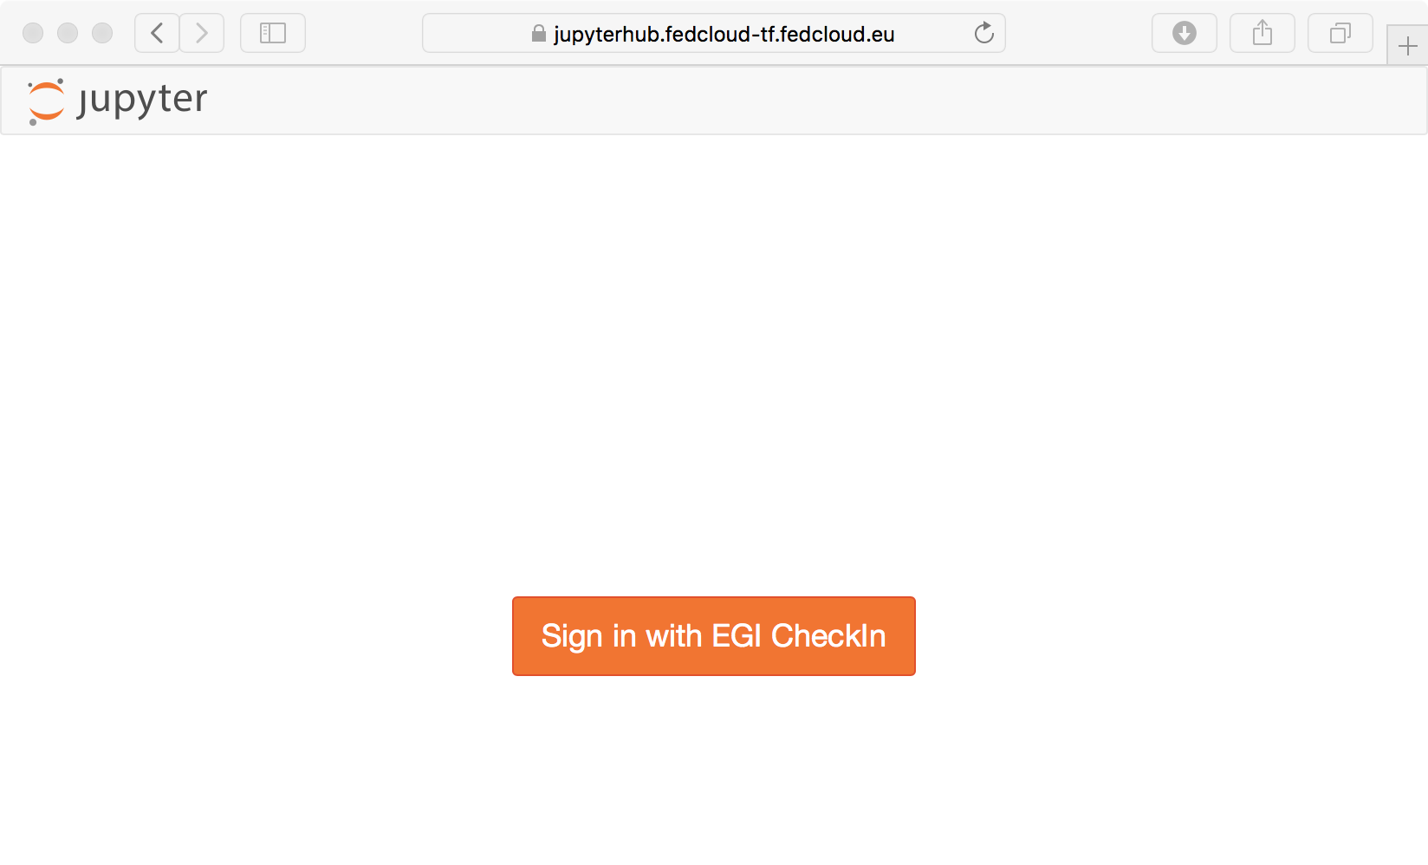
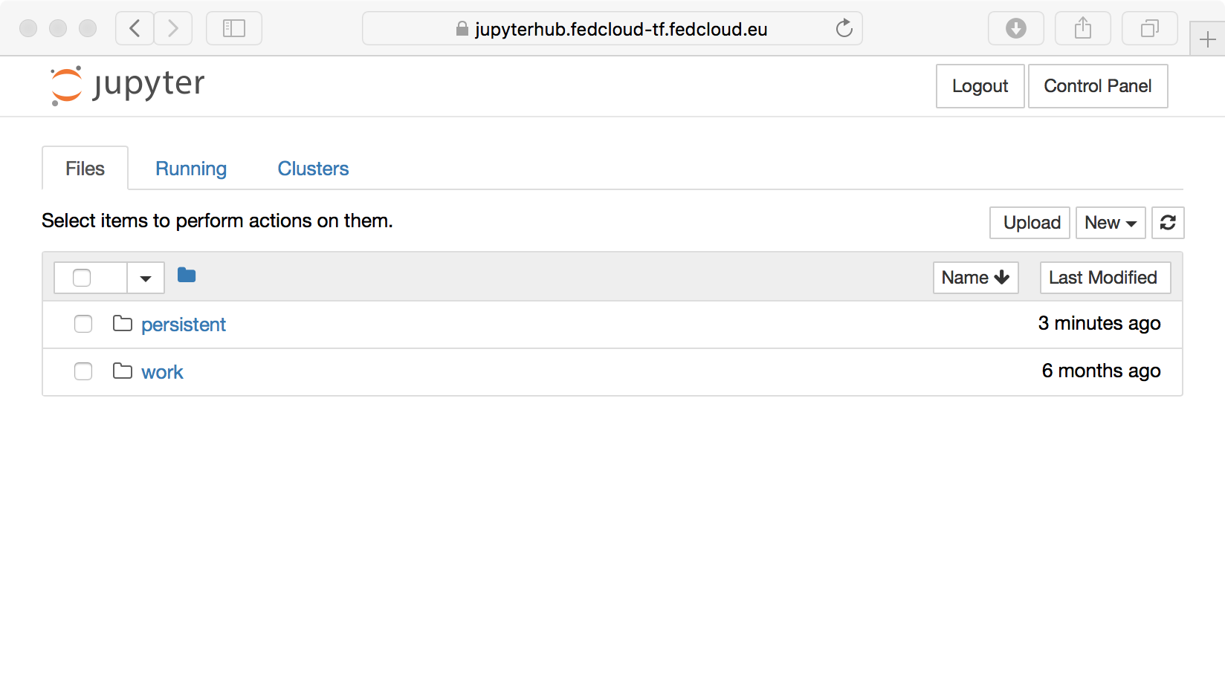
Added value services: EGI Notebooks
Offer Jupyter notebooks ‘as Service’
One-click solution, just login and start using
EGI Features:
Login with Check-in
Persistent storage
Bring your own environments/kernels
Use EGI computing and storage resources from your notebooks

Slide 25
Conclusions
EOSC is going to be an important and international computing infrastructure to whom GEOSS must interoperate
GEO DAB is the natural interoperability point
The first challenge to address for such an interoperability is AAI: for this reason, in the framework of EOSC-hub
GEO-DAB will implement the EOSC AAI
In keeping the vision for GEOSS evolution, EOSC can offer a set of analytics services that GEOSS needs to generate insight from the corps of data it manages.
In the framework of EOSC-hub, EOSC and GEOSS will work together on recognizing the necessary rules for governing the interoperability between the two platforms.

Slide 26
contact@mailman.eosc-hub.eu

