Slide 2
Landsat : Earth Observations for Decision Making Fueling the Open Data Revolution
Ivan DeLoatch / Executive Director / Federal Geographic Data Committee
Pete Doucette / Associate Program Coordinator / National Land Imaging Program, USGS
Notes:
Provide and overview of how Landasat has fueled the Open Data Revovlution

Slide 3
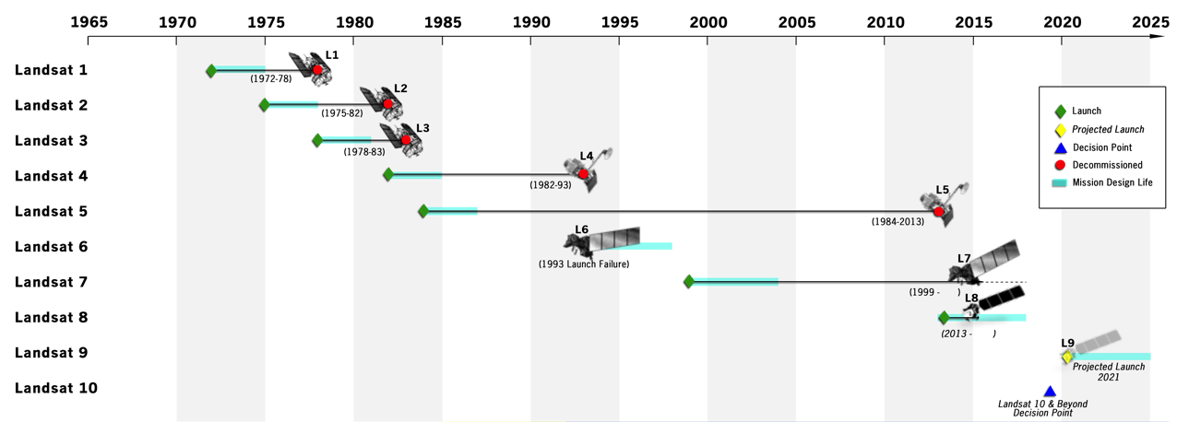
Landsat / Data Continuity Since 1972
NASA – space segment
DOI/USGS – ground segment
Landsat 7 & 8 operating
Landsat 9 in development for 2020 launch
Landsat 10 architecture study in 2018
The Landsat Program has amassed the longest and most comprehensive record of the Earth’s land surface in existence
Notes:
The main point to make here is that it’s the 46-year archive that makes Landsat special compared to other/similar missions. The mission going forward is governed by the “sustainable land imaging” program, which is a close collaboration between NASA and USGS, where NASA is responsible for building and launching spacecraft, and USGS is responsible for operating spacecraft once on orbit, and downlinking, processing, archiving, managing, and distributing the data.

Slide 4
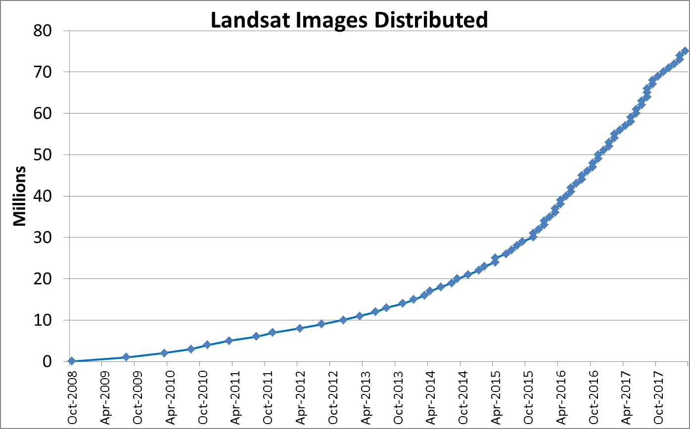
Landsat / Demand for Free and Open EO
Landsat demand, economic value, application & commercial, services for EO data is increasing.
$2.2B in annual global economic benefit
(OPR2013-269, USGS/DIO)
Free and open data policy
Emergent data hosts
Google (entire Landsat archive)
Amazon Web Services (L8)
Notes:
Since the free and open data policy in 2008, demand has soared, and has created a marketplace (particularly agricultural monitoring applications) for moderate resolution satellite imagery that simply did not exist prior to 2008. A USGS study in 2011-2012 time-frame demonstrated an annual economic benefit of $2.2B globally, which more than pays for the development and missions costs of the satellites. Google and Amazon have been rehosting Landsat data for free use for several years now (for their own business purposes—not via any formal agreement with USGS), and the use metrics from users of Landsat on Google and Amazon clouds are not factored into this graph, but which we know (anecdotally) are quite high.

Slide 5
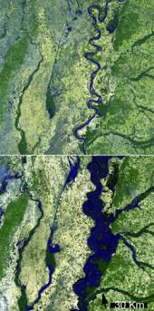
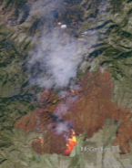
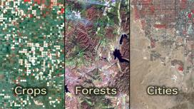
Drivers for Landsat data
Landsat / End-user Application(s)
“Moderate” resolution
8-day global landmass refresh for monitoring seasonal change
The “gold standard” of data calibration (radiometry/geometry)
Flooding Wildfire Crops Forests Cities
Notes:
Discuss some of the End-User Applications and benefits.

Slide 6
Thank you
Landsat : Earth Observations for Decision Making Fueling the Open Data Revolution
Ivan DeLoatch / Executive Director / Federal Geographic Data Committee
Pete Doucette / Associate Program Coordinator / National Land Imaging Program, USGS
Notes:
Encourage attendance at 2:30 to learn how Application Ready Data is fueling the next generation of EO for Open Data

