Slide 1
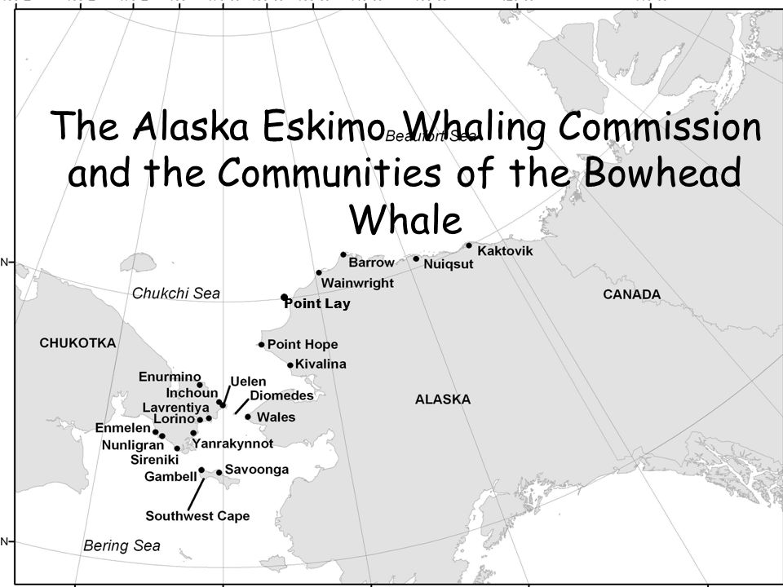
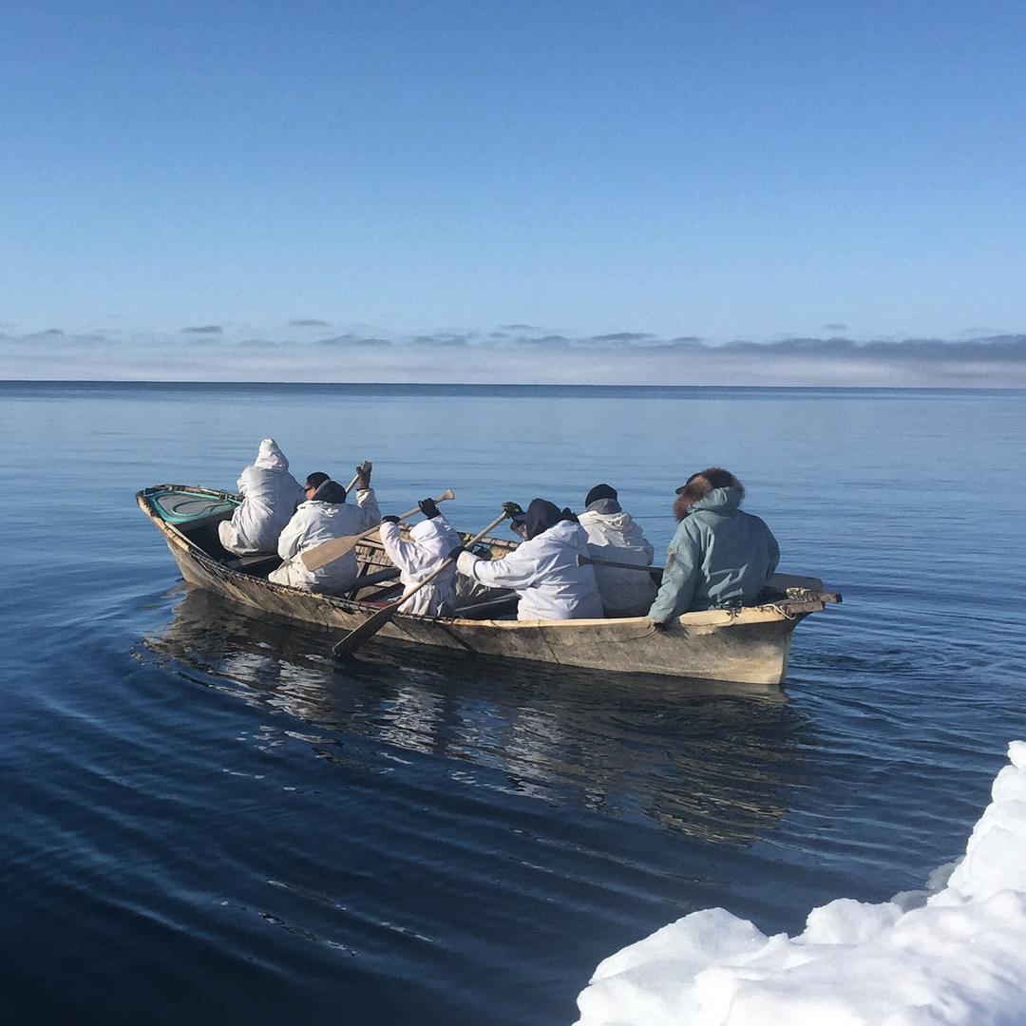
Climate Change in the Arctic
Arnold Brower Jr
Executive Director
Alaska Eskimo Whaling Commission

Slide 2
Issues with Ice: Satellite Data shows *Shorefast ice edge *Ice trails to whale camp *Ice thickness *Danger of Ice Flows

Slide 3
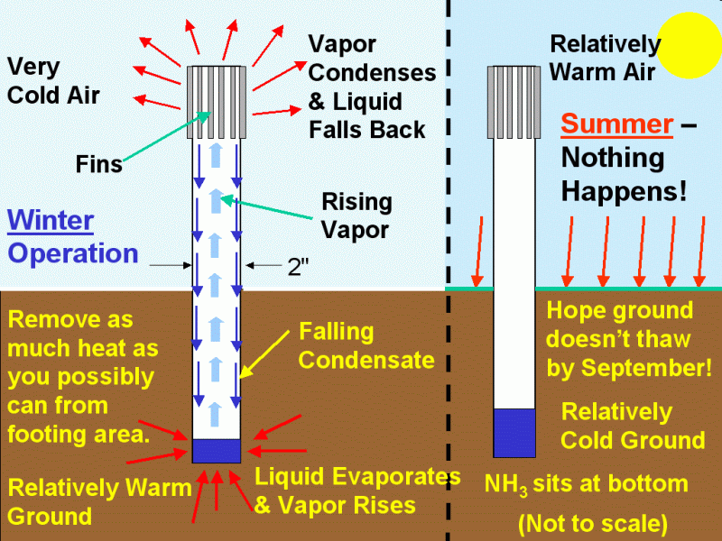
Ice Cellar Collapse with Permafrost Melting

