Slide 2
Citizen Science as a new data provider
Joan Masó / researcher / CREAF

Slide 3
The need to consider Citizen Science as data provider in GEOSS
Main Message

Slide 4
What is CS and CO?
Citizens' Observatories (European Commission)
are community-based environmental monitoring and information systems. They build on innovative and novel Earth observation applications embedded in portable or mobile personal devices. This means that citizens can help and be engaged in observing our environment.
Citizen science (Wikipedia)
is scientific research conducted, in whole or in part, by amateur scientists. Citizen science is sometimes described as "public participation in scientific research", participatory monitoring and participatory action research.
Notes:
https://ec.europa.eu/easme/en/news/have-you-heard-about-concept-citizens-observatories

Slide 5
The diversity of CS topics
There are many CS projects.
Example
Conrad CC, Hilchey KG (2011) A review of citizen science and community-based environmental monitoring: issues and opportunities
Identifies and analyzes 20 different CBEM projects
Bowser A (2016) Global Mosquito Alert: A Common Protocol and Platform for Citizen Science Vector Monitoring
Identifies 7 mosquito monitoring active projects.
Proposes the creation of the Global Mosquito alert

Slide 6
The four COs active in H2020 for GEOSS
Inventory of citizen observatories and sustainability
Accelerate the uptake of Citizen Observatories
Facilitate adoption in EO communities
From citizen-based data collection to knowledge sharing for joint decision-making, cooperative planning and environmental stewardship
Considers the social and the technical dimensions
Six demo cases
Crowdsourcing platform used to collect images and text from citizens
Calibration and validation of satellite imagery using the crowdsourcing
Annotate images with serious gaming and machine learning
Two demo cases Kifisos river, Greece (urban) and Danube Delta, Romania (rural)
Landsense
Sustainable custodianship of land and soil
Meet the demands of food production
Calibrate/validate satellite-based soil moisture products with CS in-situ sensors
Campaign-based approach for engaging
Builds a engagement platform
Emphasis on services
Photoquest (pictures in 4 directions), change detection in alerting about bird habitat risks, single sign-on
Three demo cases on landscape changes, agriculture and habitat monitoring

Slide 7
The integration of CS
At the project description level
Project documentation via Public Participation in Scientific Research metadata model (and the COST action efforts)
At the service level
SWE4SC
IoT
At the data level
Conflation of datasets using semantic mediation

Slide 8
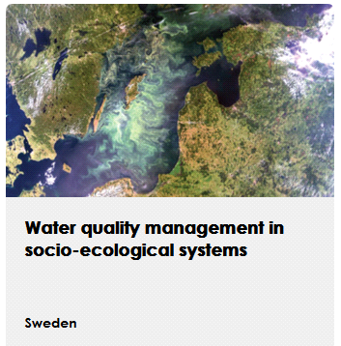
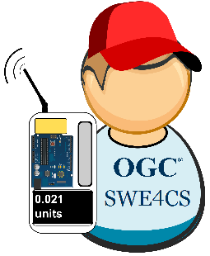
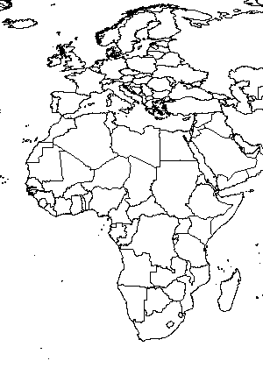
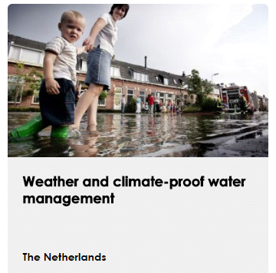
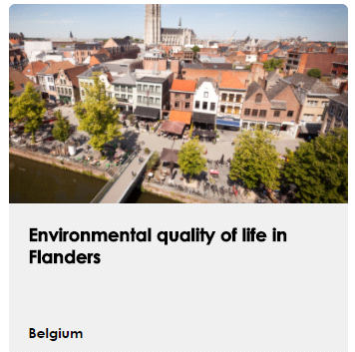
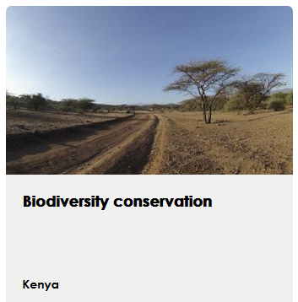
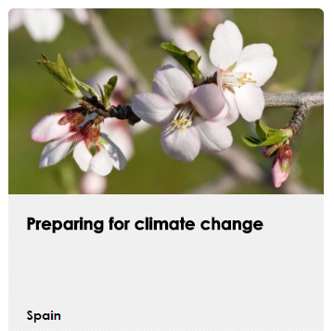
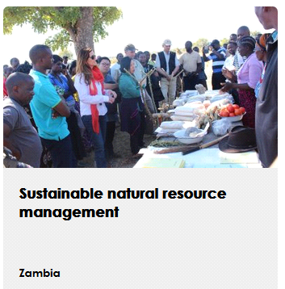
demonstration cases

Slide 9
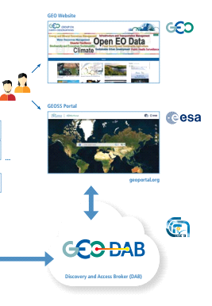
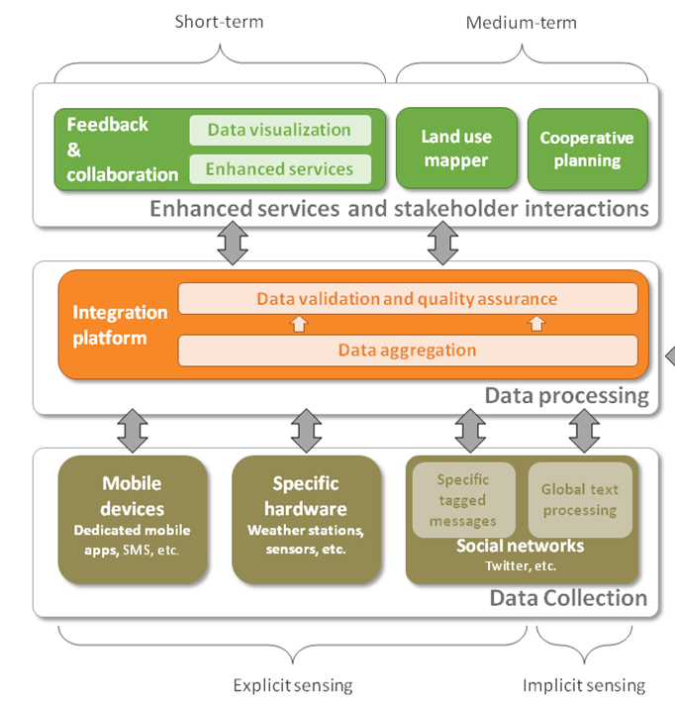
as a GEOSS data provider

Slide 10
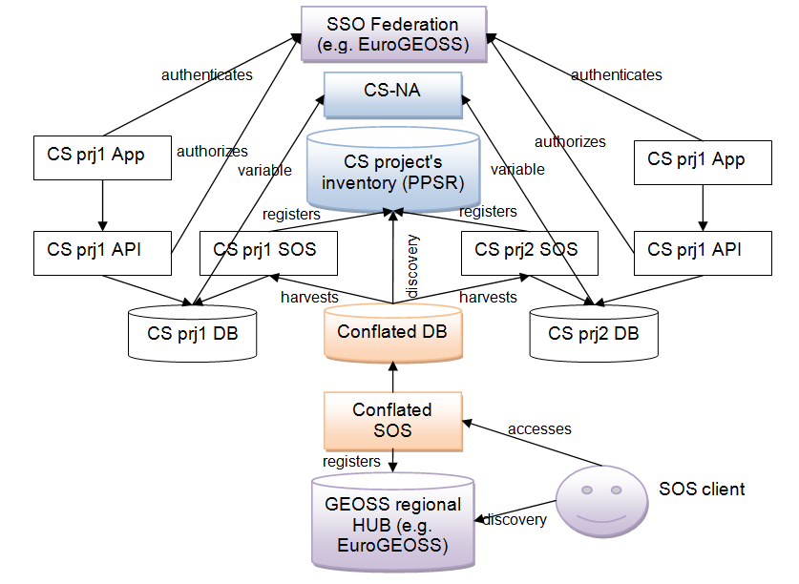
The interoperability experiment on CS supported by
Kick off in the Citizen Science Workshop “ECSA conference extra day”
June 6th 9-12h
Please participate!
OGC
Notes:
https://www.cs-eu.net/events/external/citizen-science-workshop-day-university-geneva

Slide 11
Community Activities
Access to climate data in GEOSS
Advancing Communication Networks
African Geochemical Baselines
Airnow International: Expanding Networks and Integrating Methods for Air Quality and Health Data
Chinese Tsunami Mitigation System
Citizen Observatories and Crowdsourcing
Copernicus Atmospheric Monitoring Service (CAMS)
Copernicus Climate Change Service (C3S)
Data Analysis and Integration System (DIAS)
Digital GEOMUSEUM
Earth2Observe
Earth Observations for Cultural Heritage Documentation
Earth Observations for Disaster Risk Management
Earth Observations for Geohazards, Land Degradation and Environmental Monitoring
Earth Observations for Health (EO4HEALTH)
Earth Observations for Managing Mineral Resources
Earth Observations for the Water-Energy-Food (W-E-F) Nexus
Forest Biodiversity in Asia and the Pacific Region: Capacity Building Phase
GEO-CRADLE
Global Agricultural Drought Monitoring
Global Ecosystems and Environment Observation Analysis Report Cooperation (GEOARC)
Global Flood Awareness System (GloFAS)
Global Flood Risk Monitoring
GFCS - GEO Collaboration
Global Mangrove Monitoring
Harmful Algal Bloom (HAB) Early Warning System
Himalayan GEOSS
In-Situ Observations and Practices for the Water Cycle
Land Cover and Land Cover Change
Research Data Science Summer Schools
Socio-Economic Benefits of Earth Observations
Space and Security
Synergized Multi-Source Remote Sensing Products and Services
TIGGE (Thorpex Interactive Grand Global Ensemble) evolution into a Global Interactive Forecast System (GIFS)

Slide 12
The need to consider Citizen Science as data provider in GEOSS
Main Message

Slide 13
Conclusions Questions
Requirements to be a CS project in GEOSS?
(extent, theme, standard access, continuity/resources)
How to connect to the GEOSS?
Yellow pages
Regional initiatives
Centralized CitSci catalogues
Next year four CO projects will request to connect to GEOSS.
We will need the answer to this questions

Slide 15
Thank you
Joan.Maso@uab.cat/ www.creaf.cat / @joanma747

