Slide 2
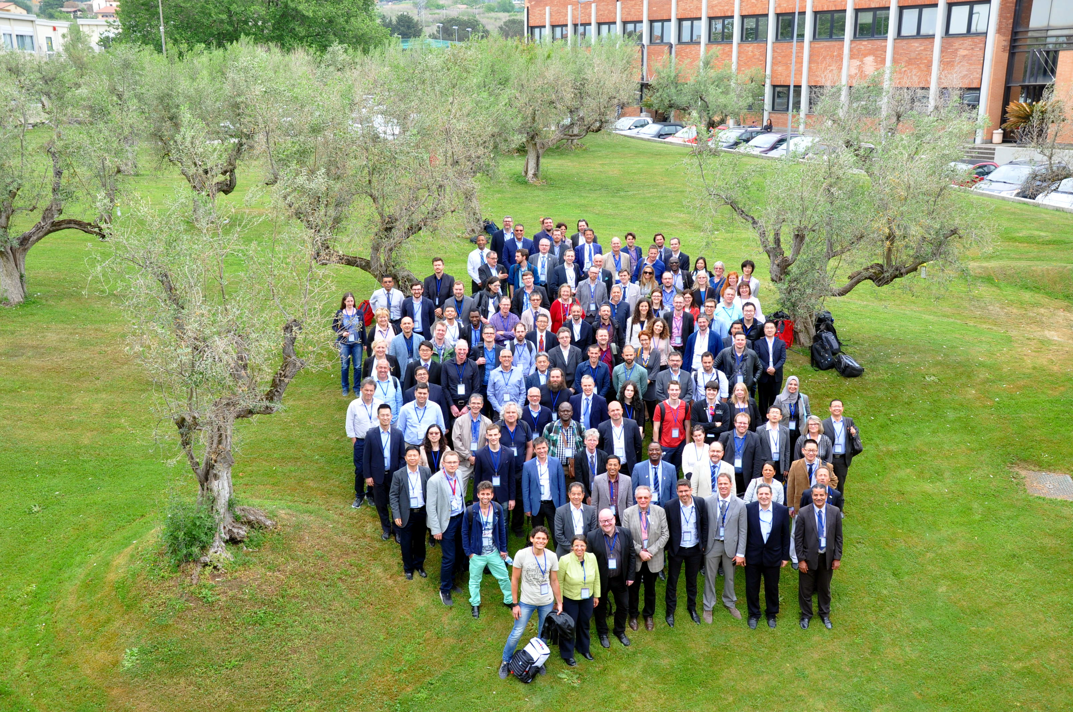
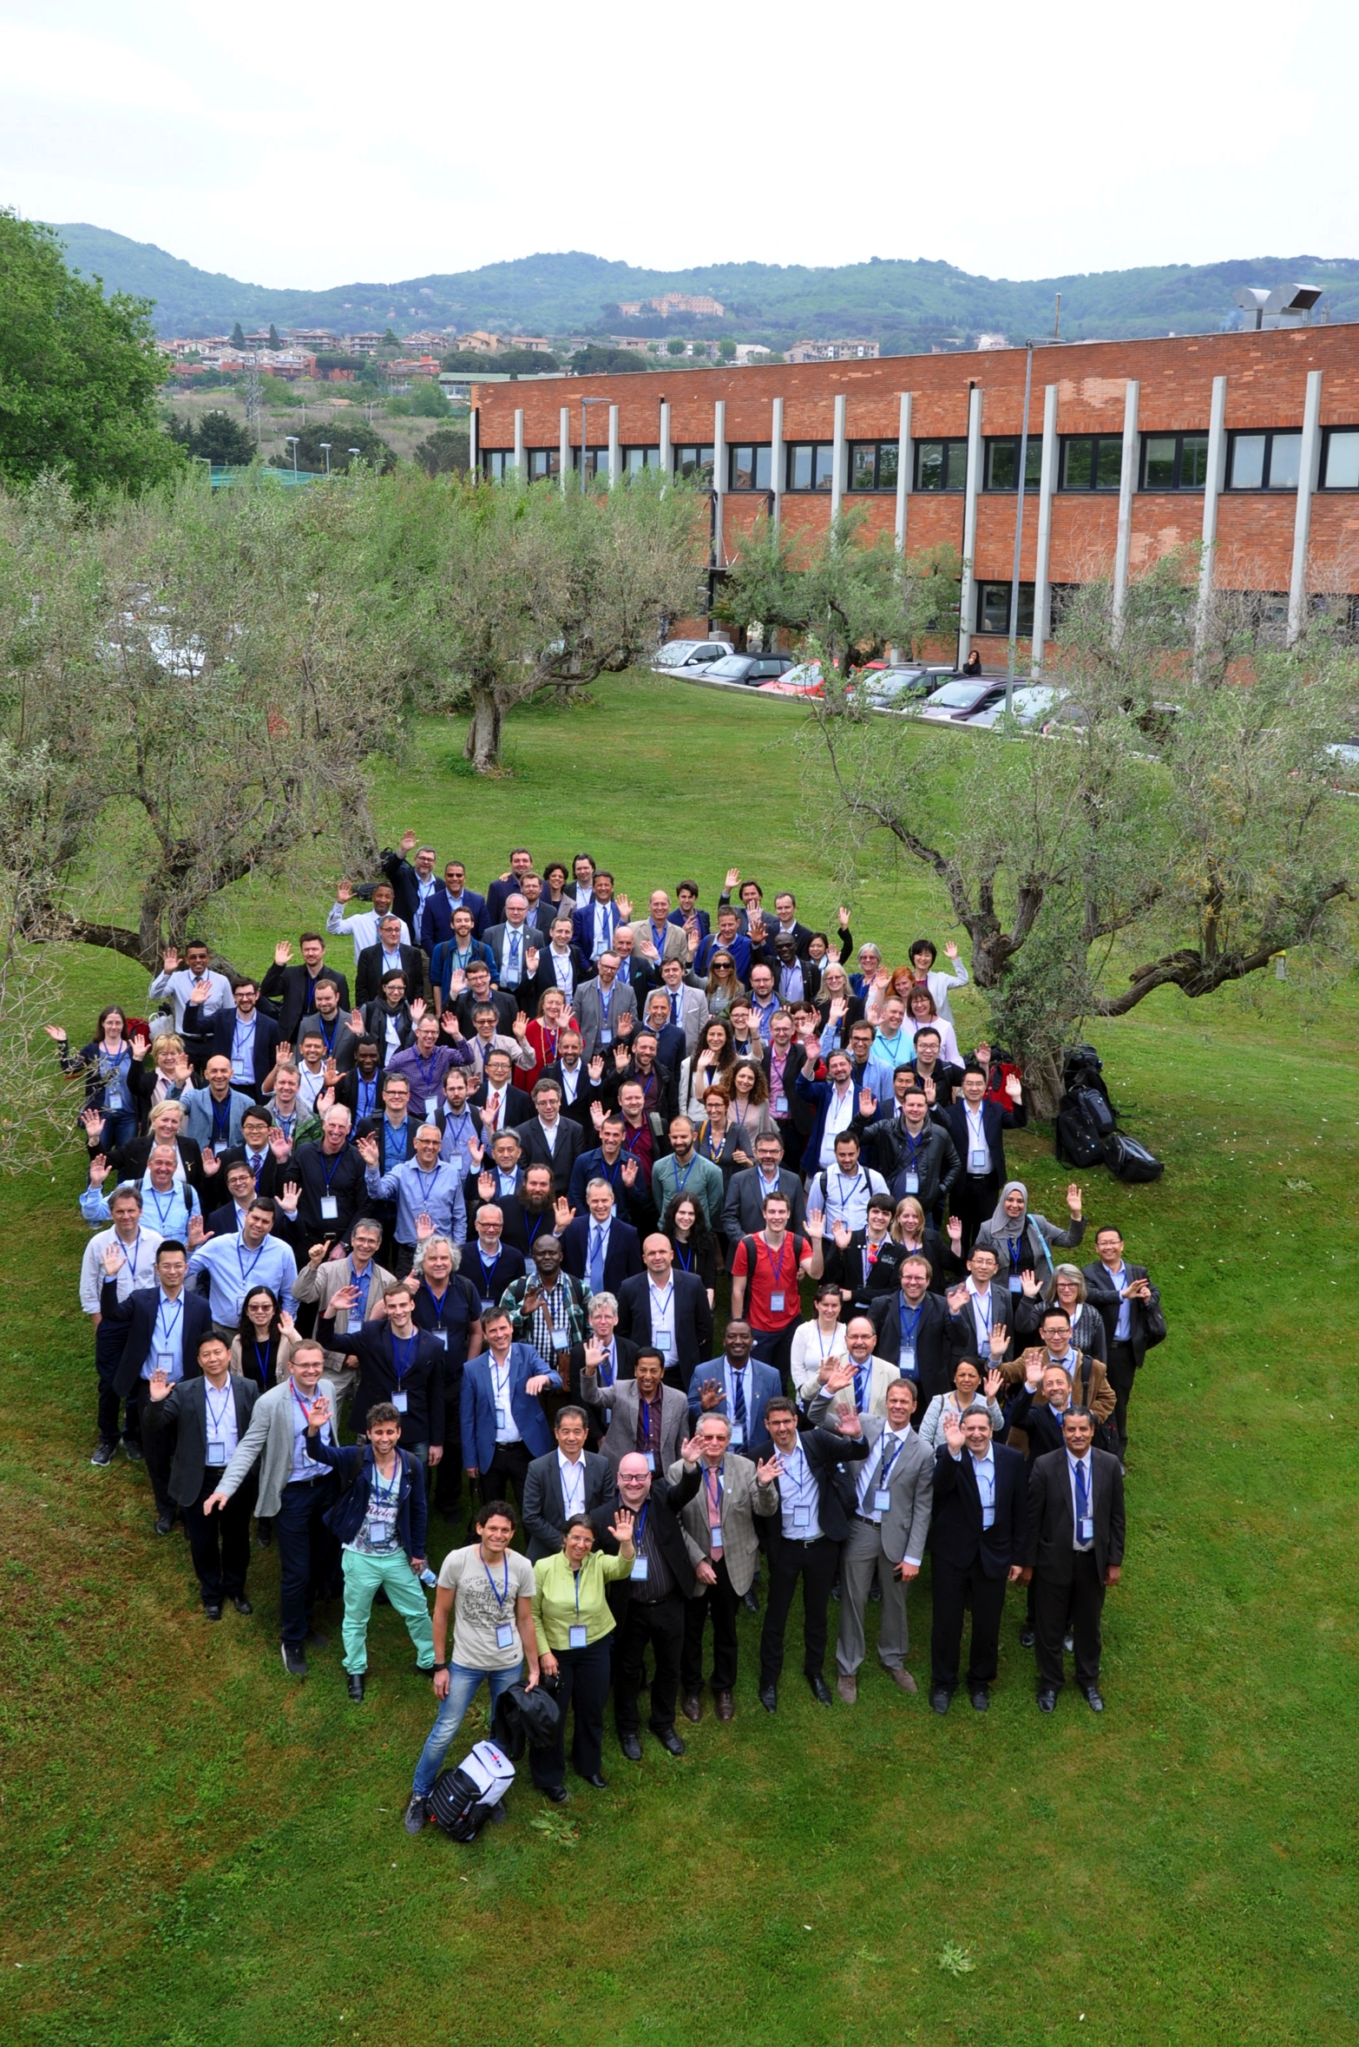
Workshop
Summary
GEOSS Platform Team

Slide 3
We still can do a lot…

Slide 4
Various Challenges
Algorithms
Wishdom
Engaging the User
Big Data
Application Ready Data
Analysis Ready Data
Ground Truth Data
In-situ Data

Slide 5
Move towards an era of
Applied GEOSS…
or
Applied Earth Observations enabled by GEOSS

Slide 6
But we are on our way
Given the interest seen today
Of Data Providers and Users

Slide 7
3° Data Providers Workshop
Preliminary Numbers
>200 Attendees from more than 130 organizations from 5 Continents
Public and Private organisations
97 Speakers
20 Scientific Sessions
11 Training Sessions
Hackaton (xxx participants)

Slide 8
33 Countries – 5 Continents
3° Data Providers Workshop
Australia | 1
Austria | 4
Belgium | 6
Brasil | 1
Cambodia | 1
Canada | 1
China | 10
Congo | 1
Denmark | 1
Egypt | 3
UK | 15
France | 13
Germany | 22
Ghana | 1
Greece | 3
Hungary | 2
Italy | 56
Japan | 3
Namibia | 2
Nepal | 1
The Netherlands | 4
Norway | 1
Poland | 3
Portugal | 2
Slovenia | 1
South Africa | 1
Spain | 5
Sweden | 2
Switzerland | 10
Tanzania | 1
Ukraine | 4
USA | 10
USA- Alaska | 3

Slide 9
Thanks again to our Sponsors

Slide 10
See You Next Year
In Vienna
23-25 April 2019
4th GDPW

Slide 11
Thank you
Joost.van.Bemmelen@esa.int / www.esa.int

