Slide 2
GEOSS Data Management Principles:
Importance and Implementation
Alex de Sherbinin / Associate Director / CIESIN, Columbia University
Gregory Giuliani / Lecturer / University of Geneva
Joan Maso / Researcher and GIS developer / CREAF

Slide 3
Why?
“Ensure that data and information of different origin and type are comparable and compatible, facilitating their integration into models and the development of applications to derive decision support tools.”
GEO Strategic Plan 2016-2025
Interoperability
Quality (Fitness for use)
Trustworthiness

Slide 4
GEOSS Data Management Principles (DMPs)
Build on GEOSS Data Sharing Principles
Set standard for good data (management) practices
GEOSS DMPs Approved in April 2015:
Long version
Condensed version
GEOSS DMPs Implementation Guidelines
Endorsed in November 2015

Slide 5
GEOSS DMPs
10 Principles in 5 categories
Discoverability
Accessibility
Usability
Preservation
Curation

Slide 6
GEOSS DMPs condensed
Earth observations will be catalogued or otherwise advertised on the internet so that they can be discovered, and will be accessible online using open-standard encodings and services. Data and services will be comprehensively documented using international or community-approved standards, and to the extent possible, peer-reviewed publications, so that users can understand and make use of the data. Metadata will include access and use conditions, the results of quality control procedures, and provenance statements indicating the origin and processing history of the dataset or product. Data and associated metadata will be protected from loss and periodically verified to ensure integrity, authenticity and readability. Corrections and updates to data and metadata records will be performed as required. Finally, persistent identifiers will be assigned to data so that they can be tracked and cited and data providers can be acknowledged.

Slide 7
Implementation of DMPs
“A priority mission for GEO is to encourage the implementation of the Principles (DMPs) by organizations contributing to GEOSS”
GEO Strategic Plan 2016-2025

Slide 8
GEOSS DMPs Implementation Guidelines
For each DMP:
Terms used to describe the principle and its implementation
Explanation of the DMP
Guidance on implementation with examples
November 2015
www.earthobservations.org/documents/geo_xii/GEO-XII_10_Data%20Management%20Principles%20Implementation%20Guidelines.pdf

Slide 9
Implementation guidelines uptake?
Monitoring DMPs implementation
GEOSS Data Providers
Data Repositories Certification
Status checker…
Dataset/Collection
Data fitness for use: Certification, DMP Labels…
User feedback…

Slide 10
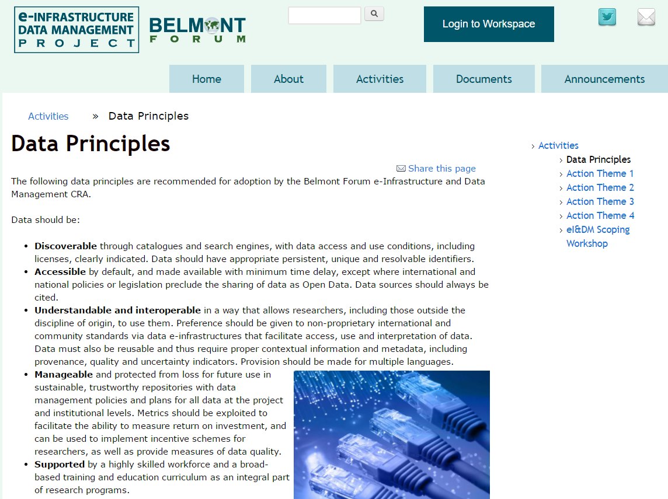
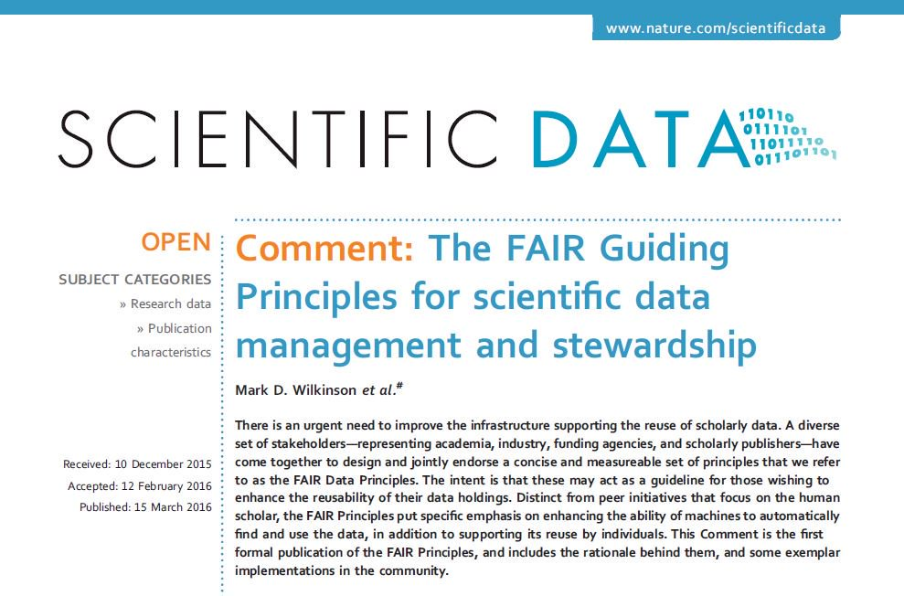
From Principles to Implementation
DOI: 10.1038/sdata.2016.18
2009-15
2015
2016

Slide 11
Practical Implementation
Formal Certification ISO 16363
(0 Repositories, 100+ requirements)
Extended Certification
(2 Repositories, 34 requirements)
CoreTrustSeal Certification (150+ Repositories, 16 requirements)
Trustworthy Data Repositories (TDRs)

Slide 12
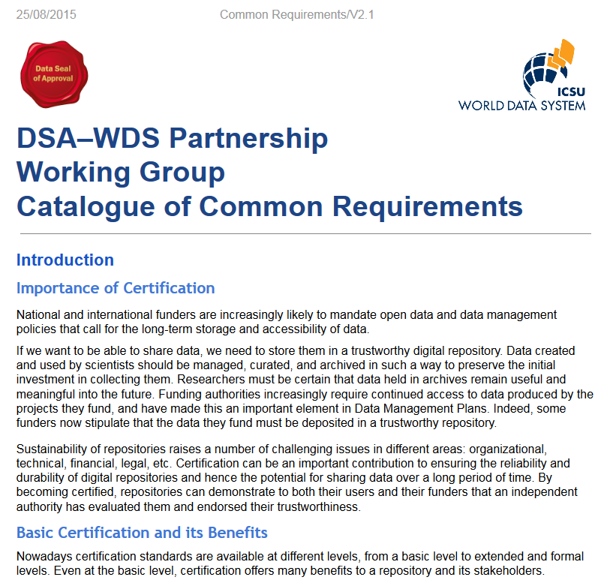
Core Trustworthy Data Repository (TDR) certification
Catalogue of requirements (16):
Context
Organizational infrastructure (6)
Digital object management (8)
Technology (2)
Applicant feedback
Certification procedures :
Self-assessment: documented public evidence + compliance level
Peer-review (2 reviewers)
Renewal (3 years)
2009-15
2017-forward

Slide 13
CORE TDR Requirements
Context Repository type, designated community, Level of curation performed , Outsource partners, Impact
Organizational infrastructure
R1. DR has an explicit mission to provide access to and preserve data in its domain.
R2. DR maintains all applicable licenses covering data access & use & monitors compliance
R3. DR has a continuity plan to ensure ongoing access to and preservation of its holdings.
R4. DR ensures that data are created, curated, accessed, and used in compliance with disciplinary and ethical norms.
R5. DR has adequate funding and sufficient numbers of qualified staff managed through a clear system of governance
R6. repository adopts mechanism(s) to secure ongoing expert guidance and feedback (either in-house, or external, scientific guidance).

Slide 14
CORE TDR Requirements
Digital object management
R7. DR guarantees the integrity and authenticity of the data.
R8. DR accepts data & metadata based on defined criteria to ensure relevance and understandability for users.
R9. DR applies documented processes and procedures in managing archival storage of the data.
R10. DR assumes responsibility for long-term preservation and manages this function in a planned and documented way.
R11. DR has appropriate expertise to address technical data and metadata quality sufficient to make quality evaluations.
R12. Archiving takes place according to defined workflows from ingest to dissemination.
R13. DR enables users to discover the data and refer to them in a persistent way through proper citation.
R14. DR enables reuse of the data over time, ensuring that appropriate metadata support the understanding and use of the data.

Slide 15
CORE TDR Requirements
Technical infrastructure
R15. DR functions on well-supported operating systems and other core infrastructural software and is using hardware and software technologies appropriate to the services it provides to its Designated Community.
R16. The technical infrastructure of the repository provides for protection of the facility and its data, products, services, and users.

Slide 16
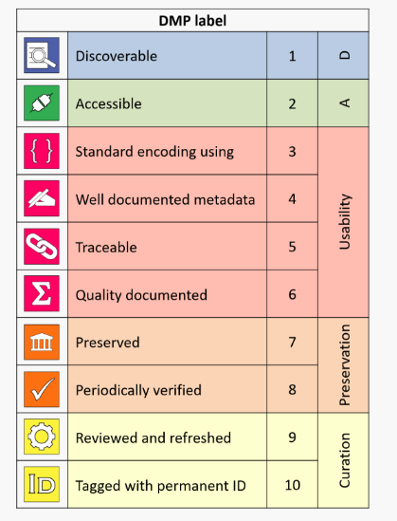
Mapping CORE TDR to GEOSS DMPs
R1.
R2.
R3.
R4
R5.
R6.
R7.
R8.
R9.
R10.
R11.
R12.
R13.
R14.
R15.
R16.

Slide 17
Myths about Core TDR Certification
Costly !
Pass or fail !
Difficult for small data providers…
Time consuming!
Not yet recognized?

Slide 18
Thank you!

Slide 19
GEOSS DMPs in detail
Discoverability
DMP-1: Data and all associated metadata will be discoverable through catalogues and search engines, and data access and use conditions, including licenses, will be clearly indicated.
Accessibility
DMP-2: Data will be accessible via online services, including, at minimum, direct download but preferably user-customizable services for visualization and computation.

Slide 20
GEOSS DMPs in detail
Usability
DMP-3: Data should be structured using encodings that are widely accepted in the target user community and aligned with organizational needs and observing methods, with preference given to non-proprietary international standards.
DMP-4: Data will be comprehensively documented, including all elements necessary to access, use, understand, and process, preferably via formal structured metadata based on international or community-approved standards. To the extent possible, data will also be described in peer-reviewed publications referenced in the metadata record.

Slide 21
GEOSS DMPs in detail
Usability (ctd.)
DMP-5: Data will include provenance metadata indicating the origin and processing history of raw observations and derived products, to ensure full traceability of the product chain.
DMP-6: Data will be quality-controlled and the results of quality control shall be indicated in metadata; data made available in advance of quality control will be flagged in metadata as unchecked. of their data.

Slide 22
GEOSS DMPs in detail
Preservation
DMP-7: Data will be protected from loss and preserved for future use; preservation planning will be for the long term and include guidelines for loss prevention, retention schedules, and disposal or transfer procedures.
DMP-8: Data and associated metadata held in data management systems will be periodically verified to ensure integrity, authenticity and readability.

Slide 23
GEOSS DMPs in detail
Curation
DMP-9: Data will be managed to perform corrections and updates in accordance with reviews, and to enable reprocessing as appropriate; where applicable this shall follow established and agreed procedures.
DMP-10: Data will be assigned appropriate persistent, resolvable identifiers to enable documents to cite the data on which they are based and to enable data providers to receive acknowledgement of use of their data.

Slide 24
Contact information
Alex de Sherbinin adesherbinin@ciesin.columbia.edu
Gregory Giuliani gregory.giuliani@unige.ch
Joan Maso joan.maso@uab.cat

