Slide 2
GEOSS Evolution : The GEOSS-Evolve Initiative A user Driven GEOSS for the Future
Ivan DeLoatch / Executive Director / Federal Geographic Data Committee
Max Craglia/ JRC, Stefano Nativi, JRC

Slide 3
GEOSS Evolve / The Need to Evolve GEOSS
….GEO will evolve GEOSS and its infrastructures to meet current and emerging needs by: Extending the user audience to decision-makers and the general public; Placing additional focus on the accessibility and usability of Earth observation resources to improve our scientific understanding of the Earth processes, and enhance our predictive capabilities that underpin sound decision-making; Providing a service framework to engage partners and user communities in evolving the current infrastructure to enable collaborative tools for co-creation of products and services suitable for effective exploitation by user communities; and Evolving the current system of systems component based architecture with an open systems platform that is flexible, sustainable and reliable for data access, integration and use, and the delivery of knowledge-based products and services.
Notes:
The objectives of GEOSS-EVOLVE are:
To advance and evolve the GEOSS architecture based on the architectural principles described in the GEO Strategic Plan 2016-25,
The analysis of the evolving landscape for technology and production/ consumption of Earth Observation (EO) data products and services, and the specific user requirements coming from the GEO flagships and initiatives.
To conduct research and development activities, in collaboration with public, private, and voluntary sectors, to develop and test new functionalities, solutions, and components, including those needed to advance the GCI, to support the GEO Strategic Plan objectives and user needs.
To prepare documentation and training materials needed to support the transition from development to operations of the new components and solutions identified.

Slide 4
GEOSS Evolve / New Opportunities and Challenges
The emergence of regional nodes of GEOSS:
Opportunity: Better address local needs and increase visibility/relevance of GEOSS to national/local levels
Challenge:
How to ensure interactions among regional nodes so that we continue to have a SoS and share data, processes, and knowledge for the global good.
The interoperability of analysis-ready-data e.g. data cubes (at all levels) and Big data analytics
From data analysis to scientific understanding & predictions → AI, Machine & Deep learning
Opportunity for GEOSS as global cooperative effort to develop new methods and algorithms on shared global data to address global needs.. All of these needs a shared reflection on how to evolve the Governance of GEOSS
Notes:
Opportunities and Challenges
Strengthen regional, national and local capabilities
Address gaps and needs in data, tools, applications and services needed by users and decision-makers
Leverage new technologies and capabilites
- Cloud, Machine learning, data cubes etc.

Slide 5
GEOSS Evolve / Structure and Work Packages
Established in 2016
Co-chairs
Ivan DeLoatch Max Craglia
WP1
GEOSS Architecture Evolution
(Lead:USGS and CNR-IIA)
WP3
DMP Guidelines Implementat. & Process
(Lead: ESIP and CODATA)
WP4
Standard & Interoperab. Forum
(Lead: IEEE)
WP5
Demonstration Pilots
(Lead: OGC)
WP6
Community Portals
(Lead: NOAA)
WP2
Functionality and Usability testing
(Lead:China-RADI and CNR-IIA)
GEO Secretariat
Secretarial support
Coordination with GCI Operations FT and User Requirements FT
Notes:
6 work packages
WP 1: GEOSS Architecture and Evolution (Lead: US-USGS/Italy-CNR)
Advance and evolve GEOSS architecture based on technology watch and user requirements by selected flagships and initiatives;
Develop and Maintain the “Evolution of GCI functionalities and Architecture” document and service framework
Research and report on emerging technologies that facilitate the use of Earth observation resources.
WP2: Functionality Testing (lead China-RADI)
Test functionalities of the GCI, the GEOSS data providers and the GEOSS community portals needed to support the requirements expressed by the users through the dedicated foundational tasks.
WP3: Data Management Principles (Lead: ESIP, ICSU-WDS, CODATA)
Demonstrate implementation of DMP with selected initiatives and flagships
WP 4: Standards Interoperability Forum (lead IEEE)
Develop and evolve standards and best practice guidelines, Support selected GEO initiatives and flagship in extending their interoperability arrangements.
WP 5: Demonstrations Projects (Lead OGC)
Implement demonstration projects with selected GEO initiatives and flagships that advance the functionalities of the GCI and GEOSS, and address user needs.
WP 6: Community Portals (Lead NOAA)
Develop community portals catalogue, Develop training material and guidance for community portals to benefit from interoperability arrangements with GCI, Develop recommendations based on lessons learned.

Slide 6
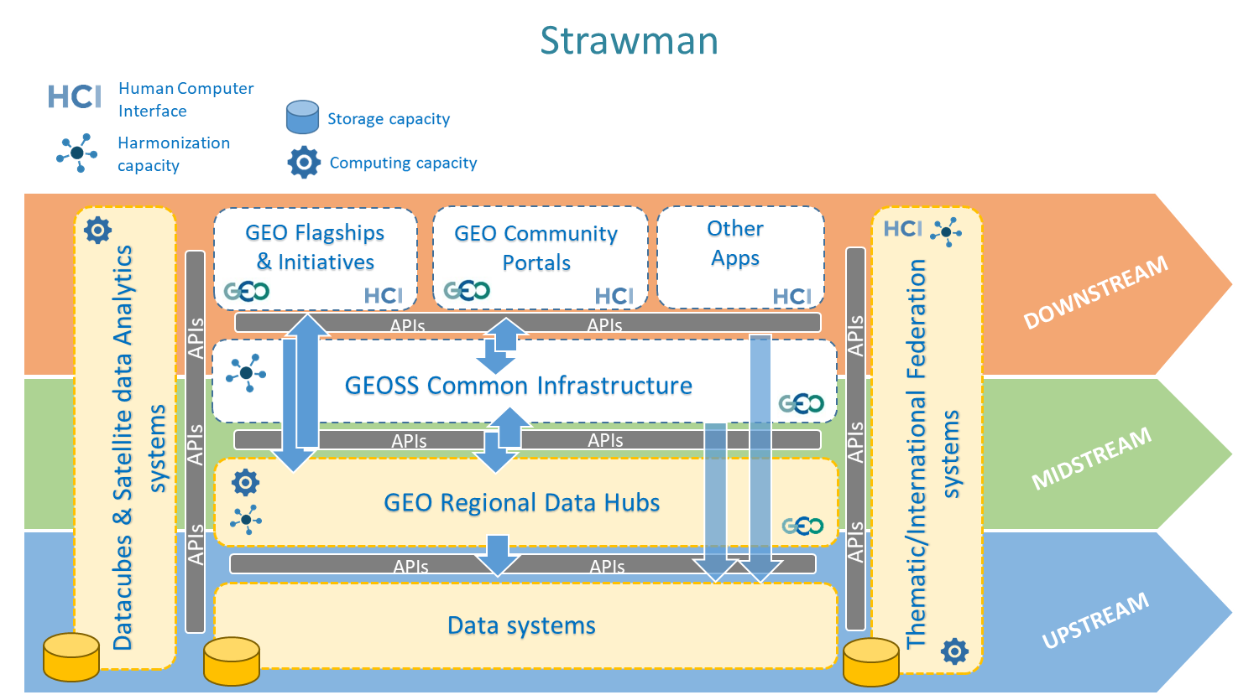
GEOSS Evolve / Conceptual Architecture––GEOSS Ecosystem
Notes:
As part of Work Package #1 we have developed a conceptual architecture “strawman”
New architecture recognizes:
GEOSS as a system of system includes many autonomous information systems and infrastructures,
some organized along thematic lines,
other emerging at the regional level (e.g. in the Americas, Europe, Africa, Asia, polar regions etc.). The aim of GEOSS-EVOLVE is therefore to consider the evolution and interoperability arrangement of the whole GEOSS, not just of the GCI.
Key principle -- Must support a variety of constructs, implemenataion mechanisms, users and ability to transform data to knowledge

Slide 7
GEOSS Evolve / Improving Interoperability Leveraging Systems
Data Cubes and Data Analytics Systems
Notes:
The draft architecture recognizes the need to extend the current architecture to support the development of products and services.
The GEOSS platform concept has emerged as the conceptual architecture that can support this goal.
We will have to improve interoperability and support a variety of new user requirements.
Regional Platforms, API’s, widgets, views, portals and plugins are new components and concepts to
support interoperability,
Transformation of data into products and services.
Allow co-creation of products and services. We recognize this new architecture is more evolved and complex we will have to address Governance/coordination challenges

Slide 8
GEOSS Evolve / Key Activities
To maintain an open, user-driven collaborative GEOSS to ensure that we keep sharing data and knowledge at the global level to support the Delivery function of GEO
There is the need for additional capabilities & analytics in GEOSS to transform data to knowledge for decisionmaking
A global collaborative governance is needed that evolves with the times and harnesses new technologies and best practices
Notes:
In conclusion the GEOSS evolve activities support advancement of the GEOSS 2025 Vision
The strawman architecture and current efforts seek to extend current capabilities of the GEOSS Platform to be more responsive to user needs
We appreciate any feedback and input you may have to further develop the conceptual architecture

Slide 9
Thank you
GEOSS Evolution : The GEOSS-Evolve Initiative A user Driven GEOSS for the Future
Ivan DeLoatch / Executive Director / Federal Geographic Data Committee
Max Craglia/ JRC, Stefano Nativia, JRC

