Slide 1
The age of anxiety

Slide 2
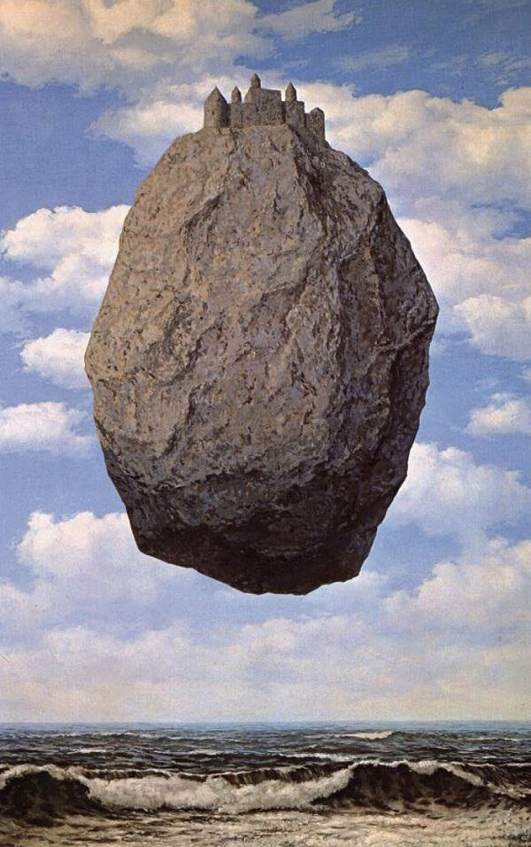
“Globalization has given a cosmopolitan character to production and consumption in every country”. (…) The continuous technological revolution has transformed the whole relations of society, bringing about everlasting uncertainty and agitation” (…) All that is solid melts into air”.

Slide 3
Karl Marx
(05.05.1818)

Slide 4
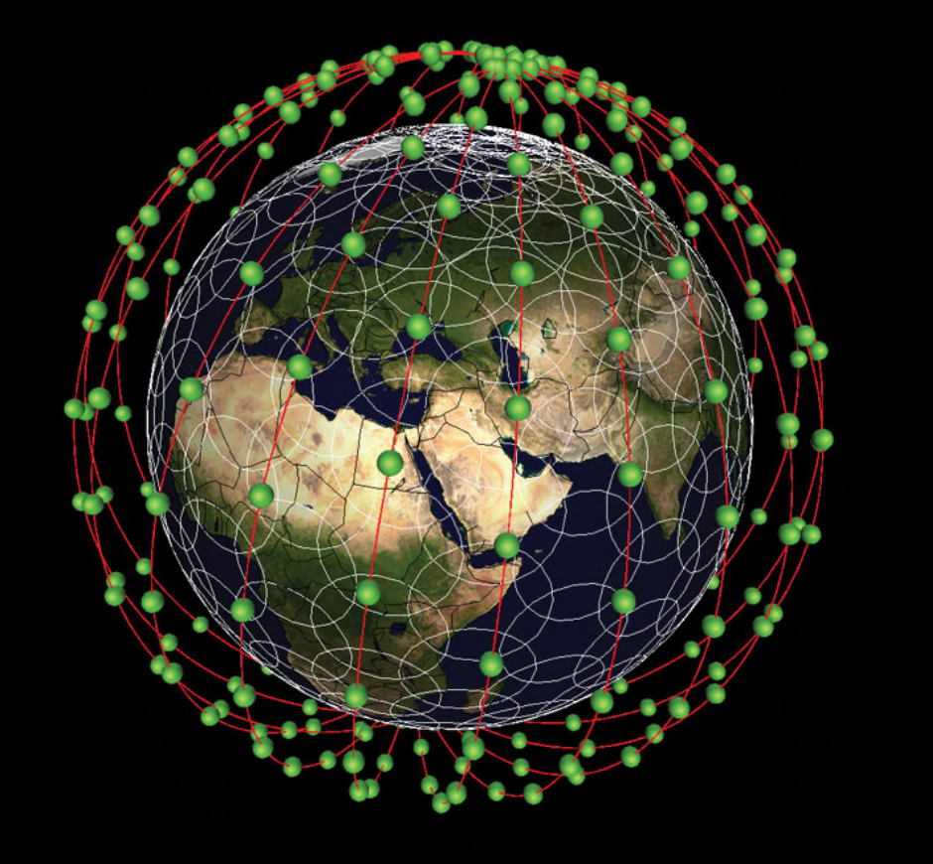
How best to use/provide/apply big Earth observation data?

Slide 5
Globalization?
Globalization?
Democracy?
Trade policies?
Climate Change?
Decision-maker
Future jobs?

Slide 6
Which data?
What products?
Make or buy?
How to improve my capacity?
EO stakeholder

Slide 7
Innovation vs. risk?
What will the users need?
How to stand out on the crowd?
Private sector
How to be profitable?

Slide 8
New methods!
New methods!
New knowledge!
More projects!
Researcher

Slide 9
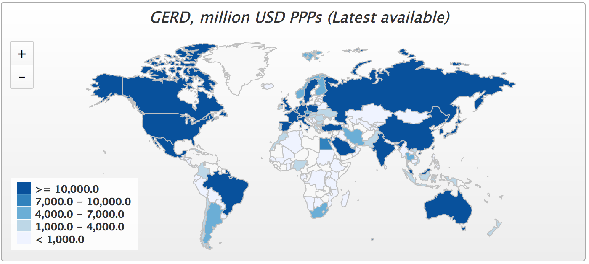

Slide 10
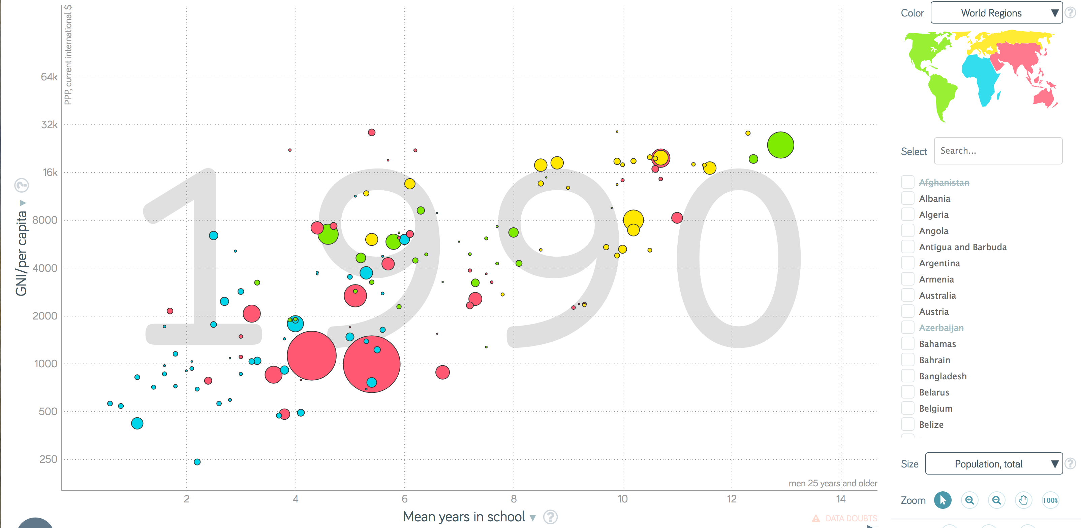
Mean years in school (linear) x GNI-per capita (log)

Slide 11
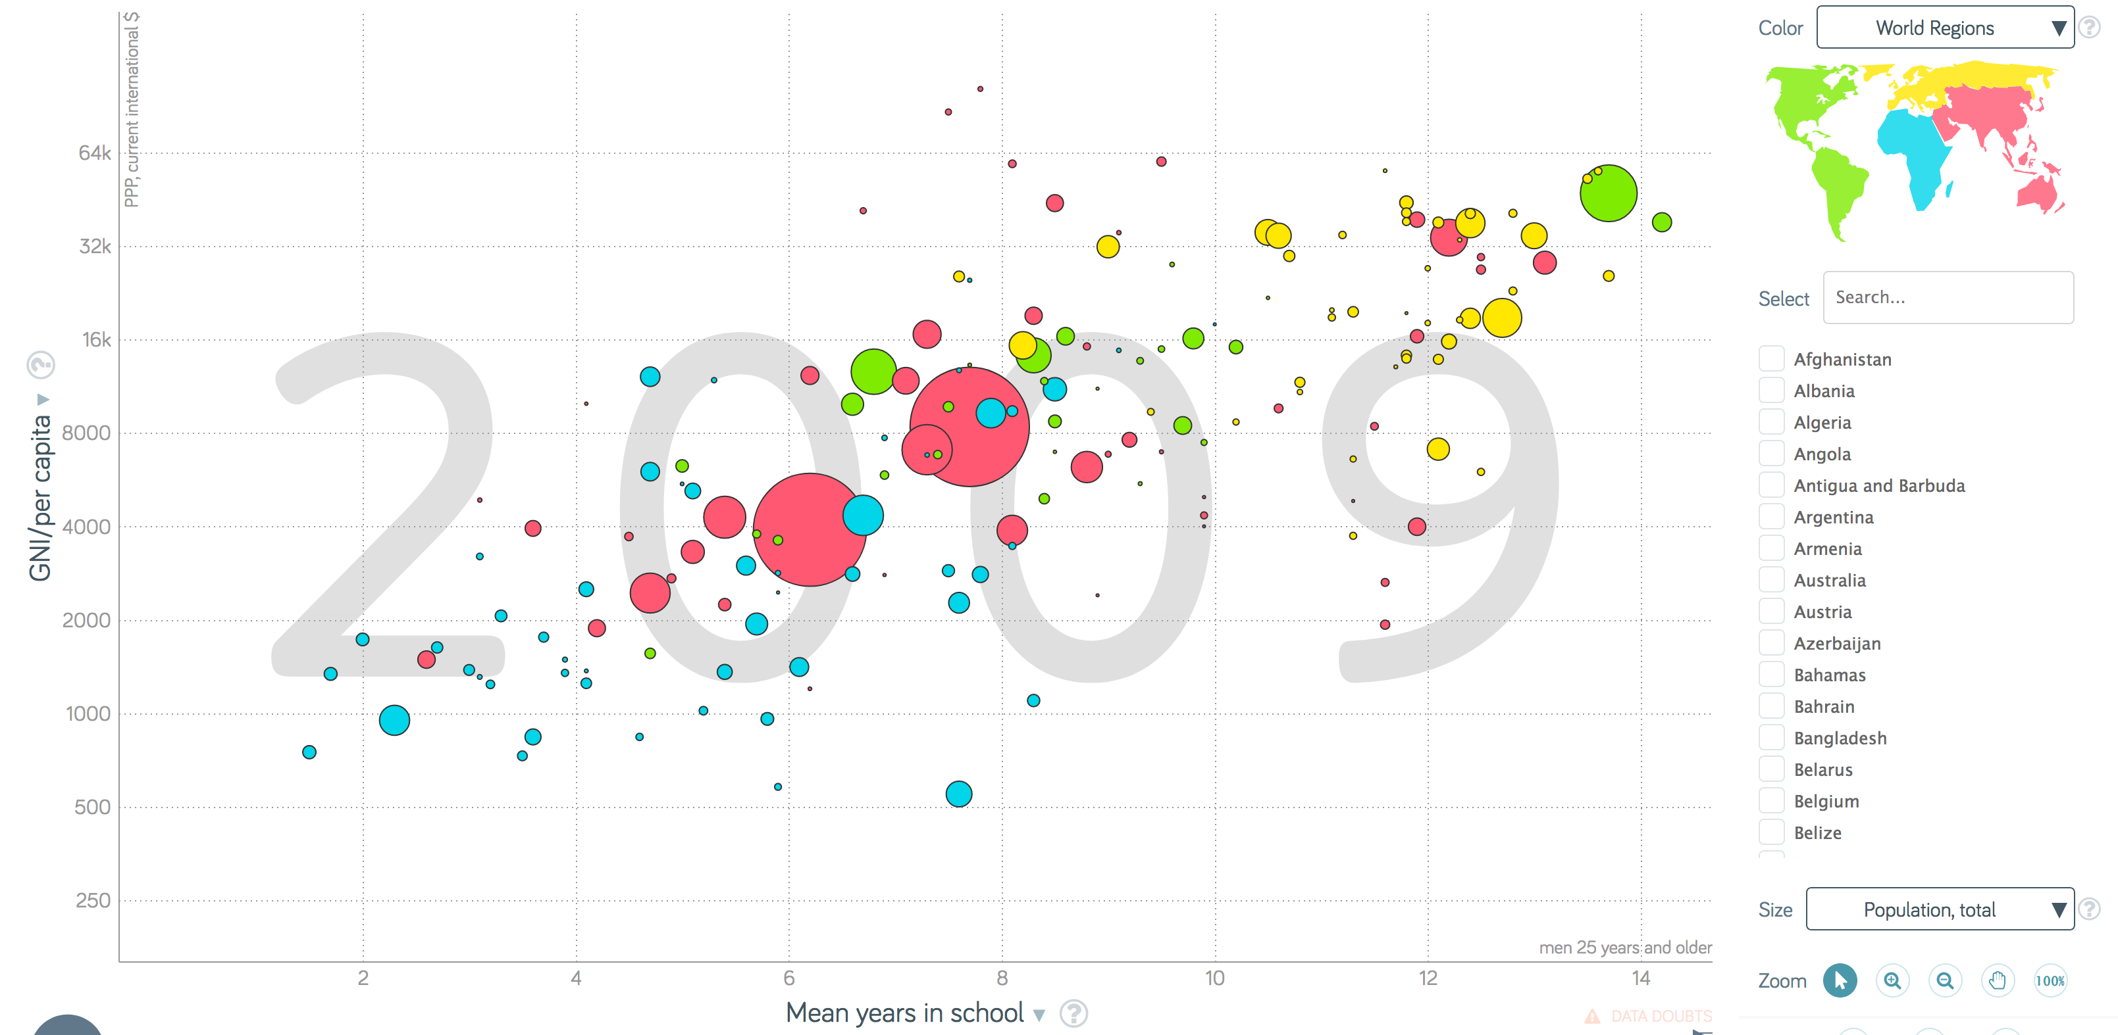
Mean years in school (linear) x GNI-per capita (log)

Slide 12
Citations | Share (1991-1995) | Share (1999-2003) | Share (2005-2009) | Growth
Brazil | 0.30% | 0.60% | 0.95% | 6.61%
China | 0.50% | 1.50% | 3.60% | 11.5%
India | 0.50% | 0.80% | 1.21% | 5.03%
Turkey | 0.10% | 0.30% | 0.57% | 10.1%
S. Africa | 0.20% | 0.30% | 0.32% | 2.65%
US | 44.2% | 39.0% | 29.3% | -2.25%

Slide 13
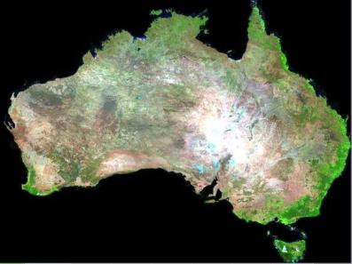
Big data requires new concepts
How best to use the information provided by big data sources to support public policies in GEOSS?

Slide 14
Metadata hub
Trusted, reliable, and expert guidance on best use of Earth observation data
knowledge hub

Slide 15
Needs
Design
Analytical scaling: from the desktop to the cloud
data analytics?
Collaborative work: share results
Cloud computing
Replication: countries build their own infrastructure.
Data cubes?

Slide 16
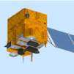
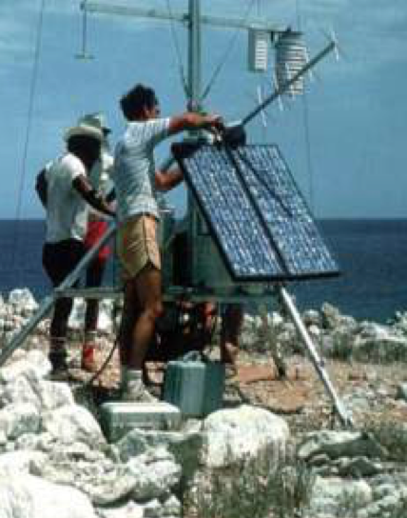
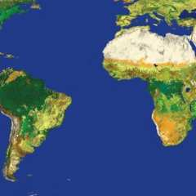
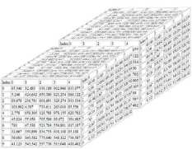
Multisensor data
Innovative, shared algorithms
Flexible data cube architectures
In-situ observations
Realistic case studies and research investment

Slide 17
The Facebook-Waze-WhatsApp effect
The Global South will only use EO information which is free at the point of access. How to pay for it?

Slide 20
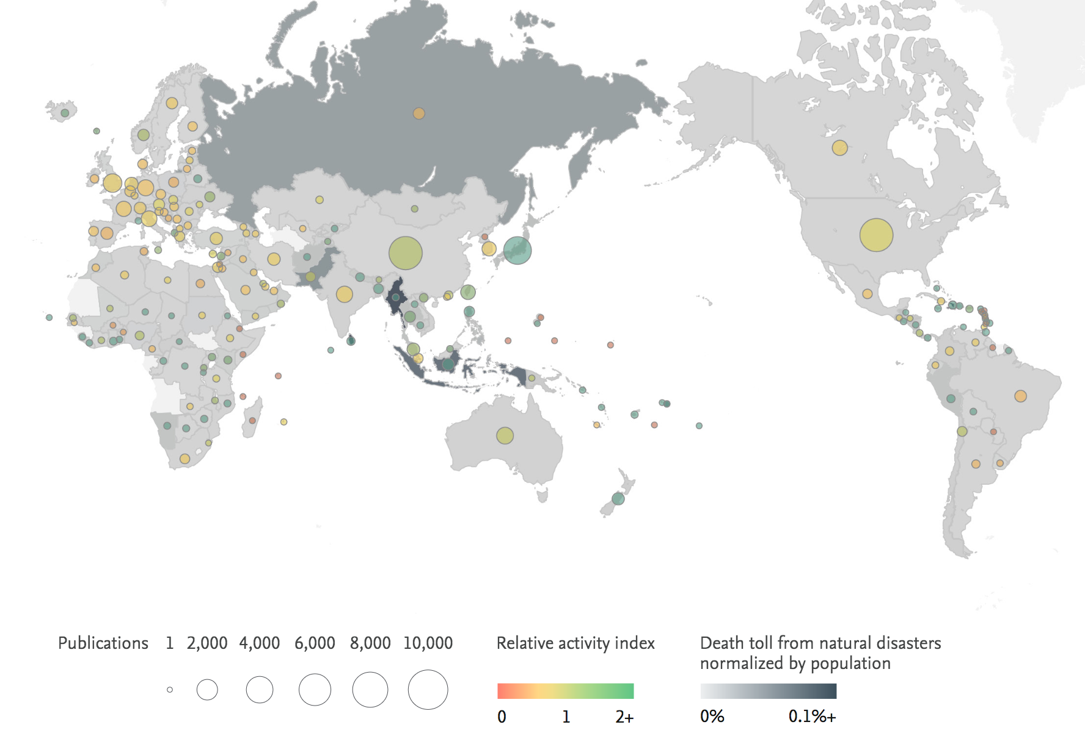
Science and deaths from disasters

Slide 21
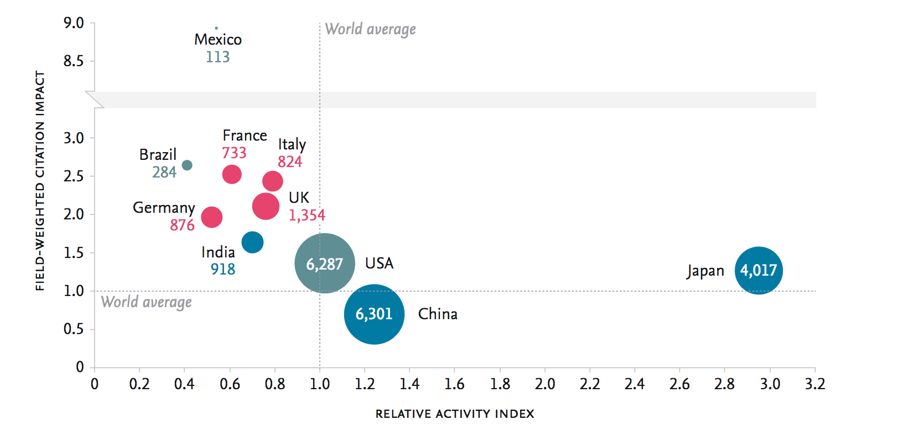
Disaster Science relative index

Slide 22
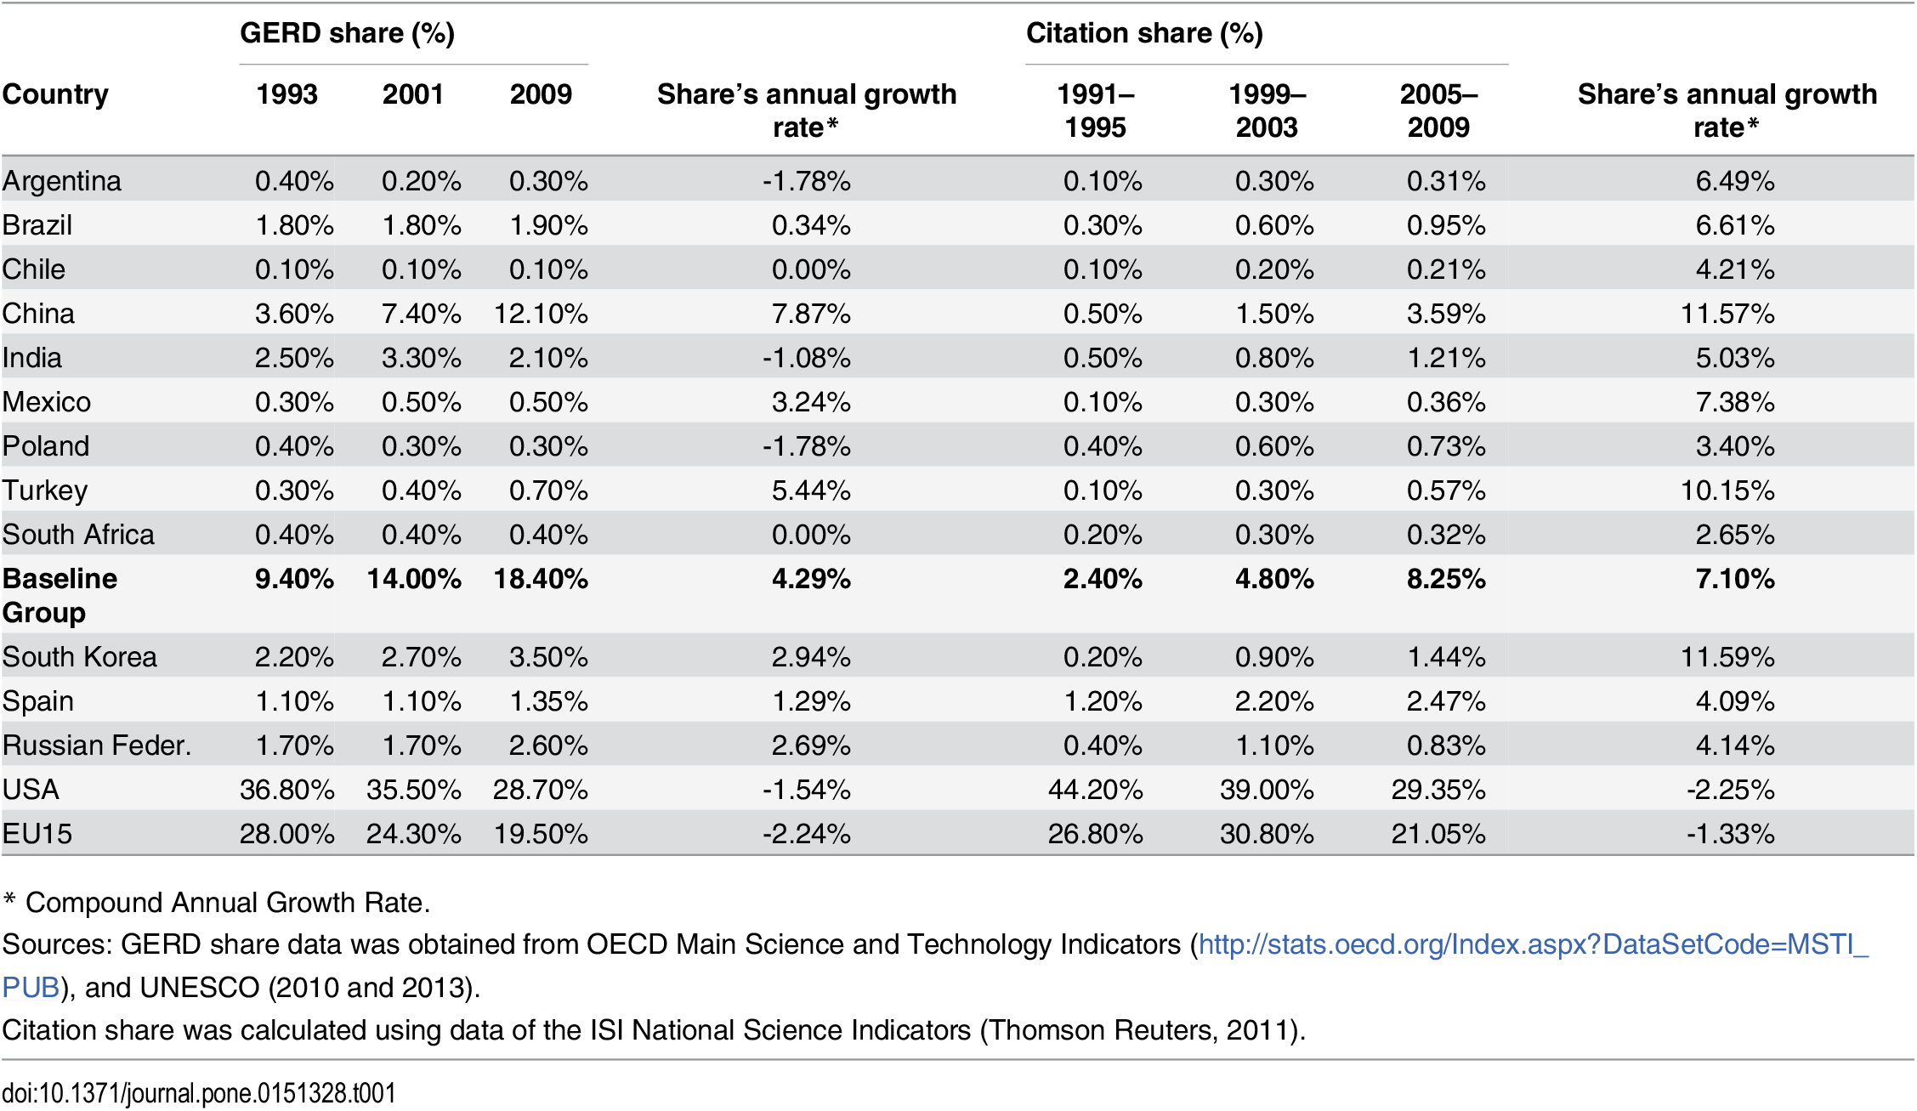

Slide 24
Foundations of modern democracies
State (power by technical staff)
Rule of law
(limits power)
Society
(public accountability)

Slide 25
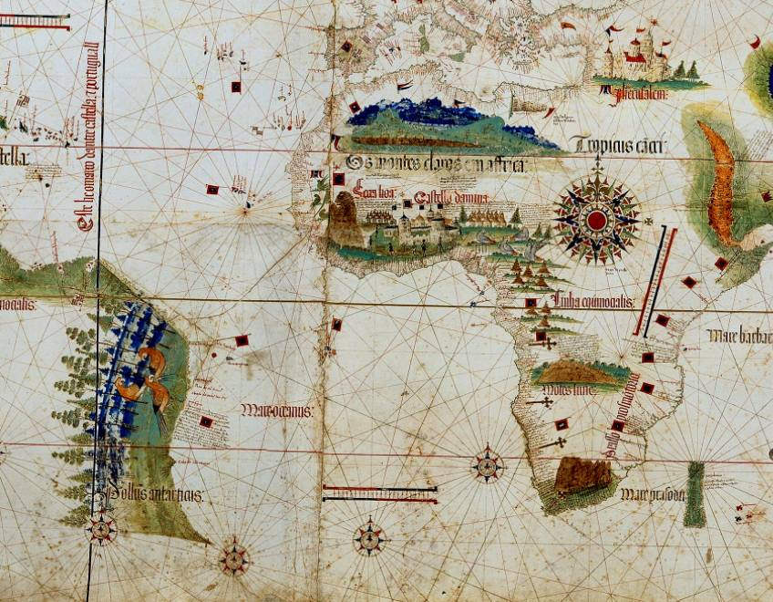
Cantino planisphere (1502)

Slide 26
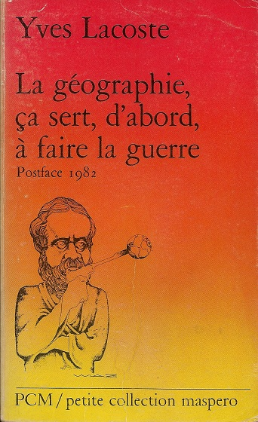
Cantino planisphere (1502)

Slide 27
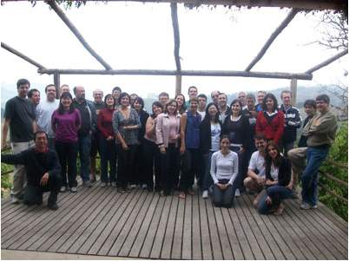
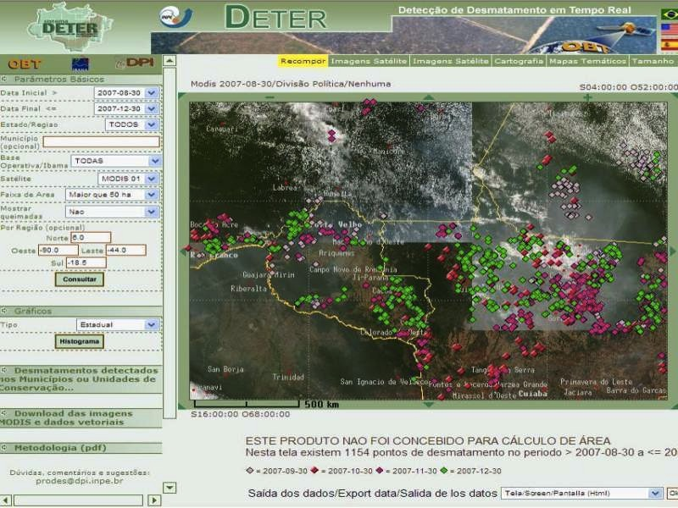
EO as part of state-building
Earth observation as power
Empowerment of technical staff

Slide 28
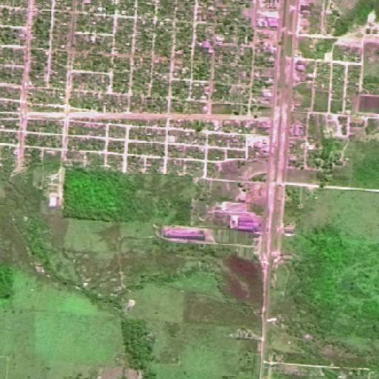
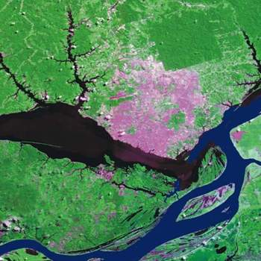
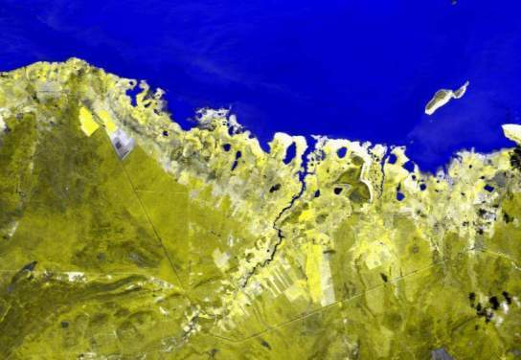
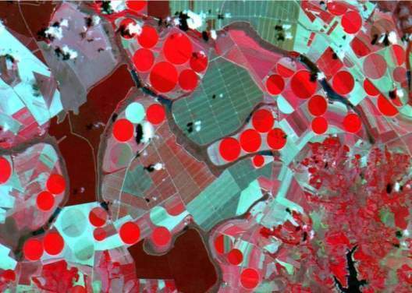
RIO-92 Declaration – principle #10
Environmental issues are best handled with participation of all citizens.
Individuals shall have appropriate access to information concerning the environment.

